Slide 1
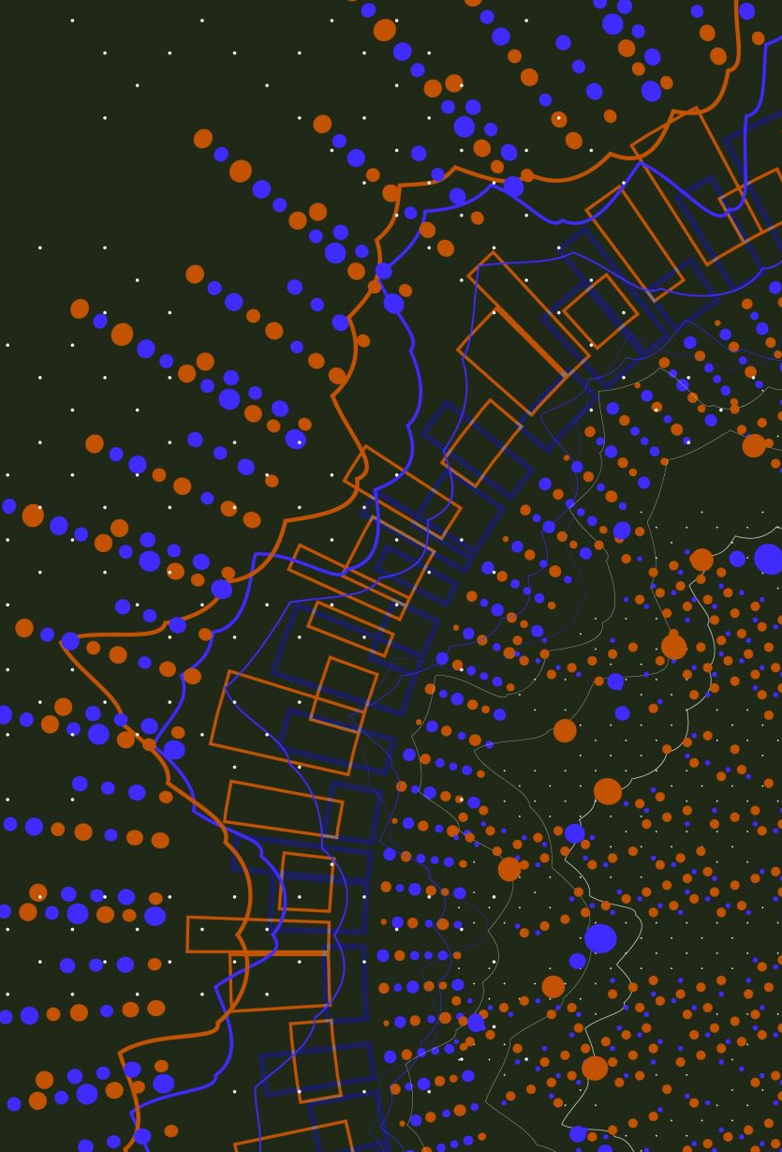

Home learning
Year 1 and 2 parent and carer workshop
Friday 19th September, 2025

Slide 2
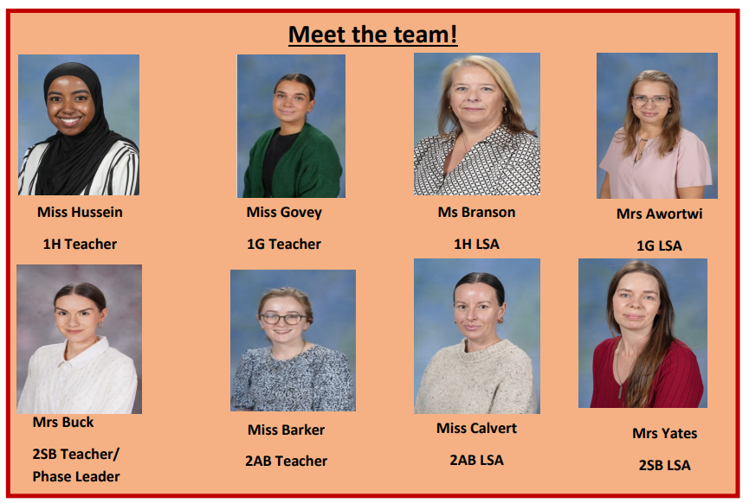
Year 1
Year 2

Slide 3
Home learning expectations at Varna
Each week, your child will be given homework to help them consolidate the learning that they have been doing at school.
This will consist of the three core areas of the curriculum – Reading, Writing and Maths as well as a selection of topic based activities focussing on the other subjects.
The homework will be checked weekly by a member of the KS1 team.
We want children to be encouraged to take responsibility for their own work and remember to bring the work in on Tuesday and let a member of the team know if they are finding it tricky so we can help them in school.

Slide 4
Reading
All children will be given a reading journal and a RWI book to take home. They will also be given the chance to visit the school library to borrow another book.
Children are expected to write a minimum of 2 entries in their reading journal each week.
These should be signed by an adult at home once a week – any comments from grown-ups at home are welcome so we can know how your child is getting on.
We encourage you to ask questions at the back of your children’s books.
Year 1 will also be sending phonics videos on Tapestry that children can do at home.

Slide 5
Writing
Your child will have spelling/ handwriting homework that continues what they have been learning in school each week.
We will be looking at spelling and writing red words in Year 1 and common exception words in Year 2. These are words that they need to spell correctly by the end of their year to be expected.
Handwriting can be something that children can practice at home.

Slide 6
Maths
Each week, your child will have a maths worksheet glued in their blue books. These worksheets will be linked to what we are learning in school that week.
If they need help, please let us know and we can show you our strategies.
Also, we would like children to play on Numbots as much as possible to practise their fluency and number bonds.
We do not recommend KS1 children playing TTRockstars yet as they have not learned multiplication and division facts. Year 2 will get their log ins in Spring term when we learn this skill.

Slide 7
Topic
Each half term, children will be given a “Topic Menu.”
This will have a range of activities for children to complete. They can choose the order they do these and should complete at least one per week.
The topic menu will be glued at the front of their purple books and you can use the pages in the purple book to complete some tasks.
Some tasks will be creative and can be brought into school.

Slide 8
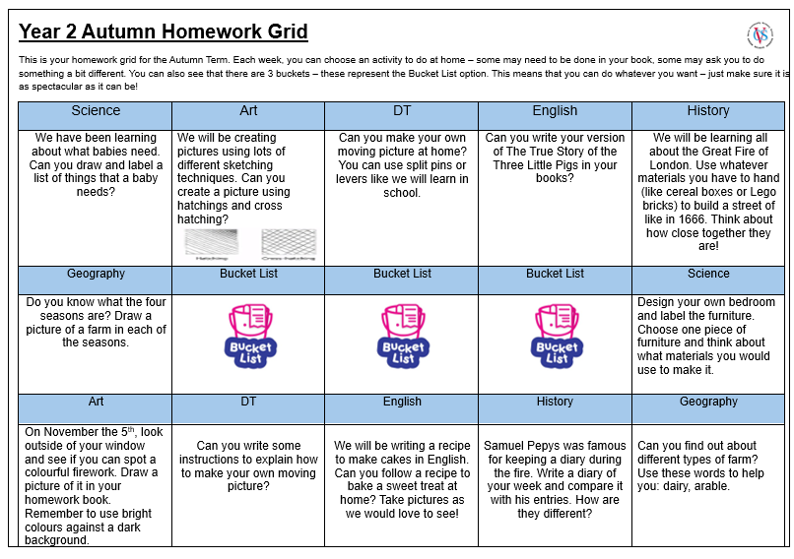

Slide 9
Workshop
We now have the opportunity to sit within your child’s class whilst the class teacher models how to best support home learning.

Slide 10
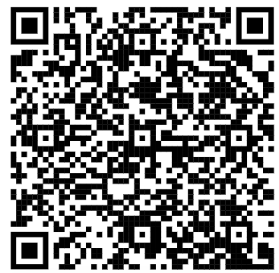
Feedback
Thanks for coming!
Please complete the short feedback form on an iPad. We will be having workshops throughout the year, and would love suggestions about what you would like us to focus on next time.

