Slide 1

Revise with GCSEPod

Slide 2

A reminder: What is GCSEPod and how can GCSEPod help?
GCSEPod provides you with highly concentrated 3-5 minute bursts of audio-visual, expert-written learning which can help to reinforce and consolidate key GCSE topics.
GCSEPod is available online or offline, you can study on the move.
Test yourself with our check and challenge feature.
Favourite Pods, making it easy to revisit the ones you find difficult.
Create your own playlists, creating a clear study plan.

Slide 3

When used effectively, GCSEPod can have a BIG impact on final grades
Data from over 2,200 students shows that higher GCSEPod users are more likely to exceed their predicted grades by a larger margin than those who don’t use GCSEPod.
High academic year usage yielded a greater impact than high usage in just the exam period.
On average, highest users received 3 grades higher across their subjects than predicted.
High Users = average 122 Pods watched in academic year
Medium = average 34 Pods watched in academic year
Low = average 6 Pods watched in academic year
Non Users = 0 Pods watched in academic year

Slide 4

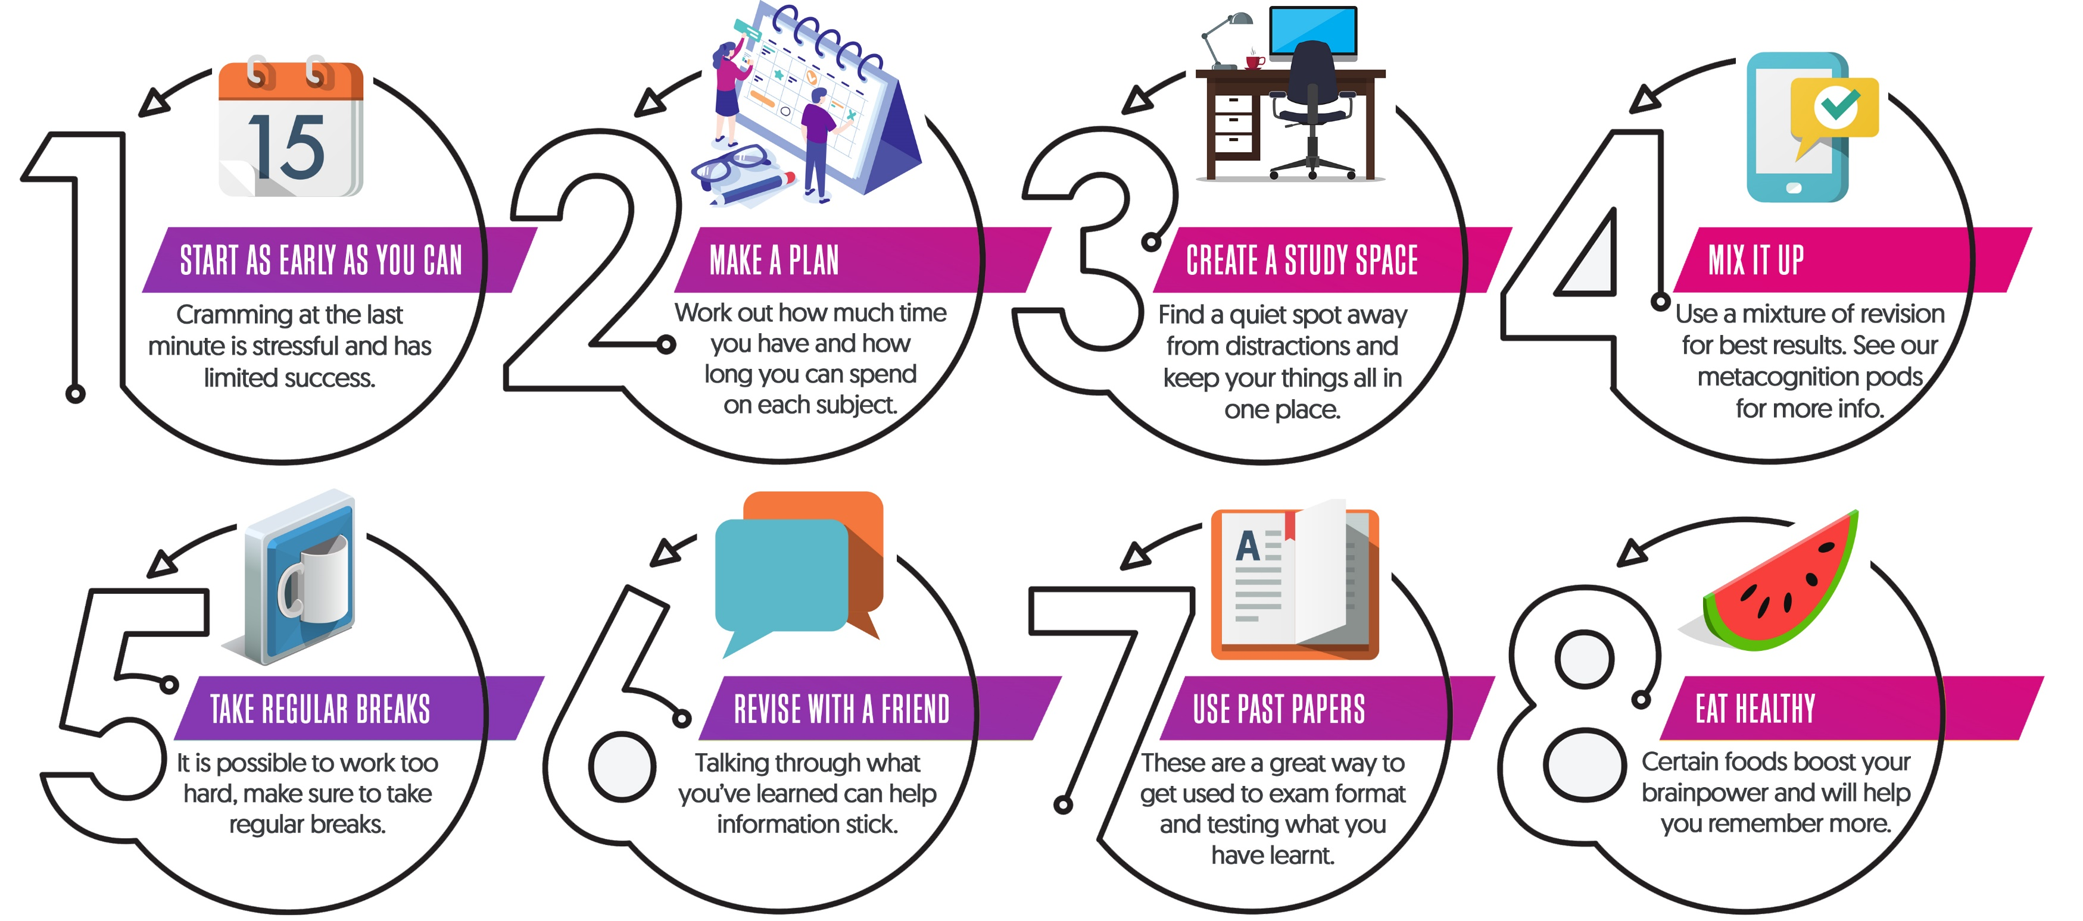

Slide 5

GCSEPod can be used on any device

Slide 6
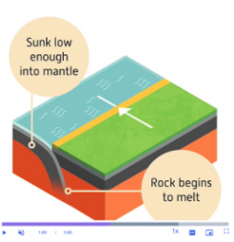
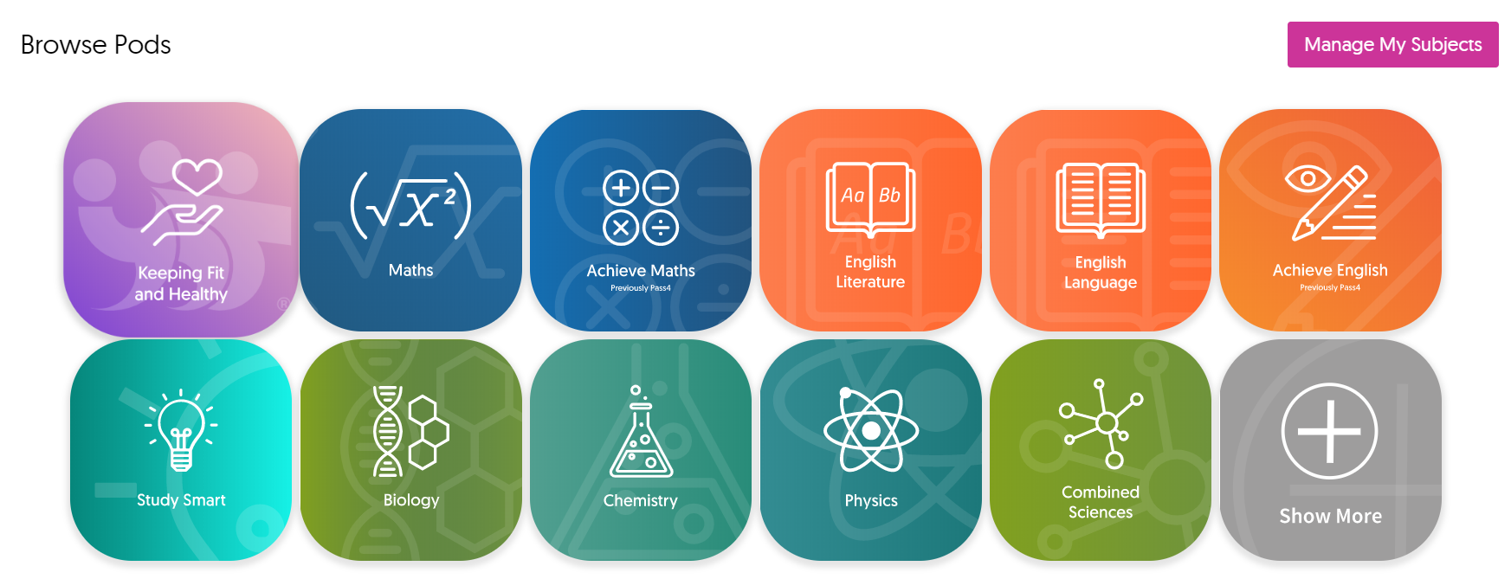

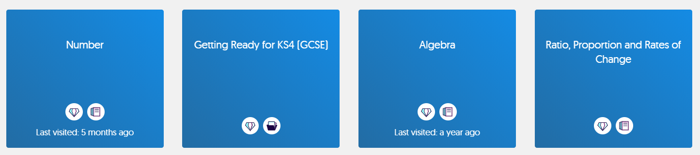
How to find Pods to watch
Visit www.gcsepod.com or download our app and log in.
From the homepage choose your subject from the list of tiles.
Within your subject choose your topic

Slide 7


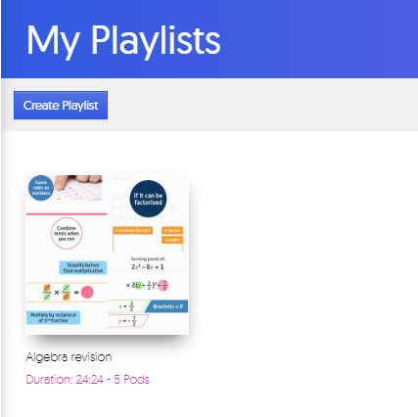
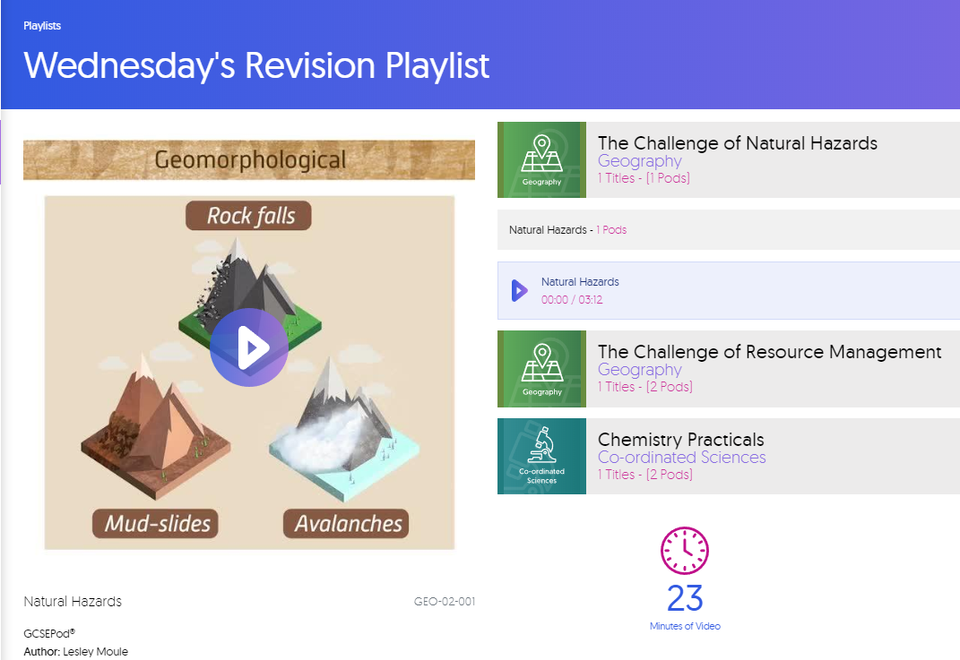
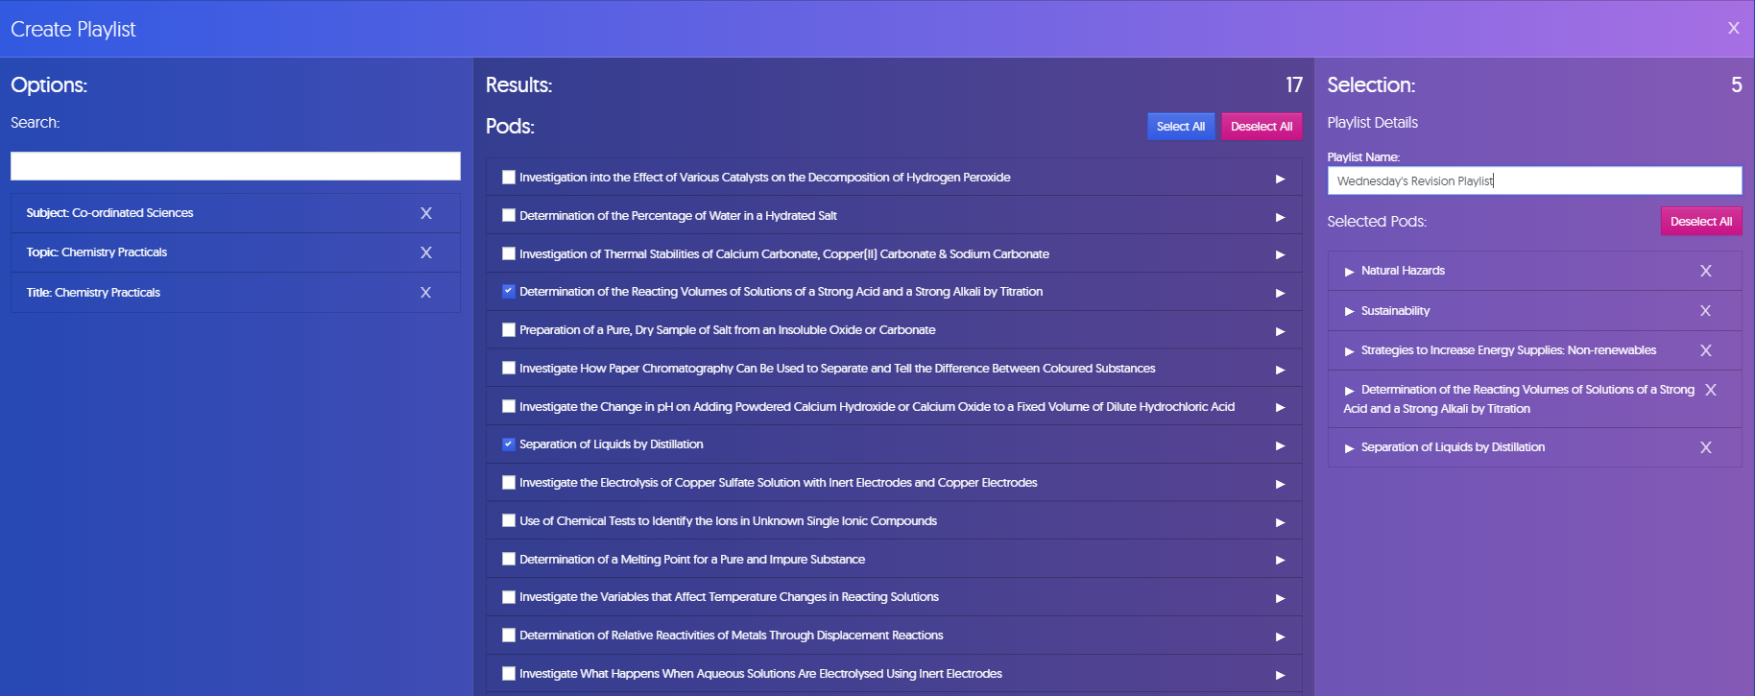
How to create a Playlist
If you are struggling with a certain topic in a subject, you could create a playlist of Pods to focus on. This will show on your homepage under ‘My Playlists’. You can create playlists by:
Going to My Playlists
Choose Your Pods
Name your playlist and get started with your studies

Slide 8
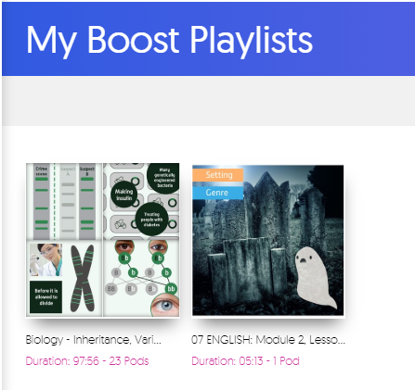

Assignments: Boost Playlists
Boost Playlists – helps to fill in knowledge gaps
When you complete an assignment, you’ll be given access to a Boost Playlist with recommendations on what you should be watching based on any incorrect answers.
GCSEPod will identify knowledge gaps for you, this will highlight areas you need to pay more attention to.

Slide 9
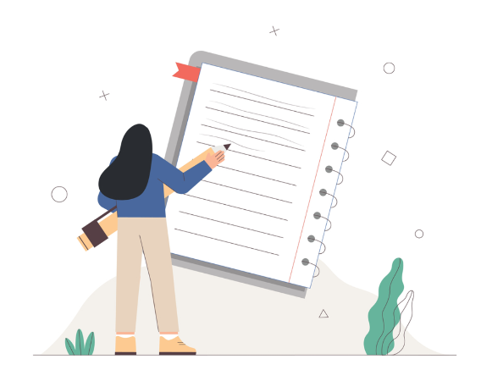
GCSEPod and Note Taking
Notes help to improve your understanding of a topic in your own words. Keep your notes brief and don’t forget to highlight key words, quotes and dates.
Write short and concise notes whilst watching a Pod. Watch a Pod fully first and then replay it whilst pausing it and writing notes.

Slide 10

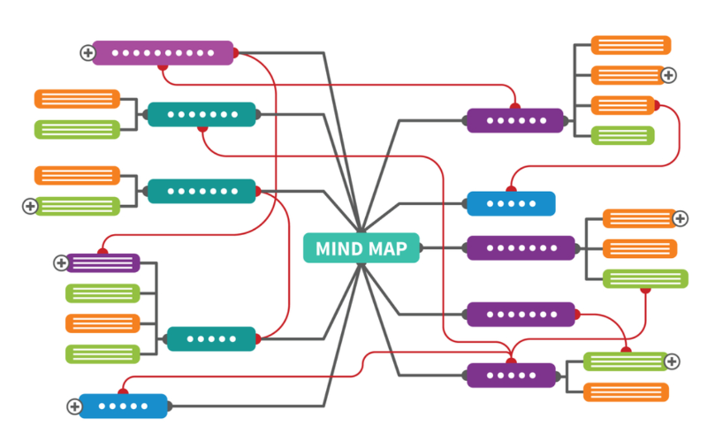
GCSEPod and Idea Mapping
Summarise what you’ve learnt by creating an idea-map. Start by putting the name of the topic in the centre of a piece of paper. Add branches (like a tree) and add additional key words to each branch which are associated with the main topic. Keep adding more detail as the branches become smaller and use images and colours as well as words to help the information stand out.
Activity idea
Draw an idea-map with all the key words and images that you see and hear in a Pod. Try matching the colours you use on your
idea-map to the colours shown within the Pod. Don’t be afraid to be creative, it’ll help you remember more.

Slide 11

GCSEPod and Flash Cards
Summarise a topic on a flash card or post-it, on one side of the card, write the topic’s name. This will help you when you come to test your knowledge. On the flip side, write down all the key words, symbols, dates, quotes and places that you’ve learnt. When you test yourself, simply look at the topic’s name and see if you can remember everything on the other side of the card without looking.
Activity Idea
Create a flash card for each Pod you watch. Write the name of the Pod on one side, and on the other, write all the key information you’ve learnt. Search YouTube for a video on the “Leitner System” to find out more about creating effective flash cards.

Slide 12
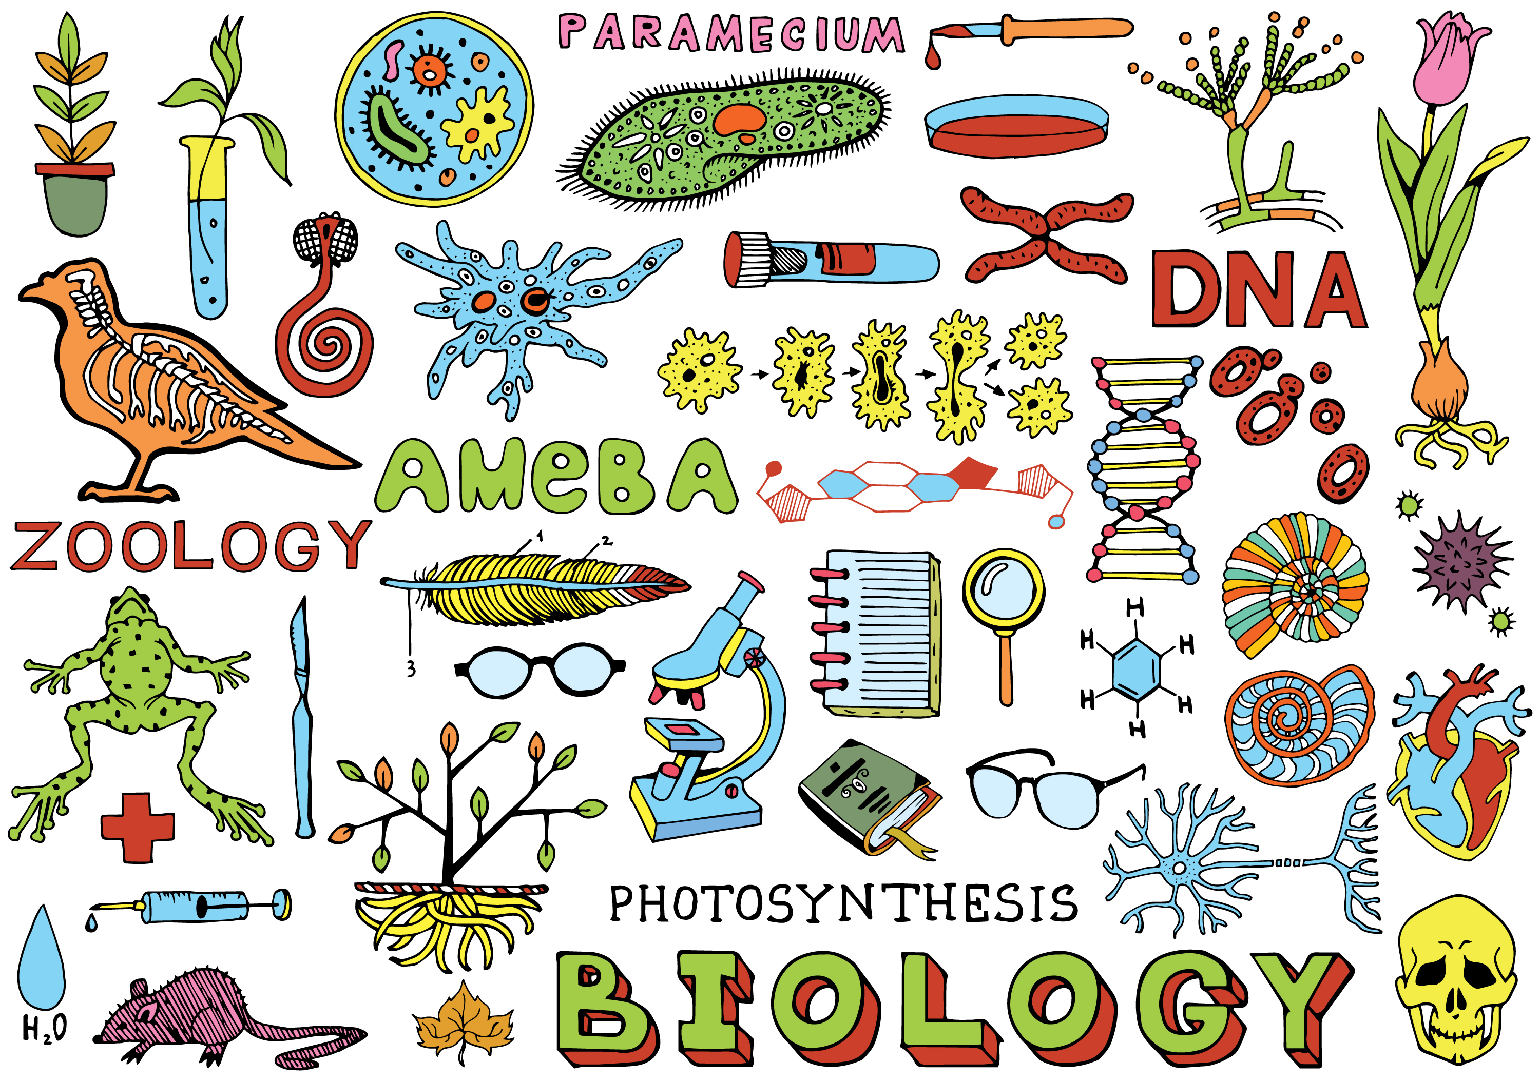
GCSEPod and Summary Posters
Use keys words, pictures and definitions to design a poster on a topic or whole subject. Put the summary poster up in your room and spend regular time looking at it.
Watch a Pod and whilst you can remember, draw a summary poster with all you’ve learnt. Once you’ve finished your poster, re-watch the Pod and see how much you remembered.

Slide 13

GCSEPod and Practice Exam Questions, Past Papers
Practising exam questions and past papers helps to perfect your exam techniques whilst checking your knowledge and highlighting any gaps you may have.
Activity Idea
Watch Pods and then answer practice exam questions and past papers. Highlight questions you struggled with and watch the Pods.

Slide 14

GCSEPod and Mnemonics
Create a code using rhymes, phrases or acronyms.
For example, colours of the visible spectrum:
Richard of York Gave Battle in Vain (Red, Orange, Yellow, Green, Blue, Indigo, Violet)
Pick out key words from a Pod and create mnemonics to help you remember.

Slide 15
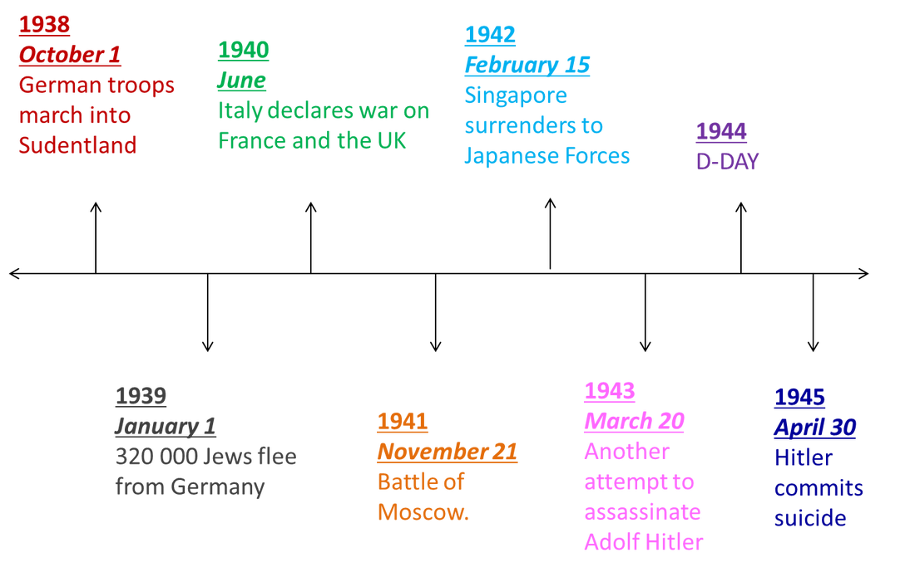
GCSEPod and Timelines
Design a timeline for those subjects where chronology is important like History and English Literature. Timelines are invaluable for making sense of a series of events or stories.
Use key dates within a Pod to create a timeline; it will help you visualise the order of the story.

Slide 16
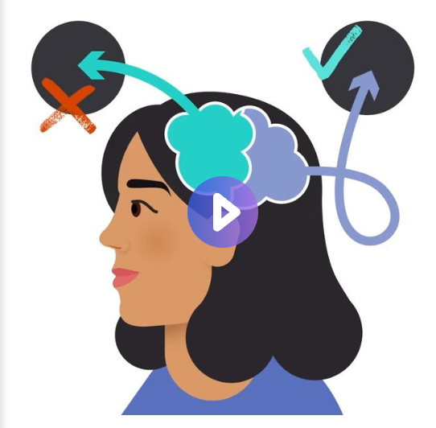
For more revision techniques visit STUDY SMART Pods
https://members.gcsepod.com/shared/studysmart

Slide 17
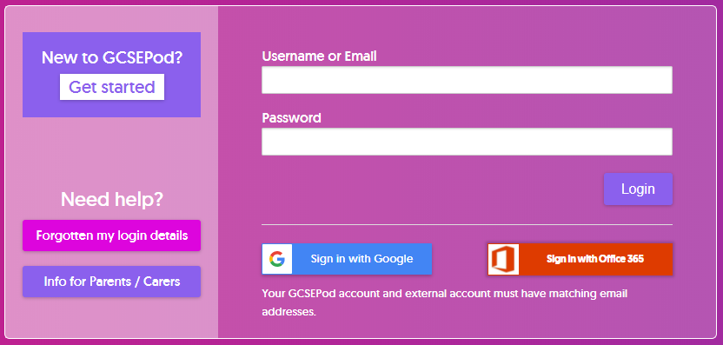
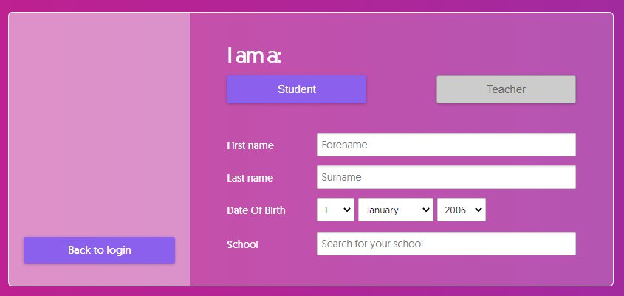
Not Activated Yet?
Go to: https://members.gcsepod.com
Click “New to GCSEPod?
Get Started!”
2
Enter your name, date of birth and school details
Create your own username and password

Slide 18


