Slide 1


JPC Revision Tips

Slide 2
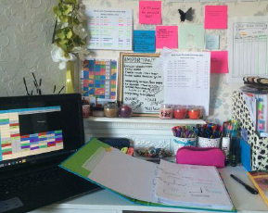
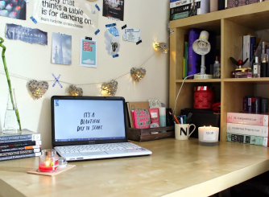
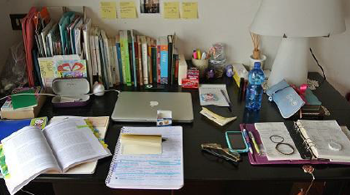
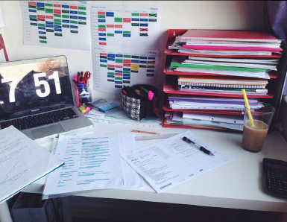
Dedicated Revision Area
Resources to hand
Organised
Limit distractions

Slide 3




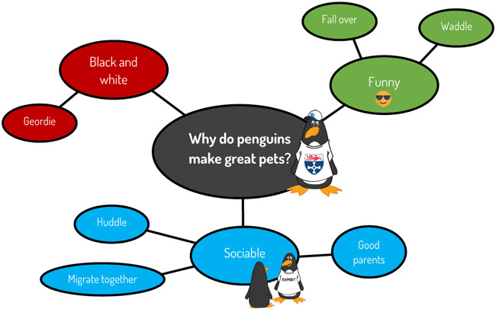
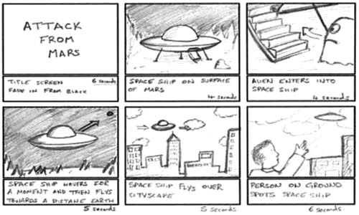

Four Key Techniques
Flashcards | Retrieval Practice Low stakes quizzes Flashcards Brain dumps
Transform it! | Dual Coding

Slide 4

Use It!
There is no substitute for timed practice of the type of questions you will be asked
Revise a topic then use the info to do a practice question
‘Memory is the residue of thought’
Find past paper questions/ specimen questions/ model responses at exam board websites, in revision guides or in the revision materials/ topic books provided by school
Make more marking for us- we love it!

Slide 5


Slide 6

A reminder: What is GCSEPod and how can GCSEPod help?
GCSEPod provides you with highly concentrated 3-5 minute bursts of audio-visual, expert-written learning which can help to reinforce and consolidate key GCSE topics.
GCSEPod is available online or offline, you can study on the move.
Test yourself with our check and challenge feature.
Favourite Pods, making it easy to revisit the ones you find difficult.
Create your own playlists, creating a clear study plan.

Slide 7
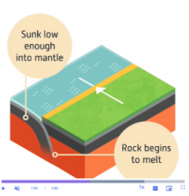
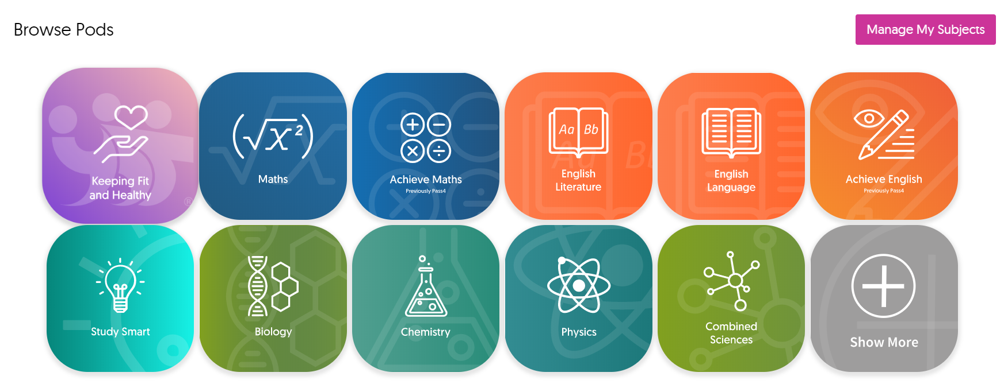

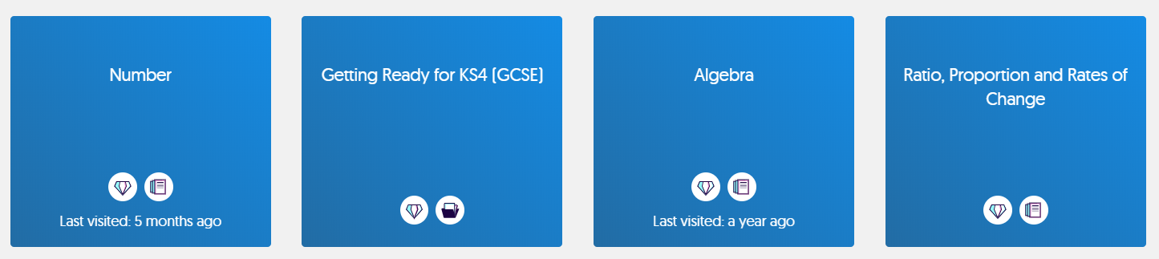
How to find Pods to watch
Visit www.gcsepod.com or download our app and log in.
From the homepage choose your subject from the list of tiles.
Within your subject choose your topic

Slide 8
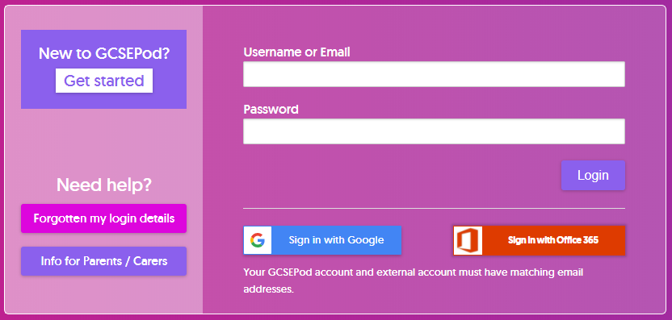
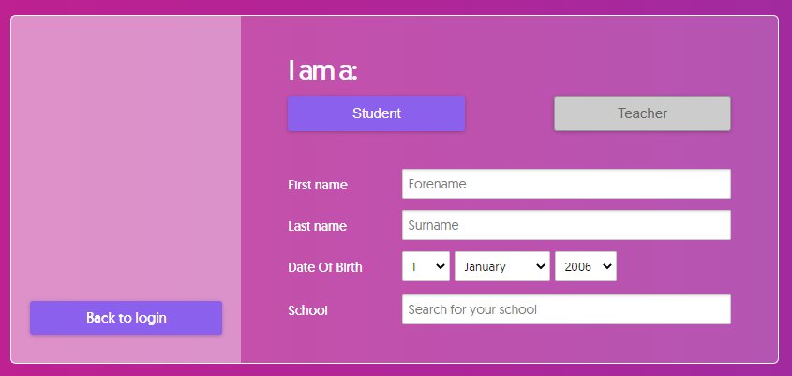
Not Activated Yet?
Go to: https://members.gcsepod.com
Click “New to GCSEPod?
Get Started!”
2
Enter your name, date of birth and school details
Create your own username and password

