Slide 1
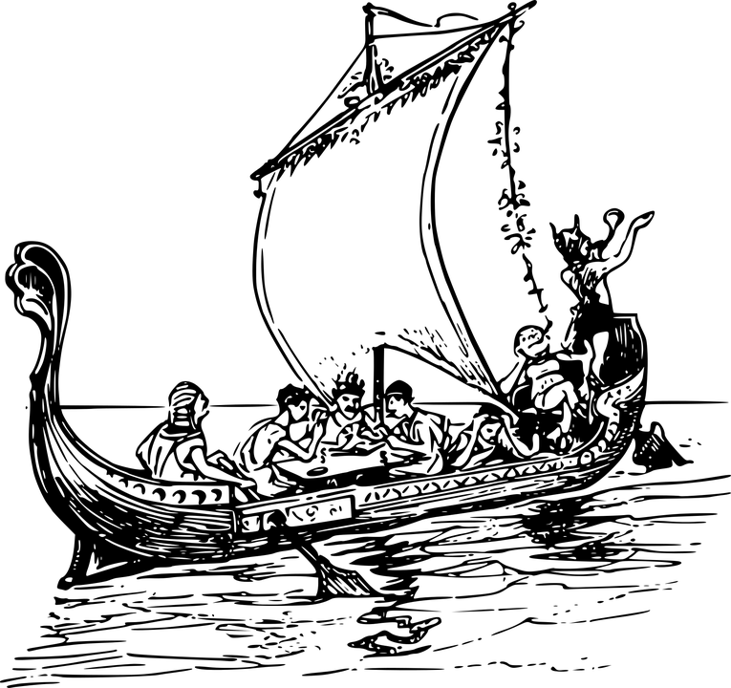
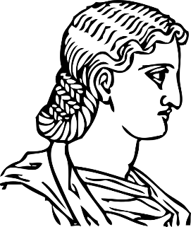
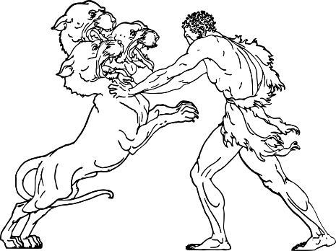
Odysseus and The Cyclops
Imagine you are living in ancient Greece. You have decided to go on an epic journey across the seas in order to return home after having fought in a famous war.
You are not sure exactly where you are going or what you will find along the way.
How does that make you feel? Why?
What might a Greek hero encounter along the way? Why?
What adventures might be most appealing to a reader? Why?

Slide 2
Learning outcomes
To describe how the characters are portrayed in the story of Odysseus and the Cyclops
To explain how we can support our interpretations with evidence
To evaluate the effectiveness of our analytical paragraphs using success criteria

Slide 3
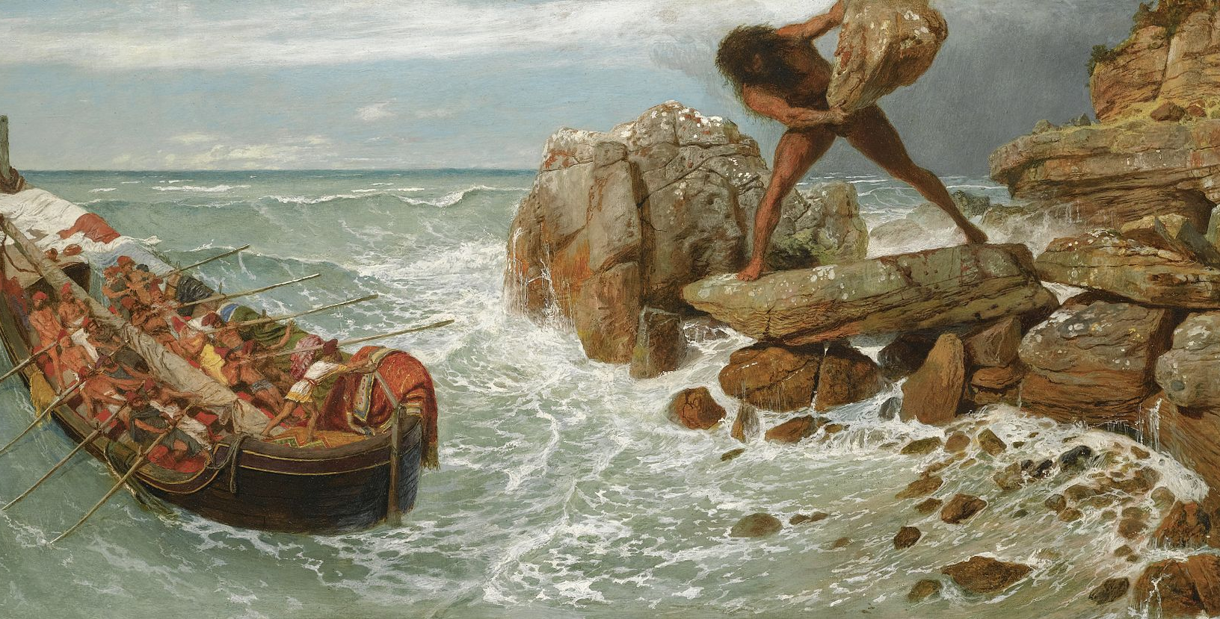
https://www.youtube.com/watch?v=XGrQ1Ybxbwo
Today we’re going to look at the story of Odysseus and the Cyclops. It’s one of the most famous parts of The Odyssey by Homer, an epic story of Odysseus’ journey at the end of the Trojan War as he and his soldiers attempt to travel back home to Ithaca.
We’ll watch the video clip. As we do, make notes on:
What you think about Odysseus as a character
Whether you feel sorry for the Cyclops or not and why
How this story fits well into ancient Greek myth conventions

Slide 4

Now, we’ll read the story
We’ll read this by ourselves. As we’re reading:
Highlight parts of the story that support or back up what you think about Odysseus and the Cyclops and why
Explain why you chose these parts of the text. This illustrates that Odysseus is intelligent because…
Evaluate how the writer uses language to convey ideas about Odysseus and the Cyclops to us as readers. The writer has used a simile to illustrate Odysseus’ intelligence because…

Slide 5
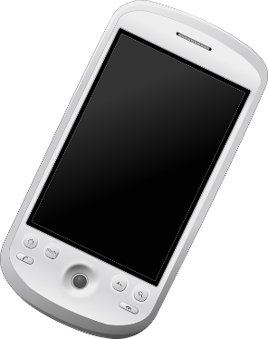
“Apple phones are better than Samsung phones!”
You’ve probably had arguments with people you know about lots of different opinions, but how can you show others that your opinions are valid?
Discuss with the person nearest to you your opinion on the controversial statement above!
How did each of you try to win the argument?

Slide 6

In order to win an argument, we need evidence
Samsung is better | Apple is better
Samsung screens are a similar size to Apple’s, but they have a higher resolution. | App development on Apple phones is quicker than on Android because apps are develops for only one phone brand.
Samsung’s top model of phone provides more storage capacity than Apple’s | Apple phones generally have a faster CPU than Samsung’s, making them quicker
Samsung models tend to have a longer battery life than Apple’s equivalents | Apple phones have more durable casing than Samsung phones, including shock-proof value.
Samsung sells more phones across the world than Apple. | Apple phones’ resale value is much higher than that of Samsung’s.
If we can’t support our arguments with evidence then no one has to believe our opinions or respect them.
Here are some examples of evidence you could have used in your arguments regarding phone brands.
In English, we use “quotations” as evidence. These are short parts of a text. We can use this to support out interpretations.

Slide 7
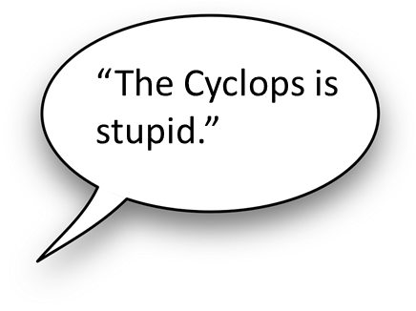
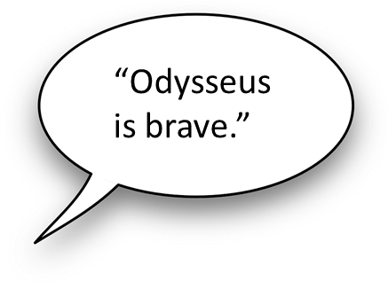

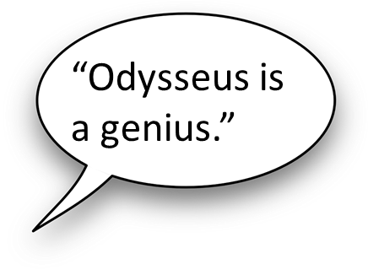
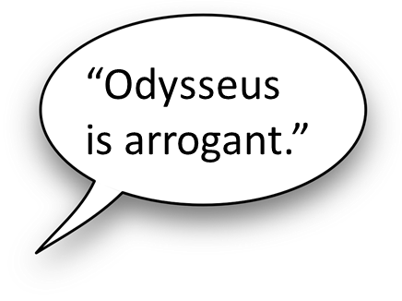
Let’s use evidence to support our interpretations of Odysseus and the Cyclops
Choose one of the interpretations above.
Find one “quotation” to support this interpretation.
Explain how this quotation supports the interpretation.
Choose three or more quotations to support one interpretation and explain how they support that interpretation.
“Drink and see what a strange draught we had in our ship.“
This illustrates how stupid the Cyclops is, as he trusts Odysseus and his strange drink, despite knowing he is trying to escape from his cave.

Slide 8
Now that we have our evidence, we need to transform our ideas into analytical paragraphs
Homer portrays Odysseus as a highly intelligent character that is able to find his way out of seemingly impossible situations. For instance, when Odysseus says: “…” he highlights to the readers that… because… In this particular example, the writer uses [technique] in order to…
Moreover, Homer reiterates his portrayal of Odysseus as smart when as readers we are told, “…” and “…” because… These examples reinforce views that Odysseus is able to find a solution to difficult problems.
Success criteria:
Include clear interpretations
Include quotations (evidence) to support your interpretations
Explain how specific techniques help Homer to convey his character.
Bonus success criteria:
4) Use a range of analytical verbs (reinforces, reiterates, illustrates, elucidates, etc).
5) Discuss patterns of language within your answer.
Use the sentence starters here and the success criteria to write your complete answer to this question.
If you want to really challenge your brain, why not meet the ‘bonus’ success criteria?

