Slide 1


September 2020
What will stay the same and what will be a bit different?

Slide 2



How are you feeling about returning to JPC?
At the moment you might be confused about coming back to school. You might be looking forward to some things and worried about some things
This is ok – lots of students feel this way.
Some students are worried that lots of things will feel or be different
Some students are worried about how they will manage.
In this PowerPoint we will tell you the facts about all of the things which will stay the same and the things that will be different.

Slide 3


Why are some things slightly different in school?
Remember most things in school are the same as before Lockdown.
All schools have to make some changes to follow Government rules and keep students safe.
We will tell you why some things will be different for a while.
We will help you to think of some of the ways you can feel less worried about coming back to school.
We will all work together and help each other to manage any changes.

Slide 4
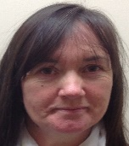
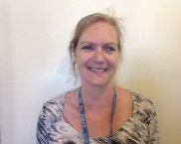
First Day back Thursday 3rd September
When you come back to school Jackie and Vicky will be at the door as usual. They will be able to answer any of your questions and help you.
You will go to your old form room and form class (the form you were in in March).
Your old Form Tutor will explain any changes to you.
You will then meet your new Form Tutor.
We will let you know before the end of term who your new Form Tutor will be.

Slide 5

What will stay the same?
Staff will still understand that you sometimes find things difficult.
Staff will find ways to help you follow Government guidelines.
Staff will understand that it is sometimes hard for you to learn.
Staff will listen to you and try to help you.
You will still be able to have sensory breaks with a Teaching Assistant if you need them.
You will still have a daily timetable which will show you any changes in the day.

Slide 6
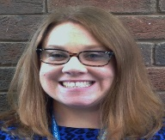
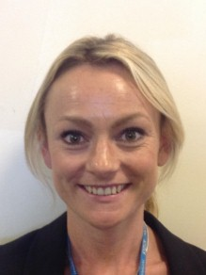
Staff at Joseph Paxton
What will be the same?
Most of the staff will be returning to Joseph Paxton in September.
What will be different?
Mrs Danks is on Maternity Leave so there will be a new maths teacher until she comes back.
Mr Jackson Twist has left JPC to do another job.
The TAs Hannah and Grant have left JPC to do another job.
Mrs Saverimutto will be returning to JPC.

Slide 7
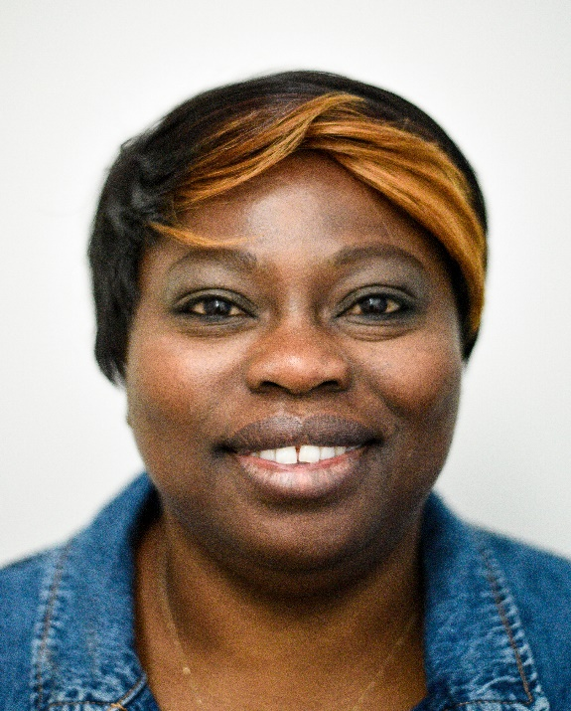
There will be a new Maths Teacher
Mrs Olanipekun is a new Maths teacher at JPC.
Mrs Olanipekun will be teaching in G7
You might have Mrs Olanipekun as your Maths teacher – your Form Tutor will tell you in the first day back who your teachers will be this Year.
Mrs Olanipekun is looking forward to teaching at JPC and will understand that you might sometimes find things difficult. Mrs Olanipekun will help you just like the other teachers at JPC.

Slide 8
The Classrooms at Joseph Paxton
Staying the Same
Most of the classrooms are the same.
When you come back to school, your Form Tutor will take you around the school so that you can see the changes that have been made.
Changes
G9 Is now an Animal Care room instead of a normal classroom.
F9 Is now an English teaching room
The House Bases
The House Base rooms have moved:
Mrs O’Loughlin’s Blue Base is now upstairs in F10
Mrs Hoey’s Green Base is now downstairs in G14

Slide 9
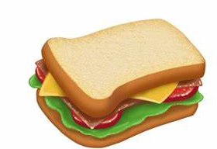
What will happen at Lunchtime?
The Government have made strict guidelines about how food should be served and used in school
Students will make their own individual plan for Lunchtime with their Form Tutor.
For most students this means they will eat in the Hall at the tables.
Students cannot eat in any of the classrooms.
For some student we can arrange a smaller room for them to eat lunch.
Students cannot use the House Base at Lunchtimes.
Students can still go to lunchtime clubs at 12.20 as normal – all clubs will stay the same.
We will make plans to help any student who needs a place to go at lunchtime.

Slide 10
Breakfast Club
What will be the same?
You will still be able to come to school early at 8.30am and your Learning Mentors and TAs will be there to chat to and help you.
What will be different?
Breakfast Club will now take place in the Hall so that people can practice good Social Distancing.
School cannot serve any drinks or food at Breakfast club.
Students should continue to bring non fizzy drinks in water bottles.

Slide 11
What will be different during lesson times?
During this time some things have to be different because schools have to follow strict Government guidelines.
At JPC the things that will be different are:
All staff must be able to practise social distancing – this means that they must be able to be 2m away from others.
Rooms will be cleaned more often.
We will try not to share equipment – for example we will make sure you have your own pen/pencil/rules etc.

Slide 12
What will happen if I need to leave my classroom?
Students will not be able to go to House Bases instead of being in class– this is because of the rules about social distancing and room cleaning.
If you need to leave the classroom a TA will come to the room and take you for a walk or sensory break.
When you are ready they will take you back to your classroom or next lesson.

Slide 13
Where will I go if I can’t go to a lesson?
Most of the time students will be in class and learning.
If you can’t be in a lesson a TA will take you to one of the small study rooms. TA will check you are ok and wait nearby for you.
The TA cannot be in the small room with you because there is not enough room to practice good social distancing.
If you need more support than this, an individual plan will be made for you.

Slide 14

How else will JPC staff help me to manage the changes?
We will make sure you have a chance to talk about your worries if you want to as soon as you get back to school.
We will ring all families during the first week in September to see of we can help with concerns and plans about coming back.
JPC staff are really looking forward to getting back to school, seeing you all again and helping you to get back to learning!
See you in September!

