Slide 1




PowerPoint Guide
The news icon is hyperlinked to a related article or website.
Simply click to access
The film icon is hyperlinked to a related clip.
Simply click to access
The discuss icon indicates suggested points to discuss
The writing icon indicates a written activity or question time

Slide 2
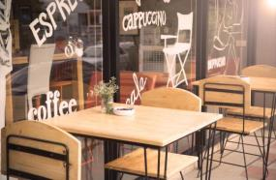
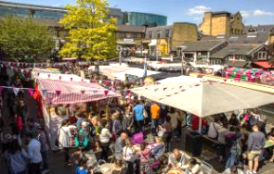

Spotting a business opportunity
1.2.4 The competitive environment

Slide 3
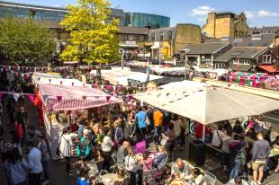
Operating in a competitive environment
Markets and competition
Types of competition
Effects of strong and weak competition
Competition and business decisions

Slide 4
What is a competitive environment?
Where a business operates in a market where there are other businesses producing the same or similar goods and services.

Slide 5
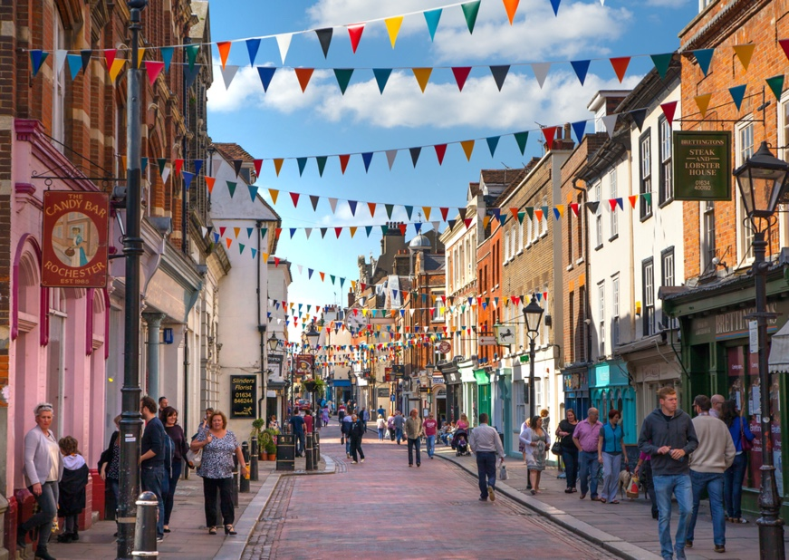
Competitive markets
Businesses aim to produce goods/services in markets where they will face minimal competition. Competition will always exist, but it can be at different levels.
Competition might be strong: Large number of businesses providing similar goods or services.
Weak or no competition: Few firms in the market. If there is little or weak competition, this gives a business considerable market power. Where a single business dominates the market and does not have any competition, this is known as a monopoly.

Slide 6
Situations where a business faces little or no competition
When a business is the only seller of a particular good or service
When a business develops a unique, innovative product
When a business is one of a few large businesses which sells a particular good or service
When a business offers much better value for money than its competitors

Slide 7
Just a minute…
State one benefit to a business of having very few or no competitors.

Slide 8
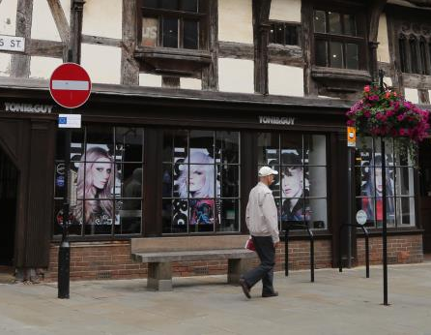
Effects of weak competition
A business can find itself in a very profitable situation, if it faces minimal competition.
Customers have no alternatives to buy, if they wish to purchase this product.
The business can charge higher prices and make good profits.
Profits may be reinvested into the business to make it more efficient or more can be distributed to the owners.
Quality, however, might suffer as the lack of competition can make the business “lazy”.

Slide 9
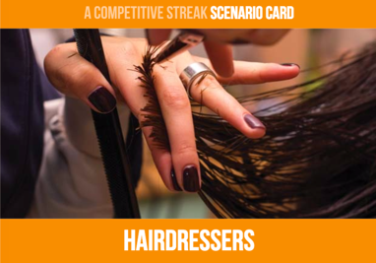
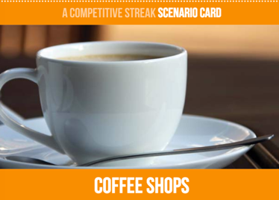
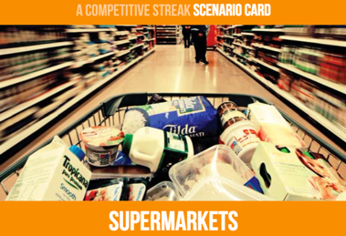


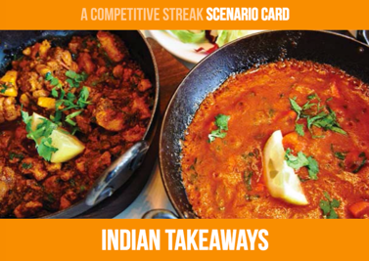
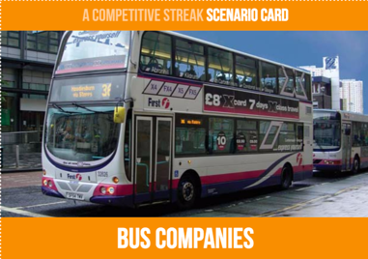
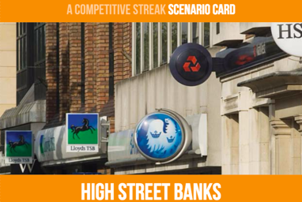
Competitive streak
Rank the above in order of the most competitive to the least competitive markets – be prepared to justify your thoughts!

Slide 10
Competitive streak
What makes a market more or less competitive than another?
How many firms/brands are in the market?
How easy is it to enter the market?

Slide 11

Benefits of competition
Competition can clearly benefit the consumer through lower prices and better products and services, but it can also benefit the business too.
Encourages a business to make its product different or better than its competitors
Businesses will focus on one area of the market and their market strengths
Research will take place to improve their product and reduce costs
Improved customer service to retain existing customers
Can look at what competitors do well and improve their own product

Slide 12
Types of competition
If a business operates in a competitive market, the competition that exists can take many different forms. A business’s strategy or plan towards a competitor will depend on the type of competition it is facing.
Type of competition | Effect
Price | Price decreases
Quality | May decrease to save costs or may increase to differentiate from a competitor
Location | Locate close to competition to steal customers away or locate away from other firms to avoid direct competition
Product range | Can be focused to specialise on one particular product or may be widened to prevent competition/spread risk
Customer service | Will improve in order to gain a USP, customer loyalty and a strong reputation in the marketplace

Slide 13
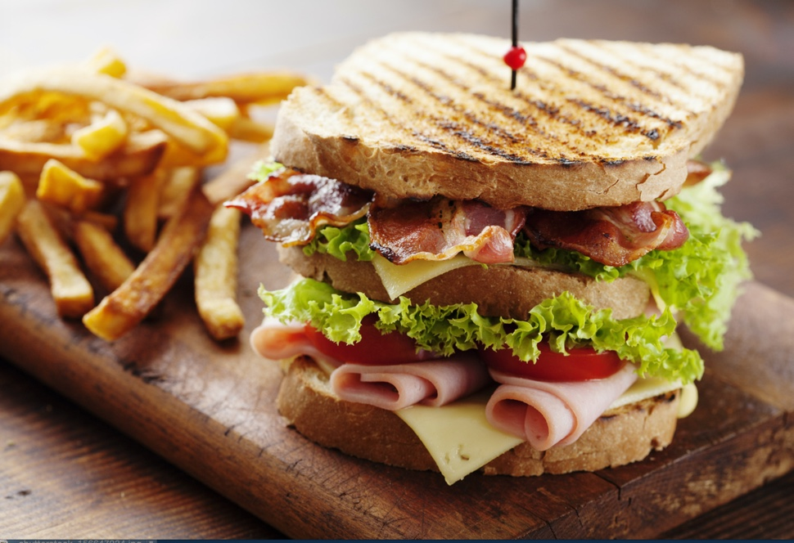
Time to think about food!
Working in groups of 3, think about your local town.
List all the different places you can go out for lunch.

Slide 14
Pick 3 eating places from your list…
Name of business
 | Strengths | Weaknesses
Price
Product Range
Quality
Location
Customer Service
Draw a table like the one here and, for each of the businesses chosen, note down their specific strengths and weaknesses.

Slide 15

Compare your findings
Which of the 3 businesses did you feel is the most competitive? Justify your choice.
Which business is the least competitive?
Suggest and explain three ways this business could improve its competitiveness.

Slide 16
Making decisions
In order to make successful decisions, a business requires information.
Internal information about the business situation is easy to find and to use when making decisions.
External information about the market in which the business is competing is harder to gain, more difficult to interpret/use to ensure that reliable decisions are made.

Slide 17

Just a minute…
You are an entrepreneur hoping to start a small business that specialises in making handmade bookmarks from dried flowers.
You have 60 seconds to write down possible market information that you might need to ensure your business is a success.

Slide 18

Market information
Who are the competition?
Products produced – are they the same or different to yours? Can you protect your product idea to prevent others copying it?
Price – is it similar or lower?
Quality – is it as good? What level of customer service is provided?
Location - Where are rivals based? What are their distribution costs?

Slide 19
Impact of competition on business decision-making
The level of competition and actions of competitors will influence the decisions a business makes.
For example, faced with competition, should the business lower the price, widen the product range or focus on innovation?
These decisions will be important to a business, if it is to remain competitive and ultimately survive in the market it operates within.

Slide 20

Yorkshire Meatballs – surviving the competition
The Yorkshire Meatball Company (YMCo) was launched in 2014. The restaurant chain specialised in meatballs, with locations in Harrogate and York.
In 2016, a large number of national restaurant chains set up in these towns, providing fierce competition for YMCo.
Notes:
http://startups.co.uk/startups-100/2017/99-the-yorkshire-meatball-co/

Slide 21
Impact of competition on YMCo
Explain how the increase in competition could impact on the Yorkshire Meatball Company in each of the following areas:
Profits
Costs
Prices
Staffing
Fall - due to a loss of customers to competitors, therefore fewer sales
Effects - less money to invest in the expansion of the YMCo restaurant chain
Increase – costs of keeping the restaurant open when there are fewer customers, possible increased costs of food wastage
Increased costs of advertising to promote YMCo in order to attract more customers
Decrease – in order to compete, YMCo may need to reduce the price of its meals.
Perhaps offer meal deals, such as cheaper early bird offers or a specials menu
Fall – staff have more choice of restaurants to work in so may leave to work for a bigger chain that may offer higher wages and better chances of promotion

Slide 22
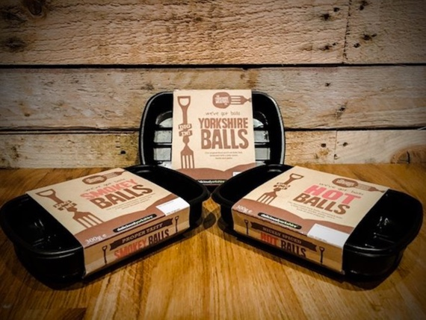
What happened next for the YMCo…
As a result of staff leaving and fewer customers, its restaurants had to close.
Change of Plan for YMCo
Not wanting to give up, the father and son owners decided to become a supermarket supplier.
By 2016, they had secured crowdfunding capital and successfully launched their meatball products in over 200 retailers, including national supermarket chains.

Slide 23
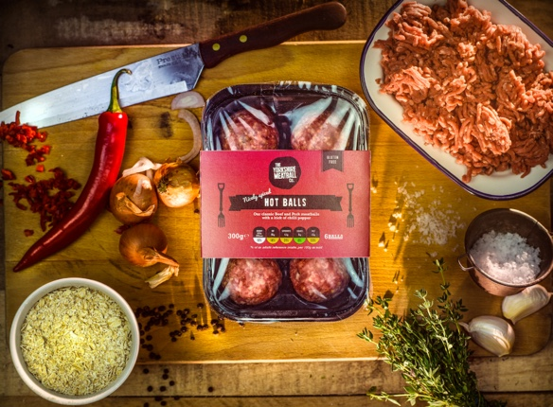
Quick questions
State two ways competition from the restaurant chains affected the Yorkshire Meat Company.
In 2016, YMCo launched a range of meatballs into the retail market, securing deals with a number of supermarkets. Identify three ways YMCO can ensure it is able to compete against its rivals.

Slide 24
Ways to compete…
Product differentiation -
Making the product different in some way to other products on the market.
Advertising – YMCo could promote their USP, different flavours, larger than normal meatballs
Eye-catching packaging – to make sure that its products stand out from rivals
Developing new products – continue to introduce new types of meatball – different flavourings, meats etc
Price – YMCo could lower the price, although this depends on how sensitive demand would be to a change in price

Slide 25


