Slide 1




PowerPoint Guide
The news icon is hyperlinked to a related article or website.
Simply click to access
The film icon is hyperlinked to a related clip.
Simply click to access
The discuss icon indicates suggested points to discuss
The writing icon indicates a written activity or question time

Slide 2
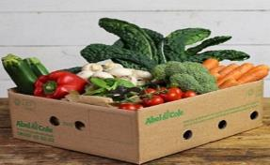


1.2 Spotting a business opportunity
1.2.1 Customer needs

Slide 3
Key elements to this topic
What are customer needs?
Importance of identifying and understanding customers

Slide 4
Understanding customer needs
A business needs to have an effective understanding of the needs and wants of customers in its target market segment.

Slide 5
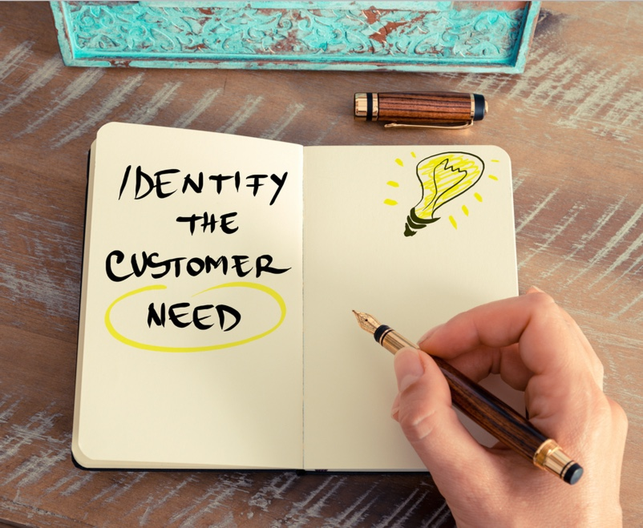
What are customer needs?
To be successful, a business will need to know what its customer needs are and understand what customers expect.
Right product/service
Convenience
Offers the quality expected
Right price
Provides choice

Slide 6

Quality
Customers will want the product/service to be of the quality that they require and expect.
This is not necessarily high quality, as customers may be happy with a cheaper product of a reasonable quality.
Name a business whose brand is known for
providing a high quality product or service

Slide 7

Price
Customers will expect to pay a reasonable price for goods or services. Price can vary depending on quality, timing, delivery arrangements and the popularity of the item.
E.g. train ticket prices can change according to different circumstances, in this instance – the time of day!

Slide 8

Let’s consider Snapchat…
Identify the target market and 3 ways Snapchat meets the needs of its customers

Slide 9
Snapchat customer needs
Convenient way to send photo messages and videos
High quality and effective app
Installed on IOS and Android phones, widely available
Product – photo and video messaging, messages automatically delete in set time
Price – App is free to download
Choice of features - snap to multiple friends, private messaging, create a story, create a social network

Slide 10

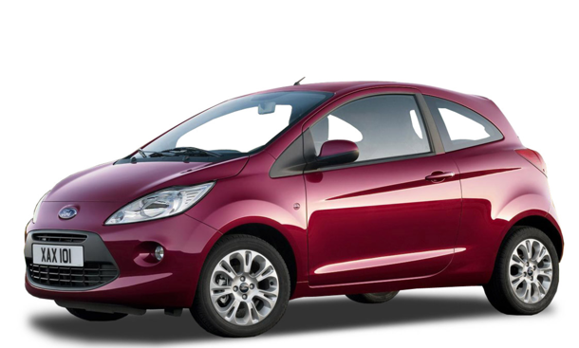
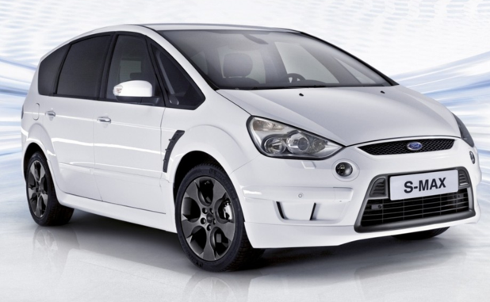
Choice and competition
Customers may be looking for a wide choice of features or options from a good or service. These could include different brands, different quality and price combinations and even different varieties of the same product.
Car manufacturers offer a wide choice of cars. The cars offer different features to meet the needs of different types of customers.

Slide 11
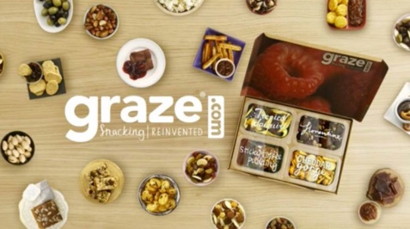
Convenience
The growth of online shopping and home delivery highlights how customer needs have changed in recent years.
Most successful retailers will now have websites and e-sales options that are more convenient and increasingly expected by customers.
Retail store opening hours and locations are also factors that are affected by customer needs.
Graze – provides healthy snacks in a box delivered directly to customer homes.

Slide 12
The importance of businesses understanding the market they intend to enter or they currently operate in…
A lack of understanding increases the risk that the business will fail
Understanding the market will help the business to generate sales and to survive
However, a new business is rarely able to afford substantial market research
The challenge is to focus on the information that the business planning process requires

Slide 13
Useful information for a business to know and understand…
How big is the market? (measured by sales, volume etc)
How fast is the market growing and what is the market growth potential?
Who are the existing competitors and what market shares do they have?
How is the market segmented? (“segments” are the different parts of a larger market – e.g. low price or high quality)

Slide 14
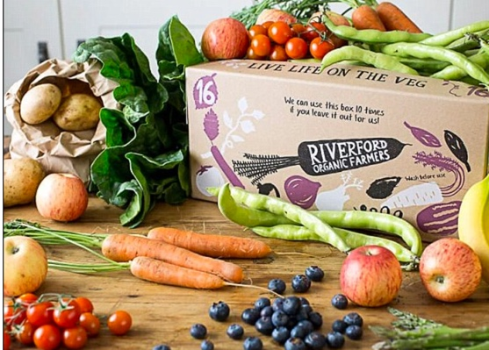
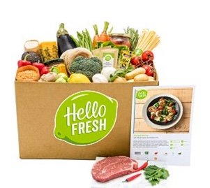

A box full of goodness
Over recent years, there has been a significant growth in the market for fresh, organic food that can be ordered online and delivered direct to the customer. Businesses such as Riverfood Organic Farmers, Hello Fresh and Abel and Cole have added value to their boxes by providing recipes and the exact amount of ingredients needed to create a wholesome meal, ready in 40 minutes. A variety of weekly recipe boxes are offered to successfully meet different customer needs and wants.
https://www.youtube.com/watch?v=mpohO-noTvQ

Slide 15
A box full of goodness
List the potential customer needs for the weekly recipe food boxes
Identify two different types of customer for Hello Fresh
How will their customer needs differ?
Explain two benefits to Hello Fresh of having a good understanding of the needs of its customers

Slide 16

“Evidence Hunter”
Watch the Dragons Den clip, note down the questions and find the answers.

Slide 17
Note these questions down and watch the clip
What goods/services does Flavourly offer?
Flavourly operates in the food and drink market. What is the value of this market?
How did Flavourly research customer likes and dislikes?
How many paying subscribers do Flavourly have and what is the value of their sales currently?
How did Flavourly raise the 150K of seed capital?
What issues did the Dragons have with Flavourly?

Slide 18

Into the “Den” – Flavourly
https://www.youtube.com/watch?v=ZcsctdV2G7Y

Slide 19
Answers
What products/services does Flavourly offer?
Flavourly operates in the food and drink market. What is the value of this market?
How did Flavourly research customer likes and dislikes?
Online business that delivers a selection of fine food, drinks and snacks direct to customers. A platform for independent food suppliers.
Page on business website, customers rate the products and indicate their food preferences.
£27bn
How many paying subscribers do Flavourly have and what is the current value of their sales?
How did Flavourly raise the 150K of seed capital?
What concerns did the Dragons have about investing in Flavourly?
Number of other investors. Ryan owns less than 50% of the company.
2,000 subscribers
£300,000 sales
Crowd funding

Slide 20
Quick questions
Ryan used a website to gather information on customer preferences. What other information would be useful to Flavourly to ensure the business was successful?
Explain why it is important for Flavourly to identify and understand its customer needs

Slide 21
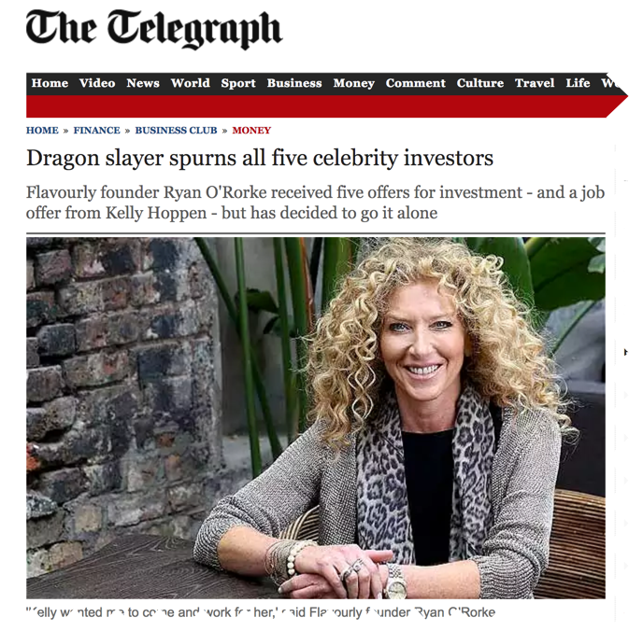
Flavourly – What happened next?

Slide 22
Importance of identifying and understanding customers:
A new entrepreneur will start with finding out and identifying what a customer wants and needs through market research.
He/she will then design a good or service that meets these needs and decide on a price to charge that customers are prepared to pay.
This will help the business to generate sales early on and continue to make sales, which will help to secure the survival of the business.

Slide 23


