Slide 1



Year 11 Transition
Who?
What?
When?

Slide 2

Who - Key people at JPC
Ms Marrion Deputy Headteacher
Mrs O’loughlin Head of Learning for Life
Faye Rafferty 1:1 meeting and support
frafferty@wirralhs.co.uk
Ms Hoey EHCPs & transition meetings
Carol & Louise Blue house –Travel training / applications
Helen & Anthony Green House –Travel Training / applications

Slide 3
What - Careers Education at JPC
WHAT
Careers Lessons
National Careers Week Activities
Apprenticeship Information
1:1 Careers interview with an independent advisor
Mock Interviews
In -house work experience
Work related visits
Visits to Further Education Colleges
Visits to Universities
Enterprise Activities
Travel Training
WHEN
Weekly - Work related learning, PSHEE, Entry Level 3 qualification, Mentor Time lessons
All students get at least 1 interview
Term 1
Term 1
Term 1 & 2
Term 1
Term 2
‘Market place’ Term 2 14 February 2025
When required

Slide 4
Careers Education
Qualifications at JPC
Food Safety & Hygiene
Basic First Aid
CPR
Entry Level 3 in Personal & Social Development

Slide 5
In-house work experience
½ day working with staff in specific areas of school 9.00am - 12.00pm
Work dress
Application & interview

Slide 6
Local Labour Market Information
Information about what jobs are available
Where these jobs are
What qualifications and skills are needed to get these jobs
How much these jobs pay
Who is available to do these jobs and how they give themselves the best chance of getting one of these jobs

Slide 7





Merseyside LLMI
Caring professions
Retail
Administration
Hospitality
Education
    Source ONS 2021

Slide 8




When – Time line
Leaving JPC
Starting college
Prom
Half Term Break
Half Term Break
Half Term Break
Summer Holidays
Christmas Holidays
Easter Holidays
Summer Holidays
September
October
November
December
January
February
March
April
May
June
July
August
September
2025
2024
2025
Work experience
Mocks
Exams
Coursework
College applications and visits
Transition meetings
College interviews
Results?

Slide 9


Family Support
Open Evenings
Applications
Space at home to revise
Don’t talk about transition every week!

Slide 10

What courses can I apply for?
What happens if I fail all my exams??!!!!

Slide 11





Entry Level Vocational Qualification
e.g. BTEC
Entry Level Qualifications (or even no qualifications!)
Level 1 Vocational Qualification
e.g. BTEC
Level 1 Qualifications
GCSE Grade 1,2 or 3
Level 1 BTECs
Level 2 Vocational Qualification
e.g. BTEC
Level 2 Qualifications
GCSE Grade 4, 5, 6, 7, 8 or 9
Level 2 BTEC
Level 3 Qualification
e.g. BTEC or A-Levels
Higher Academic Level 2 Qualifications
GCSE Grade 5, 6, 7, 8 or 9
A-Levels at the colleges with higher entry requirements

Slide 12

Making sure you have the support you need at college
Everybody at our school has a Learning Plan.
This is a document that explains what your goals are, what your skills are, what makes things difficult for you at times, and support or help that can make things easier and help you achieve your goals.

Slide 13
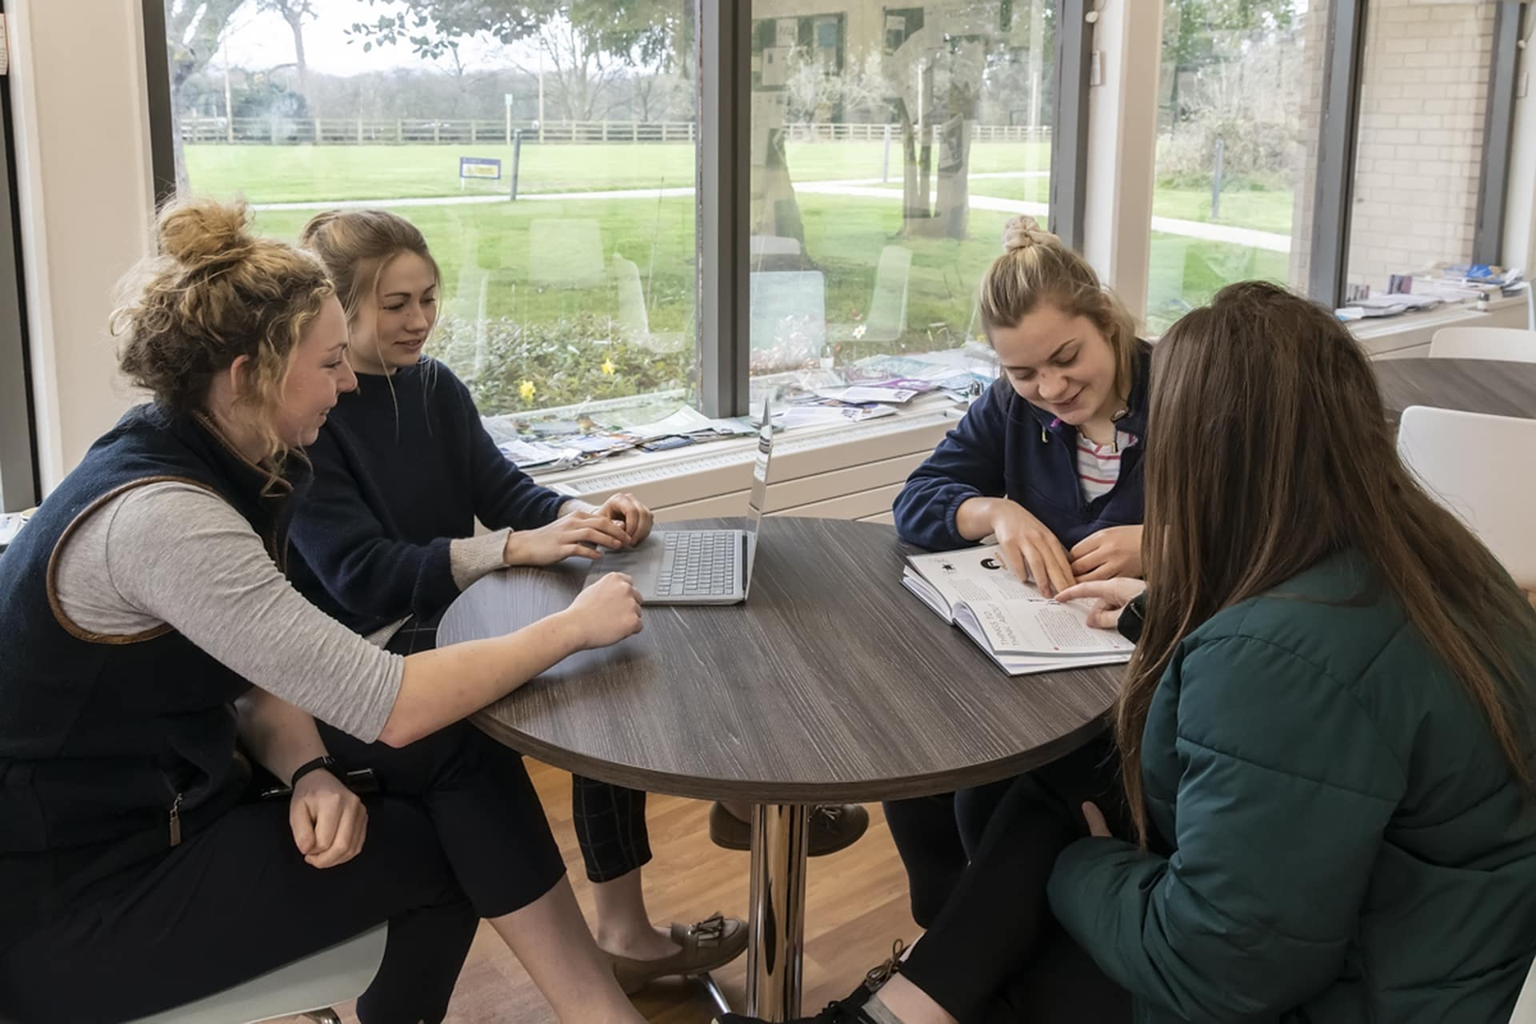
As soon as you have an idea where you would like to study next year, please let us know.
We will have a Transition Meeting with someone whose job it is to make sure people have the right support and help in college.
We will show them your Learning Plan and talk with them about what will help you do well there.

Slide 14

Some students will be wanting to go to college and not want any help or support, some will be worried whether there will be enough help and support at college, most will be somewhere in between.
We will listen to you and agree with you, your family and college to make sure you are happy with all the plans around you as you start your new adventure!

Slide 15
Useful websites
https://successatschool.org/
https://www.apprenticeships.gov.uk/
https://amazingapprenticeships.com/
School Website: Parents > CEIAG
https://www.wirralhs.co.uk/

