Slide 1


JPC Revision Tips

Slide 2


Slide 3
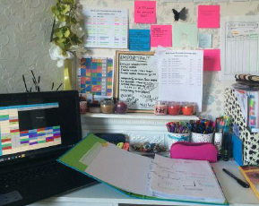

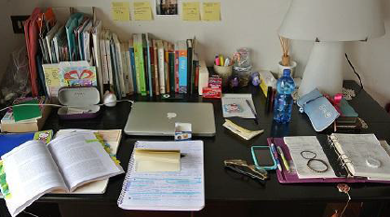
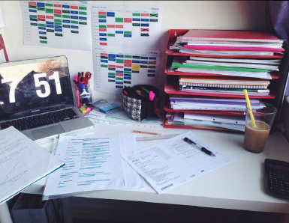
Dedicated Revision Area
Resources to hand
Organised
Limit distractions

Slide 4
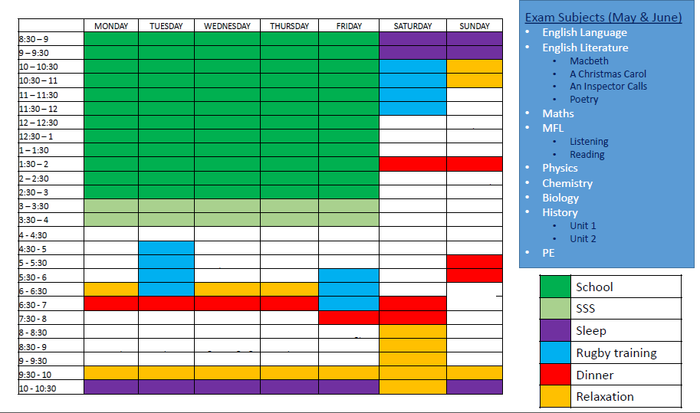

Slide 5
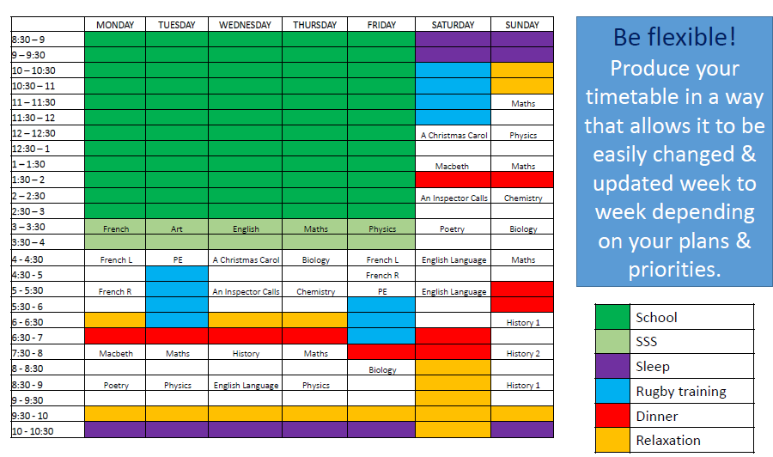

Slide 6
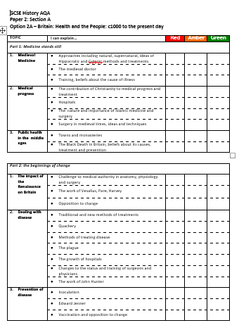
Break it down
Review the spec
Use this breakdown to ‘chunk’ your revision
RAG rate it- Prioritise the topics that worry you most

Slide 7




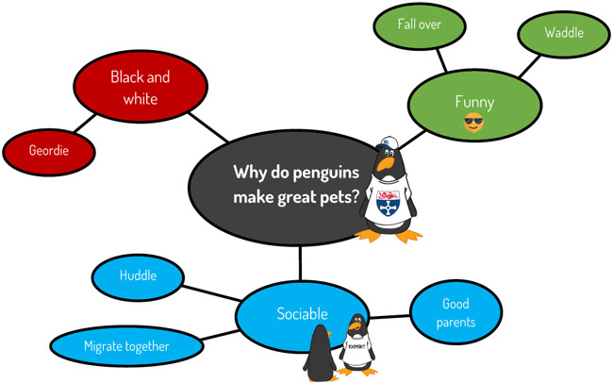
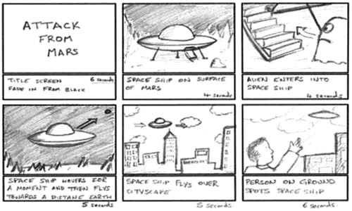

Four Key Techniques
Flashcards | Retrieval Practice Low stakes quizzes Flashcards Brain dumps
Transform it! | Dual Coding

Slide 8
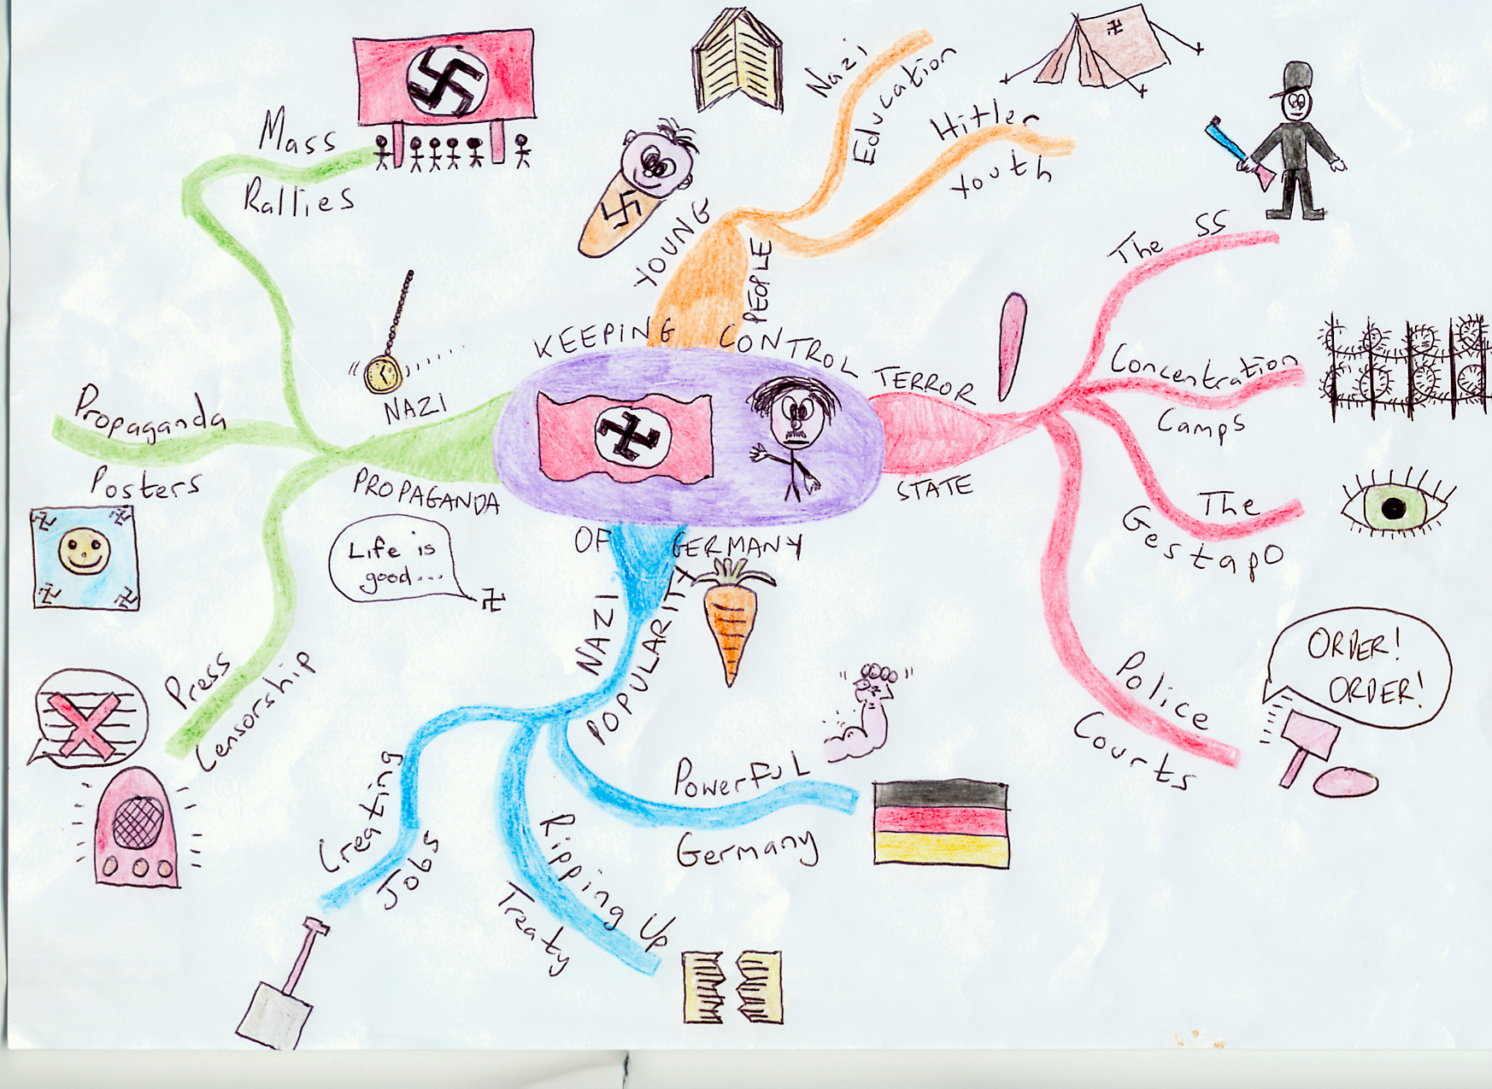

Slide 9

Use It!
There is no substitute for timed practice of the type of questions you will be asked
Revise a topic then use the info to do a practice question
‘Memory is the residue of thought’
Find past paper questions/ specimen questions/ model responses at exam board websites, in revision guides or in the revision materials/ topic books provided by school
Make more marking for us- we love it!

Slide 10


Slide 11


