Slide 1

Yr11 Spring Update
Dear governors,
I will go through this PowerPoint on the night but I just wanted to point out a couple of things in case you choose to have a look at it beforehand.
Slide 6 shows the projected headline figures based on teacher estimated grades. Please be aware these are very rough figures - we’re unable to predict which students will be too unwell on the day to sit the exam and how this may impact on final grades.
Questions welcome at the meeting,
Laura

Slide 2

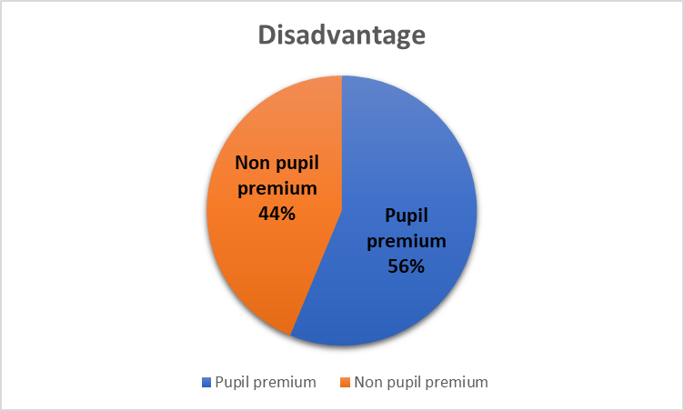
Yr11 Background Information
32 students in Yr11
18/32 PP

Slide 3
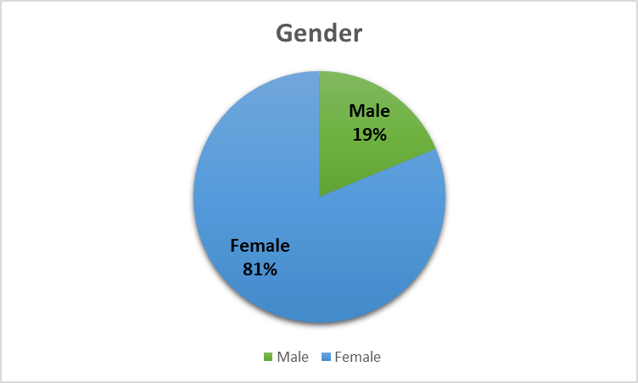
Yr11 Background Information
32 students in Yr11
  6/32 Male
  26/32 Female

Slide 4
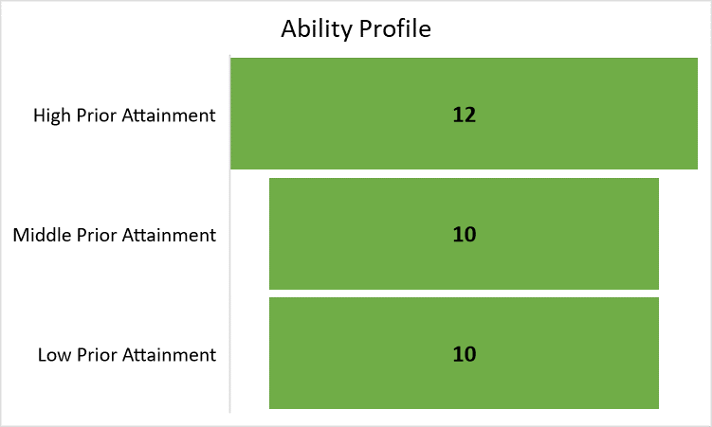
Yr11 Background Information

Slide 5
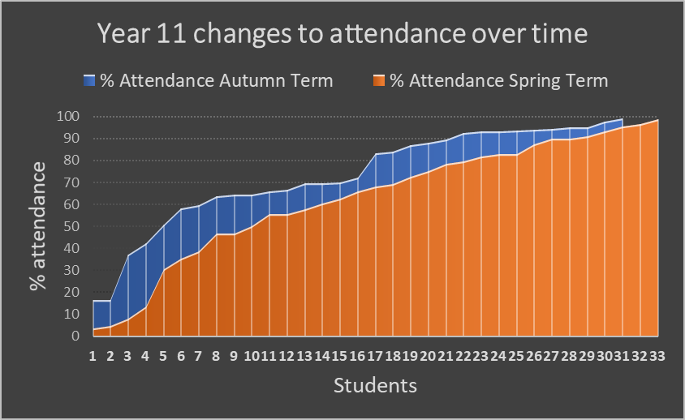
Y11 Background Information
Attendance
The graph shows a clear decline in attendance from the Autumn Term to this term.

Slide 6
Yr 11 Estimated grades
 |  | 2024 | 2023 | 2022 | 2021 | 2019
1 GCSE 9-1 |  | 94% | 100% | 97% | 97% | 100%
5 GCSE 9-1 |  | 84% | 85% | 67% | 50% | 50%
5 Passes | 4-9 | 44% | 39% | 35% | 37% | 22%
 | 5-9 | 16% | 15% | 32% | 20% | 13%
5 Passes inc English and Maths
 | 4-9 | 41% | 33% | 29% | 27% | 13%
 | 5-9 | 16% | 9% | 13% | 20% | 6%
% achieving the threshold in English and Maths
 | 4-9 | 48% | 36% | 45% | 40% | 13%
 | 5-9 | 22% | 12% | 19% | 10% | 6%

Slide 7
Yr11 Current concerns
  12 students sitting on the Grade 3 / 4 borderline for either English or Maths
  Cw concerns – Performing Arts, BTEC Science, Animal Care, Food, Art, Photography
  Attendance – collectively and individually (6 students not attending. All at risk of not sitting all exams).
  NEET figures – All 6 of the above students are at risk of NEET. Our total NEET figure for last year was 4.

Slide 8
Yr11 Next Steps
Target 3/4 borderline students
  Quality first teaching
  Targeted interventions (Inference, “Elephant Maths”)
Informed decisions re Entry Level entries
Coursework deadlines
  Maximise support time
  Clear priorities, communicated with key staff
  Collapsing timetables where necessary
Practise access arrangements
  Utilising TAs through new faculty system
Tier 2 language
  Using form time to boost key terminology
  “Elephant Maths” exam techniques shared with all staff
Timetabled revision sessions after school

