Slide 1
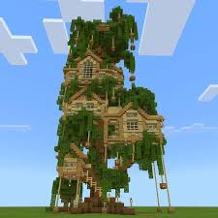
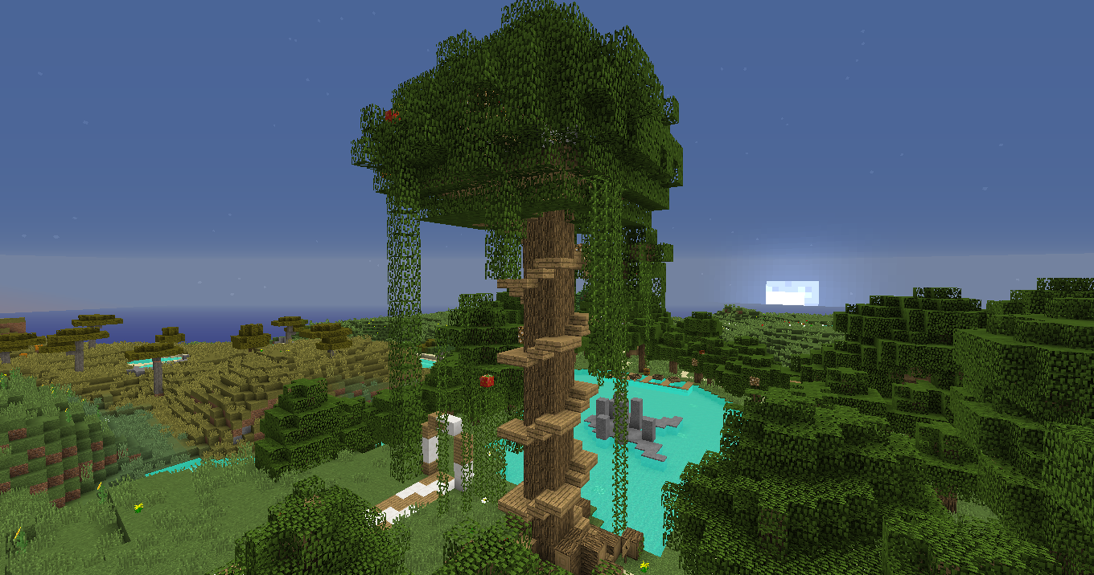

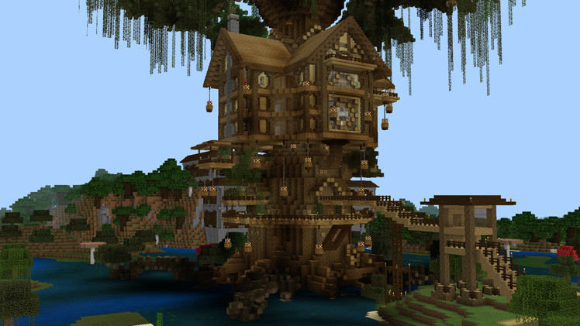
My treehouse
Click me first

Slide 2
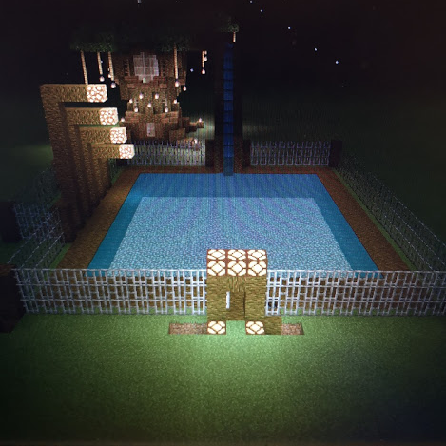
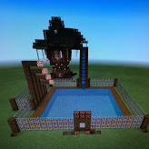
NIGHT
DAY
vs

Slide 3

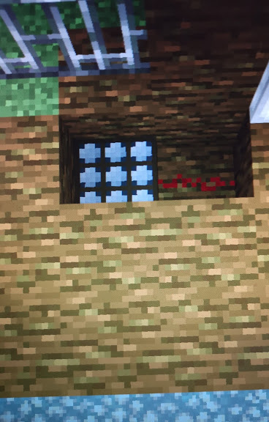
Here is the pool
It is made out of:
Jungle wood
And
Glowstone
It is three blocks deep
And
It is 21x21 blocks wide
The second picture is the Redstone to open the pools door

Slide 4
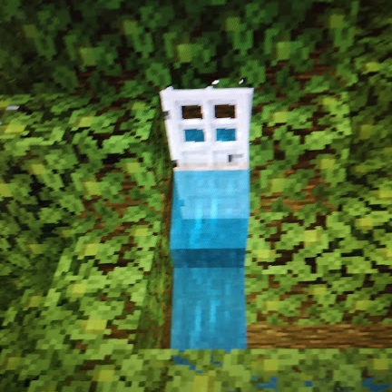
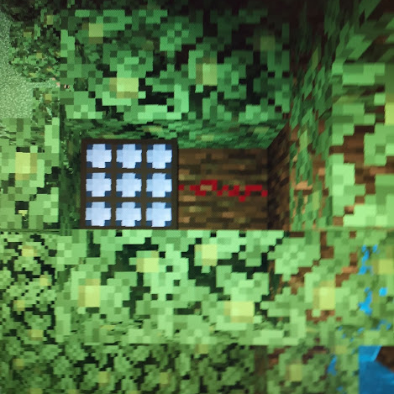
The day light sensor is set to night which means the slide door opens at night like the pool door

Slide 5
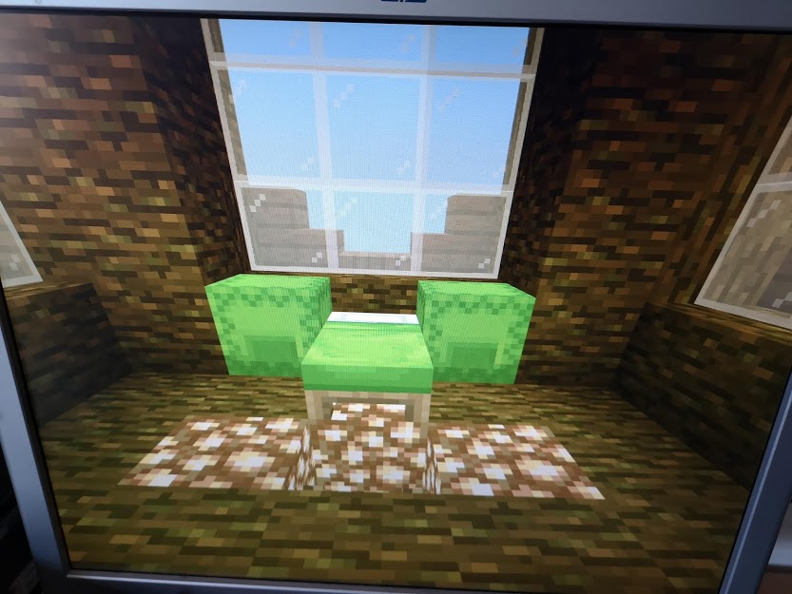
This is my bed room
It has a lime green bed , shulker boxes and a good view

Slide 6
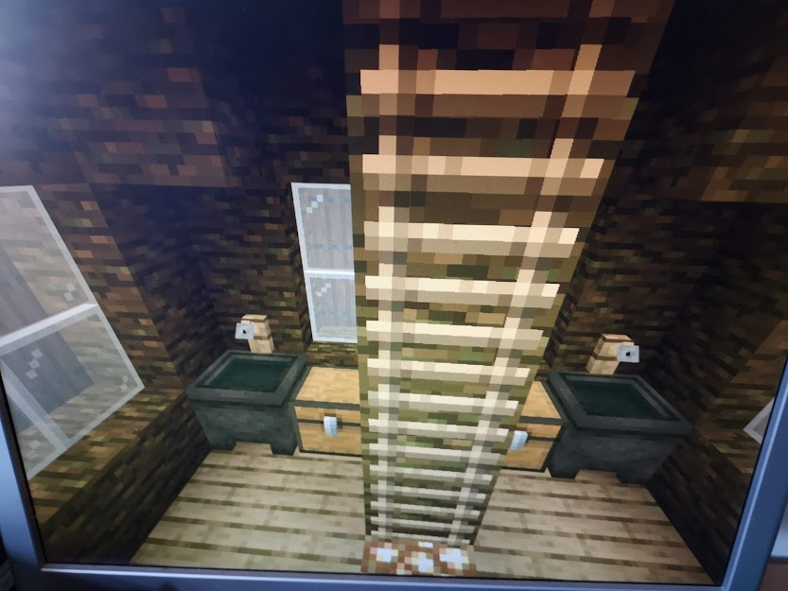
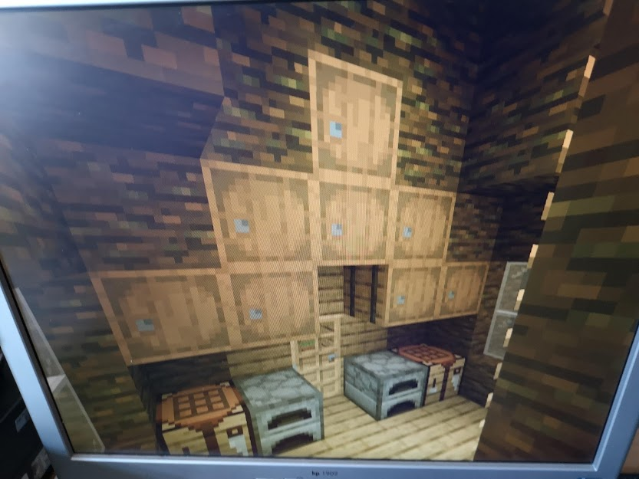
This is my kitchen I have two furnaces , two crafting tables and eight barrels it also has two sinks and two chests

Slide 7
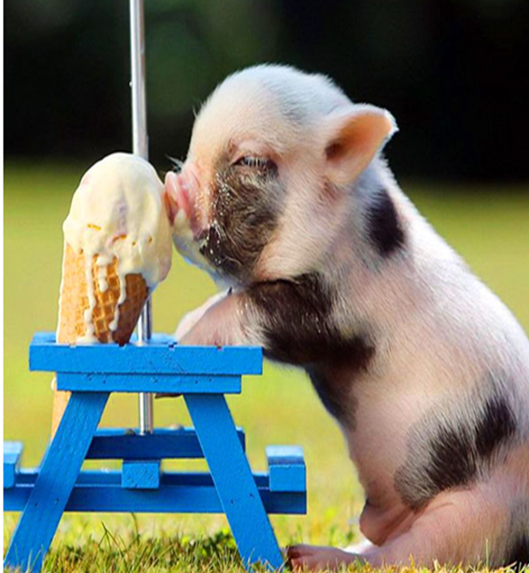

Click the picture

