Slide 1
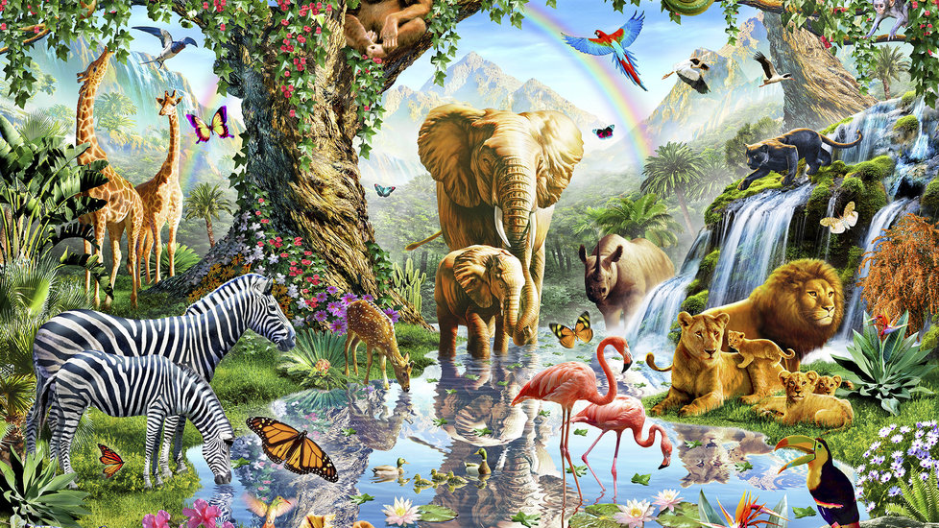
My visit to animal town

Slide 2
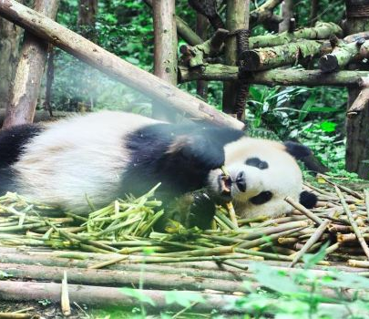
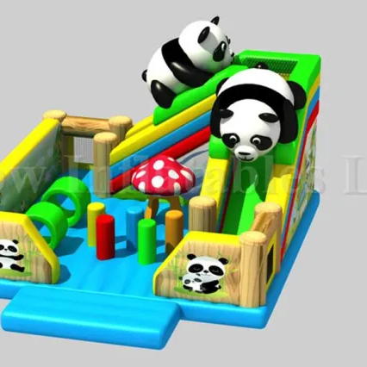
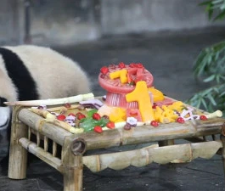
Panda park
We finally arrived at animal town and a panda greeted us at the entrance, everyone was confused
“ hey there kids.” said the panda in excitement” I’m so glad you got are invite, come on everyone we have got a train to catch.” everyone got on to the train and then they set off
“next stop panda park.” announced the panda. Everybody looked in amazement at the pandas playing in a park that was like no other.
“every body heads inside the train we are going to the next stop, GIRAFFE GYM.

Slide 3
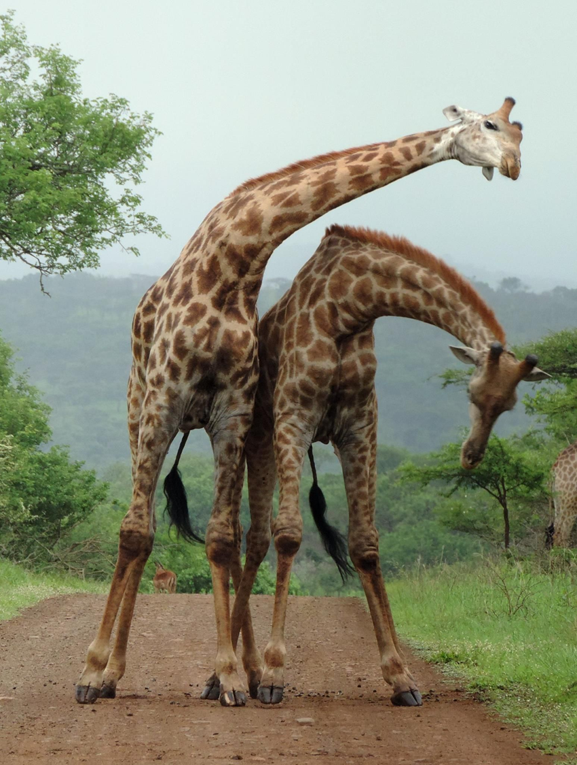
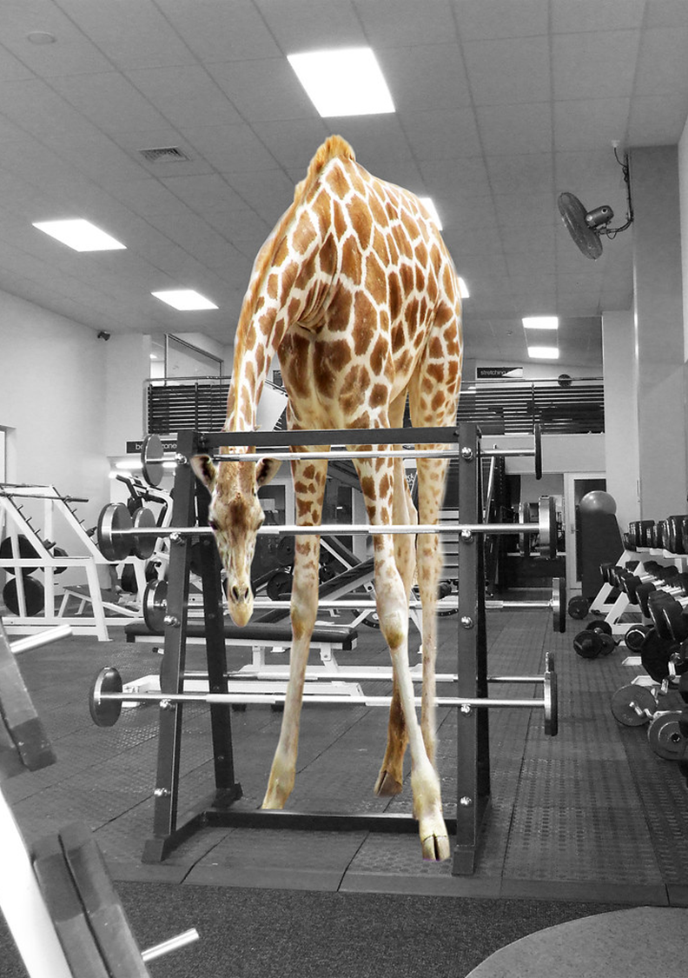
Giraffe gym
We made it to giraffe gym. Everyone (even the teachers) laughed when they saw giraffes on treadmills, the giraffes waved and everyone waved back. And then they moved on to the next stop, MONKEY MANSION.

Slide 4
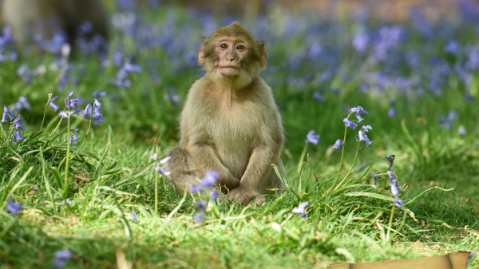
Monkey mansion
We arrived at monkey mansion and it was massive but this time we could actual go in side. There was lots of lose monkeys claiming, swinging, playing and we got to feed them it was my second favourite I will tell you my favourite on when we get there. And the next stop was my favourite place of the town ,DOLPHIN DECK.

Slide 5
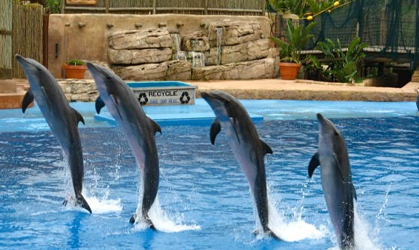
DOLPHIN DECK
After 10 minutes we made it to dolphin deck there were dolphins standing on their tails on the water it was amazing I loved it so much I wish I could be one it looked so fun and we got to swim with them. Then we got dried and went to the next stop, PARROT PARADISE .

Slide 6
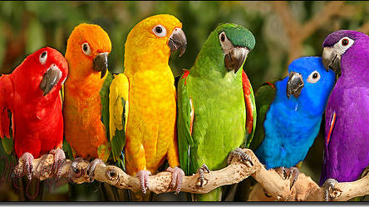
Parrot paradise
parrot paradise was so colourful, everyone loved it and we got to holed some of the parrots on are hands it was amazing. So then we went to, LAMA LAKE.

Slide 7
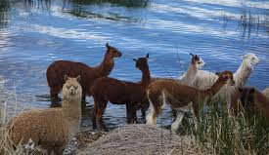
Lama lake
When we got there it turned to 20 degrees and every one was sweating it was that hot. All the lamas looked so soft and they were and when we feed them they would lick your hand and it tickled and I loved it.
“next stop LUNCH.”

Slide 8
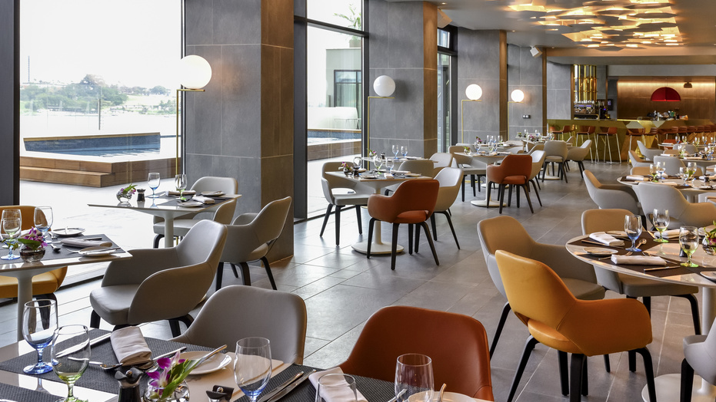
Lunch time
It was finally lunch everybody was hungry from all the animals they visited. I had a healthy lunch, I had: turkey sandwich, fruit salad, an aloe Vera drink and some maltloaf. It was really nice were we eat. Then we went to ,POLAR PEAK.

Slide 9
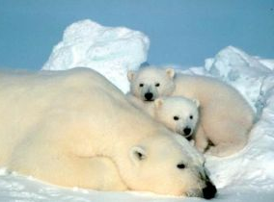
POLAR PEAK
When we arrived at polar peak the baby polar bears were so cute when they swam and I know this is dangerous but we got to swim with the polar bears. Then we went to, LEMUR LAND.

Slide 10
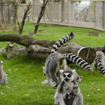
LEMUR LAND
lemur land was a place where lemurs could run wild in a massive jungle container and lots of lemurs came to me and climbed on me they were so soft. So we then went to ,RINO ROCK .

Slide 11
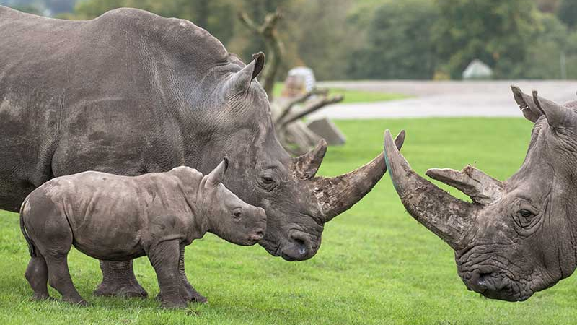
Rino rock
Rino rock is a massive rock with a waterfall on it and a huge watering hole where the rinos loved to bathe in and the grass is a really bright green and the baby's were so cute. Then we went to ,VULTURE VALLEY.

Slide 12
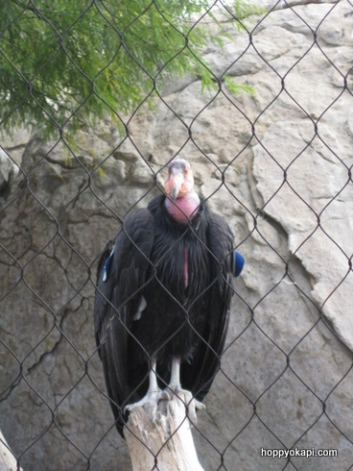
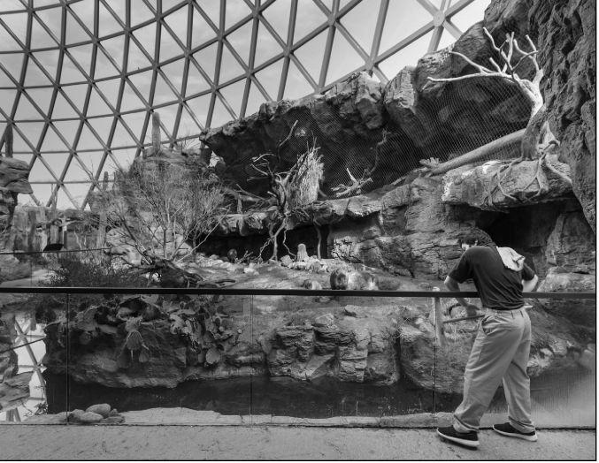
Vulture valley
Vulture valley is a massive glass dome with a valley in the middle. The vultures mainly spend there time in the valley and start flying around at night luckily we are staying here for 2 days so we can still see them. Next up is HYENA HOUSE

Slide 13
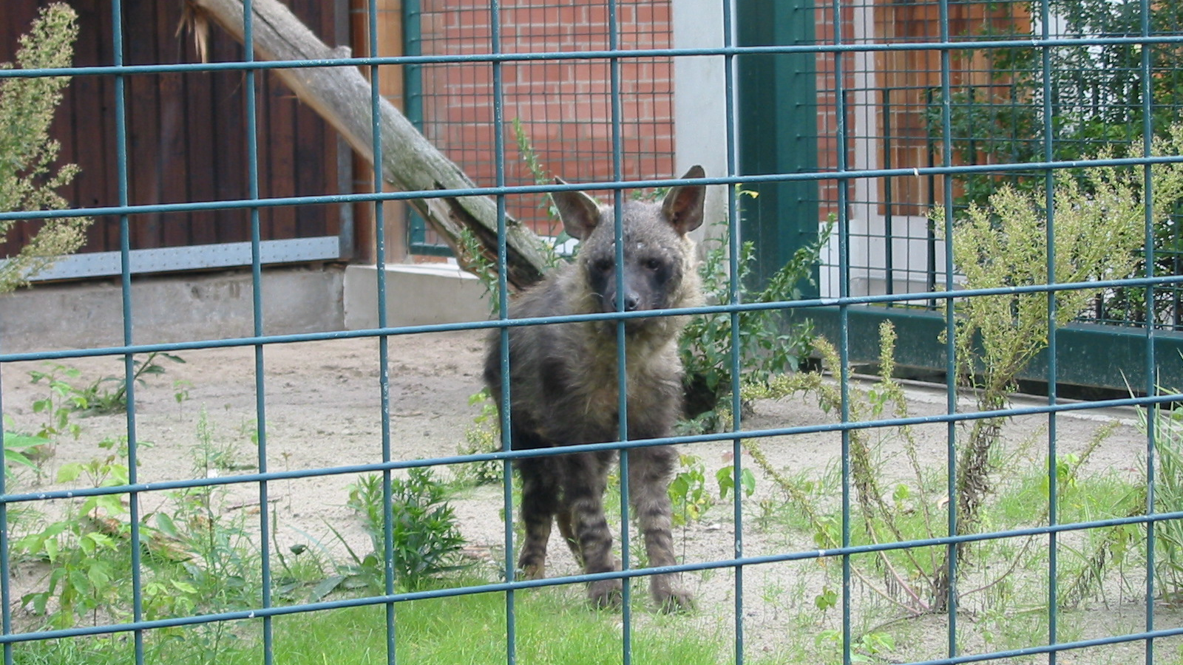
Hyena house
The hyenas look extremely happy and love the house. It has a nice swimming pool in and a shady place for when it is hot. Next stop

Slide 14
The trip has ended so we are going home now
the end

