Slide 1
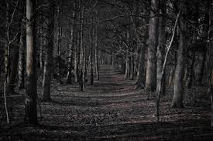
The wood of DOOM
No one has seen or herd of this man since the day of the crazy event
Terrifying woods with unbelievable mysteries
Created by
Lucas

Slide 2
It was 2017 as the 27 year old man started his crazy adventure, off he went through the eerie place. Some people say that these woods have had others lost as they will never return. As he walked around swamps of mud and gnarled old trees and branches the man saw a old tree-house with smashed up rocky walls. There was even a rotten old gate with a sign on the wall saying :
COME IN IF YOU DARE!!!

Slide 3
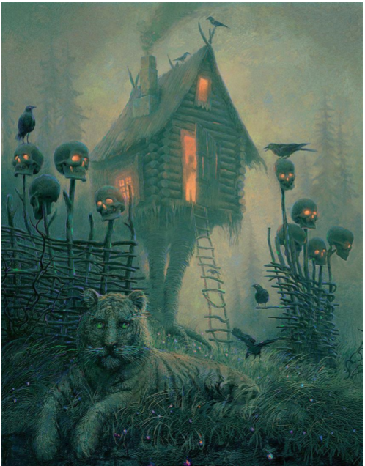
These are the facts of the woods!
A creepy jungle treehouse with firetrap eye skulls, terrifying everyone that comes too close to the treehouse of doom. There are vicious camouflaged striped tigers waiting for you to come into the boundaries of sudden death.

Slide 4
Extra Facts !
Once you are 2 metres away from the barrier of the vicious, hungry tigers they will start to surround you and they will be ready to eat you alive. If you were lucky enough to have got into the treehouse or didn’t get captured by the tigers and managed to escape the ring of death you would know not to visit the creepy woods ever again.

Slide 5
He sneaked into the base of total craziness like he knew something bad was going to happen, but as he knocked on the door loudly to see if anybody was living there. The hungry tigers woke up angry at the young gentle man and without him knowing the tigers surrounded him on the wooden stairs. He climbed onto the roof of the treehouse and waited until they ran away so that he could walk home and tell everyone the creepy story but from the moment he walked into those woods, no one had seen him since.

