Slide 1
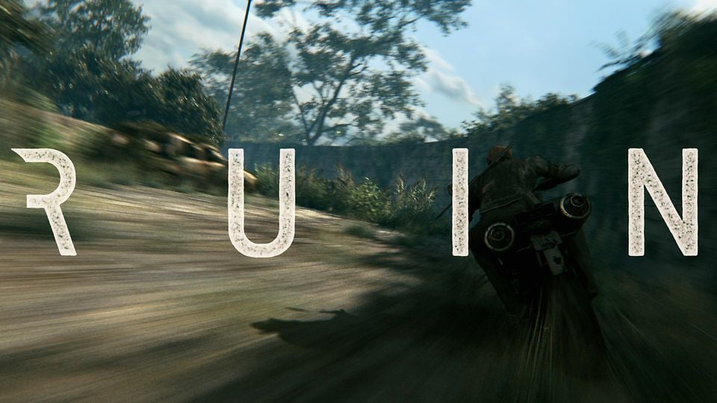
THE RUIN
By Christian Williams

Slide 2
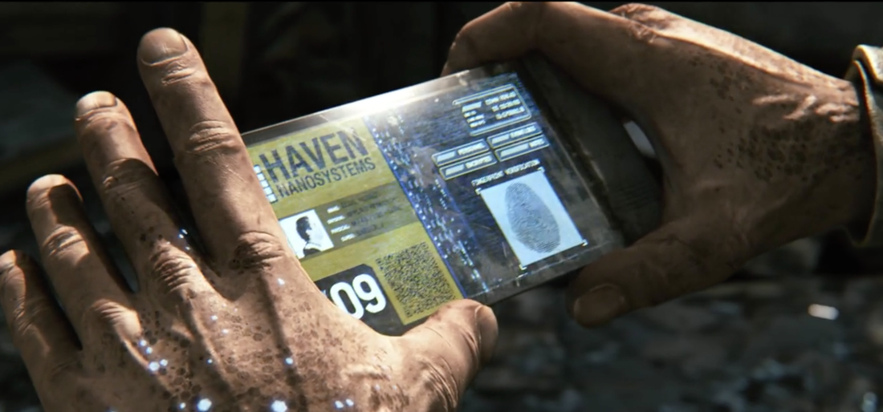
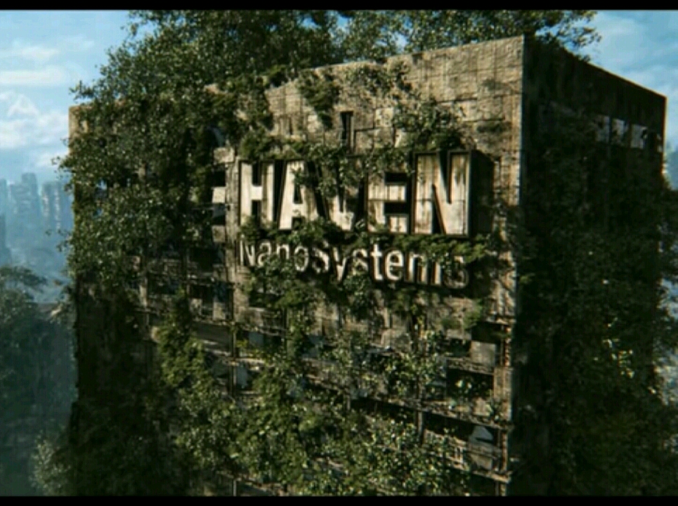
There he was in an abandoned city. He pushed a safe off an overgrown sky scraper. There was a loud bang from the safe when it hit the floor. The door fell off. There was a holographic screen showing information of the city haven.

Slide 3
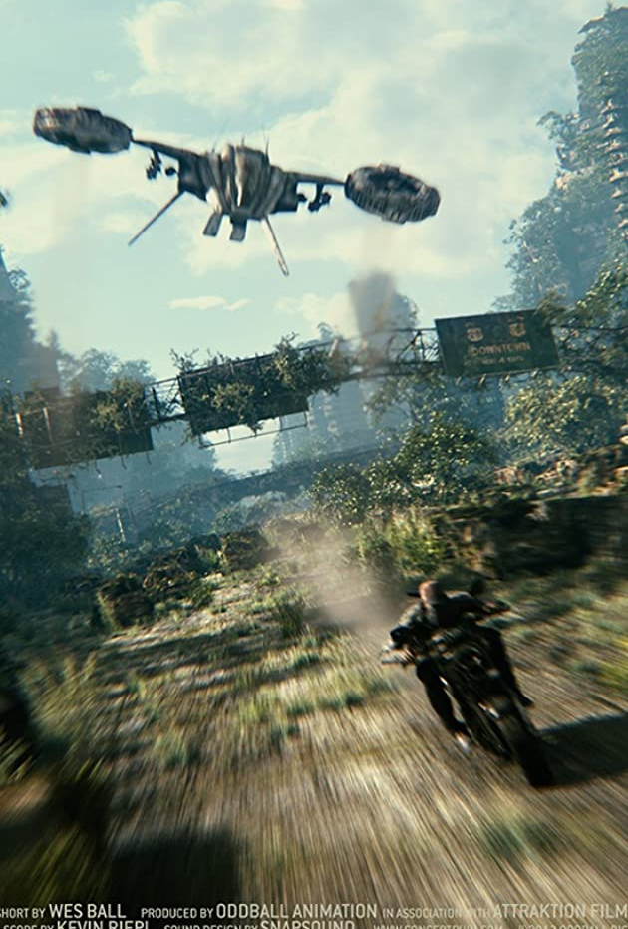
He heard a noise but he didn’t know what it was. He turned both ways, didn’t see anything but suddenly a helicopter appeared he ran to his motorbike and drove for his life. The helicopter shot out two rockets which followed him until he blew them up.

Slide 4
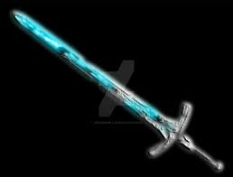
Then he got his electric sword and stabbed the helicopter, and then he drove home.
THE END

