Slide 1
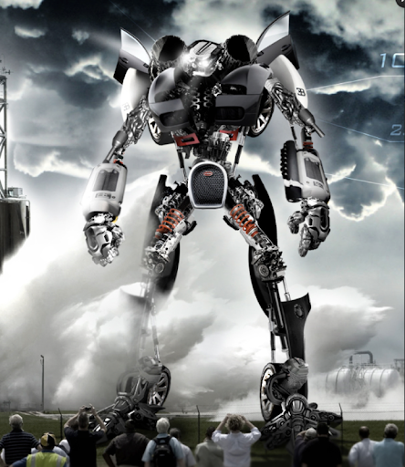
The visitor

Slide 2
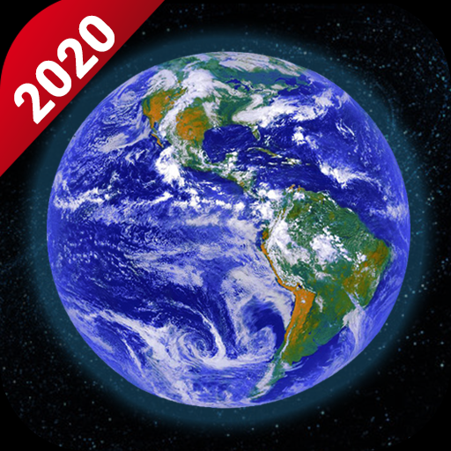
Once there was a peaceful planet called Earth, every one was happy. Except one person named Tom he wanted the Earth to turn into a giant robot factory to take over other planets until every planet was his. So he became an astronaut and flew to a planet that generates metal randomly , he could start ruling all the planets in all the different galaxy’s. He packed lots of people to work there and lots of materials to start building the factory. Some time later (2 years later) the factory was done and so was some of the robots. So Tom climbed into one and flew to the first planet. EARTH!!!

Slide 3
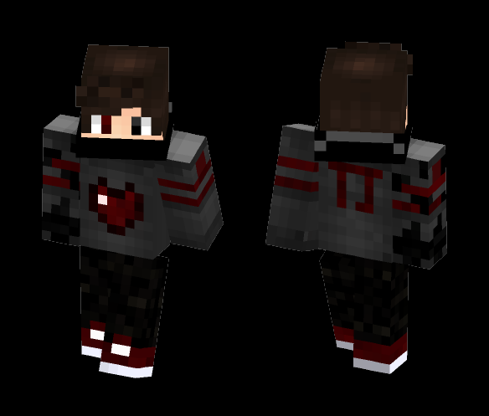
He finally made it to Earth. He landed the robot carefully on a farm, everybody crowed around the big metal thing. Everyone was confused. They said to themselves why was it here, what did it want and who controlled it. The hatch opened, smoke came out of the driver's seat and out came Tom with a half robot face. He was the master of robots, anyone who made robots would be taken as a slave or would be killed with his robots missiles and there would be blood everywhere.
Tom

Slide 4
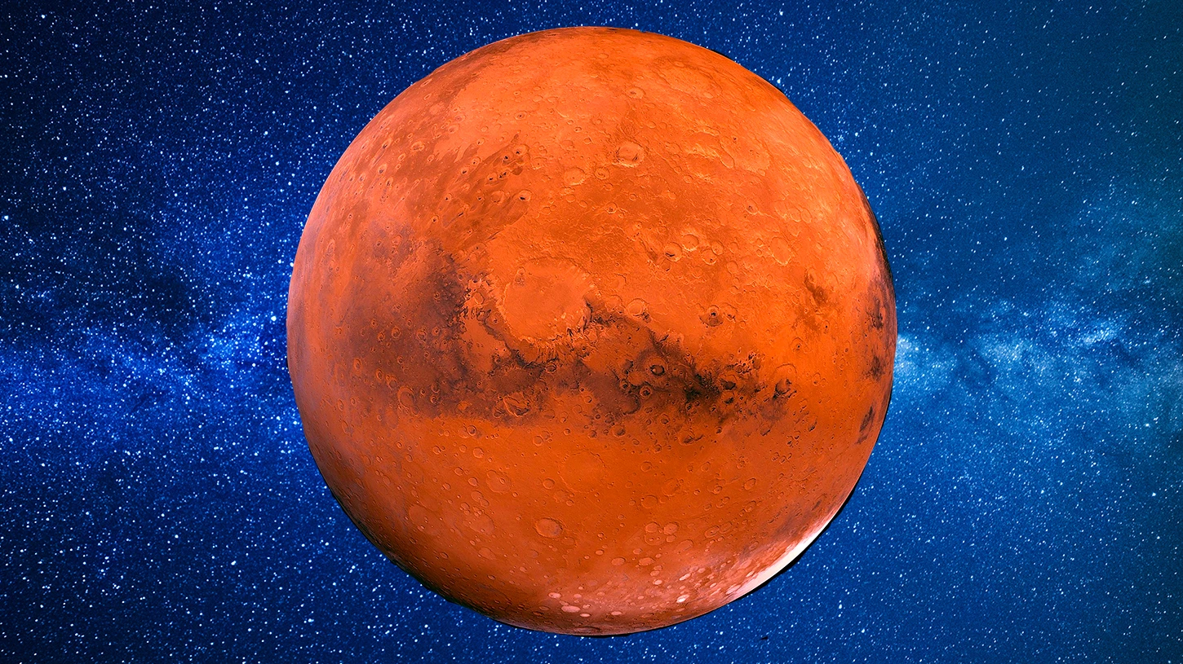
He finished his mission on Earth. So he went to the next planet. MARS!!!

Slide 5
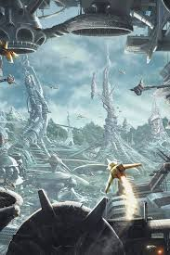
He landed safely on Mars in a town called Marsvill. Again Marsvill was quiet and peaceful but then came Tom ,crushing some of the houses but he didn’t mind because he was going to turn it in to a robot factory. So then he imprisoned the people of Marsvill (or should I say aliens of Marsvill) and took them to his robot factory on Metal Meteors to build him robots.

Slide 6
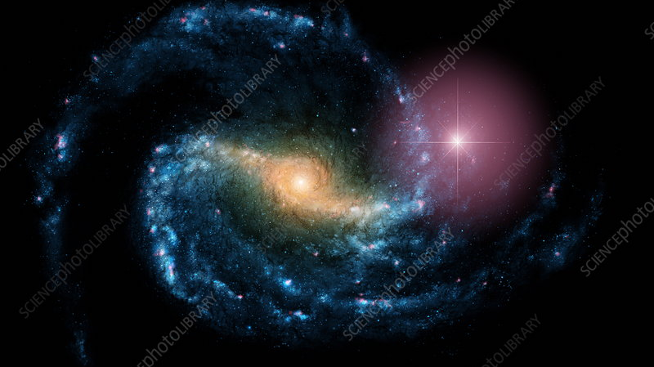
After one galaxy had been taken over it was time for the next one called the NGC 1300

Slide 7
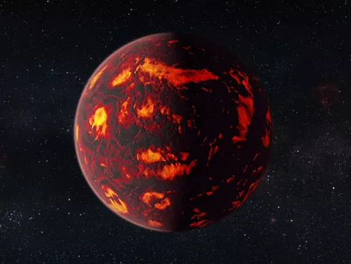
He went to the planet Hubble next ,and again it was peaceful until he landed on it and imprisoned more aliens from there town Hubble Hill and took them to Metal Meteors.

Slide 8
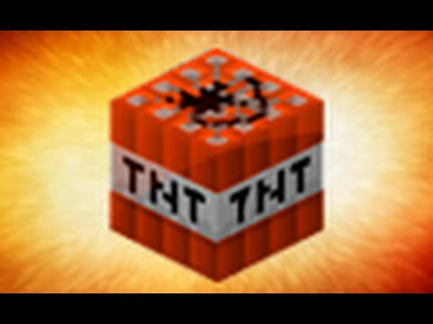
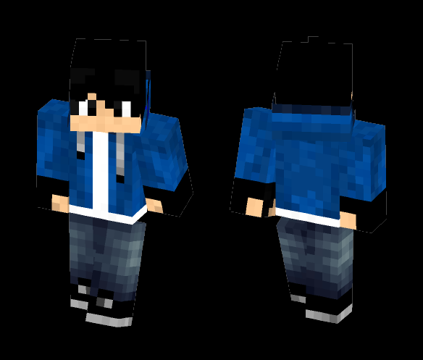
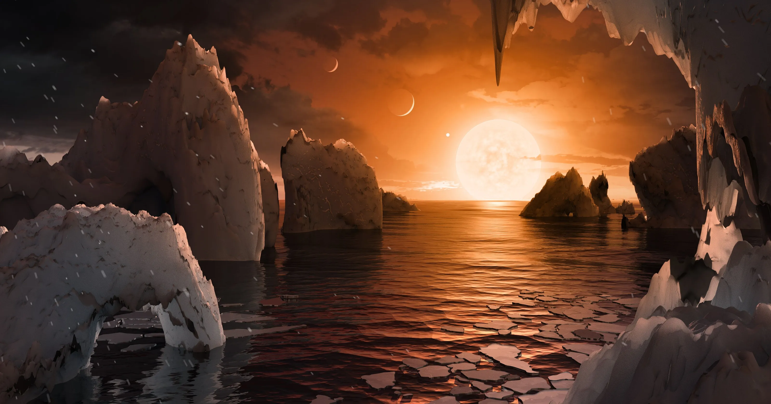
But what Tom did not know is that on this next planet there was a chosen child to save all of the galaxies. So Tom landed on Ice City and imprisoned more people and Alex was one of them , when he landed on Metal Meteors Alex escaped from the prison and went to cut the power. On his way to the power, Tom showed up but he did not see him because thx to Alex’s mum, for his birthday his mum got him a Prop Gun so he can turn into anything he wanted so that is how he didn't get caught , he carried on searching for the power and eventually he found it , all of the lasers cages shut down so now all of the prisoners can be free but how would they get of the planet. Alex always had TNT and his phone , he called his mum to call the planet to rescue him and the prisoners. Before they left, Alex placed the TNT down and exploded all of the planet but luckily for Tom they saved him to so Tom change his ways and was like Alex's brother from another mother. But Tom’s parents died when he was one years , he went to a foster family but they chucked him out so he lived on the streets but now he lived with Alex’s family and they would play on Tom’s PS4 all day long and every planet was happy.

Slide 9
THE END

