Slide 1

Year Six
Day of the Week | Activity
Monday | Danger Ball!
Tuesday | Wacky Gym – Partner Balances
Wednesday | Athletics Coach
Thursday | Personal Train…Somebody else!
Friday | You choose!

Slide 2
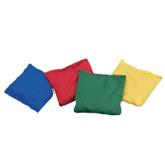

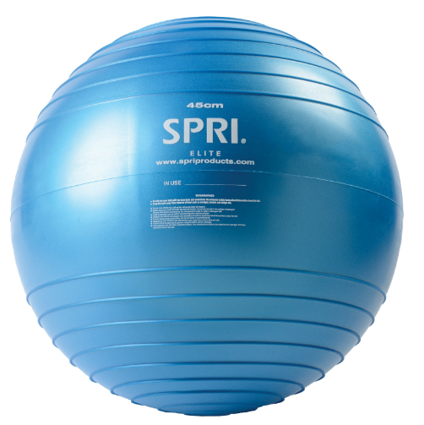
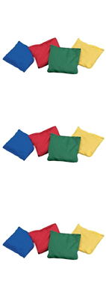
Monday – Danger Ball!
For this game split your group into two teams (or play 1 v 1), they can’t cross the line of cones (blue circles). The aim is to throw bean bags (you could use socks) at the large ball to make it roll towards the other team.
If the ‘Danger ball’ crosses the Red teams line, the Yellow team win!

Slide 3
Tuesday – Wacky Gymnastics: Partner Balances
You will need the help of an adult for this one
We know you might be a little squished for space at the moment, but on Tuesday’s your challenge is your own Gymnastics challenge.
Your challenge is to complete partner balances in peculiar clothes or in peculiar places in your house (staying safe please!)

Slide 4
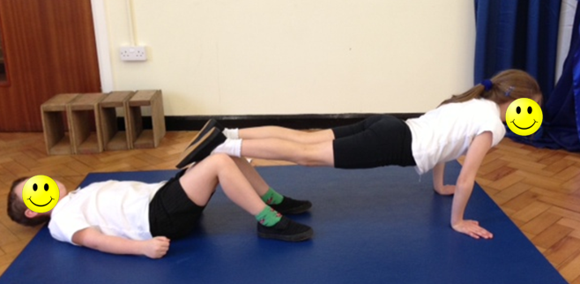
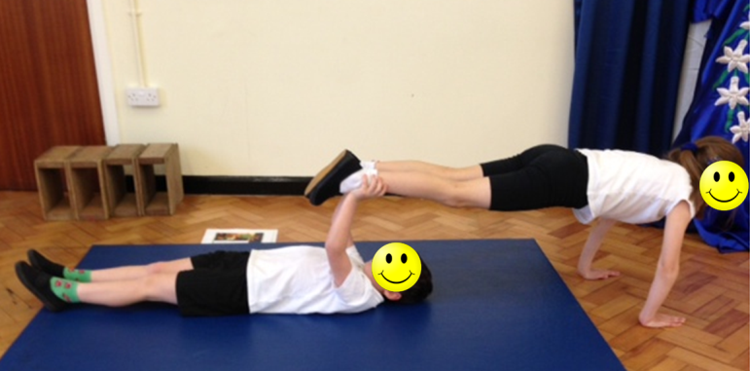
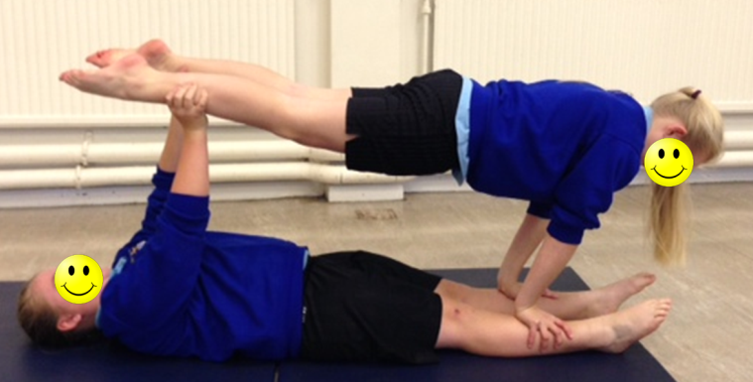
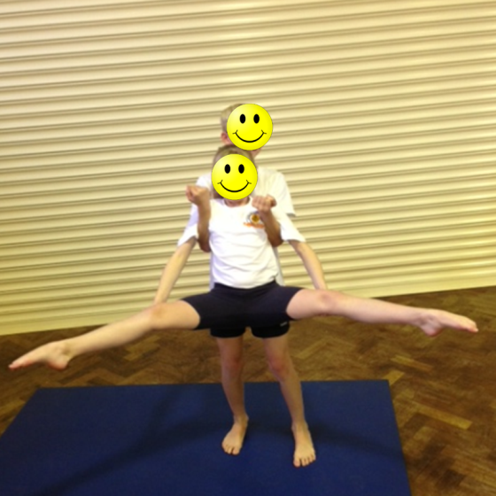
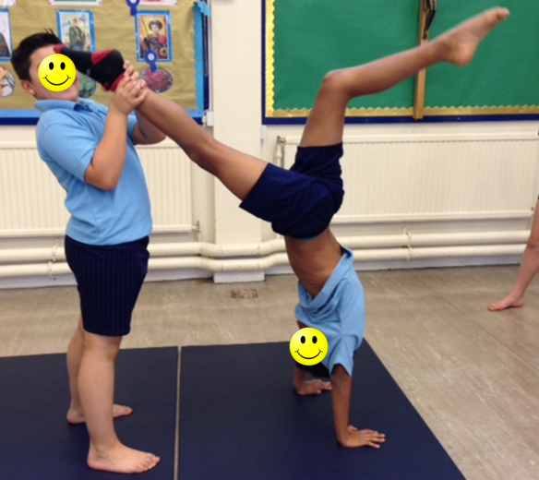
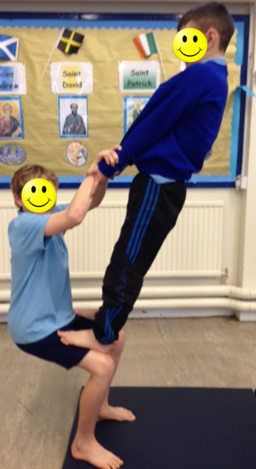
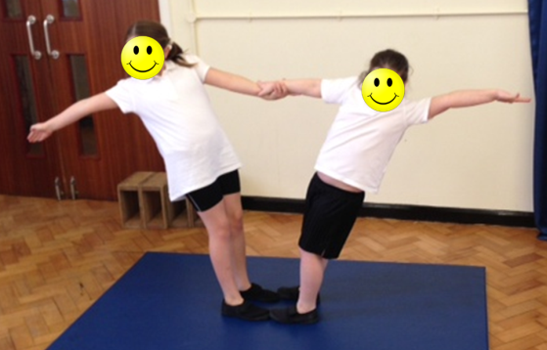
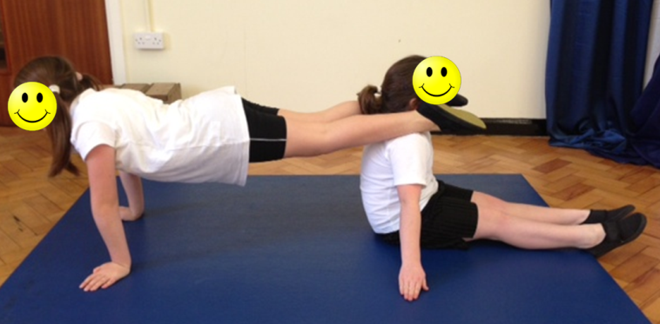
How do I do that?

Slide 5
Wednesday – Athletics Coach
Film yourself doing one of the four following events:
Sprinting, Long Jump, Triple Jump or Throwing for distance.
Watch the video back and use the tips on the next page to coach yourself how to improve.
Good luck and enjoy!

Slide 6
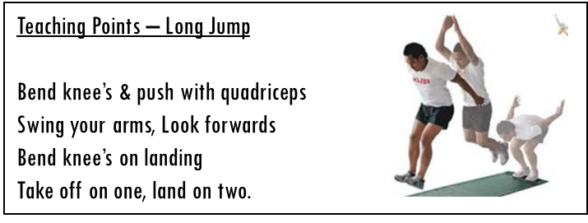
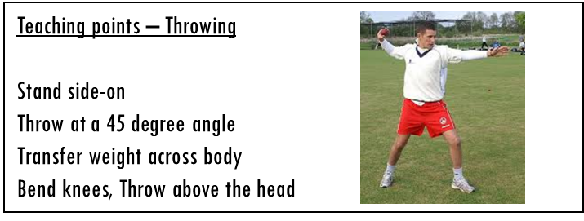
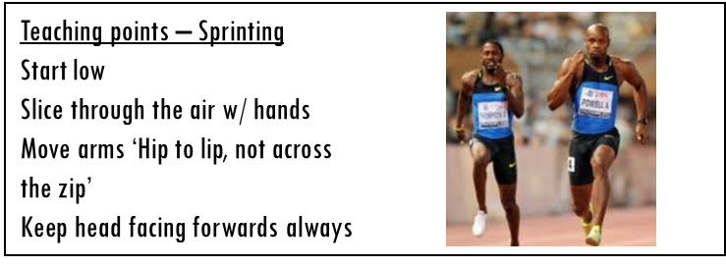
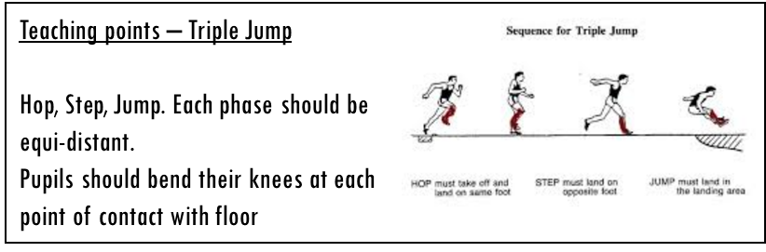
Athletics Coach

Slide 7
Thursday – Personal Train… Somebody else!
Ask someone in your house if there is one area in P.E that they would like to improve?
Maybe they would like to improve their catching?
Maybe they would like to get a little faster?
Maybe they would like to be able to compete for a little longer? (Not get tired as fast)
Well on Thursdays your challenge is to design your a training regime to help them improve on an area of their choice.
Congratulations you are now a personal trainer!....

Slide 8
Area your client would like to improve:
What exercises will you do to improve this area? REMEMBER: You must make sure your exercises will have an impact. I.e – If you want to improve your catching, don’t run laps of the garden!
How many times will you do these exercises? ‘Reps’ means how many times you complete the action (10 press ups) ‘Sets’ mean how many times you’ll repeat the actions (I’ll do 3 sets of 10 press ups = 3 x 10)
If you need to – how will you make it easier/harder?

Slide 9

Friday – You choose!
Happy Friday
Do whatever type of exercise you enjoy the most/feel like doing!

Slide 10
“I can do that…. What’s next?”

Slide 11
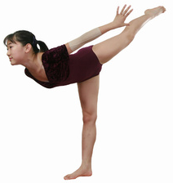
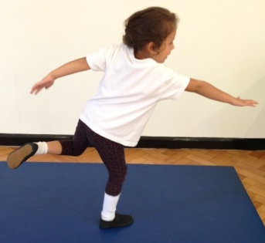
Progressions: Balance
Children can maintain balance when performing a task on one leg (this applies when static or when moving) (Develop through setting challenges where children must perform tasks on one leg. I.e – Throw and catch bean bag with alternate hands on one leg – Individual or as pairs)
Children can maintain their balance whilst standing on one foot (Set time challenges, use apparatus to focus children. Encourage the children to look at something that is level with their eyes – ears govern our balance! Some children will initially find it easier balancing with a bend in their knee, allowing the Quadriceps to contract slightly and control their body)
Children maintain their balance whilst standing in a stationary position and performing a task (2 feet) (Develop by asking children to balance a bean bag on their shoulder>back of hand>head>on head whilst holding arms out and touching nose with one hand)
Children maintain balance when standing in a stationary position on the floor (2 feet) (Develop this skill through activities involving a ‘freeze’ OR ask children to balance objects on particular parts of their body. I.e - Bean Bag/Cone)
As children develop their balance, ask them to hold their limbs further away from their core!
Increase in Complexity
of Skill

Slide 12
Progressions: Catching
Standing – Using two bean bags!
Standing – Practice catching with a medium sized ball
Resting on knee’s – Practice catching with a medium sized ball
Sitting – practice catching with a medium sized ball
Standing – Practice catching with a bean bag
Resting on knee’s – Practice catching with a bean bag
Sitting – practice catching with a bean bag (doesn’t roll away!)
Standing – Using two bean bags!
Standing – Practice catching with a medium sized ball
Resting on knee’s – Practice catching with a medium sized ball
Sitting – practice catching with a medium sized ball
Standing – Practice catching with a bean bag
Resting on knee’s – Practice catching with a bean bag
Sitting – practice catching with a bean bag (doesn’t roll away!)
Large group working in a set space, one child acts as the DEF, the rest keep ball away from DEF
Standing in a circle, no adult in the middle, practice catching with a medium sized ball
In a circle, no adult in middle, practice catching a bean bag
Standing in a circle, adult in the middle, practice catching with a medium sized ball
Standing in a circle, adult in the middle, practice catching with a bean bag
Individual
In Pairs
In a Small Group
Increase in Complexity
of Skill

Slide 13
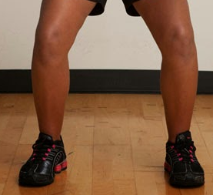

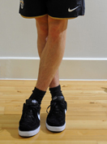
Progressions: Running
& Stopping
Children maintain balance when moving fast in all directions & changing directions. Children react to variables and maintain balance whilst moving in a range of directions and stopping with competency (Development would now begin to integrate other factors such as another FMS – Kicking, Catching, Throwing, Jumping etc)
Children maintain their balance when changing direction in a regimented fashion, show an understanding that not crossing legs when changing direction helps them to maintain balance (Development would then focus on activities/games requiring children dodging, chasing, avoiding moving objects/people)
Children maintain their balance when moving forwards, show an understanding that bending at the knee helps them to stop quickly. Struggle to maintain balance when changing direction in a regimented fashion (I.e Running in & out of cone slaloms)
Children show a clear in-balance when moving forwards at any pace faster than walking. Need to numerous steps when coming to a stop (Development would focus on lots of activities/games requiring straight line running)
When changing direction DON’T cross your feet!
Increase in Complexity
of Skill

Slide 14
Progressions: Throwing
Can utilise the over-arm throw to throw to a target/area with moderate success (a greater distance away)
Begins to use the over-arm throw to throw over a greater distance
Can throw objects under-arm to targets 3-4 metres away with moderate success
Can throw objects under-arm to targets 1-2 metres away with moderate success
Can throw objects under-arm in a general direction with a degree of success (i.e – Forwards)
Can utilise the over-arm throw to throw to the chest with moderate success (a greater distance away)
Begins to use the over-arm throw to throw over a greater distance (close to partner’s chest)
Can throw objects under-arm to chest 3-4 metres away with moderate success
Can throw objects under-arm to chest 1-2 metres away with moderate success
Can throw objects under-arm in a general direction with a degree of success (i.e – Towards their partner)
Children select appropriate types of throw, reacting to changing situations in game play successfully (bounce pass to avoid defender)
Children can use teaching points to successfully complete different types of throw on command
Children can list the teaching points of different types of throw (I.e – How to perform a chest pass/bounce pass)
Takes part in activities using one type of throw
Individual
In Pairs
Activity specific
Increase in Complexity
of Skill

