Slide 1

Year Four
Day of the Week | Activity
Monday | Rock, Paper, Scissors – Duel!
Tuesday | Gymnastics Routine
Wednesday | 30 or Under
Thursday | Heart Rate Challenge
Friday | Joe Wicks – Fancy Dress Style

Slide 2
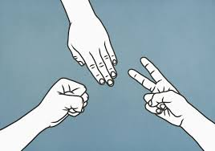
Monday – Rock, Paper, Scissors – Duel!
Find someone to play against. Challenge them to a game of Rock, Paper, Scissors whoever wins gets to decide a physical forfeit for their opponent!

Slide 3
Tuesday –Gymnastics routine!
We know you might be a little squished for space at the moment, but on Tuesday’s your challenge is to create your own Gymnastics challenge. Aim for 4-5 balances completed in succession.
You may not be able to perform a Round off – but you can practice these point balances.
Remember Gymnastics judges appreciate, Control, Extension and Fluency. So tense those muscles to stay nice and still and extend your arms, legs, fingers and toes where possible!

Slide 4
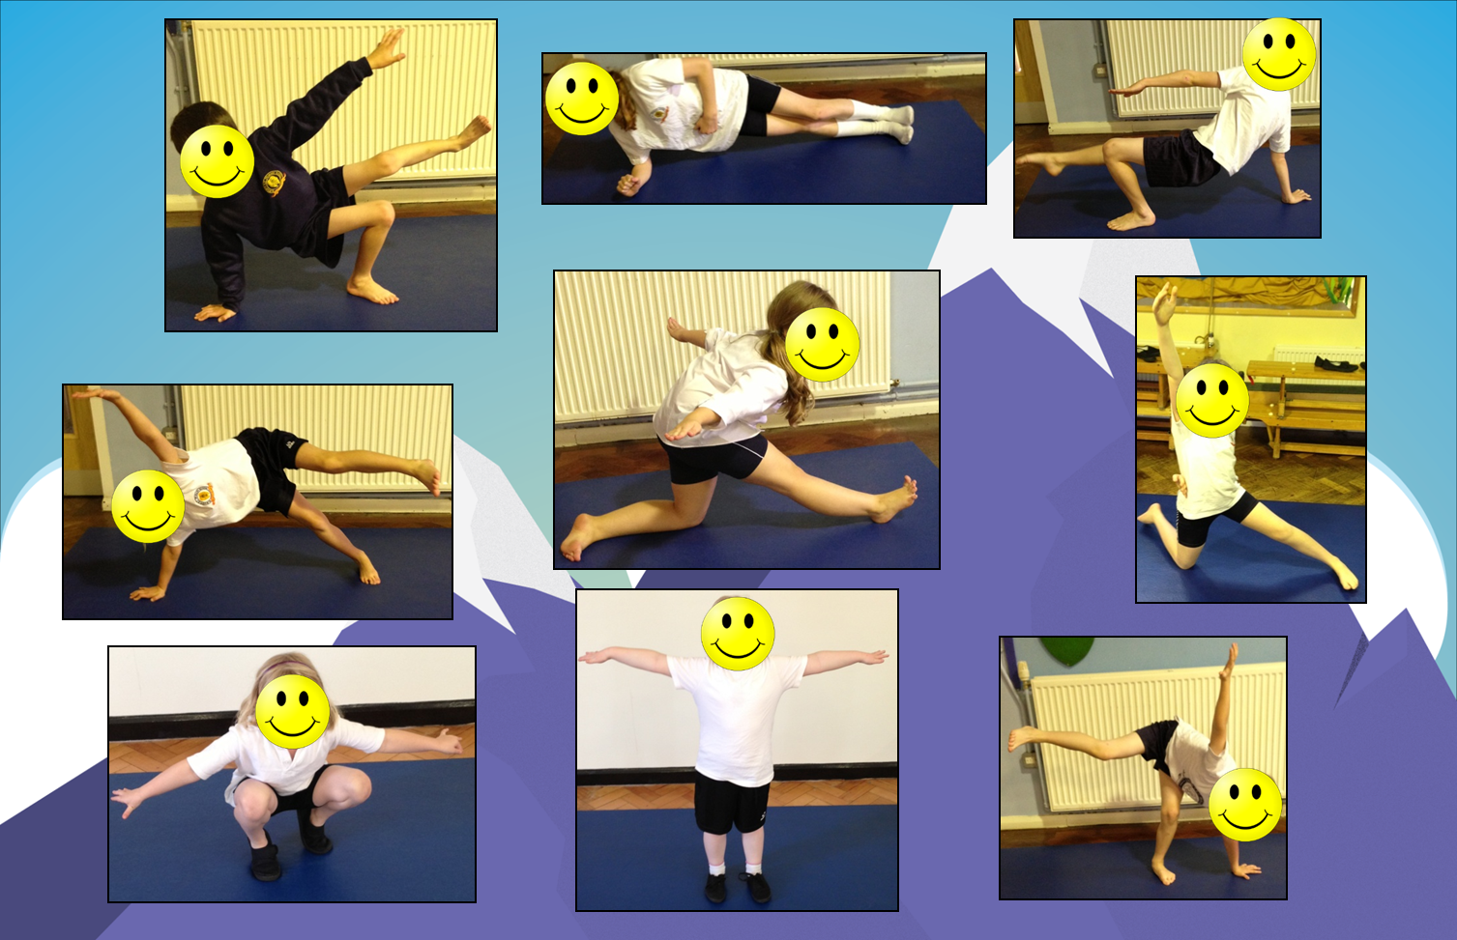
2 Point Balances

Slide 5
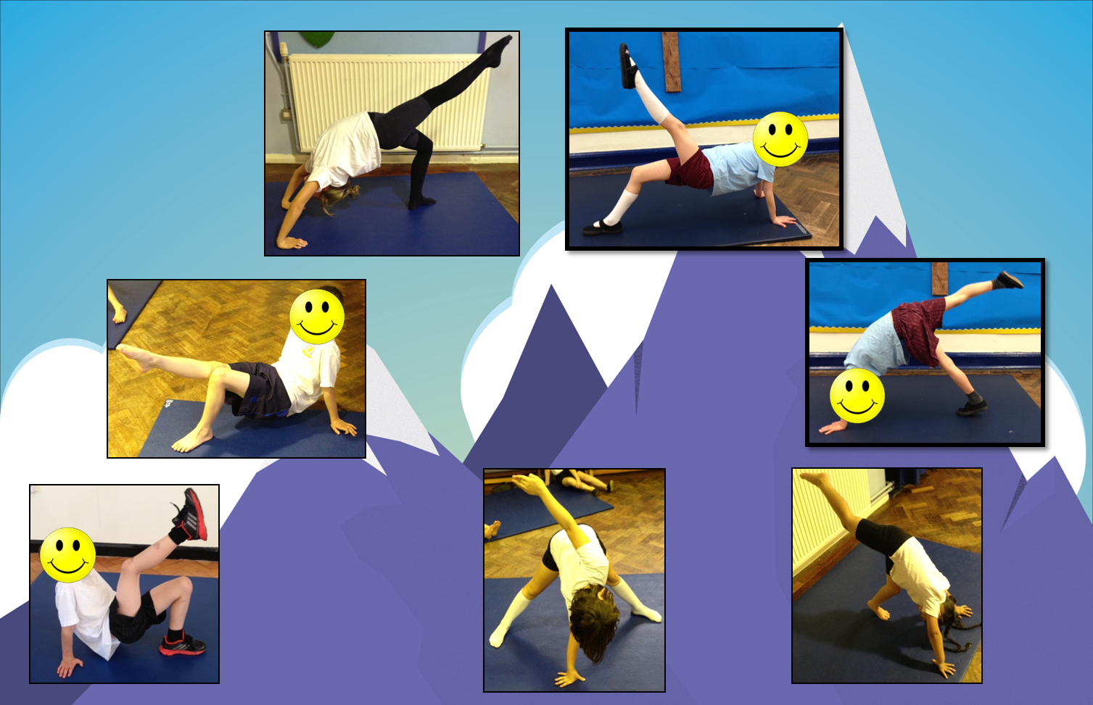
3 Point Balances

Slide 6
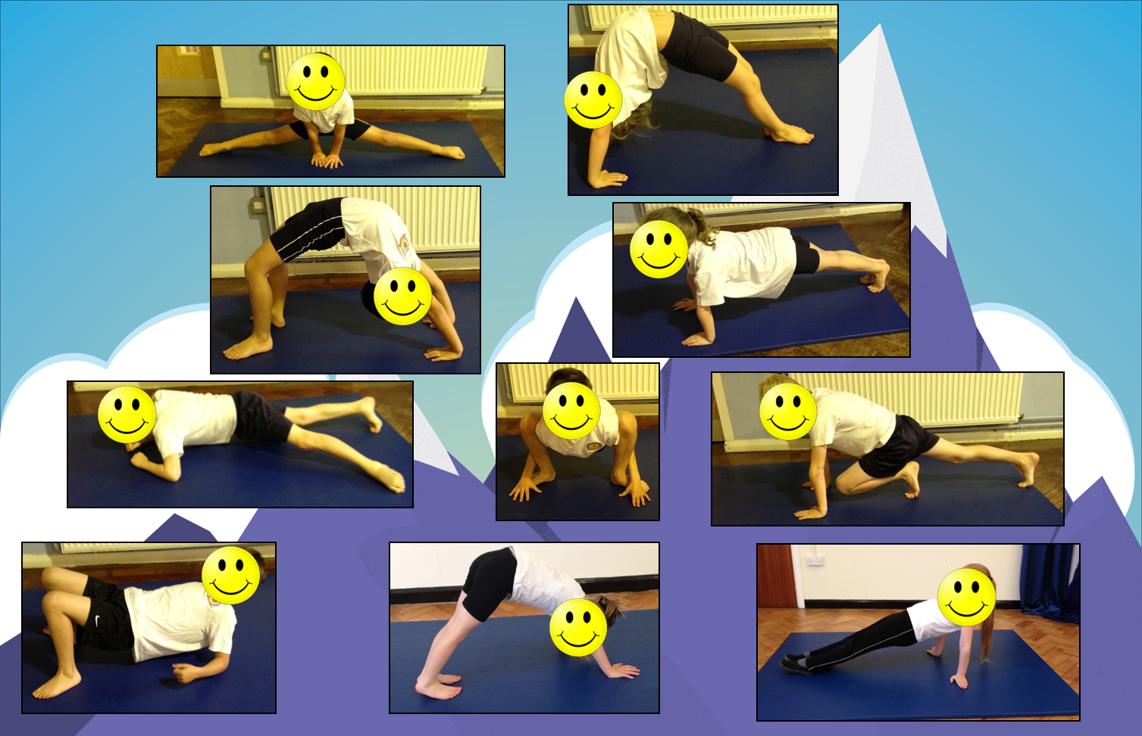
4 Point Balances

Slide 7
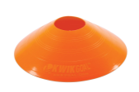
Wednesday – 30 or under
Pick a sport that you enjoy (and that you have the equipment for). It could be Hockey, Basketball or Football.
Set out 2 markers, the challenge is to dribble ‘there and back’ in under 30 seconds. If you can do it, add another marker and weave in and out!
If you can do it – make it harder for yourself!

Slide 8
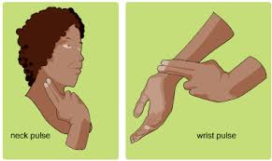
Thursday – Heart Rate Challenge
Today you will conduct a science experiment!
As you know you heart rate (how fast your heart beats) changes depending on how your body is moving.
On Thursdays you need to try lots of different types of exercise, the challenge is to see how fast you can make your heart beat!
There is one rule – you just complete the exercise for at least 2 minutes before you take your pulse. Then simply fill out the log on the sheet (or copy it and write it down on some scrap paper). Enjoy!

Slide 9
Type of Activity | Heart Rate (How fast your heart is beating)

Slide 10
Friday – Joe Wicks Fancy Dress
On Friday Joe Wicks encourages people to dress up and join in with his online work outs.
Dress up and get moving. Enjoy!
https://www.youtube.com/user/thebodycoach1

Slide 11
“I can do that…. What’s next?”

Slide 12
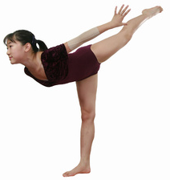
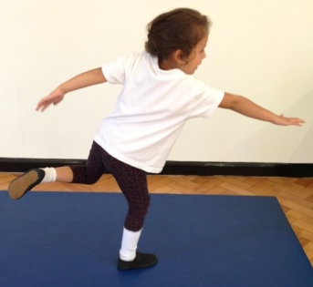
Progressions: Balance
Children can maintain balance when performing a task on one leg (this applies when static or when moving) (Develop through setting challenges where children must perform tasks on one leg. I.e – Throw and catch bean bag with alternate hands on one leg – Individual or as pairs)
Children can maintain their balance whilst standing on one foot (Set time challenges, use apparatus to focus children. Encourage the children to look at something that is level with their eyes – ears govern our balance! Some children will initially find it easier balancing with a bend in their knee, allowing the Quadriceps to contract slightly and control their body)
Children maintain their balance whilst standing in a stationary position and performing a task (2 feet) (Develop by asking children to balance a bean bag on their shoulder>back of hand>head>on head whilst holding arms out and touching nose with one hand)
Children maintain balance when standing in a stationary position on the floor (2 feet) (Develop this skill through activities involving a ‘freeze’ OR ask children to balance objects on particular parts of their body. I.e - Bean Bag/Cone)
As children develop their balance, ask them to hold their limbs further away from their core!
Increase in Complexity
of Skill

Slide 13
Progressions: Catching
Standing – Using two bean bags!
Standing – Practice catching with a medium sized ball
Resting on knee’s – Practice catching with a medium sized ball
Sitting – practice catching with a medium sized ball
Standing – Practice catching with a bean bag
Resting on knee’s – Practice catching with a bean bag
Sitting – practice catching with a bean bag (doesn’t roll away!)
Standing – Using two bean bags!
Standing – Practice catching with a medium sized ball
Resting on knee’s – Practice catching with a medium sized ball
Sitting – practice catching with a medium sized ball
Standing – Practice catching with a bean bag
Resting on knee’s – Practice catching with a bean bag
Sitting – practice catching with a bean bag (doesn’t roll away!)
Large group working in a set space, one child acts as the DEF, the rest keep ball away from DEF
Standing in a circle, no adult in the middle, practice catching with a medium sized ball
In a circle, no adult in middle, practice catching a bean bag
Standing in a circle, adult in the middle, practice catching with a medium sized ball
Standing in a circle, adult in the middle, practice catching with a bean bag
Individual
In Pairs
In a Small Group
Increase in Complexity
of Skill

Slide 14
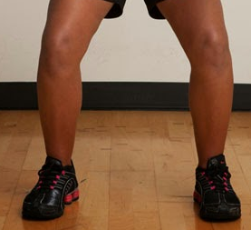

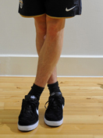
Progressions: Running
& Stopping
Children maintain balance when moving fast in all directions & changing directions. Children react to variables and maintain balance whilst moving in a range of directions and stopping with competency (Development would now begin to integrate other factors such as another FMS – Kicking, Catching, Throwing, Jumping etc)
Children maintain their balance when changing direction in a regimented fashion, show an understanding that not crossing legs when changing direction helps them to maintain balance (Development would then focus on activities/games requiring children dodging, chasing, avoiding moving objects/people)
Children maintain their balance when moving forwards, show an understanding that bending at the knee helps them to stop quickly. Struggle to maintain balance when changing direction in a regimented fashion (I.e Running in & out of cone slaloms)
Children show a clear in-balance when moving forwards at any pace faster than walking. Need to numerous steps when coming to a stop (Development would focus on lots of activities/games requiring straight line running)
When changing direction DON’T cross your feet!
Increase in Complexity
of Skill

Slide 15
Progressions: Throwing
Can utilise the over-arm throw to throw to a target/area with moderate success (a greater distance away)
Begins to use the over-arm throw to throw over a greater distance
Can throw objects under-arm to targets 3-4 metres away with moderate success
Can throw objects under-arm to targets 1-2 metres away with moderate success
Can throw objects under-arm in a general direction with a degree of success (i.e – Forwards)
Can utilise the over-arm throw to throw to the chest with moderate success (a greater distance away)
Begins to use the over-arm throw to throw over a greater distance (close to partner’s chest)
Can throw objects under-arm to chest 3-4 metres away with moderate success
Can throw objects under-arm to chest 1-2 metres away with moderate success
Can throw objects under-arm in a general direction with a degree of success (i.e – Towards their partner)
Children select appropriate types of throw, reacting to changing situations in game play successfully (bounce pass to avoid defender)
Children can use teaching points to successfully complete different types of throw on command
Children can list the teaching points of different types of throw (I.e – How to perform a chest pass/bounce pass)
Takes part in activities using one type of throw
Individual
In Pairs
Activity specific
Increase in Complexity
of Skill

