Slide 1

Year Two
Day of the Week | Activity
Monday | Bucket Challenge
Tuesday | Sumo Tail Tag!
Wednesday | Penalty Shootout (Handball or Football)
Thursday | Paper Bag Grab
Friday | BBC Sport ‘Supermovers’ ‘Just for Fun’

Slide 2
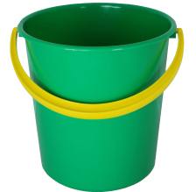
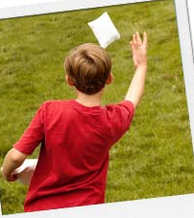
Monday – Bucket Challenge
The 5m Sock ball Challenge!
In one minute how many sock balls can you throw into a bucket in 1 minute?
Good luck!
5m

Slide 3
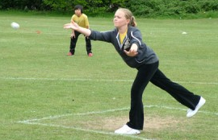
How do I do that?
What do I need to learn?:
Throwing for accuracy
When throwing for accuracy it is
best to throw under-arm, with a slight
bend in the knee. On release the children
should point their fingers at their target,
moving their arm in a steady motion

Slide 4
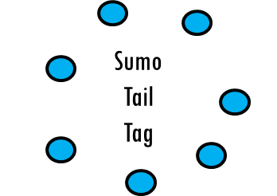
Tuesday – Sumo Tail Tag!
Each player must tuck a bib/t-shirt into the side of their shorts/trousers
Without leaving the circle, one player has to attempt to pull out their opponents bib to win!
You are not allowed to touch your opponent – you can only touch their bib/t-shirt!

Slide 5
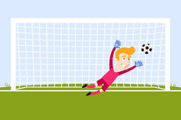
Wednesday – Penalty Shootout
You’ll need someone to play against. Make a goal out of whatever you have and select which Sport you’re going to play; Handball (throwing) or Football (kicking).
Play the best of 10. Whoever scores the most out of 10 wins!

Slide 6

Thursday – Paper Bag Grab
For this activity you will need lots of paper shopping bags that stand up on their own, it will also help if you manage to organise them into size groups (Small, Medium.. etc)
Lay out all of the paper bags in your playing area. One by one people playing must run out and try to pick up a bag, but they must pick up the bag standing up and only using their mouth!
Once you’ve had a practice – have a competition!

Slide 7
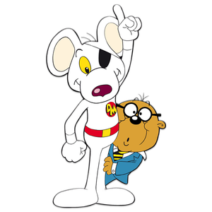
Friday – BBC Sport ‘Supermovers’
Just for Fun
Happy Friday!
Visit - https://www.bbc.co.uk/teach/supermovers/just-for-fun-collection/z7tymfr
Pick a video that interests you and
have fun!
My favourite is the Match of the Day
one or Dangermouse!

Slide 8
“I can do that…. What’s next?”

Slide 9
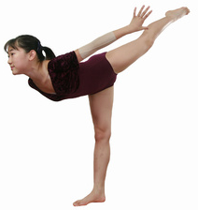
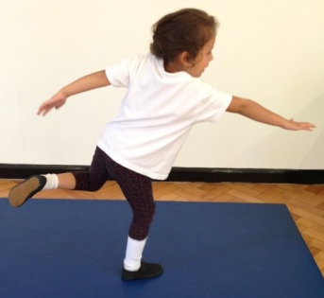
Progressions: Balance
Children can maintain balance when performing a task on one leg (this applies when static or when moving) (Develop through setting challenges where children must perform tasks on one leg. I.e – Throw and catch bean bag with alternate hands on one leg – Individual or as pairs)
Children can maintain their balance whilst standing on one foot (Set time challenges, use apparatus to focus children. Encourage the children to look at something that is level with their eyes – ears govern our balance! Some children will initially find it easier balancing with a bend in their knee, allowing the Quadriceps to contract slightly and control their body)
Children maintain their balance whilst standing in a stationary position and performing a task (2 feet) (Develop by asking children to balance a bean bag on their shoulder>back of hand>head>on head whilst holding arms out and touching nose with one hand)
Children maintain balance when standing in a stationary position on the floor (2 feet) (Develop this skill through activities involving a ‘freeze’ OR ask children to balance objects on particular parts of their body. I.e - Bean Bag/Cone)
As children develop their balance, ask them to hold their limbs further away from their core!
Increase in Complexity
of Skill

Slide 10
Progressions: Catching
Standing – Using two bean bags!
Standing – Practice catching with a medium sized ball
Resting on knee’s – Practice catching with a medium sized ball
Sitting – practice catching with a medium sized ball
Standing – Practice catching with a bean bag
Resting on knee’s – Practice catching with a bean bag
Sitting – practice catching with a bean bag (doesn’t roll away!)
Standing – Using two bean bags!
Standing – Practice catching with a medium sized ball
Resting on knee’s – Practice catching with a medium sized ball
Sitting – practice catching with a medium sized ball
Standing – Practice catching with a bean bag
Resting on knee’s – Practice catching with a bean bag
Sitting – practice catching with a bean bag (doesn’t roll away!)
Large group working in a set space, one child acts as the DEF, the rest keep ball away from DEF
Standing in a circle, no adult in the middle, practice catching with a medium sized ball
In a circle, no adult in middle, practice catching a bean bag
Standing in a circle, adult in the middle, practice catching with a medium sized ball
Standing in a circle, adult in the middle, practice catching with a bean bag
Individual
In Pairs
In a Small Group
Increase in Complexity
of Skill

Slide 11
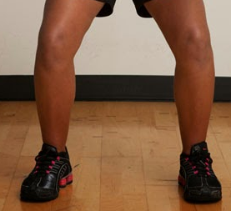

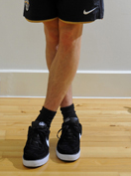
Progressions: Running
& Stopping
Children maintain balance when moving fast in all directions & changing directions. Children react to variables and maintain balance whilst moving in a range of directions and stopping with competency (Development would now begin to integrate other factors such as another FMS – Kicking, Catching, Throwing, Jumping etc)
Children maintain their balance when changing direction in a regimented fashion, show an understanding that not crossing legs when changing direction helps them to maintain balance (Development would then focus on activities/games requiring children dodging, chasing, avoiding moving objects/people)
Children maintain their balance when moving forwards, show an understanding that bending at the knee helps them to stop quickly. Struggle to maintain balance when changing direction in a regimented fashion (I.e Running in & out of cone slaloms)
Children show a clear in-balance when moving forwards at any pace faster than walking. Need to numerous steps when coming to a stop (Development would focus on lots of activities/games requiring straight line running)
When changing direction DON’T cross your feet!
Increase in Complexity
of Skill

Slide 12
Progressions: Throwing
Can utilise the over-arm throw to throw to a target/area with moderate success (a greater distance away)
Begins to use the over-arm throw to throw over a greater distance
Can throw objects under-arm to targets 3-4 metres away with moderate success
Can throw objects under-arm to targets 1-2 metres away with moderate success
Can throw objects under-arm in a general direction with a degree of success (i.e – Forwards)
Can utilise the over-arm throw to throw to the chest with moderate success (a greater distance away)
Begins to use the over-arm throw to throw over a greater distance (close to partner’s chest)
Can throw objects under-arm to chest 3-4 metres away with moderate success
Can throw objects under-arm to chest 1-2 metres away with moderate success
Can throw objects under-arm in a general direction with a degree of success (i.e – Towards their partner)
Children select appropriate types of throw, reacting to changing situations in game play successfully (bounce pass to avoid defender)
Children can use teaching points to successfully complete different types of throw on command
Children can list the teaching points of different types of throw (I.e – How to perform a chest pass/bounce pass)
Takes part in activities using one type of throw
Individual
In Pairs
Activity specific
Increase in Complexity
of Skill

