Slide 1

Year One
Day of the Week | Activity
Monday | Paired catching – Raid the Castle!
Tuesday | Assault Course!
Wednesday | Empty vs Fill
Thursday | The Golden Ladder
Friday | BBC Sport ‘Supermovers’ ‘Just for Fun’

Slide 2
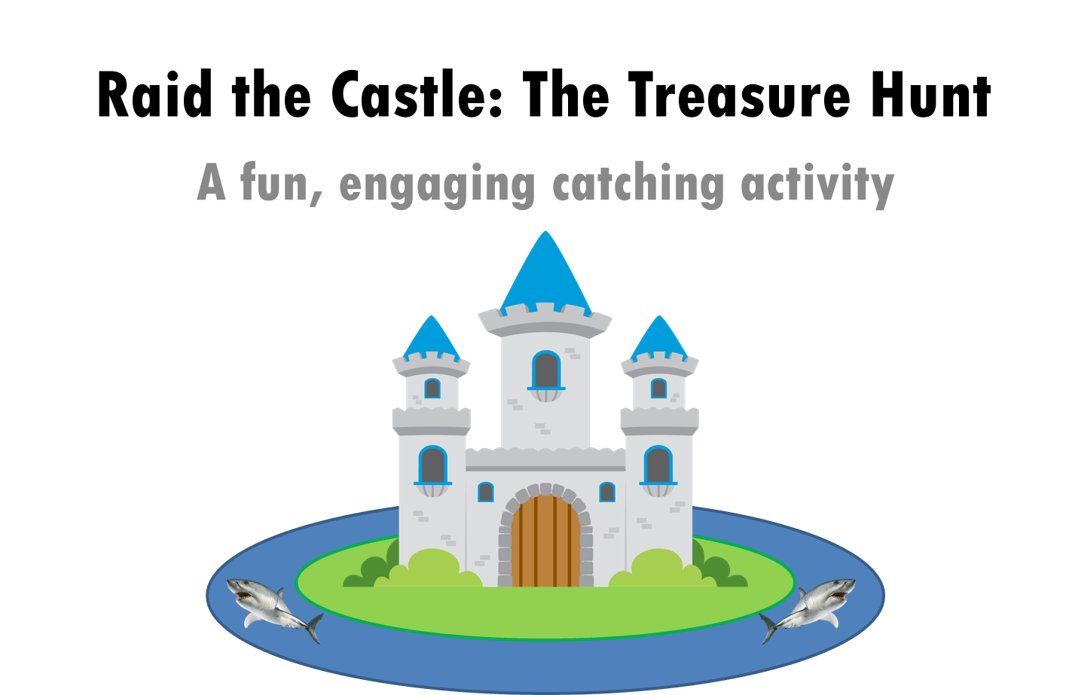
Monday – Raid the Castle

Slide 3
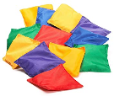
So now your ready to play ‘Raid the Castle’ against the clock. You must stay the same distance apart!
You have stormed a castle full of treasure. Make a pile of rolled up socks (this is the treasure). To take a piece of this treasure for yourselves
you must throw it
between each other without dropping it in the moat 10 times. If you manage to hit that target you get to
keep the treasure, get another and try again! Set a time limit and see how many pieces of
treasure you can get!
Start by catching in pairs
Start with bean bags (or rolled up socks) then progress to large soft balls
Progression
Progression
Every time you manage to complete 10 throws without a step, both players must take a step back!

Slide 4
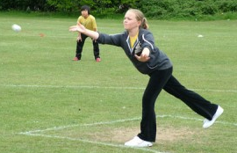
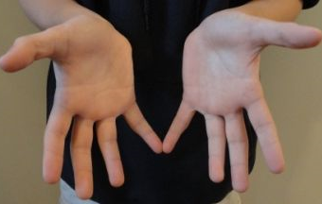
How do I do that?
What do I need to learn?:
Throwing for accuracy
When throwing for accuracy it is
best to throw under-arm, with a slight
bend in the knee. On release the children
should point their fingers at their target,
moving their arm in a steady motion
What do I need to learn?
When stopping/catching it is important
that the children place their hands close
Together. Fingers apart and outstretched,
soft hands.
When using larger balls (as an
Introduction) encourage children to keep hands close to their chest!

Slide 5
Tuesday – Assault Course!
Split the amount of people that want to play by 2 or 4, and send each team to a corner.
Roundabouts (run around something – paper plates could work?)
Agility
(Run in and out of obstacles)
The River
(Jump over the gap)
Stepping Stones
(You can’t touch the floor)

Slide 6
Wednesday – Empty vs Fill
You’ll need to find someone to play against!
One player takes the role of ‘empty’ and the other ‘fill’. You’ll need something empty – a box or a bucket. Roll up about 8/9 sock balls.
Around your bucket try and mark out the perimeter of the pitch.
Set a timer (start with a 30 second game)
Put all of the sock balls in the bucket. ‘Empty’ tries to empty the bucket (they can’t throw the sock balls pass the perimeter of the pitch) whilst ‘Fill’ tries to out them back in!
This is both silly and simple, but it will help your child develop spatial awareness and begin to consider where to aim shots to ensure success.
Oh and no knees allowed on the floor!

Slide 7
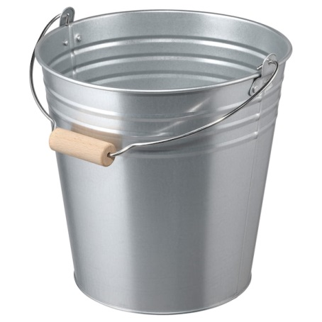
Empty vs Fill
‘Empty’ can’t throw the sock balls out of the edge of the pitch!

Slide 8
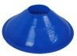
Thursday – The Golden Ladder
This is a shooting game!
You’ll need to pick some targets – at School we use hoops. Line them up equally spaced out. Throw from the starting point at Target 1 first.
If you hit Target 1, move to Target 2 and so on…..
The winner is whoever gets the top of the ladder first!
If you miss a target – you must go back to the start!

Slide 9
How do I do that?
What do I need to learn?:
Throwing for accuracy
When throwing for accuracy it is
best to throw under-arm, with a slight
bend in the knee. On release the children
should point their fingers at their target,
moving their arm in a steady motion

Slide 10
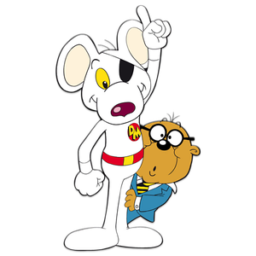
Friday – BBC Sport ‘Supermovers’
Just for Fun
Happy Friday!
Visit - https://www.bbc.co.uk/teach/supermovers/just-for-fun-collection/z7tymfr
Pick a video that interests you and
have fun!
My favourite is the Match of the Day
one or Dangermouse!

Slide 11
“I can do that…. What’s next?”

Slide 12
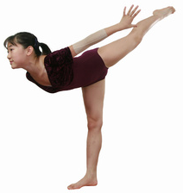
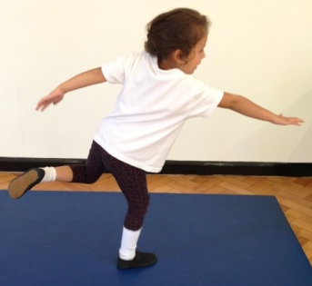
Progressions: Balance
Children can maintain balance when performing a task on one leg (this applies when static or when moving) (Develop through setting challenges where children must perform tasks on one leg. I.e – Throw and catch bean bag with alternate hands on one leg – Individual or as pairs)
Children can maintain their balance whilst standing on one foot (Set time challenges, use apparatus to focus children. Encourage the children to look at something that is level with their eyes – ears govern our balance! Some children will initially find it easier balancing with a bend in their knee, allowing the Quadriceps to contract slightly and control their body)
Children maintain their balance whilst standing in a stationary position and performing a task (2 feet) (Develop by asking children to balance a bean bag on their shoulder>back of hand>head>on head whilst holding arms out and touching nose with one hand)
Children maintain balance when standing in a stationary position on the floor (2 feet) (Develop this skill through activities involving a ‘freeze’ OR ask children to balance objects on particular parts of their body. I.e - Bean Bag/Cone)
As children develop their balance, ask them to hold their limbs further away from their core!
Increase in Complexity
of Skill

Slide 13
Progressions: Catching
Standing – Using two bean bags!
Standing – Practice catching with a medium sized ball
Resting on knee’s – Practice catching with a medium sized ball
Sitting – practice catching with a medium sized ball
Standing – Practice catching with a bean bag
Resting on knee’s – Practice catching with a bean bag
Sitting – practice catching with a bean bag (doesn’t roll away!)
Standing – Using two bean bags!
Standing – Practice catching with a medium sized ball
Resting on knee’s – Practice catching with a medium sized ball
Sitting – practice catching with a medium sized ball
Standing – Practice catching with a bean bag
Resting on knee’s – Practice catching with a bean bag
Sitting – practice catching with a bean bag (doesn’t roll away!)
Large group working in a set space, one child acts as the DEF, the rest keep ball away from DEF
Standing in a circle, no adult in the middle, practice catching with a medium sized ball
In a circle, no adult in middle, practice catching a bean bag
Standing in a circle, adult in the middle, practice catching with a medium sized ball
Standing in a circle, adult in the middle, practice catching with a bean bag
Individual
In Pairs
In a Small Group
Increase in Complexity
of Skill

Slide 14
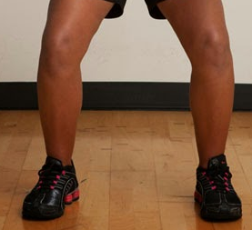

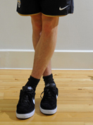
Progressions: Running
& Stopping
Children maintain balance when moving fast in all directions & changing directions. Children react to variables and maintain balance whilst moving in a range of directions and stopping with competency (Development would now begin to integrate other factors such as another FMS – Kicking, Catching, Throwing, Jumping etc)
Children maintain their balance when changing direction in a regimented fashion, show an understanding that not crossing legs when changing direction helps them to maintain balance (Development would then focus on activities/games requiring children dodging, chasing, avoiding moving objects/people)
Children maintain their balance when moving forwards, show an understanding that bending at the knee helps them to stop quickly. Struggle to maintain balance when changing direction in a regimented fashion (I.e Running in & out of cone slaloms)
Children show a clear in-balance when moving forwards at any pace faster than walking. Need to numerous steps when coming to a stop (Development would focus on lots of activities/games requiring straight line running)
When changing direction DON’T cross your feet!
Increase in Complexity
of Skill

Slide 15
Progressions: Throwing
Can utilise the over-arm throw to throw to a target/area with moderate success (a greater distance away)
Begins to use the over-arm throw to throw over a greater distance
Can throw objects under-arm to targets 3-4 metres away with moderate success
Can throw objects under-arm to targets 1-2 metres away with moderate success
Can throw objects under-arm in a general direction with a degree of success (i.e – Forwards)
Can utilise the over-arm throw to throw to the chest with moderate success (a greater distance away)
Begins to use the over-arm throw to throw over a greater distance (close to partner’s chest)
Can throw objects under-arm to chest 3-4 metres away with moderate success
Can throw objects under-arm to chest 1-2 metres away with moderate success
Can throw objects under-arm in a general direction with a degree of success (i.e – Towards their partner)
Children select appropriate types of throw, reacting to changing situations in game play successfully (bounce pass to avoid defender)
Children can use teaching points to successfully complete different types of throw on command
Children can list the teaching points of different types of throw (I.e – How to perform a chest pass/bounce pass)
Takes part in activities using one type of throw
Individual
In Pairs
Activity specific
Increase in Complexity
of Skill

