Slide 1

Reception
Day of the Week | Activity
Monday | Coconut Shy!
Tuesday | Against the clock!
Wednesday | The Catching Clap Ladder
Thursday | Doctor’s Diet – Bear Crawl style
Friday | Kids Choice – Cosmic Kids Yoga

Slide 2
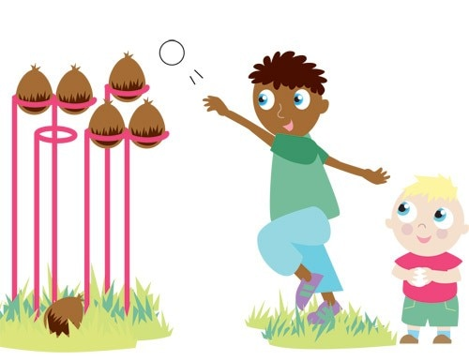
Monday – Coconut Shy!
Find a sensible place to play, some soft targets to aim at & roll up some socks to make balls. Try and place these targets quite high up to encourage over-arm throwing
Decide on how many goes each you have and take it in turns to see who can throw the socks and knock over the most targets.
To make it harder – use smaller targets or move further away!

Slide 3
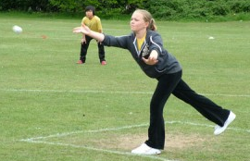
How do I do that?
What do I need to learn?:
Throwing for accuracy
When throwing for accuracy it is
best to throw under-arm, with a slight
bend in the knee. On release the children
should point their fingers at their target,
moving their arm in a steady motion

Slide 4
Tuesday – Against the clock!
Mark out a set space in a sensible place (the more space the better!)
For this challenge you will work as a team (take it in turns).
Once you have two points to move in between you’ll need something to time yourselves with.
In 5 minutes you have to see how many shuttle runs you and your team mates can complete!
Once finished check to see if your heart is beating faster…

Slide 5
Wednesday – The Catching
Clap Ladder
You will need something to catch: A ball, a bean bag, some rolled up socks.
Start by throwing your object up in the air and catching it. Then throw it in the air and clap once whilst it is in the air & catch it. Next throw it up and try and clap twice before you catch it. Then try 3 claps…. Then 4 claps…. And so on.
If you drop your object though you have to start again!

Slide 6
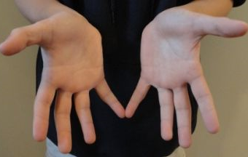
How do I do that?
What do I need to learn?
When stopping/catching it is important
that the children place their hands close
Together. Fingers apart and outstretched,
soft hands.
When using larger balls (as an
Introduction) encourage children to keep hands close to their chest!

Slide 7
Thursday – Doctor’s Diet: Bear
Crawl Style
One of the many jobs for a Doctor is to help people each a healthy diet.
For this game your child will need someone to play against.
In your playing area you’ll need to starting points (place the child closer) – then spread out different types of food out in your space (not from the freezer though!)
When the game starts players must bear crawl and grab an item of food to take back to their starting point. Keep this going until all objects have been collected!
Then work out who has won. All food collected is worth one point, but the super healthy foods are worth 5!

Slide 8
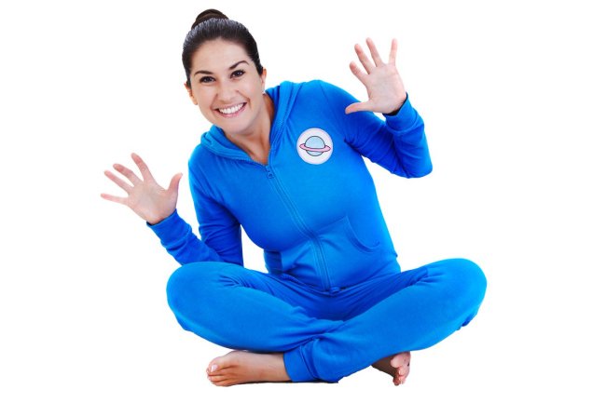
Friday – Cosmic Kids Yoga
Happy Friday!
On ‘Youtube kids’ you’ll find a channel called ‘Cosmic Kids Yoga’
This lady matches yoga moves to famous books/films/computer games
Choose one and give it a go, yoga is fantastic at improving core strength, flexibility
and co-ordination!

Slide 9
“I can do that…. What’s next?”

Slide 10
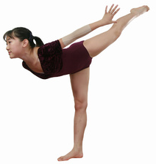
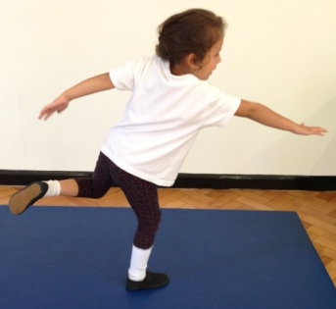
Progressions: Balance
Children can maintain balance when performing a task on one leg (this applies when static or when moving) (Develop through setting challenges where children must perform tasks on one leg. I.e – Throw and catch bean bag with alternate hands on one leg – Individual or as pairs)
Children can maintain their balance whilst standing on one foot (Set time challenges, use apparatus to focus children. Encourage the children to look at something that is level with their eyes – ears govern our balance! Some children will initially find it easier balancing with a bend in their knee, allowing the Quadriceps to contract slightly and control their body)
Children maintain their balance whilst standing in a stationary position and performing a task (2 feet) (Develop by asking children to balance a bean bag on their shoulder>back of hand>head>on head whilst holding arms out and touching nose with one hand)
Children maintain balance when standing in a stationary position on the floor (2 feet) (Develop this skill through activities involving a ‘freeze’ OR ask children to balance objects on particular parts of their body. I.e - Bean Bag/Cone)
As children develop their balance, ask them to hold their limbs further away from their core!
Increase in Complexity
of Skill

Slide 11
Progressions: Catching
Standing – Using two bean bags!
Standing – Practice catching with a medium sized ball
Resting on knee’s – Practice catching with a medium sized ball
Sitting – practice catching with a medium sized ball
Standing – Practice catching with a bean bag
Resting on knee’s – Practice catching with a bean bag
Sitting – practice catching with a bean bag (doesn’t roll away!)
Standing – Using two bean bags!
Standing – Practice catching with a medium sized ball
Resting on knee’s – Practice catching with a medium sized ball
Sitting – practice catching with a medium sized ball
Standing – Practice catching with a bean bag
Resting on knee’s – Practice catching with a bean bag
Sitting – practice catching with a bean bag (doesn’t roll away!)
Large group working in a set space, one child acts as the DEF, the rest keep ball away from DEF
Standing in a circle, no adult in the middle, practice catching with a medium sized ball
In a circle, no adult in middle, practice catching a bean bag
Standing in a circle, adult in the middle, practice catching with a medium sized ball
Standing in a circle, adult in the middle, practice catching with a bean bag
Individual
In Pairs
In a Small Group
Increase in Complexity
of Skill

Slide 12
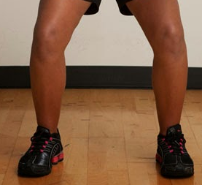

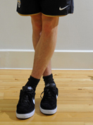
Progressions: Running
& Stopping
Children maintain balance when moving fast in all directions & changing directions. Children react to variables and maintain balance whilst moving in a range of directions and stopping with competency (Development would now begin to integrate other factors such as another FMS – Kicking, Catching, Throwing, Jumping etc)
Children maintain their balance when changing direction in a regimented fashion, show an understanding that not crossing legs when changing direction helps them to maintain balance (Development would then focus on activities/games requiring children dodging, chasing, avoiding moving objects/people)
Children maintain their balance when moving forwards, show an understanding that bending at the knee helps them to stop quickly. Struggle to maintain balance when changing direction in a regimented fashion (I.e Running in & out of cone slaloms)
Children show a clear in-balance when moving forwards at any pace faster than walking. Need to numerous steps when coming to a stop (Development would focus on lots of activities/games requiring straight line running)
When changing direction DON’T cross your feet!
Increase in Complexity
of Skill

Slide 13
Progressions: Throwing
Can utilise the over-arm throw to throw to a target/area with moderate success (a greater distance away)
Begins to use the over-arm throw to throw over a greater distance
Can throw objects under-arm to targets 3-4 metres away with moderate success
Can throw objects under-arm to targets 1-2 metres away with moderate success
Can throw objects under-arm in a general direction with a degree of success (i.e – Forwards)
Can utilise the over-arm throw to throw to the chest with moderate success (a greater distance away)
Begins to use the over-arm throw to throw over a greater distance (close to partner’s chest)
Can throw objects under-arm to chest 3-4 metres away with moderate success
Can throw objects under-arm to chest 1-2 metres away with moderate success
Can throw objects under-arm in a general direction with a degree of success (i.e – Towards their partner)
Children select appropriate types of throw, reacting to changing situations in game play successfully (bounce pass to avoid defender)
Children can use teaching points to successfully complete different types of throw on command
Children can list the teaching points of different types of throw (I.e – How to perform a chest pass/bounce pass)
Takes part in activities using one type of throw
Individual
In Pairs
Activity specific
Increase in Complexity
of Skill

