Slide 1

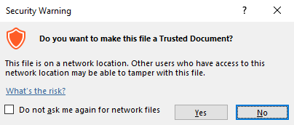
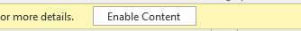

Guidance for Macros in PowerPoints
We use macros within PowerPoints to increase the interactivity of our presentations. Follow this simple process to get the most out of this resource.
What to do:
Open the PowerPoint file and enable editing.
A security warning box may appear. Click yes.
Click enable content.
Enter presentation mode (start the slide show).

Slide 2


Science
Scientists and Inventors
Year One
Science | Year 6 | Scientists and Inventors | Stephen Hawking | Lesson 1

Slide 3
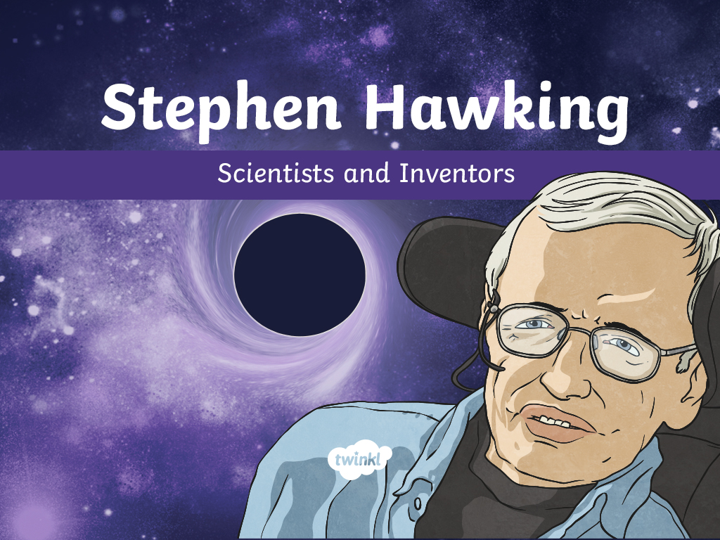

Slide 4
Aim
To understand Stephen Hawking’s theories about black holes and report my findings.
Success Criteria
I can share facts about Stephen Hawking’s life.
I can explain what I already know about black holes.
I can set up an inquiry to demonstrate the causes of black holes.
I can report about my findings from an inquiry.

Slide 5
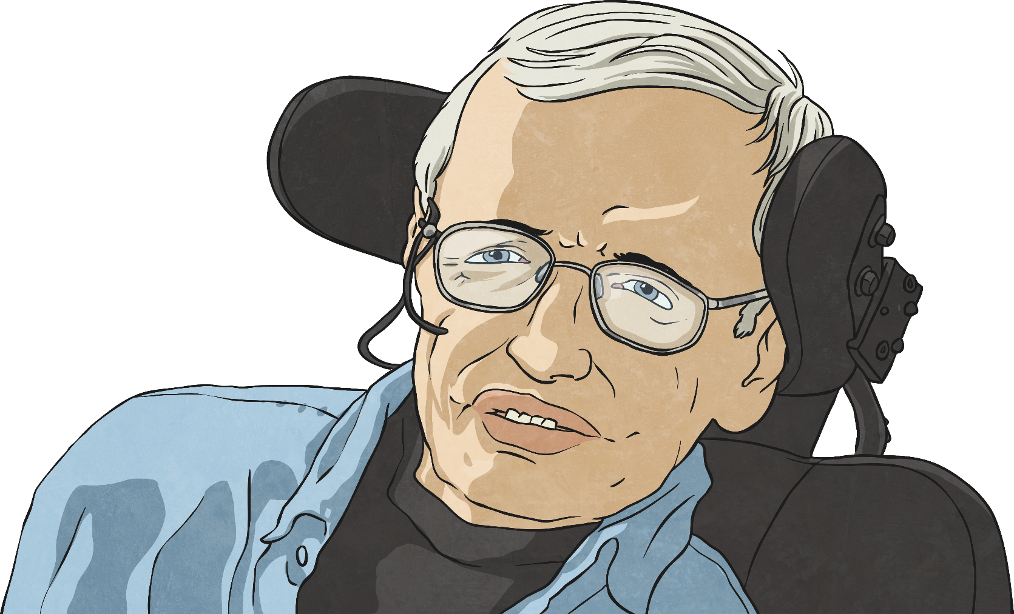
Stephen Hawking
Stephen Hawking was a prominent scientist and theoretical astrophysicist. You may
already know some facts about
him and what he studied.
Talk to your partner about any facts you
already know about Stephen Hawking’s
life and work.

Slide 6
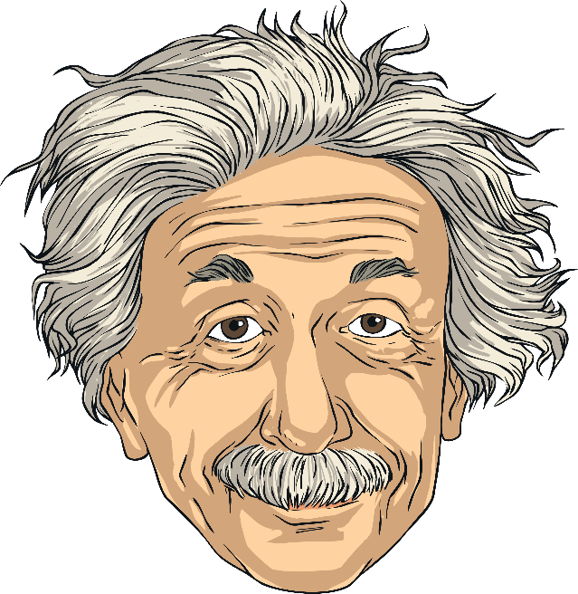

Hawking’s Life
Stephen Hawking was born in Oxford on 8th January 1942. He grew up with his parents, his brother and sisters.
At school, Hawking enjoyed science and maths and he was nicknamed ‘Einstein’ by his friends. He wanted to study maths at the University of Oxford, but Oxford didn't offer a maths degree at that time. Instead, Hawking chose to study physics and chemistry.
Hawking found the work at university very easy. He joined the college boat club and was known as a daredevil because of the risks he took when rowing the boats.
After graduating from Oxford, Hawking studied for his PhD at the University of Cambridge.

Slide 7
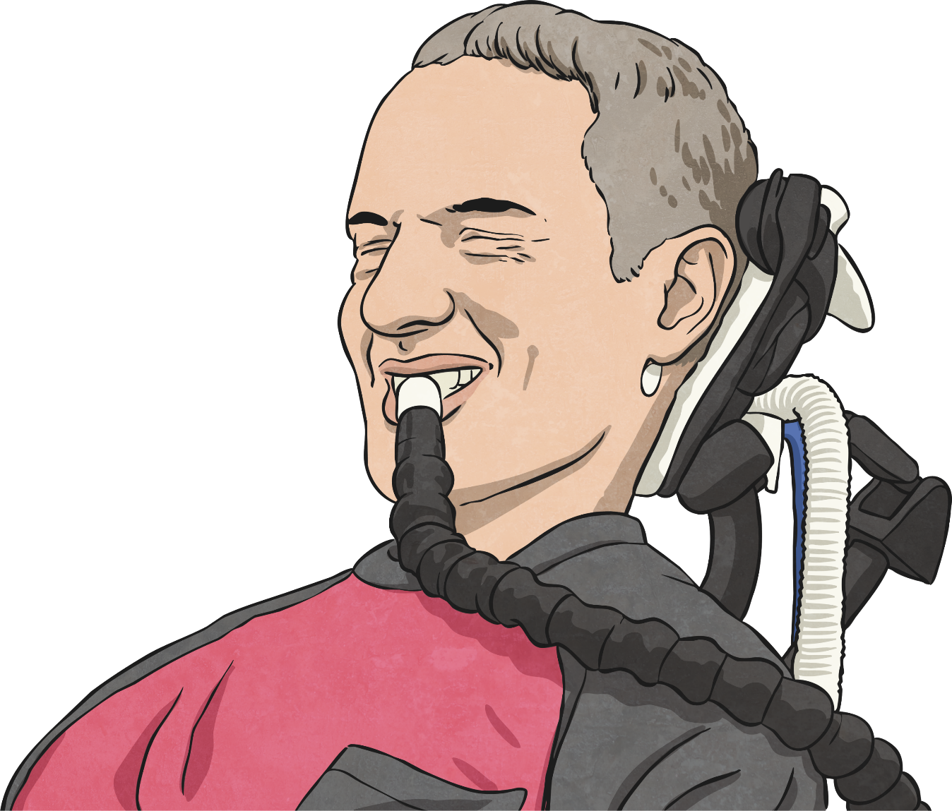
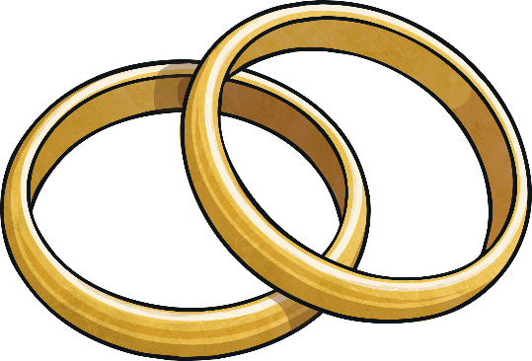
Hawking’s Life
It was at Cambridge that Hawking first developed problems with his health. He became very clumsy, regularly falling or dropping things. His speech became slurred and hard to understand.
ALS: A motor neurone disease that causes muscle weakness, paralysis and respiratory failure. It is a degenerative disease, which means it gets worse over time. There is no cure.
Doctors diagnosed Hawking with Amyotrophic Lateral Sclerosis, or ALS. Hawking was given just two years to live and he became very depressed. However, his disease progressed more slowly than doctors had imagined and he returned to his studies.
He met and fell in love with Jane Wilde, and Hawking felt that he had something to live for.

Slide 8
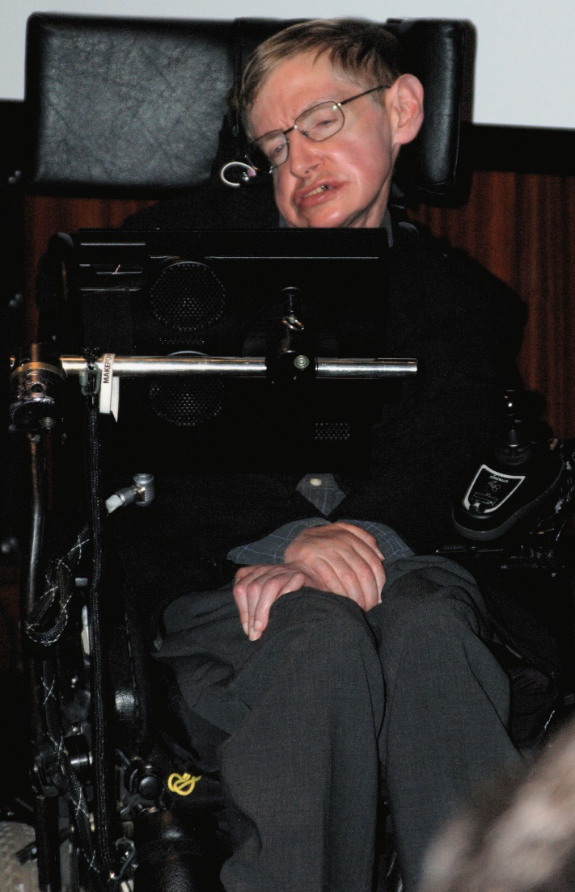
Hawking’s Life
Stephen Hawking lived a full life despite his disabilities.
He used a wheelchair to move around and a computer with a voice synthesizer to talk.
His condition did continue to deteriorate, though, and this renowned scientist sadly died on 14th March 2018, aged 76.

Slide 9
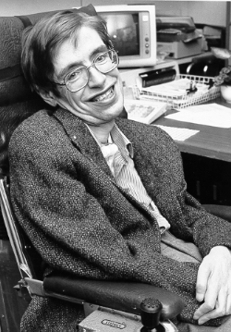
Hawking’s Life
Stephen Hawking is remembered as one of the greatest scientists that ever lived.
His theories, such as those concerning black holes, have changed the way we understand the universe.
His many books have helped millions to understand difficult scientific concepts and he has inspired people around the world with his passion for science and his ability to overcome difficulties.

Slide 10
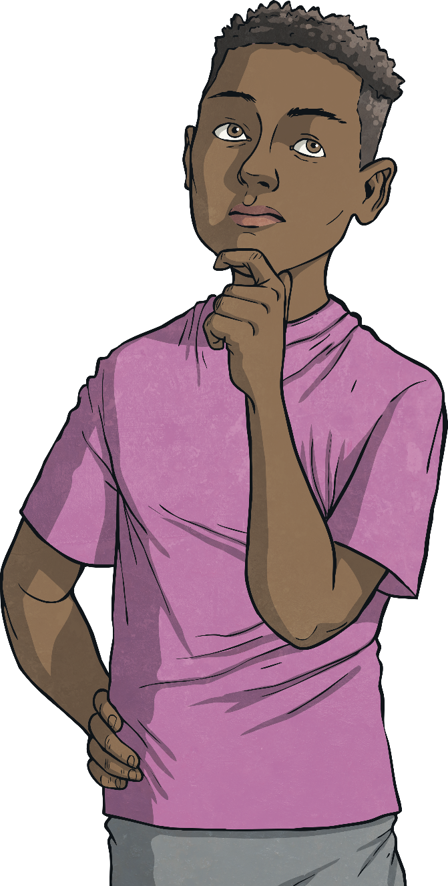

Black Holes
Much of Hawking's research was to do with black holes and he became a world expert on them.
Draw a diagram on your Black Holes Activity Sheet and add labels to explain what you already know about black holes.
Have you ever heard of a black hole?
What are they like?
Don't worry if you don't know much about them – just draw and label what you can.
What do they do?

Slide 11

Black Hole Theories
Hawking developed theories about how black holes are formed, how they behave and where they can be found in the universe. This is one of his theories:
A black hole is a place where gravity has got so strong that it pulls matter down into it and doesn't let any of this matter escape, not even light.
Anything too close to a black hole will be sucked down into it and trapped forever.

Slide 12
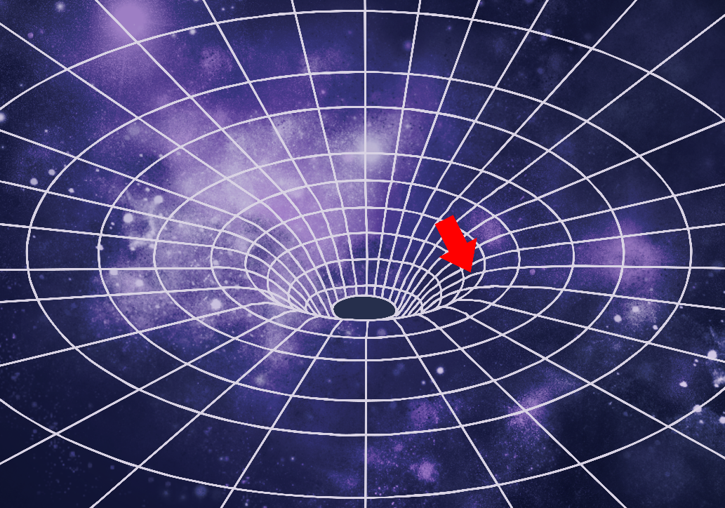
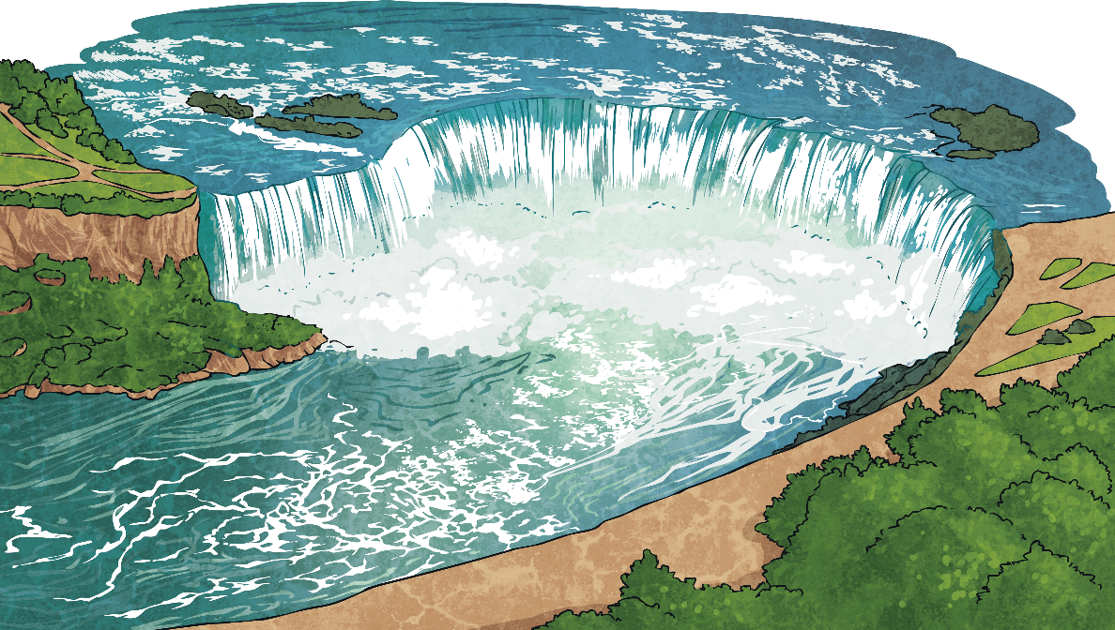
Black Hole Theories
Imagine it is like a river with a waterfall.
This is how matter is pulled into a black hole.
If you are swimming in the river away from the waterfall, you may be able to swim away fast enough so that you don't go over the edge, but as you get nearer to the edge, you cannot swim fast enough to escape the current of the water.
The edge of a black hole is called the event horizon.
Past the event horizon, nothing can travel fast enough to escape the black hole.
You will be pulled over the edge of the waterfall.

Slide 13
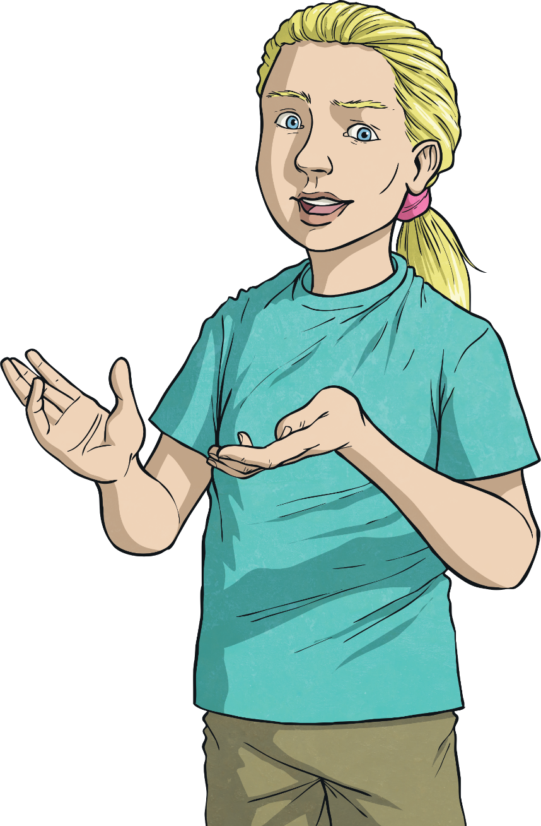
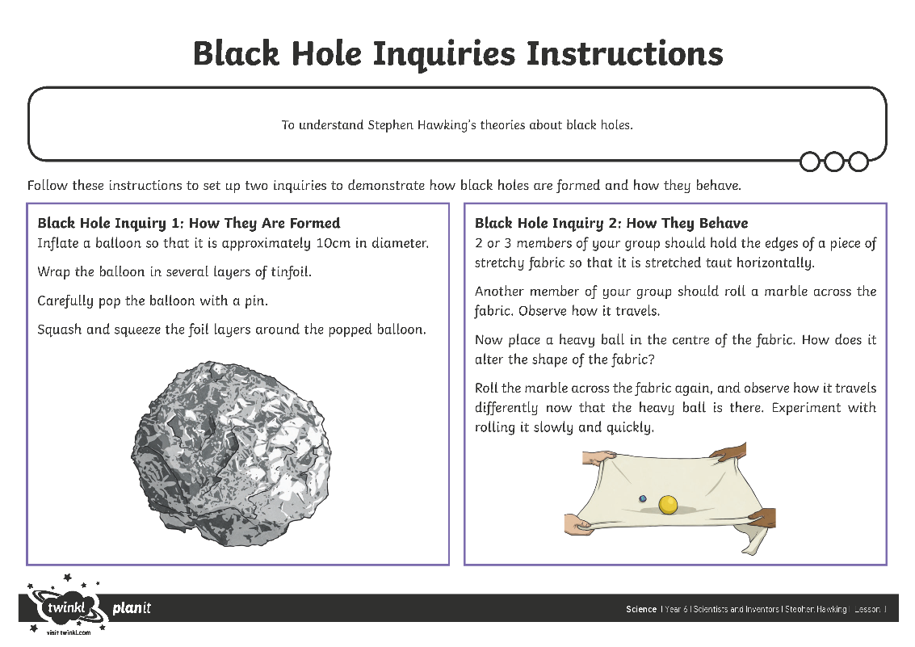
Black Hole Inquiry
You are going to carry out two demonstrations to show how black holes are formed and how they behave.
I will explain each inquiry, then you will follow the instructions on your Black Hole Inquiries Instructions sheet to carry out the
two demonstrations.
Think about Stephen Hawking's theories about black holes and how the inquiries you set up demonstrate his theories.
Once you have completed the inquiries, you will prepare a report on Hawking's theories and your own findings.

Slide 14
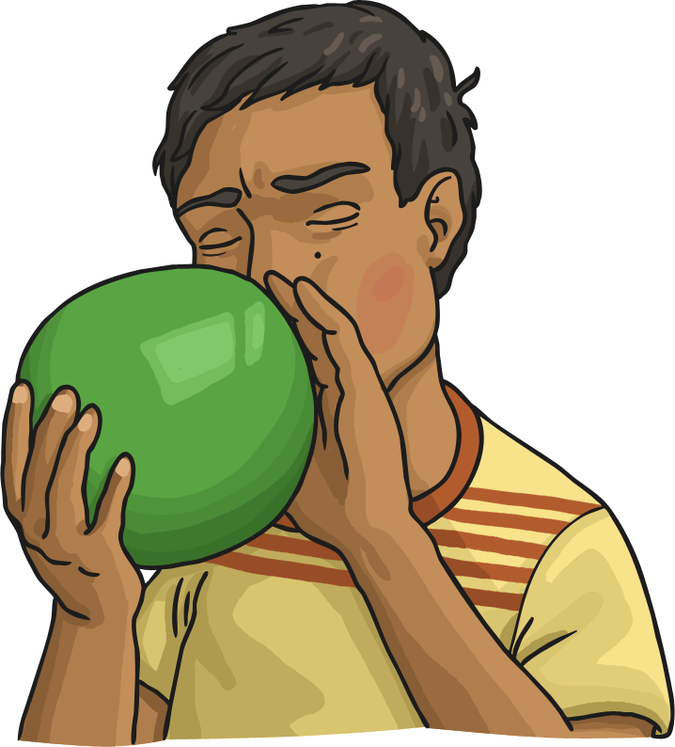
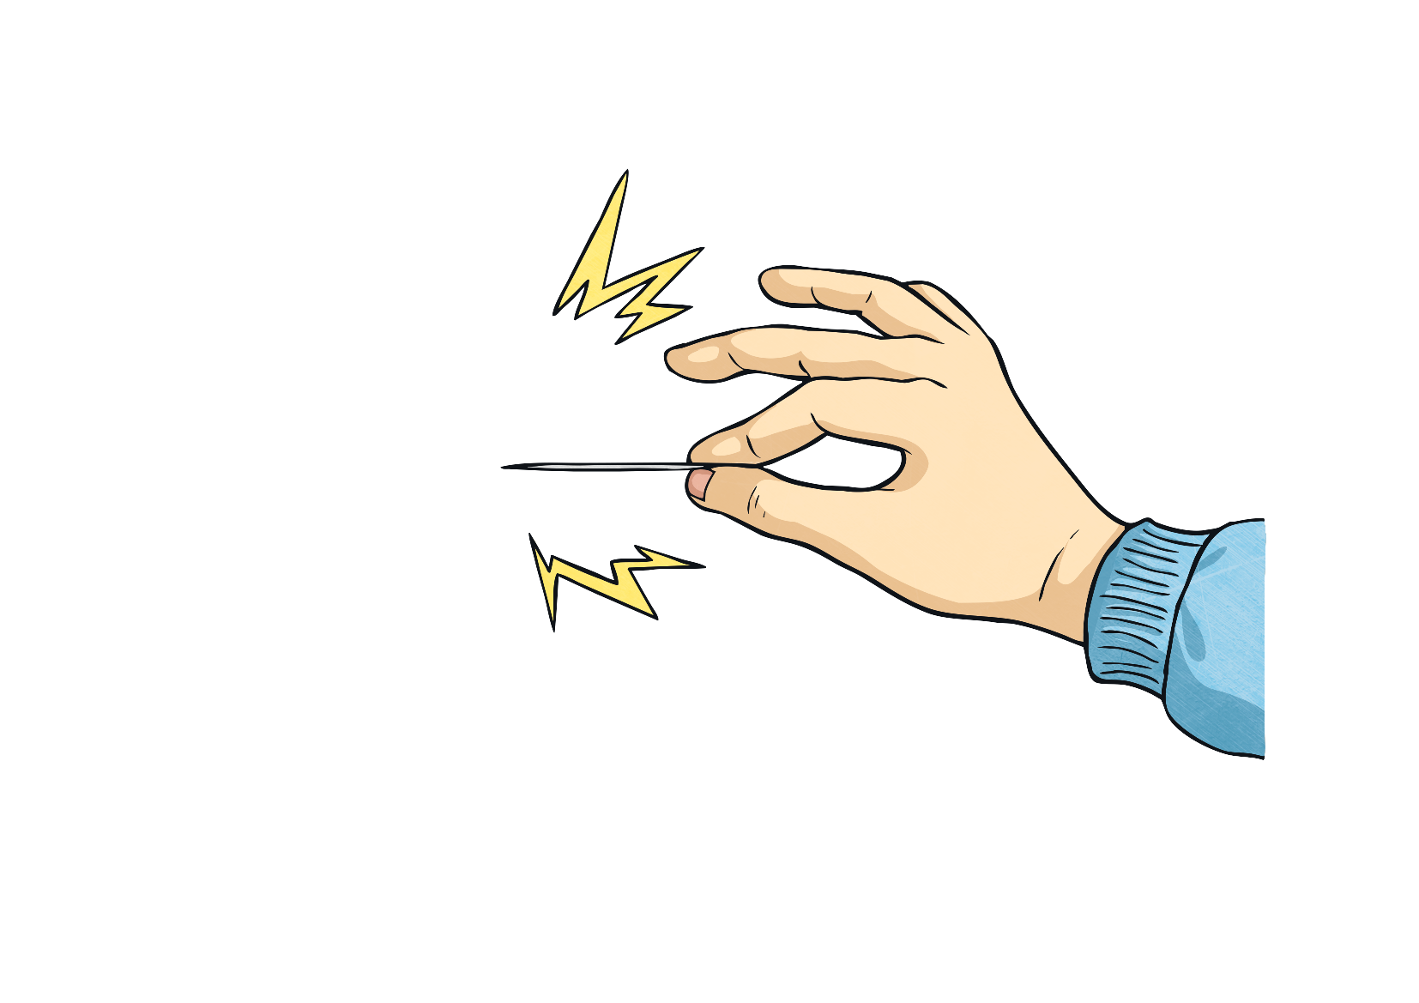
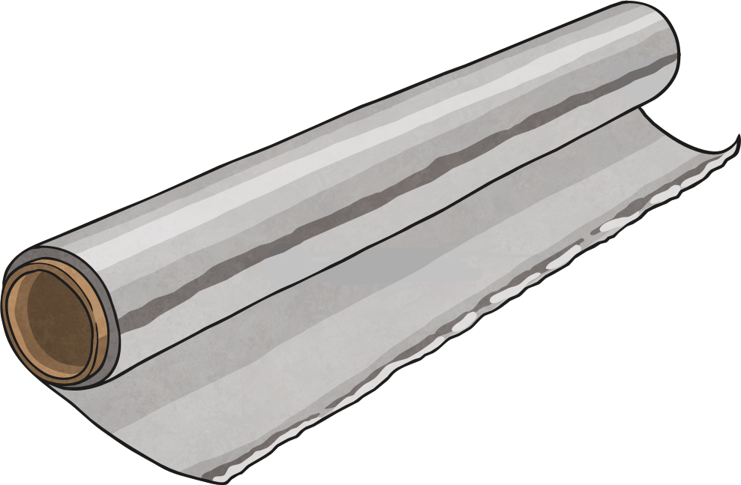
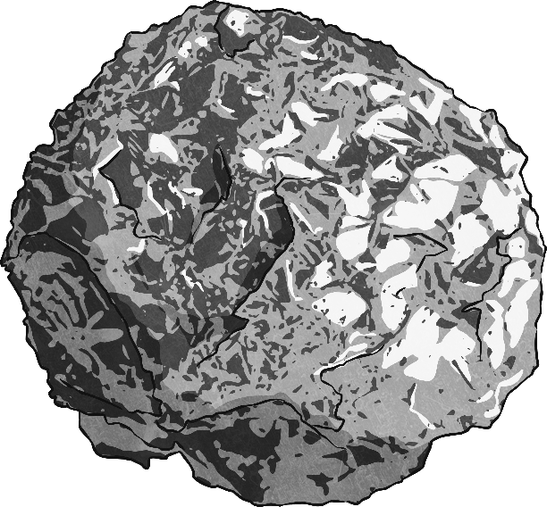
Black Hole Inquiry 1
Inflate a balloon so that it is around 10cm in diameter.
This shows how gravity compresses the star's matter around the collapsed core. The dead star has the same amount of matter, but it is compressed to a small point. This means it has greater density than the original star.
Wrap the balloon in several layers of tinfoil. This represents a star –
the balloon is its hot, burning core and the layers of tinfoil are the
layers of gas surrounding the core.
Imagine that the star has reached the end of its life, and the core has run out of fuel to burn.
This is how a black hole can be formed. The dense ball of matter exerts a large gravitational pull on all objects around it.
Carefully pop the balloon with a pin.
Squash and squeeze the foil layers around the popped balloon.

Slide 15

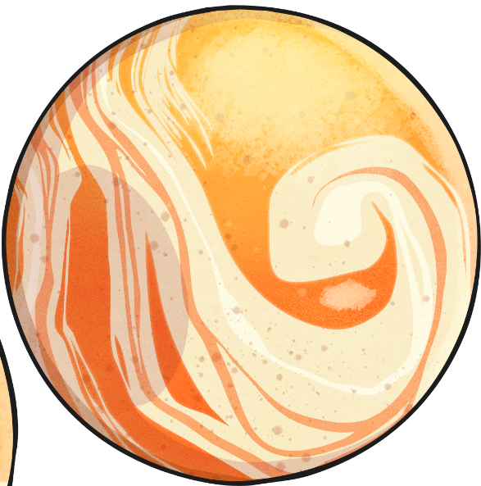
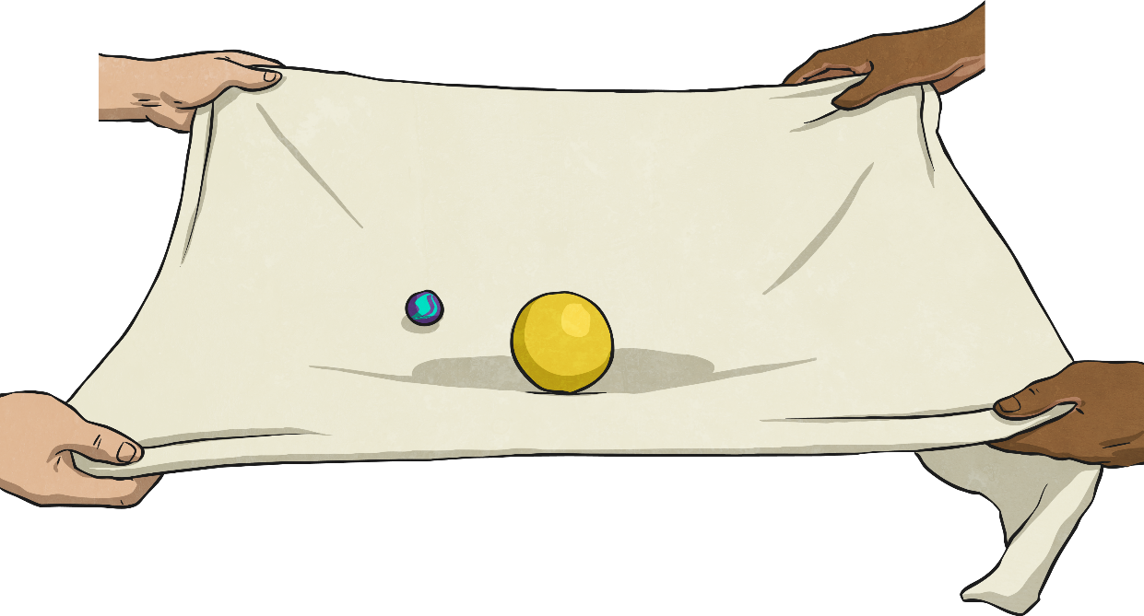
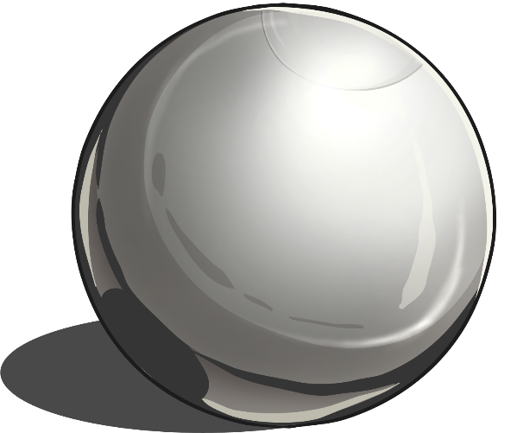
Black Hole Inquiry 2
Two or three members of your group should hold the edges of a piece of stretchy fabric so that it is stretched taut horizontally.
The ball represents a black hole. It curves the fabric of space.
Notice how the heavy ball pulls the fabric down to form a hole or a well that pulls the marble down. Once it is in the hole,
it cannot escape.
This fabric represents space.
Roll the marble across the fabric again, and observe how it travels differently now that the heavy ball is there. Experiment with rolling it slowly and quickly.
Another member of your group should roll a marble across the fabric.
Observe how it travels.
This is how black holes pull objects into themselves, and demonstrates why objects cannot escape from black holes.
This marble represents matter travelling through space, such as light, a planet or an asteroid.
Now place a heavy ball in the centre of the fabric. How does it alter the shape of the fabric?

Slide 16
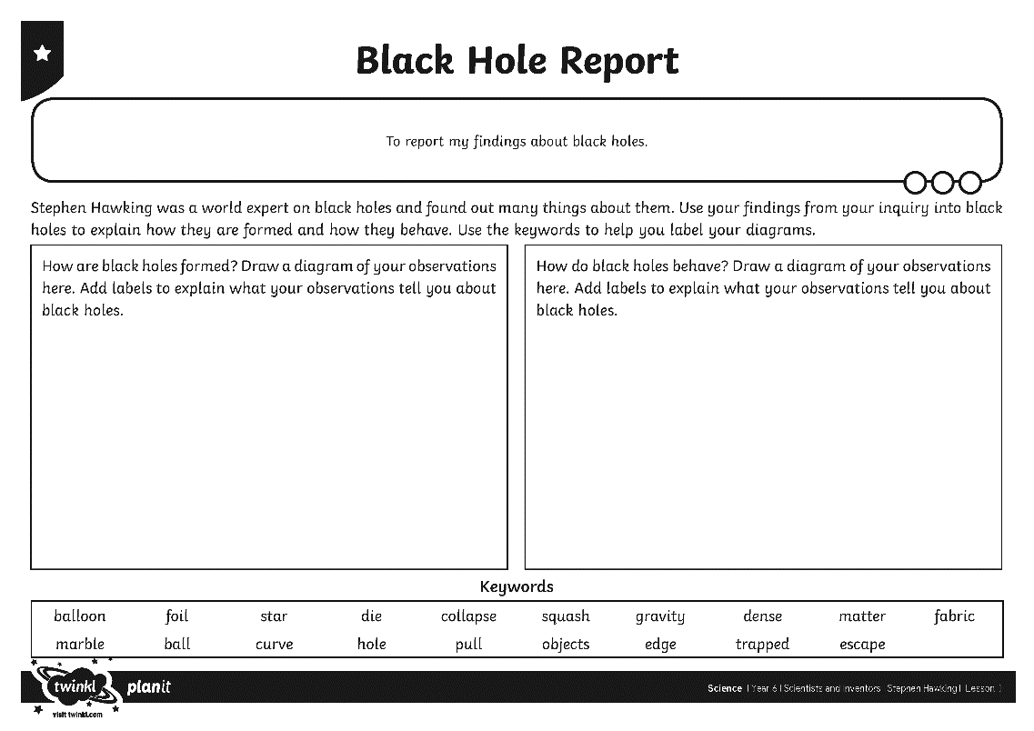
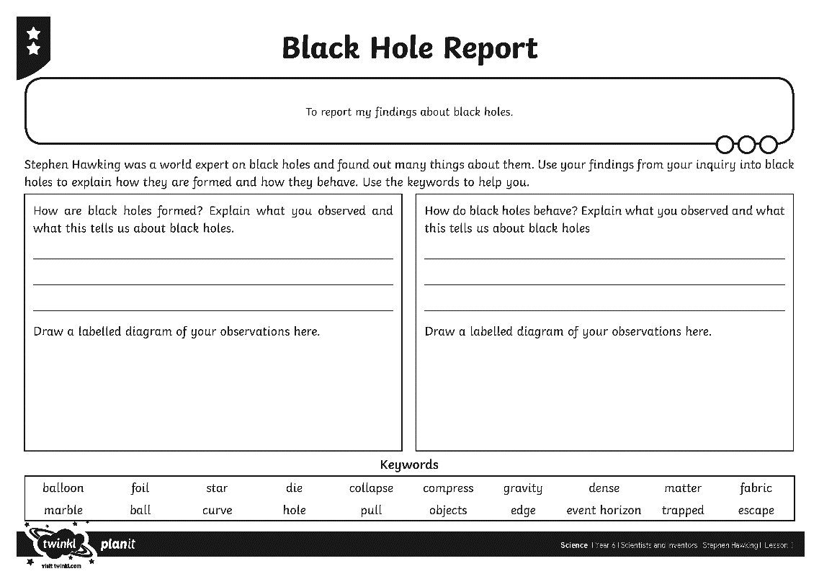
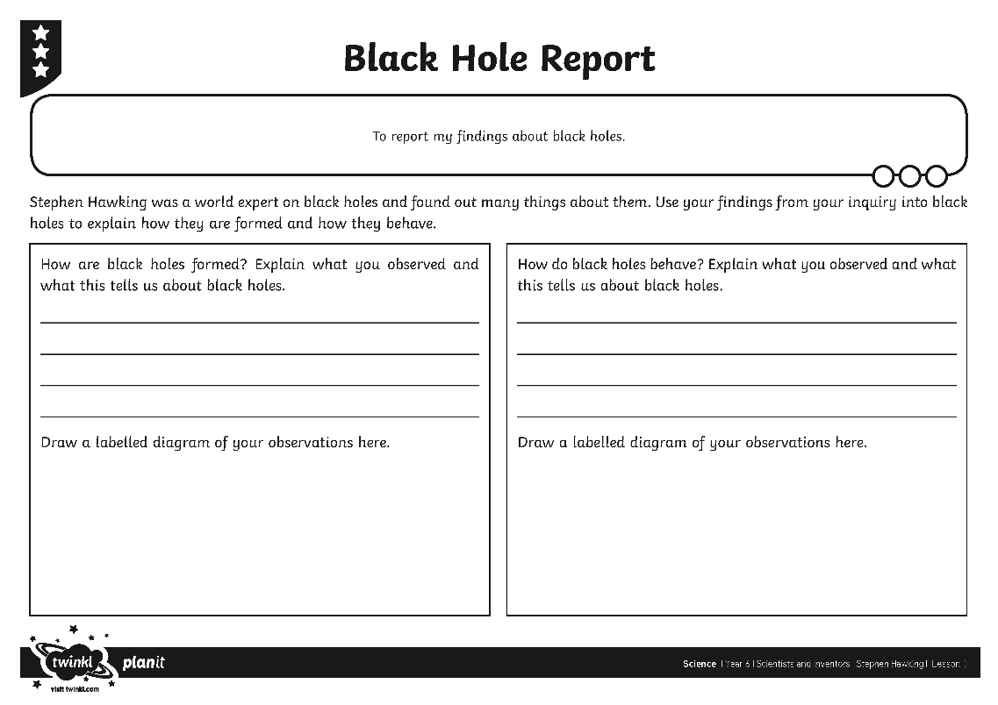
Report on Your Findings
Use your Black Hole Report Activity Sheet to report on your findings and how they relate to Hawking's theories about black holes.

Slide 17


Stephen Hawking
True or False?
Using what you have learned in today's lesson, decide if these statements about Stephen Hawking are true or false.
Stephen Hawking was born with a disability called ALS.
True
False
Well done!

Slide 18

Stephen Hawking
True or False?
Using what you have learned in today's lesson, decide if these statements about Stephen Hawking are true or false.
Hawking was a member of the boat club at university.
True
False
Well done!

Slide 19

Stephen Hawking
True or False?
Using what you have learned in today's lesson, decide if these statements about Stephen Hawking are true or false.
Hawking is renowned as a world expert on black holes.
True
False
Well done!

Slide 20
Stephen Hawking
True or False?
Using what you have learned in today's lesson, decide if these statements about Stephen Hawking are true or false.
Hawking theorised that there is a black hole at the centre of our galaxy.
True
False
Well done!

Slide 21

Stephen Hawking
True or False?
Using what you have learned in today's lesson, decide if these statements about Stephen Hawking are true or false.
The gravity of a black hole is so strong that only light can escape from one.
True
False
Well done!

Slide 22

Aim
To understand Stephen Hawking’s theories about black holes and report my findings.
Success Criteria
I can share facts about Stephen Hawking’s life.
I can explain what I already know about black holes.
I can set up an inquiry to demonstrate the causes of black holes.
I can report about my findings from an inquiry.

