Slide 1
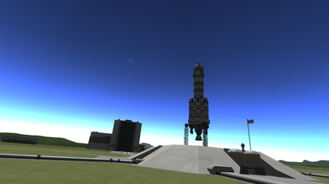
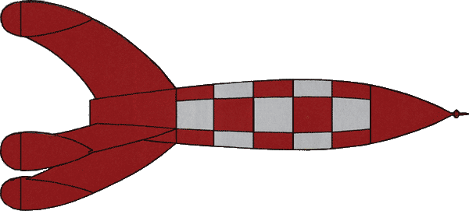

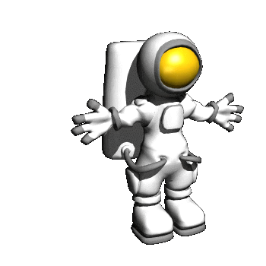




Spaceman Spiff’s ADVENTURE IN SPACE

Slide 2
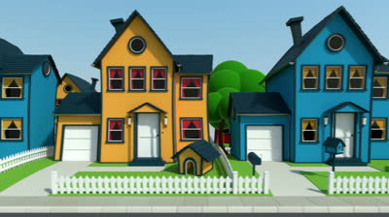

Spiff was a boy. He had ordinary hair and he wore ordinary clothes , he lived in an ordinary house and he ate ordinary food. But Spiff was special. Spiff was a spaceman.

Slide 3
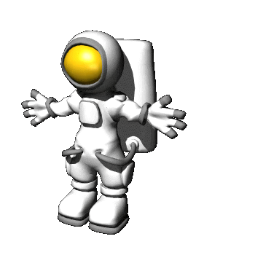
When Spiff put on his spacesuit he was Spaceman Spiff, and he was ready to fly up into space.

Slide 4
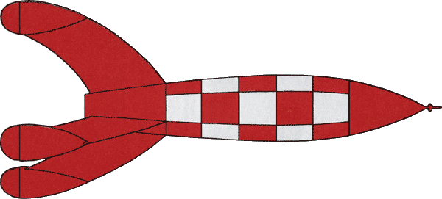
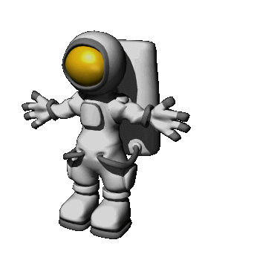
Spaceman Spiff went to his space rocket. It was ready to fly him up into space.

Slide 5

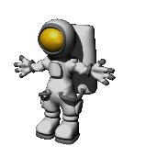
Spaceman Spiff went up to his space rocket. It was very big. Spiff climbed inside the rocket.

Slide 6
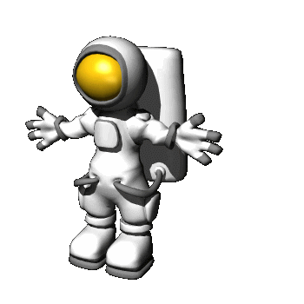
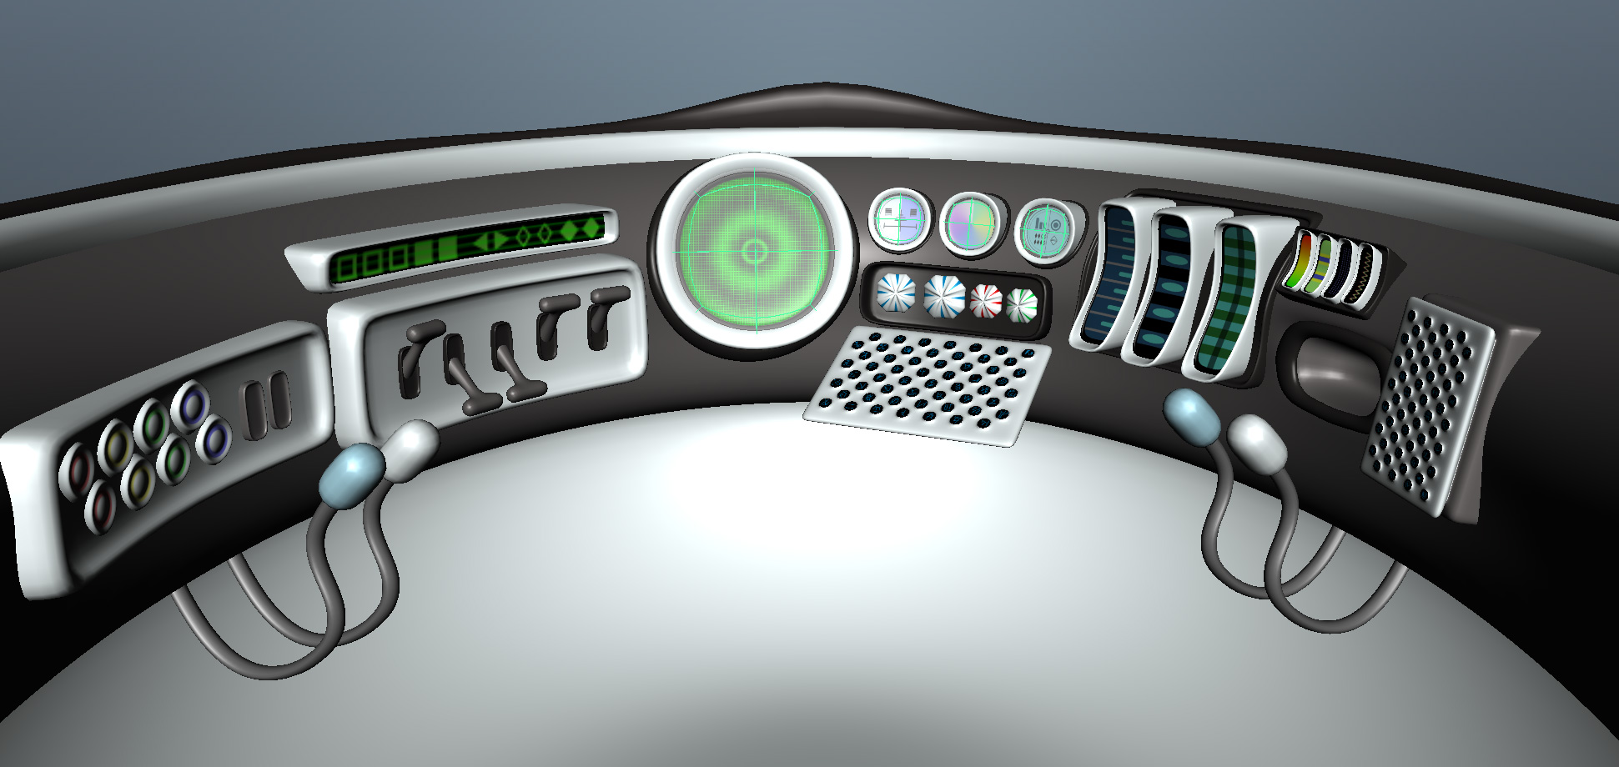
5, 4, 3, 2, 1 … BLAST OFF !
Inside his space rocket, Spaceman Spiff turned the rocket controls ready for blast off. He counted down …

Slide 7

Spaceman Spiff’s rocket engines blasted out fire and blasted his rocket up into the sky.

Slide 8
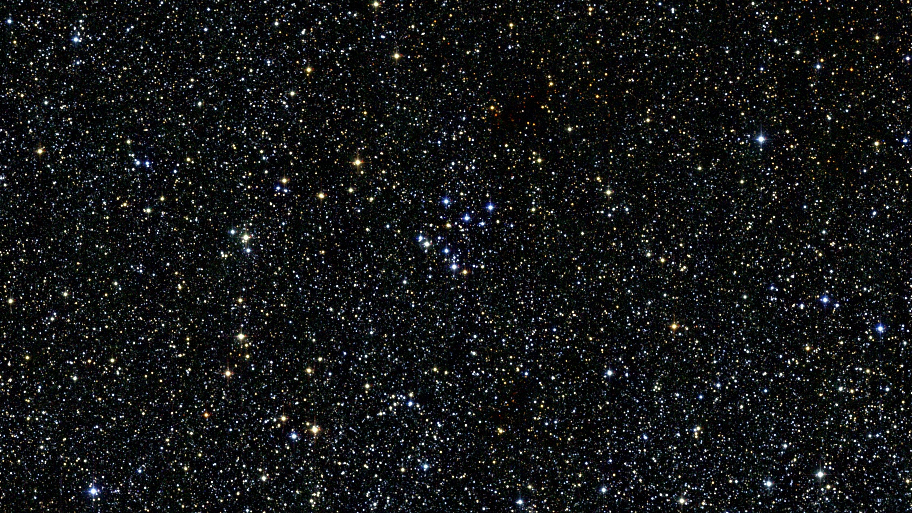
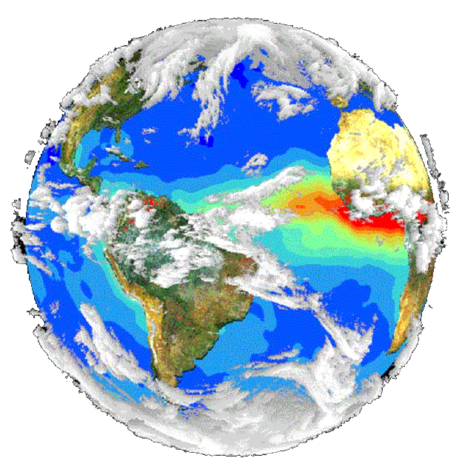
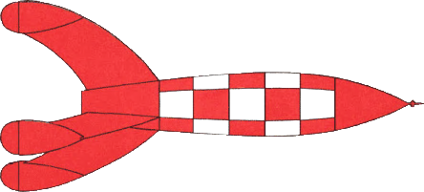
Spaceman Spiff’s rocket flew up and up, higher and higher, away from his home, away from Earth and into the darkness of space.

Slide 9



Planet Earth was far away. Spiff’s space rocket was now in space. It was very dark, but he could see lots and lots of stars twinkling in the black of space.

Slide 10
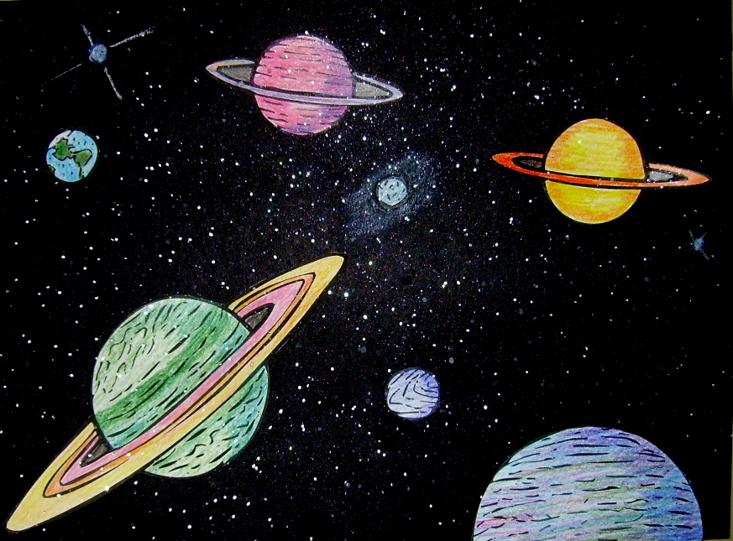
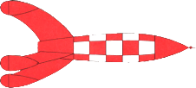
Spiff’s rocket flew through space. It flew on and on past many other planets.

Slide 11
Inside his space rocket Spaceman Spiff floated up. In space everything floats and nothing feels heavy.

Slide 12
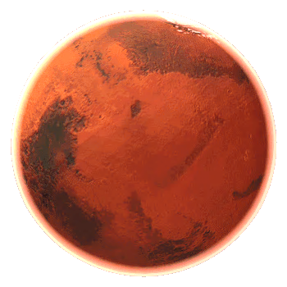

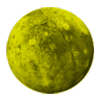
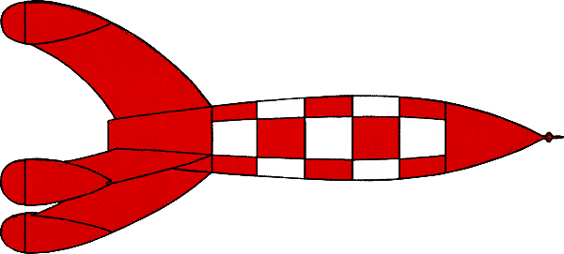


Spaceman Spiff went for a spacewalk. He floated outside his space rocket.

Slide 13
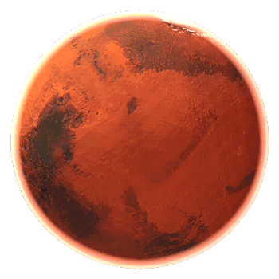

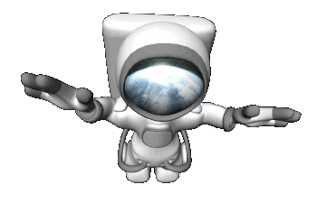
He floated away from his rocket.

Slide 14
He floated round and round in a circle.

Slide 15
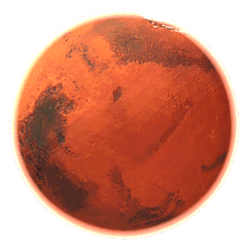

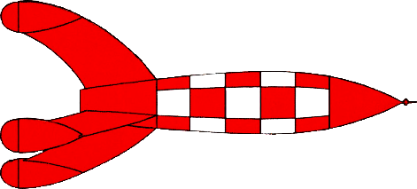
Spiff saw an alien spaceship . Spiff waved at it. The alien spaceship flew past him. Spiff floated back inside his rocket.

Slide 16
Spiff’s space rocket flew towards a big planet.

Slide 17
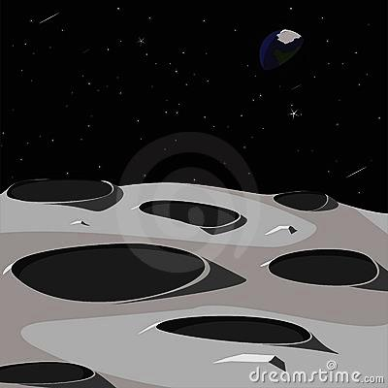
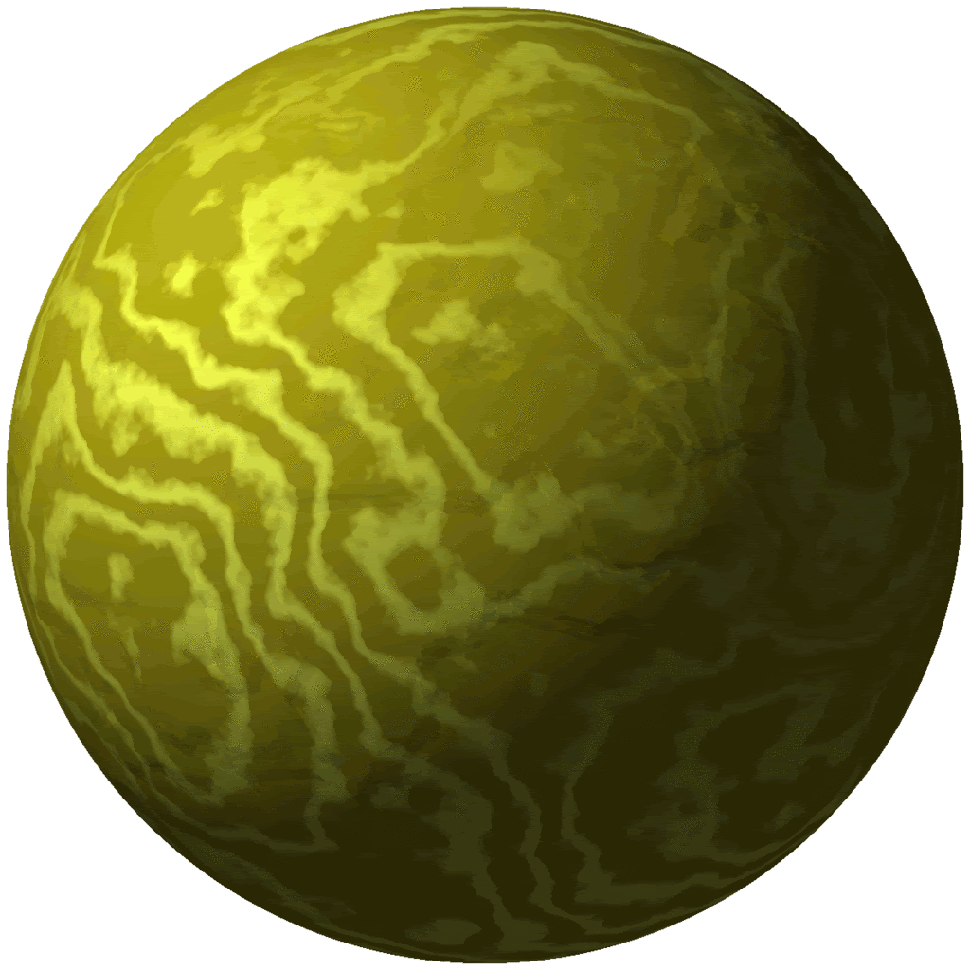
The space rocket landed on the alien planet. But it landed wrong and broke at the bottom.

Slide 18
OH NO! My rocket has landed wrong!
Inside his space rocket, Spaceman Spiff wobbled and stumbled as the rocket tilted to one side.

Slide 19
Spaceman Spiff climbed out and looked at his broken space rocket. How was he going to fix it?

Slide 20
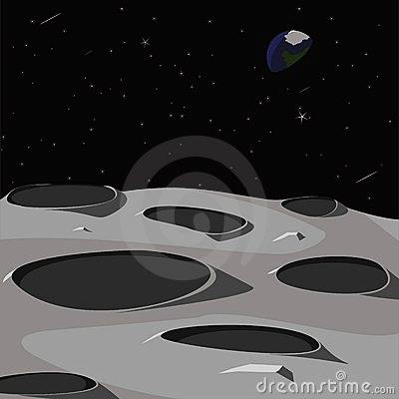

Spiff looked at the alien planet. It was not like Earth. It was not like home.
Spaceman Spiff jumped and floated over the strange alien ground.

Slide 21


Just then, the alien spaceship landed near to him.

Slide 22
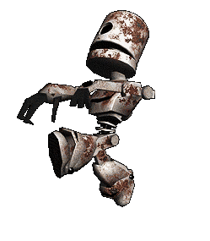
An alien robot jumped out and came toward him.

Slide 23
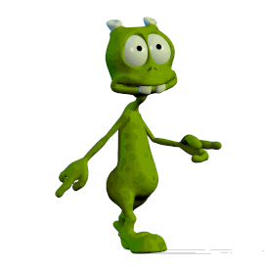
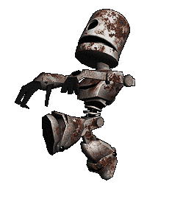
Then Spiff saw a green alien jump out of the spaceship.

Slide 24

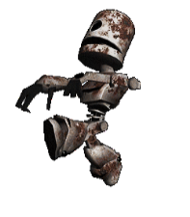
Spiff said, “Hello”. The green alien said, “Googleblop”.

Slide 25
Then lots of green aliens came out. They all said, “Googleblop!”

Slide 26
Spiff said, “ My space rocket is broken. Can you help fix it?”
The green aliens said, “Blibble gobstopper!”

Slide 27



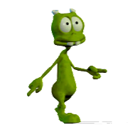

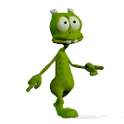
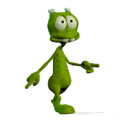
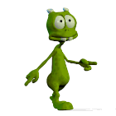
The aliens and their robot surrounded Spiff’s rocket.
Spiff was puzzled. What were they doing?

Slide 28


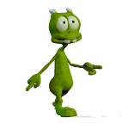

The aliens and the robot moved away from the space rocket.
Spiff was amazed. They had fixed his space rocket.

Slide 29



Spiff said, “Thank you”, and, “Goodbye.” Spiff floated back to his space rocket. The green aliens said, “Floogleblip.”

Slide 30

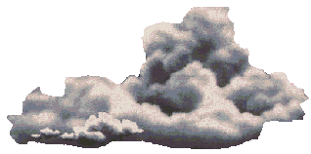
Spiff went back inside his space rocket. It blasted off the alien planet.

Slide 31
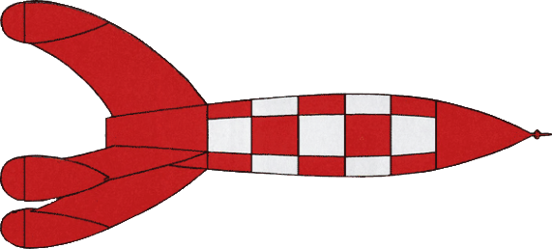
Spaceman Spiff’s space rocket flew back to Earth. And Spiff went home.

Slide 32





Spaceman Spiff had enjoyed a great adventure to the alien planet. But now it was time for bed.

Slide 33

Spiff could have another adventure … tomorrow!
THE END

