Slide 2
What Is New Year?
New Year's Day is the first day of the new year.
It is celebrated as a holiday in many countries in the world.

Slide 3
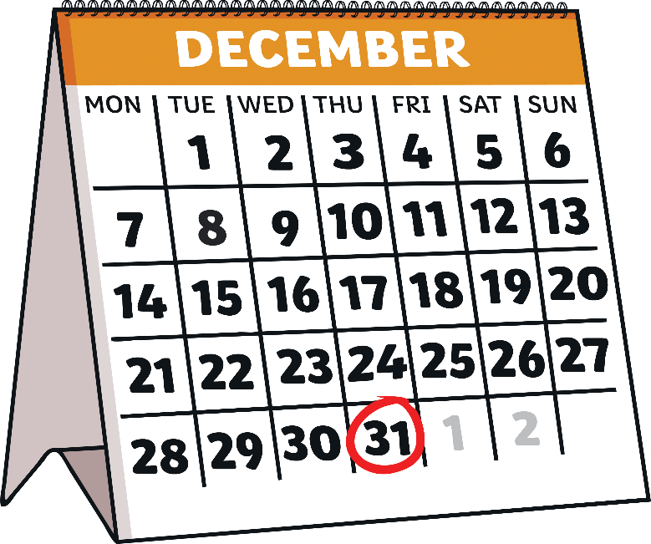
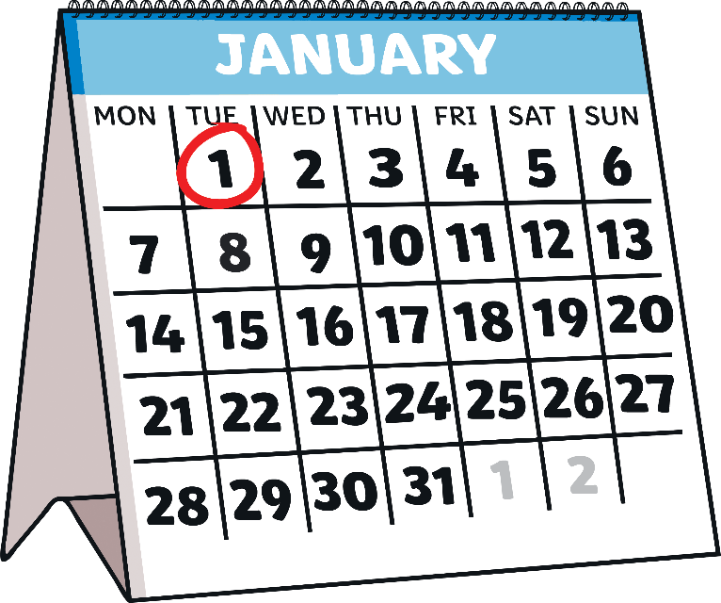
When Is New Year?
New Year’s Eve is the last day of the year. It is on 31st December. Lots of people stay up late on New Year’s Eve. At midnight, the new year begins. New Year’s Day is the first day of the new year. It is on 1st January.

Slide 4
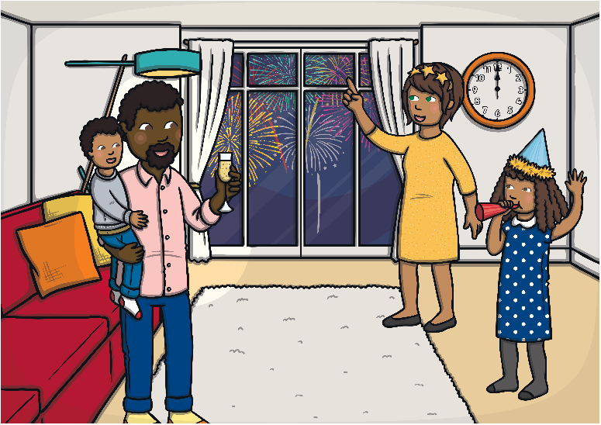
How Do People Celebrate
New Year’s Eve?
Many people celebrate New Year’s Eve by spending time with family and friends. They might have a party.
New Year’s Eve can be a time to:
Have fun and celebrate
Think about the past year
Hope for good things in the future
Think about new beginnings
Do you celebrate New Year’s Eve? What do you do?

Slide 5
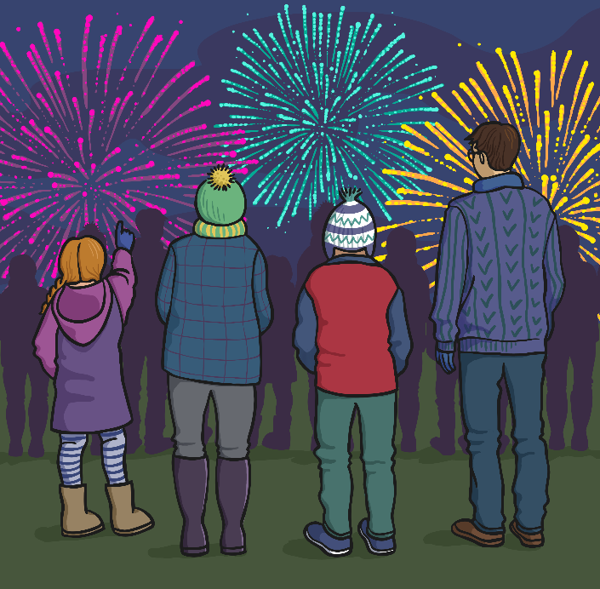
Fireworks and New Year
Many countries have firework displays to celebrate the start of the new year.
People count down to the first stroke of midnight.
10, 9, 8, 7, 6, 5, 4, 3, 2, 1…
Then, the fireworks begin and light up the sky!

Slide 6
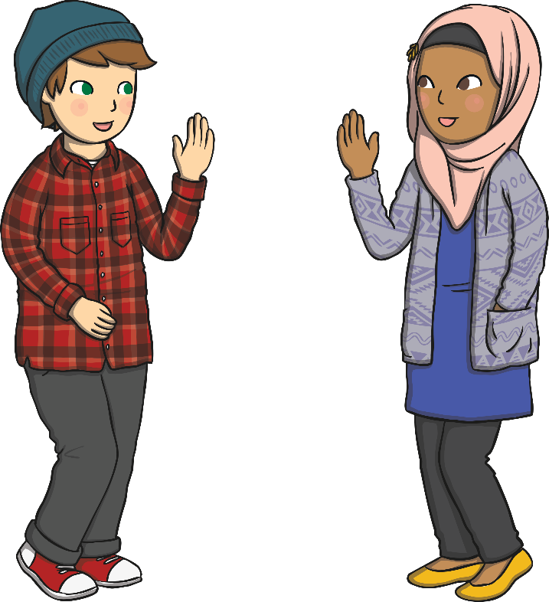
How Do People Celebrate
New Year’s Day?
Some people wish each other, ‘Happy New Year!’ when they see each other for the first time in the new year.
They send good wishes to each other for a safe and happy year.
They might talk about the things they
want to do in the coming year.
What could you say to someone who is
celebrating New Year’s Day?

Slide 7




How is New Year Celebrated in the United Kingdom?
Different countries may celebrate the new year in different ways.
In Scotland:
The cannons fire at the stroke of midnight at Edinburgh Castle.
New Year’s Eve is called ‘Hogmanay’ and people celebrate with gifts.
In England:
Big Ben strikes at midnight to welcome the new year in London.
On New Year’s Day, there is a big parade in London.
In Northern Ireland:
There are firework displays in large cities, such as the capital, Belfast.
It is traditional for some people to clean their homes before the new year.
In Wales:
In the capital city of Cardiff, the celebrations include live music, fireworks, ice skating and fairground rides.
Bread and cheese are traditional gifts.

Slide 8
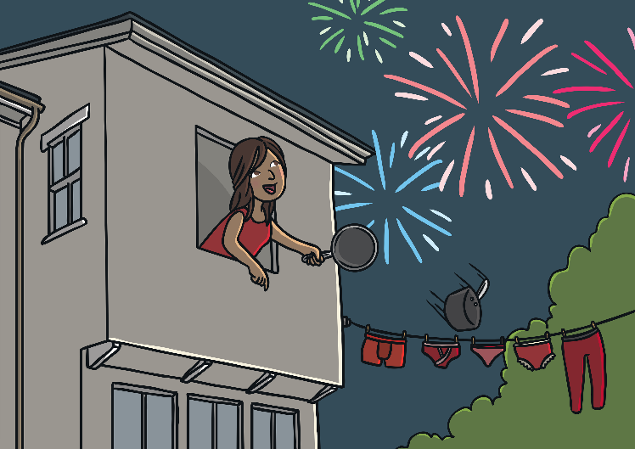

What Other Ways Are There to Celebrate New Year?
Many people ring in the new year by
banging pots and pans in the street.
In some countries, people may eat
special food for the new year.
In Spain, people eat 12 grapes on
New Year’s Eve.
In Greece, people eat a special cake called Vasilopita on New Year’s Day.

Slide 9

What Are New Year Resolutions?
Some people make promises to themselves to do some things better in the coming year. These are called New Year resolutions. Sometimes, people make a list of resolutions to help to remember them.
Is there anything you would like
to do better
this year?
Could you be more helpful or kinder in any way?
New Year resolutions can be promises like:
I will help keep my room tidy.
I will be kind to my sister/brother.
I will listen carefully.
Can you think of your own New Year resolution?

Slide 10
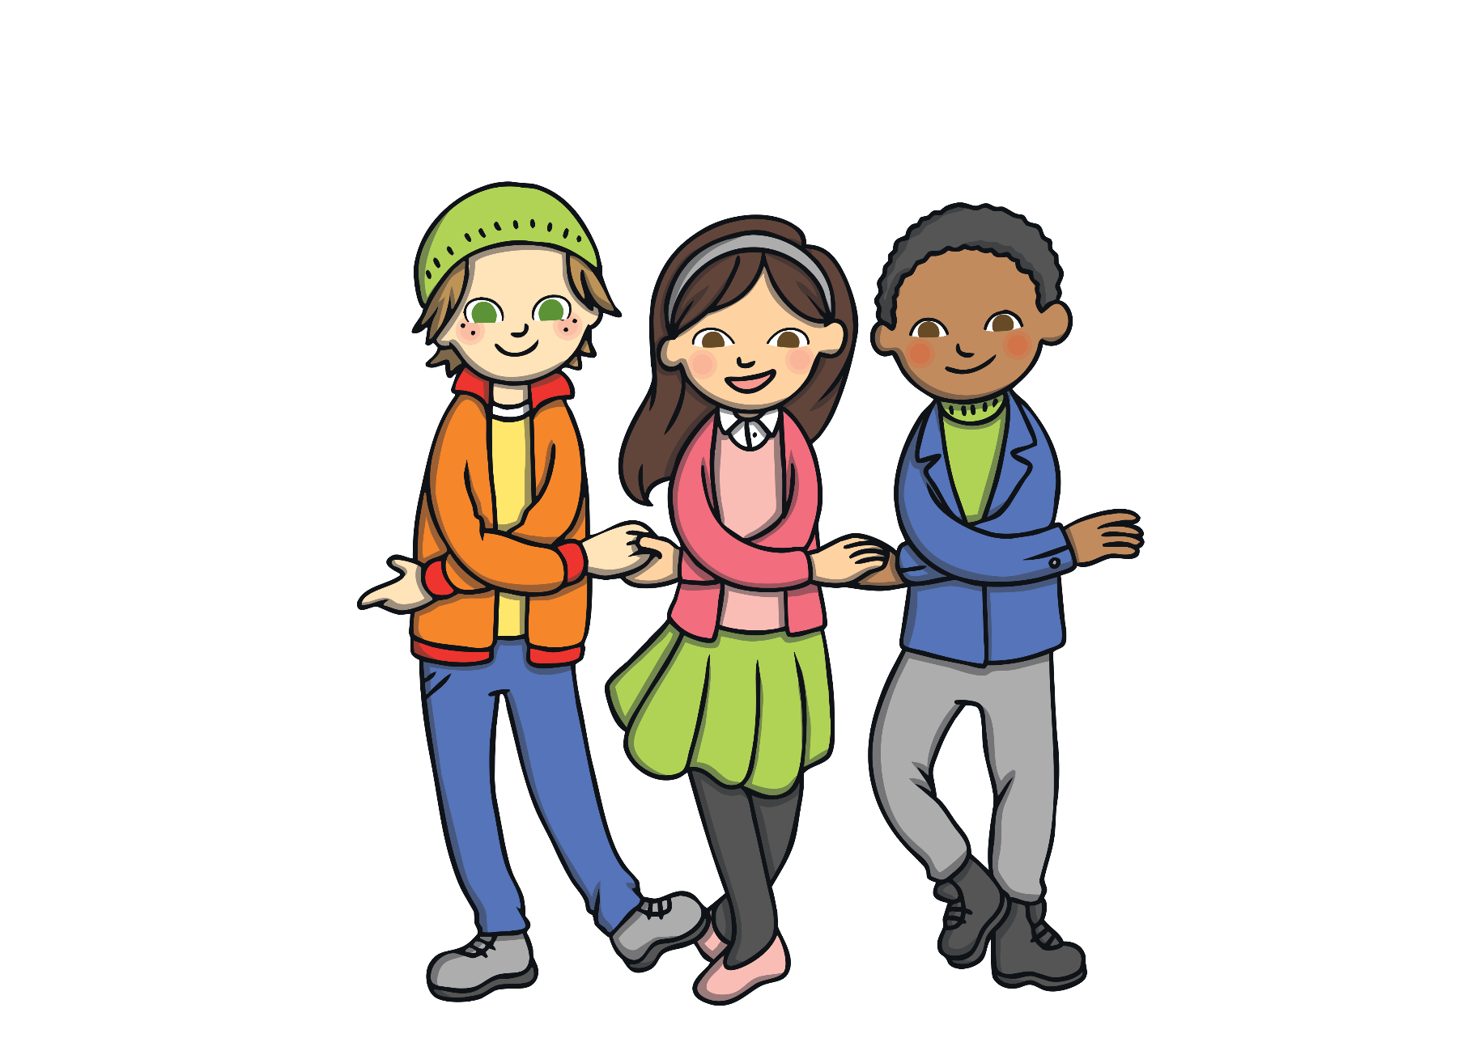
What Is the New Year Song?
Many people sing a traditional song on New Year’s Eve which is called ‘Auld Lang Syne’.
It is sung to say goodbye to the old year and to remember friends.
Often, people hold hands while they sing the song together.
You could try this with your friends as you sing the first verse on the next slide.

Slide 11
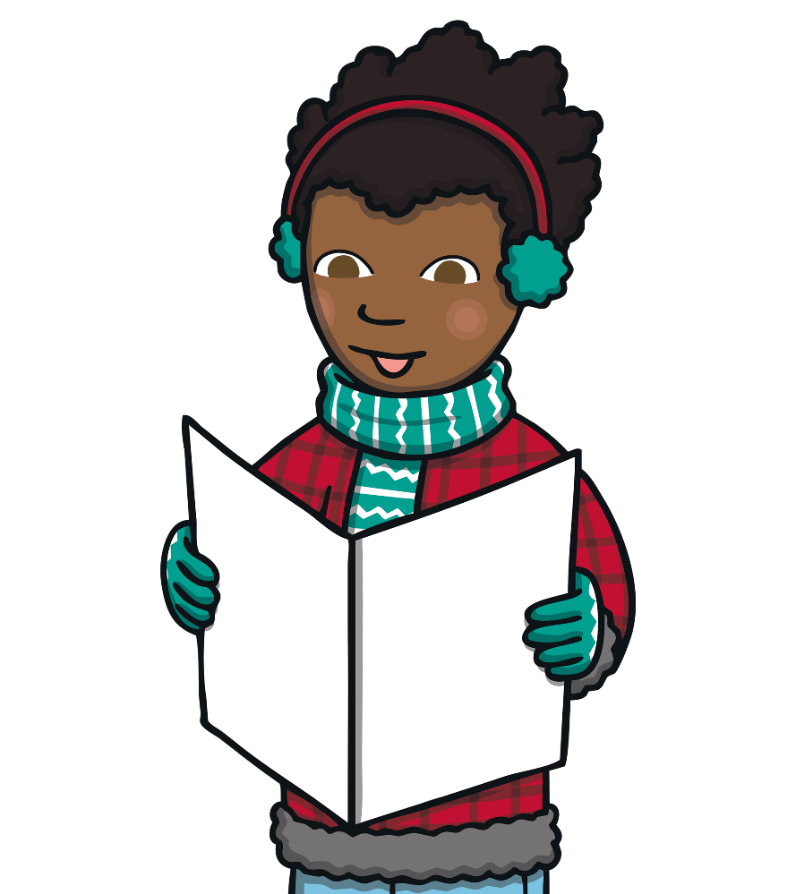


Should auld acquaintance be forgot,
And never brought to mind?
Should auld acquaintance be forgot,
And auld lang syne!
Click to listen

