Slide 1


Slide 3
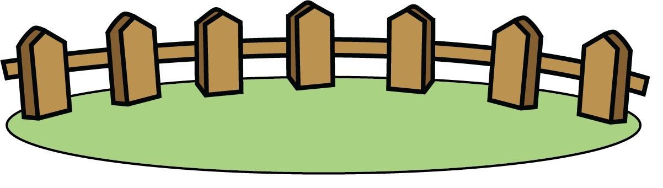

Where can you see zero?
There are zero _______.
sheep

Slide 4
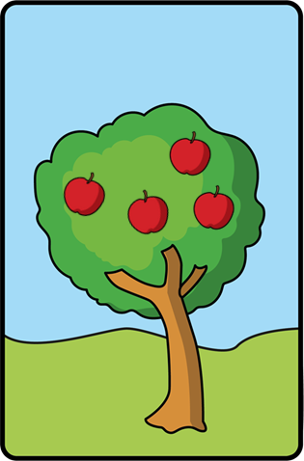
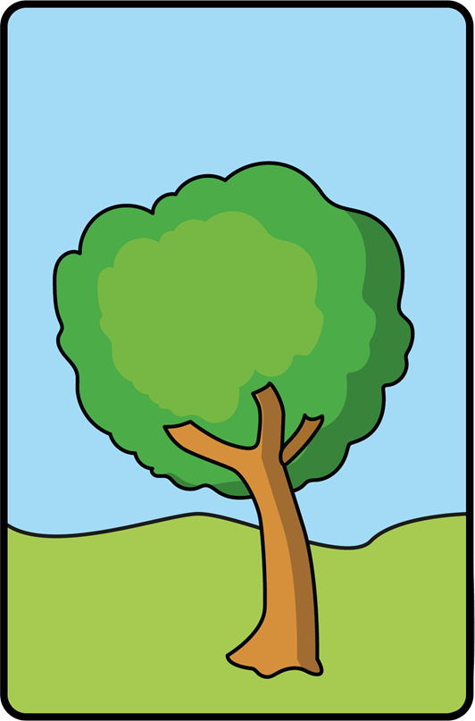
Where can you see zero?
There are zero _______.
apples

Slide 5

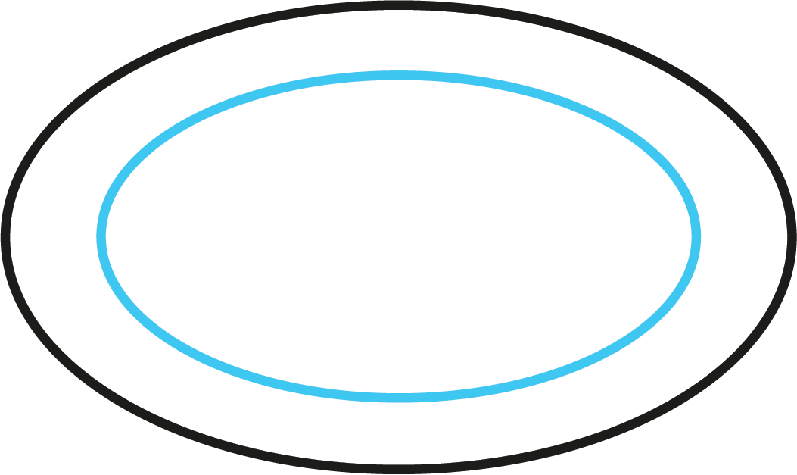
Where can you see zero?
There are zero _______.
carrots

Slide 6


Where can you see zero?
There are zero _______.
fish

Slide 7
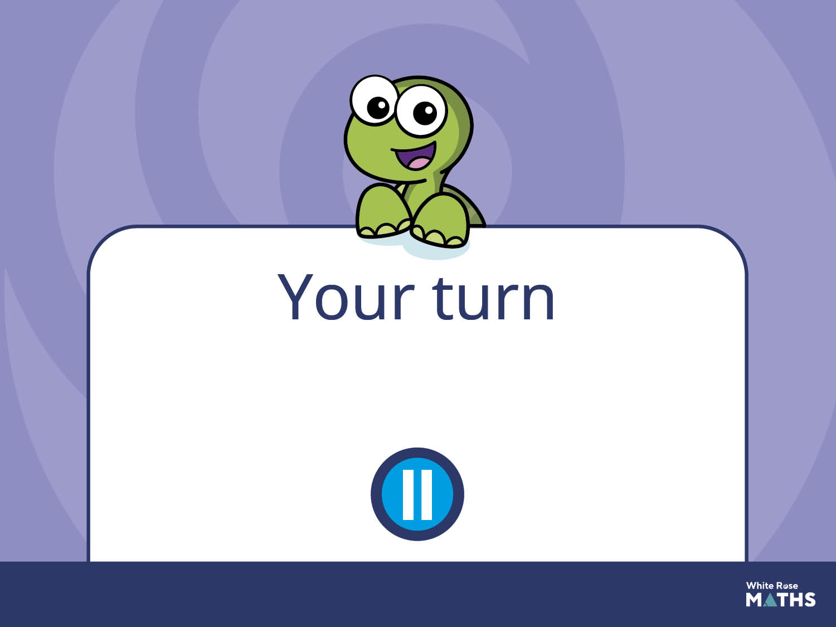
Have a go at the next activity.

Slide 8
Provide images showing familiar numbers alongside zero to support children’s understanding that zero represents the absence of something.
Can children say when images show zero and not zero?

