Slide 1

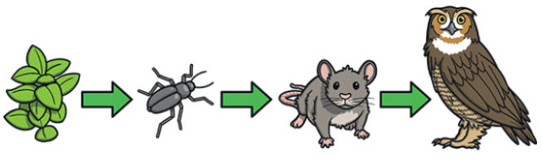
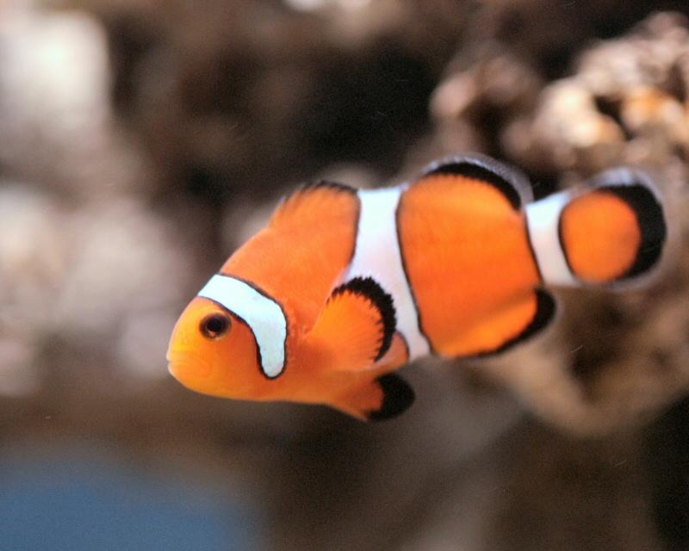
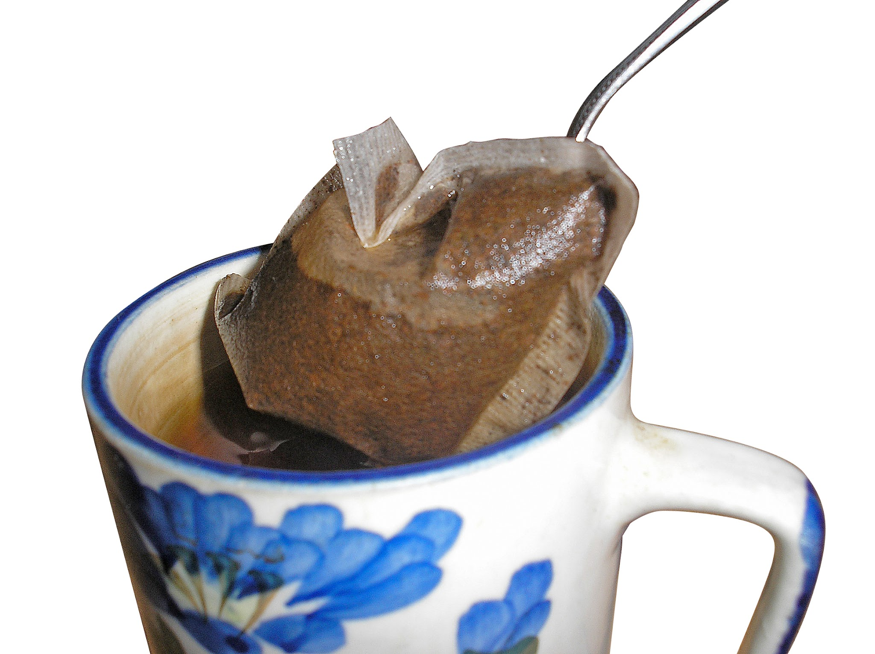
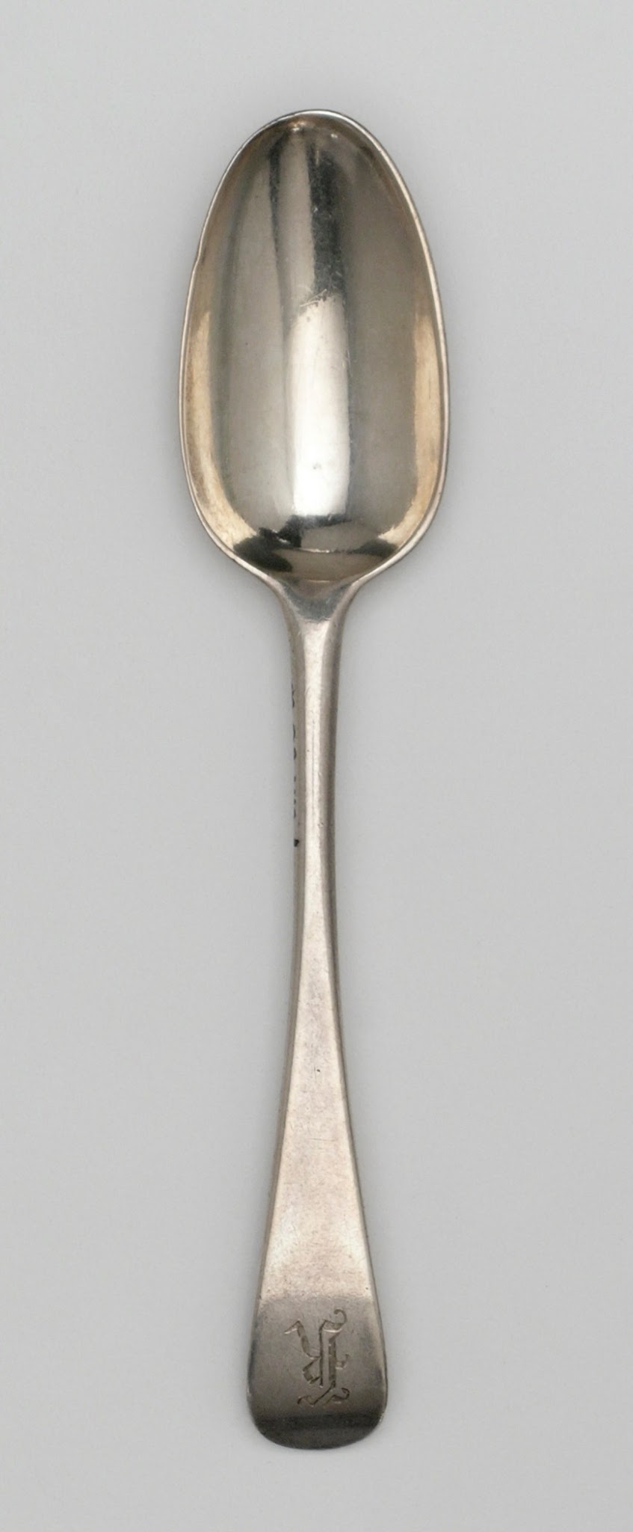
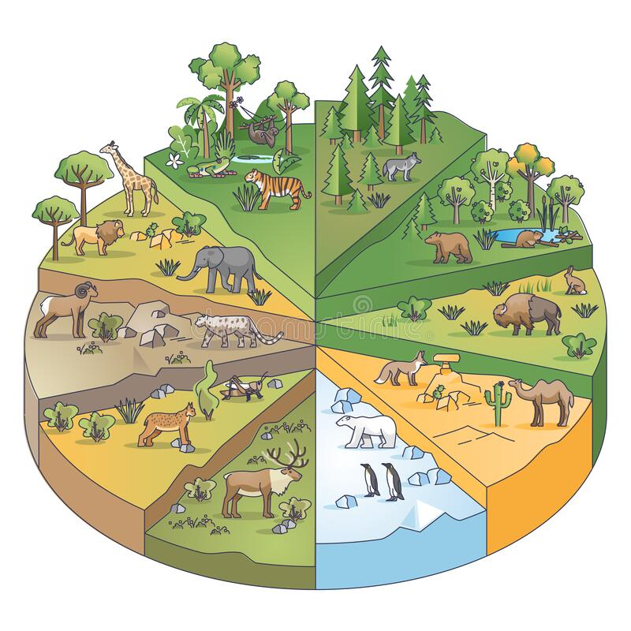
Elworth CE Primary School - Science
Year: Two | Topic: Living things and their habitats | Strand: Biology
What Should I Already Know
This is a new topic for children- they will have some understanding of a variety of plants and what animals need to live. Through previous topics on plants, and animals including humans, the children should be able to identify and name a variety of common animals, plants and trees.
Diagrams
Vocabulary
Life processes | These are the things that all living things do. They move, breathe, sense, grow, make babies, get rid of waste and get their energy from food.
Living | Things that are living have all the life processes.
Dead | Things that are dead were once living. They did have all the life processes but don’t now.
Never living | Things made out of metal, plastic or rock were never living. They never had the life processes.
Habitat | A natural environment or home of a variety of plants and animals.
Food chain | A food chain shows how each animal gets its food. Food chains are one of the ways that living things depend on each other to stay alive.
Food sources | This is the place a living thing’s food comes from.
Microhabitat | A very small habitat, for example for woodlice under stones, logs or leaf litter.
A simple food chain. The arrows show the transfer of food energy: A is eaten by B…
What Will I Know By The End Of The Unit?
explore and compare the differences between things that are living, dead, and things that have never been alive identify that most living things live in habitats to which they are suited and describe how different habitats provide for the basic needs of different kinds of animals and plants, and how they depend on each other identify and name a variety of plants and animals in their habitats, including microhabitats describe how animals obtain their food from plants and other animals, using the idea of a simple food chain, and identify and name different sources of food.
Alive Dead Never Alive
Enquiry
Why do different living things need different habitats? What processes mean something is living? What shows that something has never been alive? What is a habitat? What is a microhabitat? How do different living things obtain their food?

