Slide 1


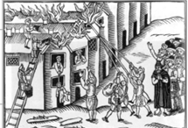
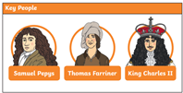
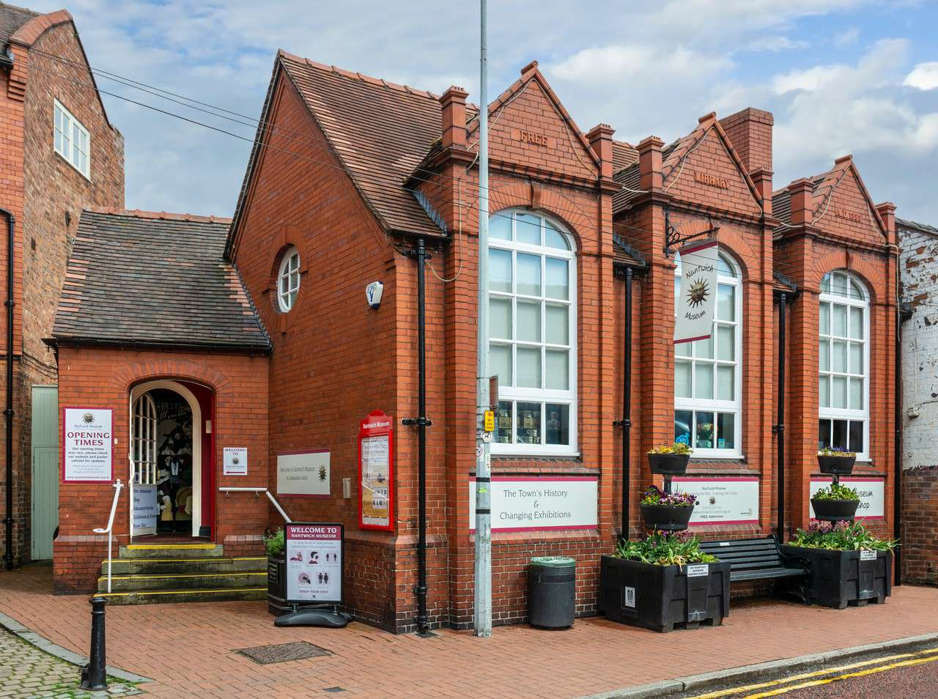

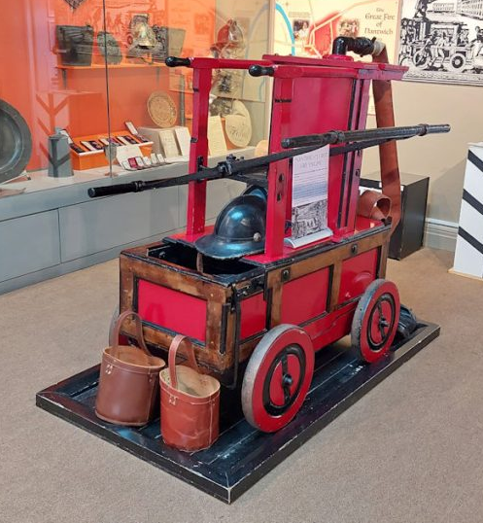
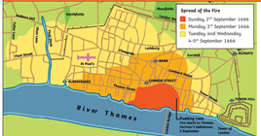
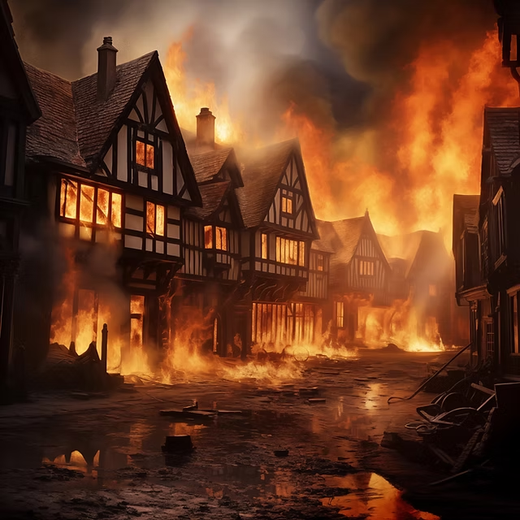
Elworth CE Primary School - History
Year: 2 | Topic Fire and Dragons
What Should I Already Know
Life in the past was different from the present. Clues help us to learn about the past. We can use the words “then” and “now”. Name a famous person from the past and explain why they are famous (Guy Fawkes)
Timeline
Great fire of Nantwich
Vocabulary
London | Capital of England
River Thames | River that runs through London
St Paul's Cathedral | Built by Sir Christopher Wren after the previous one burnt down.
Pudding Lane bakery | Where the fire started.
Diary | A book that people write about their lives
Fire break | A gap that stops a fire spreading to nearby buildings
London Bridge | The only crossing of the river Thames
Fire Hooks | Giant hooks used to pull down buildings
What Will I Know By The End Of The Unit?
The key events from the real Fire of London When and where the fire started Why did the fire spread so quickly How the fire was put out. Who Samuel Pepys was and why he was so important What happened after the fire was put out. How was London made safer Who Guy Fawkes was. Why we celebrate Bonfire night
Diagram
Historical Skills & Enquiry
sequence events or objects in chronological order find out about people and events in other times use a source – why, what, who, how, where to ask questions and find answers Use of time lines

