Slide 1

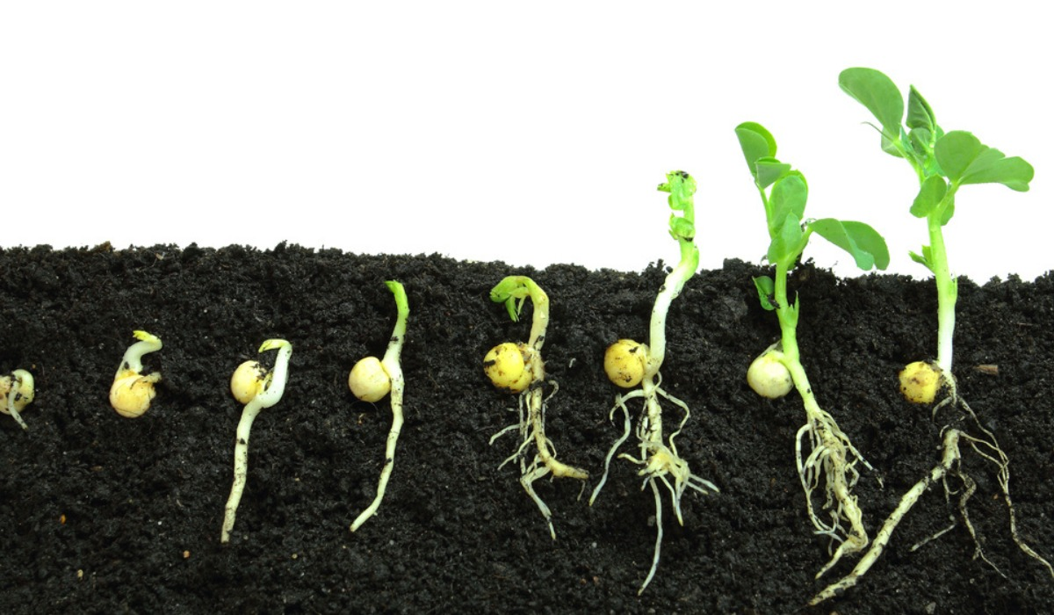
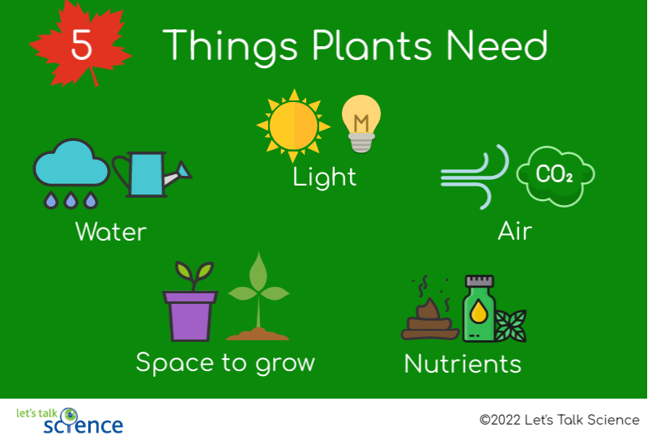
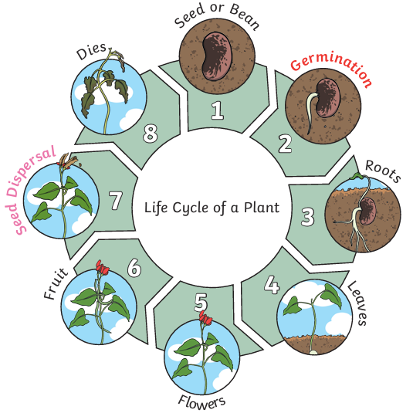
Elworth CE Primary School - Science
Year: Two | Topic: Plants | Strand: Biology
What Should I Already Know
How to identify and name a variety of common wild and garden plants How to identify and name a variety of deciduous and evergreen trees How to identify and describe the basic structure of common flowering plants and trees.
Diagrams
Vocabulary
seedling | Aa small young plant grown from a seed.
shoot | A shoot grows upwards from the seed to find sunlight.
germinate | The seed will soak up water and swell, the tiny plant bursting out of its shell.
bulb | An underground bud of a plant before it has grown.
grow | When something becomes bigger and changes its shape and size over time.
light | All plants need some light from the sun to grow well. Some need more light than others.
shade | Darkness caused by an object blocking the sunlight. It is usually colder in the shade.
warm | Not cold. Some plants prefer a warmer temperature to grow.
cool | Not warm. Some plants prefer a cooler temperature to grow.
space | How much room is around the seed or plant. Some plants like lots of space, some only a little.
water | All plants need water to grow. Without water, a seed will not germinate.
Germination:
What Will I Know By The End Of The Unit?
Plants can grow from either seeds or bulbs. Seeds germinate and grow into seedlings which grow into mature plants. Plants can have flowers which might develop into seeds, berries or fruit. Seeds and bulbs need to be planted at different times of the year outside. They will germinate and grow at different rates. Some plants grow better in sun and some in shade. Plants need different amounts of water and space to grow and be healthy.
What a plant needs to grow:
Enquiry
Make close observations, including over time, of seeds and bulbs. Classify seeds and bulbs. Research how to plant and care for seeds and bulbs. Research and set up simple tests to care for a seedling as it grows. Make observations and measurements of plants in the local environment. Make comparisons between plants as they grow.

