Slide 1

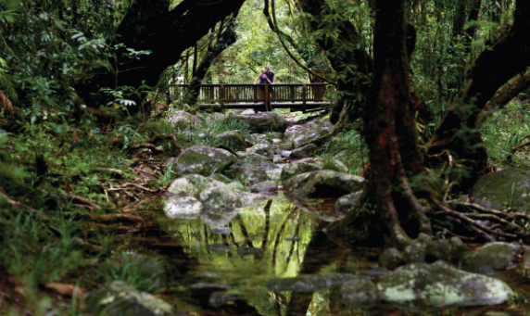
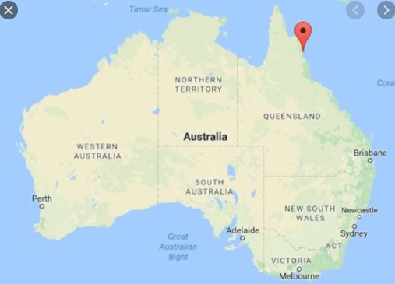
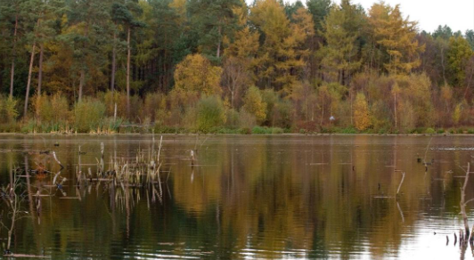
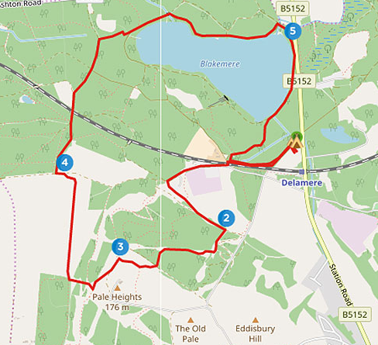
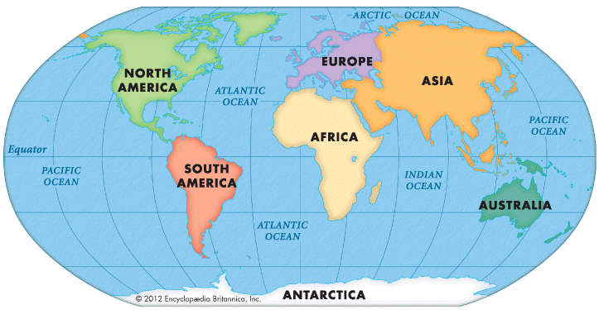
Elworth CE Primary School - Geography
Year: 2 | Topic: Lost in the Forest
What Should I Already Know
The name and location of the 7 continents Oceans are large bodies of saltwater around the continents The 4 compass points are North, East, South and West Countries that are closer to the equator are warmer Countries that are further away from the equator are colder The UK is North of the Equator The UK has forests, coasts, beaches, farms, countryside, towns and cities.
Physical/Human Features
Physical features: beach, cliff, coast, forest, hill, mountain, sea, ocean, river, valley, forest, rainforest, animals, plants, climate, season and weather | Human features: city, town, shelter
Vocabulary
Continent | The main continuous pieces of land across the world. There are 7 continents: Europe, Asia, Africa, North America, South America, Oceania (sometimes called Australia) and Antarctica
Ocean | A large body of saltwater surrounding the continents. There are 5 oceans: Pacific, Atlantic, Indian, Southern and Arctic
Deforestation | The action of clearing a wide area of trees.
Forest | a large area covered mainly with trees and undergrowth.
Rainforest | a thick forest with lots of unique plants and animals with lots of rainfall through the year
Climate | the weather conditions prevailing in an area in general or over a long period.
Habitat | the natural home or environment of an animal, plant, or other organism.
Diagrams
Daintree Rainforest (Australia): Delamere Forest (Cheshire):
What Will I Know By The End Of The Unit?
The name and location of the 7 continents and 5 oceans The location of Australia Lots of countries have forests, but they can look different How to use an aerial image to identify features Weather patterns in Spring in the UK and Australia Rainforests have many different animals and plants not found anywhere else Forests in the UK have mostly deciduous and evergreen trees Delamere Forest is the largest forest in Cheshire Daintree Rainforest is the oldest in the world and the largest in Australia How to use compass directions to create and describe a map As there are more people, trees are cut down to make way for buildings and things to do

