Slide 1

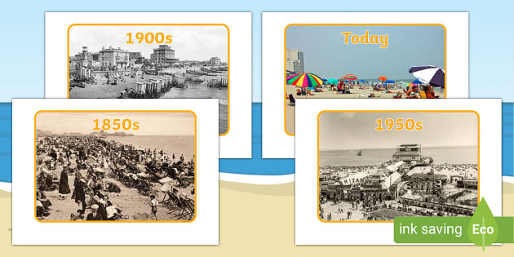
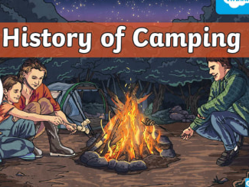
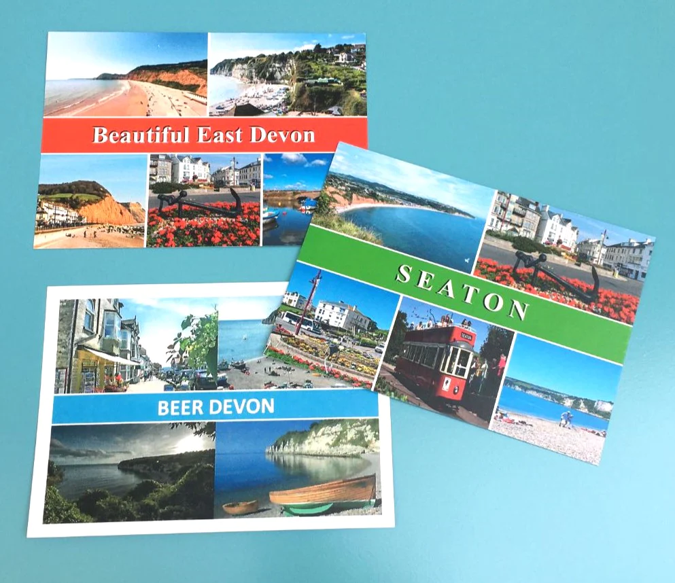
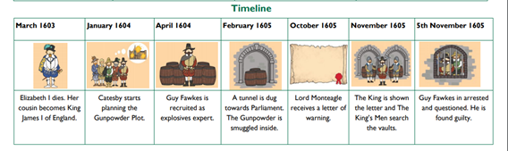
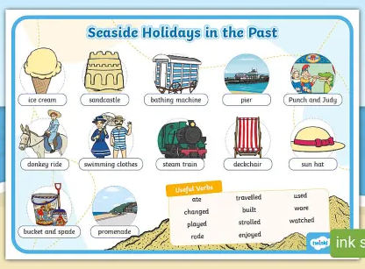
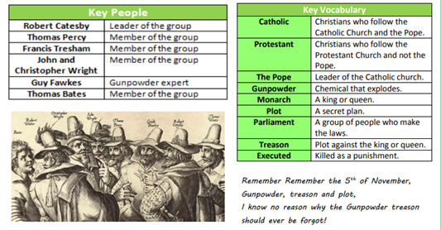
Elworth CE Primary School - History
Year: 2 | Topic Let’s go Travelling
What Should I Already Know
Life in the past was different from the present. Clues help us to learn about the past. We can use the words “then” and “now”. Name a famous person from the past and explain why they are famous (Guy Fawkes)
Timeline
Guy Fawkes and the Gunpowder Plot
Vocabulary
holiday | A time of recreation away from the home.
souvenir | Something you collect to remind you of a holiday
promenade | A walk way along the seafront
pier | A walkway on platforms going out into the sea
Punch and Judy | Traditional seaside puppet show
postcard | A message sent from aholiday on a picture
seaside | A village or town near the sea
bandstand | A covered outdoor area where a band can play
What Will I Know By The End Of The Unit?
How holidays in the UK have changed Popular holiday activities in the past How camping has changed What the souvenirs tell us about the pst What postcards tell us about the past Who Guy Fawkes was. Why we celebrate Bonfire night Why we commemorate Remembrance Day.
Diagram
Historical Skills & Enquiry
sequence events or objects in chronological order find out about people and events in other times use a source – why, what, who, how, where to ask questions and find answers Use of time lines

