Slide 1

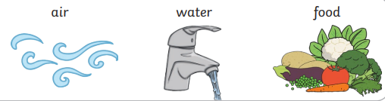
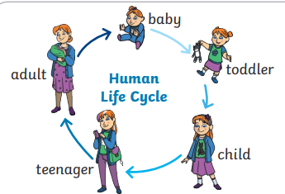
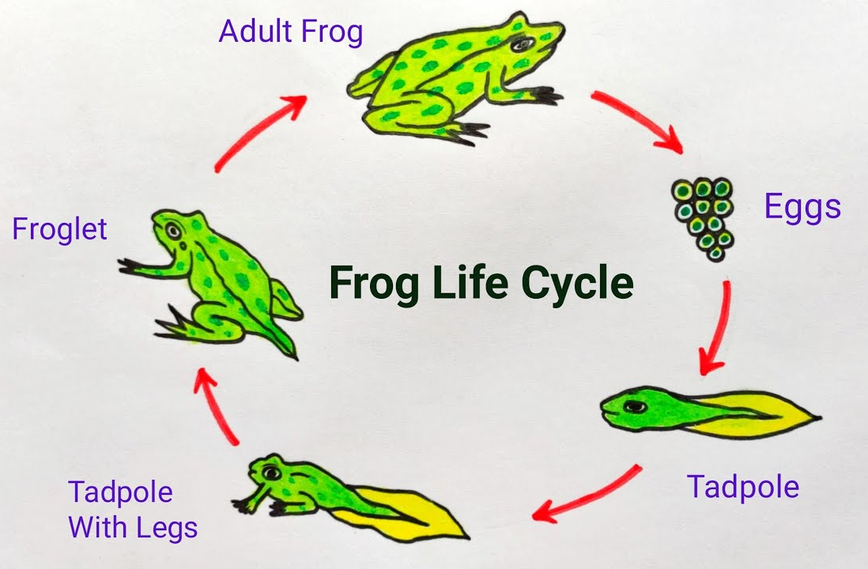
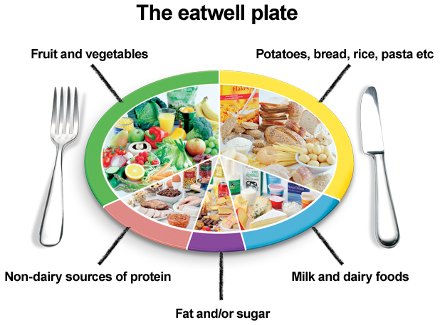
Elworth CE Primary School - Science
Year: Two | Topic: Animals including humans | Strand: Biology
What Should I Already Know
How to identify and name a variety of common animals including fish, amphibians, reptiles, birds and mammals How to identify and name a variety of common animals that are carnivores, herbivores and omnivores How to describe and compare the structure of a variety of common animals (fish, amphibians, reptiles, birds and mammals, including pets) How to identify, name, draw and label the basic parts of the human body and say which part of the body is associated with each sense.
Diagrams
Vocabulary
Adult | A fully grown animal or plant.
Young | Offspring that has not reached adulthood.
Offspring | The child of an animal.
Life cycle | The changes living things go through to become an adult.
Live young | Offspring that has not hatched from an egg.
Develop | To grow bigger and become stronger.
Nutrition | Food needed to live.
Hygiene | How we keep ourselves and the world around us clean so we can stay healthy and stop germs spreading.
To survive, all animals and humans must have:
What Will I Know By The End Of The Unit?
Notice that animals, including humans, have offspring which grow into adults How to find out about and describe the basic needs of animals, including humans, for survival (water, food and air) Describe the importance for humans of exercise, eating the right amounts of different types of food, and hygiene.
Enquiry
What are offspring? What is a life cycle? What do you need to grow and develop from young to adult? What are the basic needs of animals to survive? Why do we need to exercise? Why is good nutrition important? Why is hygiene important?

