Slide 1

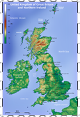
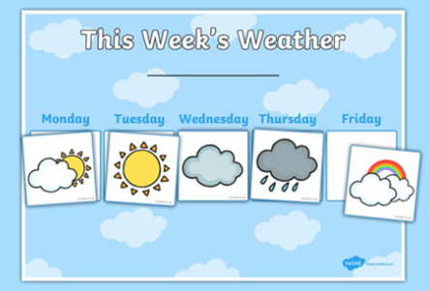
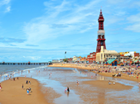
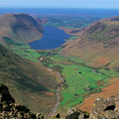
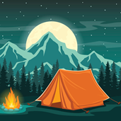



Elworth CE Primary School - Geography
Year: 2 | Topic: Let’s go travelling
What Should I Already Know
I Know the countries on a world map I know the seas and oceans I know the continents. I know the terms human and physical.
 | Physical/Human Features
Beach, cliff, coast, forest,hill mountain,sea, ocean,river, valley, field, meadow, beachriver, stream, lake | Houses, boats, landmarks within the localities, amenities , tents
Vocabulary
Countries | United Kingdom,England, Scotland, Wales, Northern Ireland
Continents | Africa, Antarctica, Asia, Australasia/Oceania, Europe, North America and South America.
Seas | North Sea,Irish Sea,English Channel, Atlantic Ocean
Seasons | Autumn,Spring,Summer,Winter, change
Weather | Cloud,cold,hot,fog,gale,rain,shoewers,snow,sun.warm,wind,thunder
Human | things that are made or built by humans
Physical | anything that is on the Earth naturally.
Aerial view | a bird's eye view.
What Will I Know By The End Of The Unit?
I can name and locate the four countries of the Uk I can use basic geographical vocabulary to refer to key physical features, including: beach, cliff, coast, forest, hill, mountain, sea, ocean, river, soil, valley, vegetation, season and weather. I can use world maps, atlases and globes to identify the United Kingdom, its countries and human and physical properties I can use aerial photos to recognise landmarks I can identify the human and physical features of given areas across the UK
Diagrams
Weather Chart UK map Blackpool Lake District
Geography Skills and Fieldwork
To visit a local park to observe physical and human features and investigate how people use and enjoy it. Observe and record seasonal changes in the school grounds and local area Look at large scale vertical aerial photographs.

