Slide 1
L.O To understand how different plants have different requirements for light, water, air and room for growth.

Slide 2
What do plants need to grow?

Slide 3
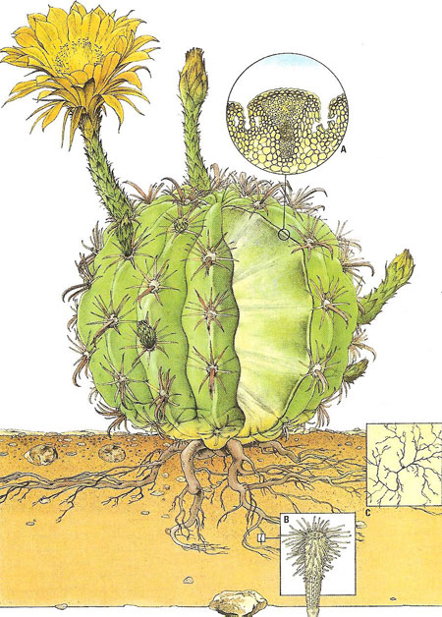
cactus

Slide 4
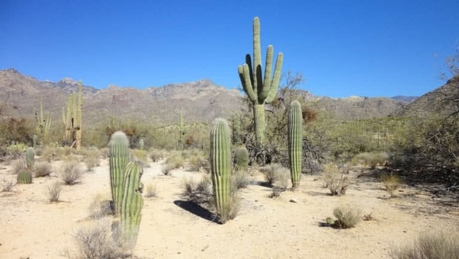
Where does it grow?
Hot places
Deserts

Slide 5
Water
It doesn’t need a lot of water to survive. The roots are very long because they search for the little water around. It stores water in its barrel-like stem.

Slide 6
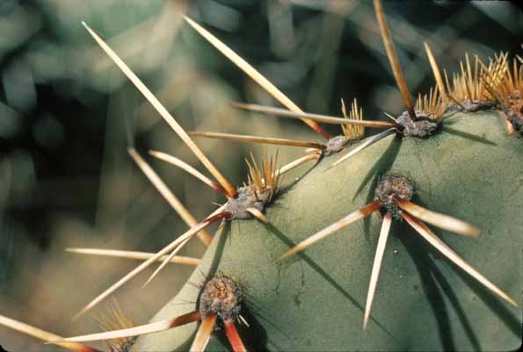
Air
The spines on a cactus help to protect it from humans and animals.
It has spikes on its body to control the amount of air it absorbs.

Slide 7
Light
Cacti love light which is why they live in hot, sunny places.

Slide 8
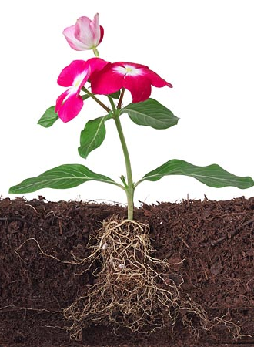
Flowering plant

Slide 9
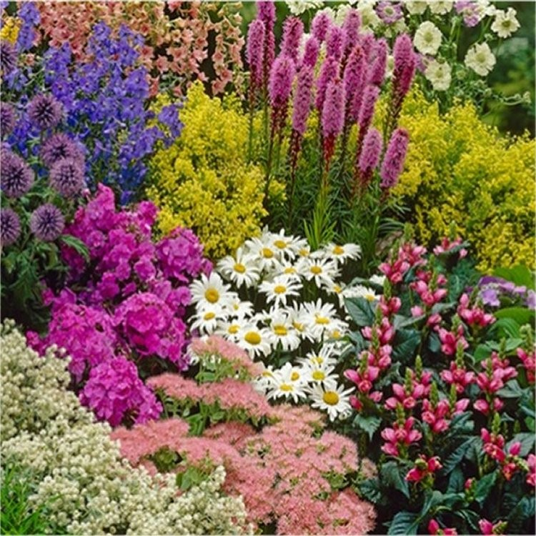
Where does it grow?
Anywhere with the right conditions.
(sun, water, soil)

Slide 10
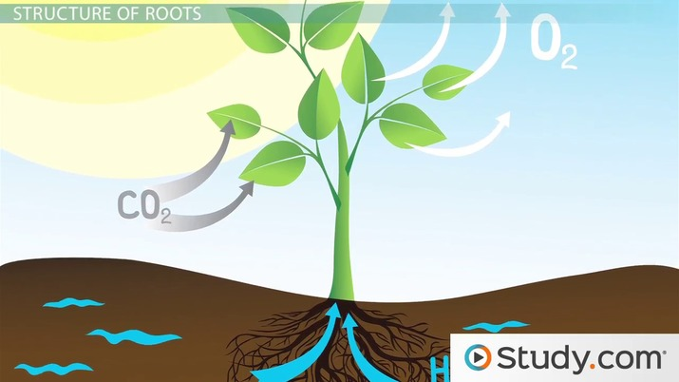
Water
It absorbs water through the roots and transports it up the stem to the leaves and the petals.

Slide 11
Air
A garden flower collects air through the leaves.

Slide 12
Light
Flowers need light to survive. It searches for light if it’s hard to find. It absorbs light through the leaves to make food.

