Slide 2



Diving into Mastery Guidance for Educators
Each activity sheet is split into three sections, diving, deeper and deepest, which are represented by the following icons:
These carefully designed activities take your children through a learning journey, initially ensuring they are fluent with the key concept being taught; then applying this to a range of reasoning and problem-solving activities.
These sheets might not necessarily be used in a linear way. Some children might begin at the ‘Deeper’ section and in fact, others may ‘dive straight in’ to the ‘Deepest’ section if they have already mastered the skill and are applying this to show their depth of understanding.
Diving
Deeper
Deepest

Slide 3
Aim
Solve problems involving increasingly harder fractions to calculate quantities, and fractions to divide quantities, including non-unit fractions where the answer is a whole number.

Slide 4

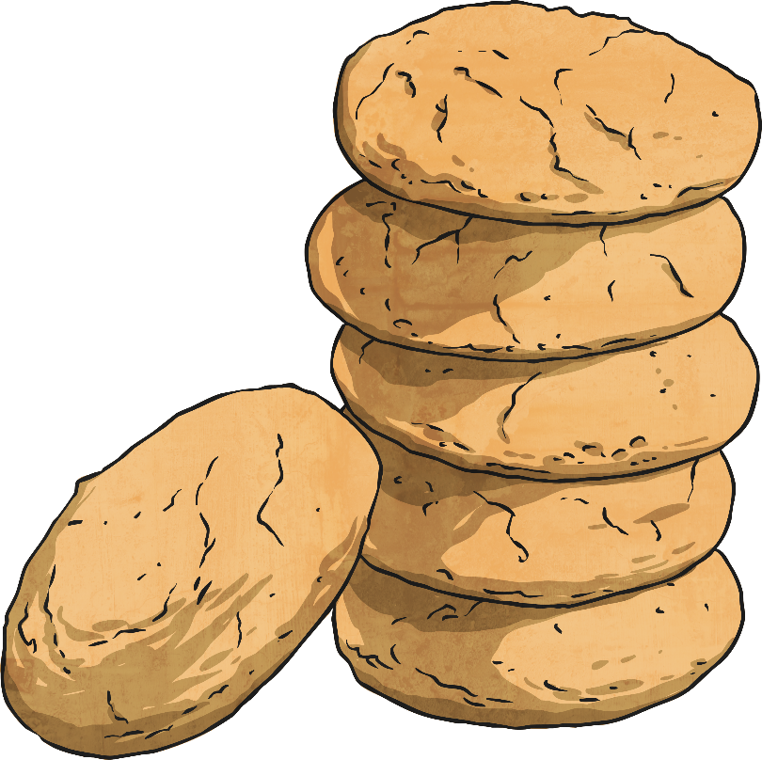
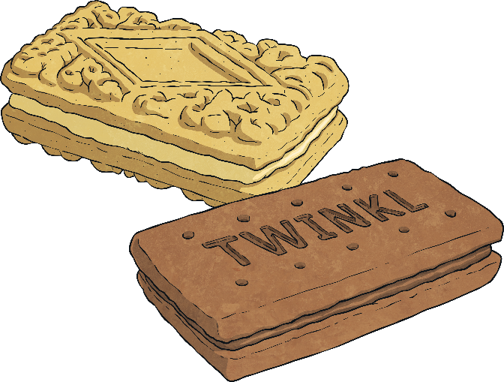
Calculate Fractions of a Quantity
Diving
Chen has 20 biscuits.
Use the counters above to represent Chen’s biscuits and find:
1
2
of 20 =
10
1
4
of 20 =
5
1
5
of 20 =
4
1
10
of 20 =
2

Slide 5
Calculate Fractions of a Quantity
Diving
Use the answers from the previous question to help find:
2
2
of 20 =
20
3
4
of 20 =
15
4
5
of 20 =
16
6
10
of 20 =
12
1
2
of 20 =
10
1
4
of 20 =
5
1
5
of 20 =
4
1
10
of 20 =
2

Slide 6

Calculate Fractions of a Quantity
Diving
Draw this bar model to find and represent:
36
36
9 | 9 | 9 | 9
36
9 | 9 | 9 | 9
36
9 | 9 | 9 | 9
36
9 | 9 | 9 | 9
1
4
of 36 =
36 ÷ 4 =
9
2
4
of 36 =
18
3
4
of 36 =
27
4
4
of 36 =
36

Slide 7
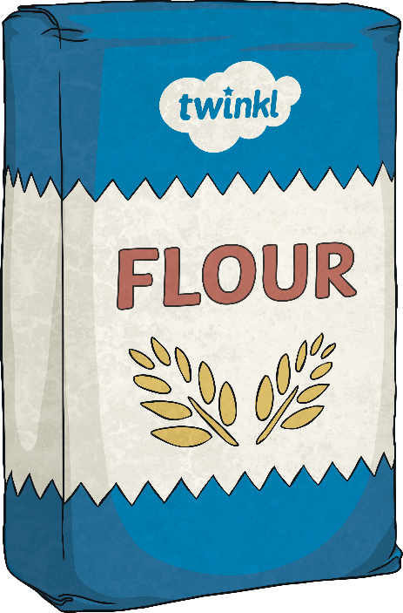

Calculate Fractions of a Quantity
Diving
Draw a bar model to help solve this problem.
3
8
Mary uses of a 400g bag of flour to make some cakes.
a) How many grams of flour
did Mary use?
150g
b) How many grams of flour
were left in the bag?
250g
400
50 | 50 | 50 | 50 | 50 | 50 | 50 | 50

Slide 8

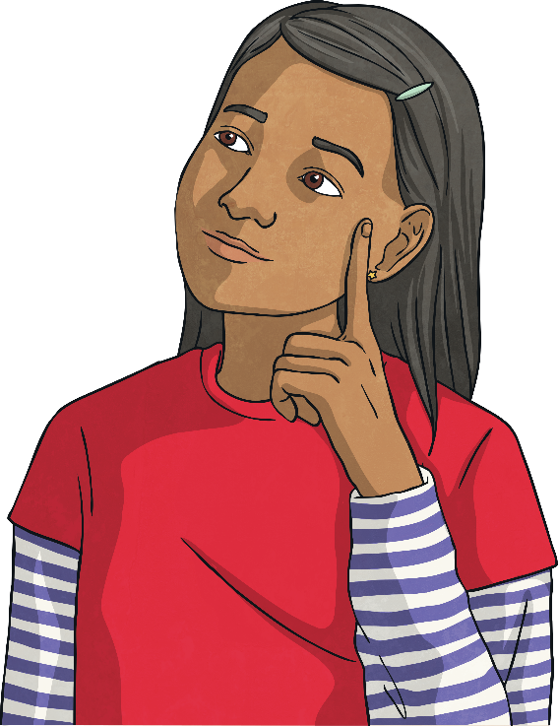
Calculate Fractions of a Quantity
Deeper
Which is the odd one out and why?
a)
3
5
of 30 =
18
The odd one out is c) because it equals 8. Both a) and b) equal 18.
b)
2
9
of 81 =
18
c)
2
6
of 24 =
8

Slide 9
Calculate Fractions of a Quantity
Deeper
5
10
Explain the mistake.
Draw a bar model to help.
of 80 = 8
This is incorrect. They have divided the quantity (80) by the denominator (10). They have worked out the value of one tenth, which is 8, but then
have forgotten to carry out the second calculation to find the value of five-tenths. They should have then multiplied 8 by the numerator (5) to make 40.
80
8 | 8 | 8 | 8 | 8 | 8 | 8 | 8 | 8 | 8
5
10
of 80 = 40

Slide 10

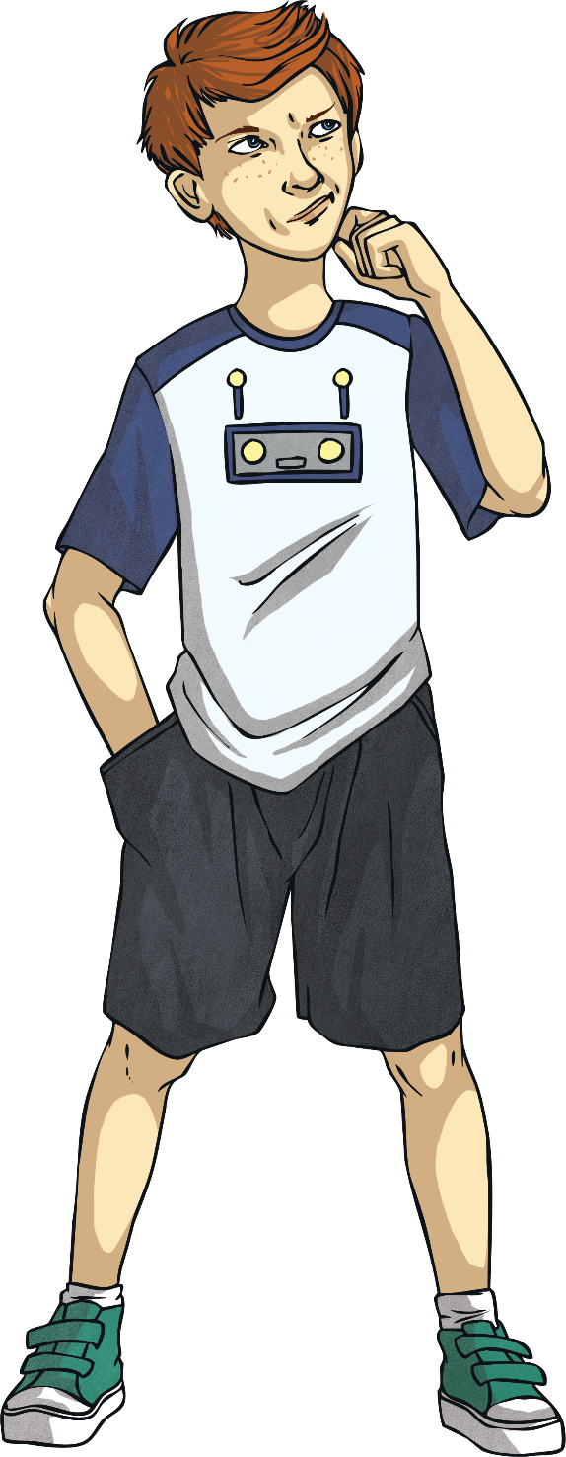
Calculate Fractions of a Quantity
Deeper
6
6
3
4
of 30 is less than of 44.
True or false? Convince me.
30
5 | 5 | 5 | 5 | 5 | 5
66
True, is the same as a whole.
of 30 = 30 and of 44 = 33 making of 30 is less than of 44.
66
3
4
66
3
4
44
11 | 11 | 11 | 11

Slide 11
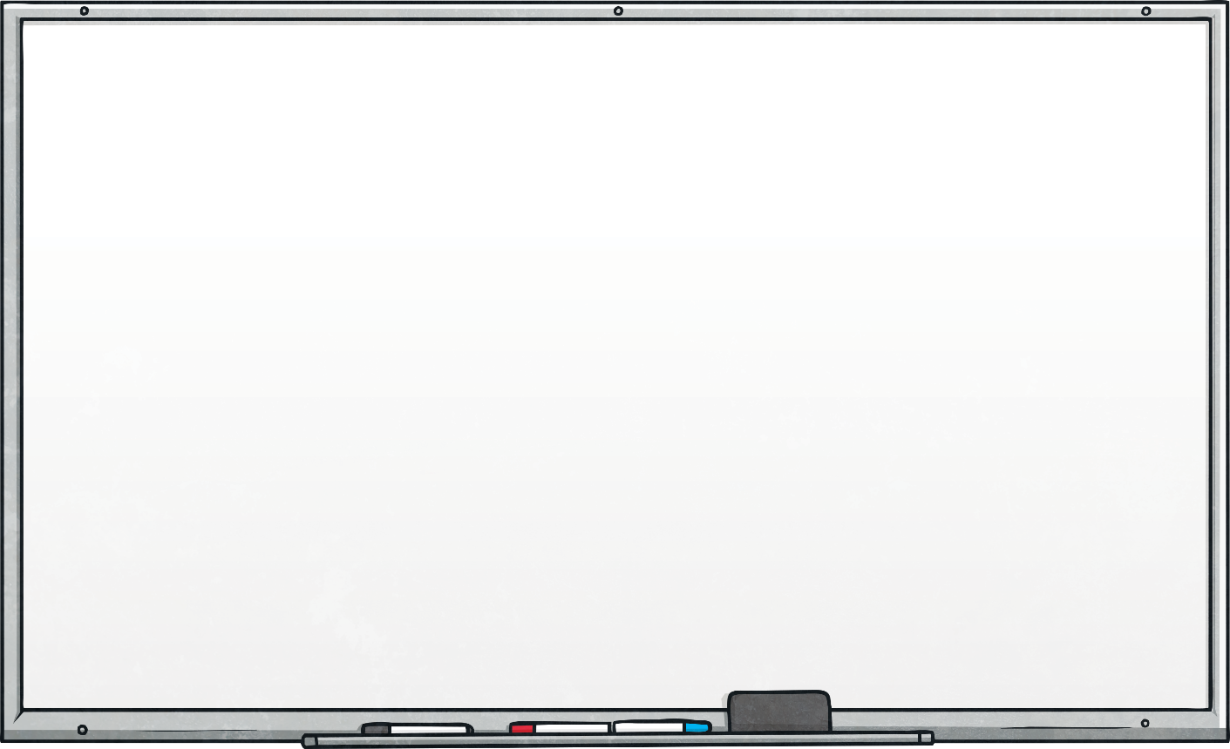
Calculate Fractions of a Quantity
Deeper
Complete the calculations.
2
of 33 = 22
3
5
9
36
of = 20

Slide 12
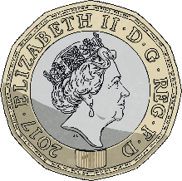
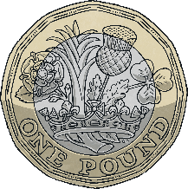
Calculate Fractions of a Quantity
Deepest
Taylor has a bag of 15 coins. He throws some (but not all of them) into the air. A quarter of them land on tails while the rest land on heads.
Taylor turns over two of the coins and now half of them are tails.
How many coins did Taylor throw up into the air at the beginning?
8

Slide 13
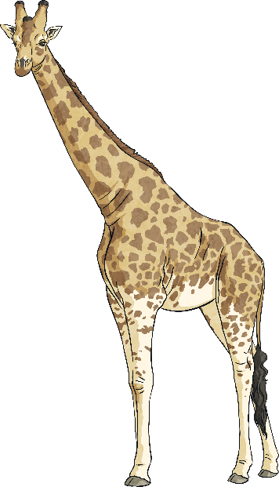
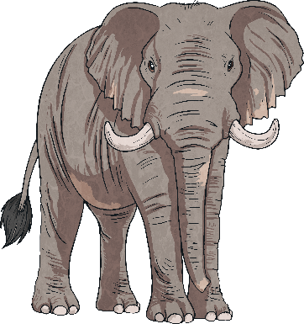
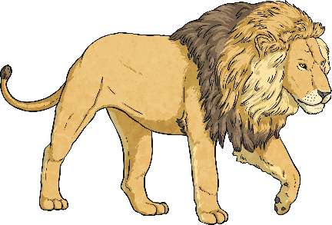
Calculate Fractions of a Quantity
Deepest
Solve this problem.
Flavia saw 64 animals whilst on safari in Africa.
Some of the animals she saw were elephants, of the animals she saw were lions and of the animals she saw were giraffes.
What fraction and quantity
of the 64 animals she saw were elephants?
1
4
64
8 | 8 | 8 | 8 | 8 | 8 | 8 | 8
64
8 | 8 | 8 | 8 | 8 | 8 | 8 | 8
64
8 | 8 | 8 | 8 | 8 | 8 | 8 | 8
5
8
64
8 | 8 | 8 | 8 | 8 | 8 | 8 | 8
1
4
2
8
lions = = = 16
5
8
giraffes = = 40
1
8
1
8
= 8 of the animals are elephants.
elephants = = 8

Slide 14
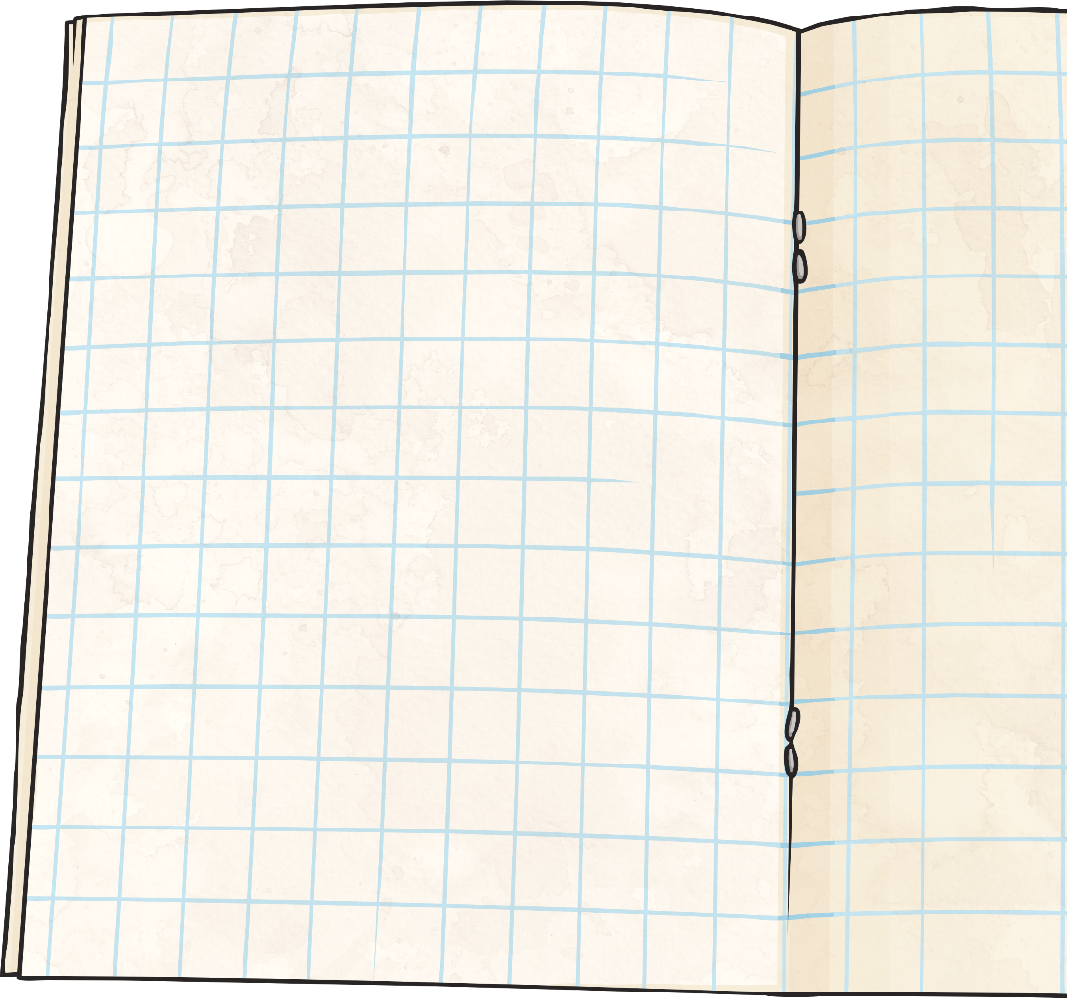
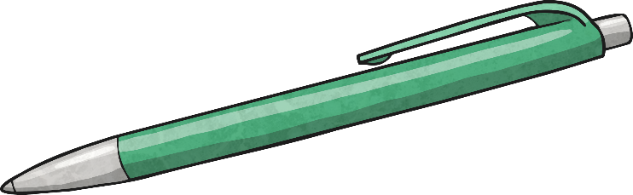
Calculate Fractions of a Quantity
Deepest
Use all the digit cards once to complete this calculation.
3
15
1
3
4
5
of 20 =
4

Slide 15
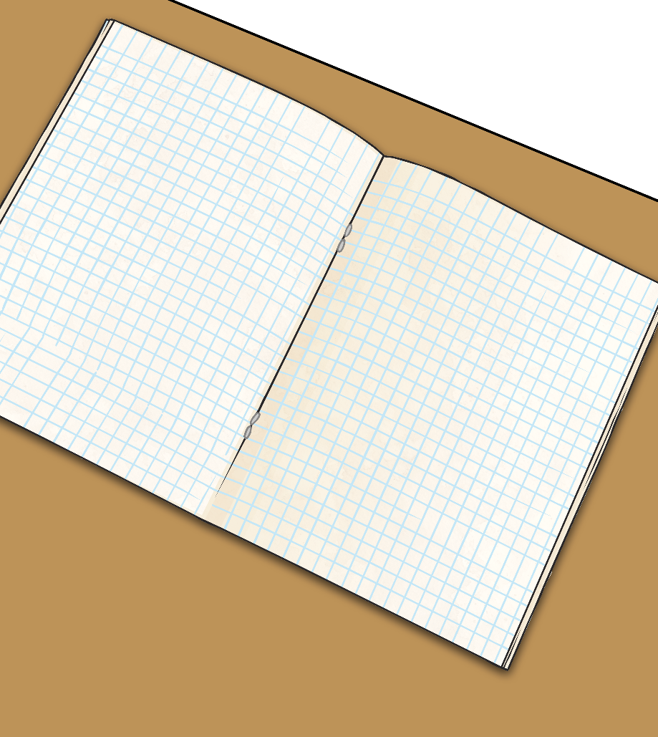
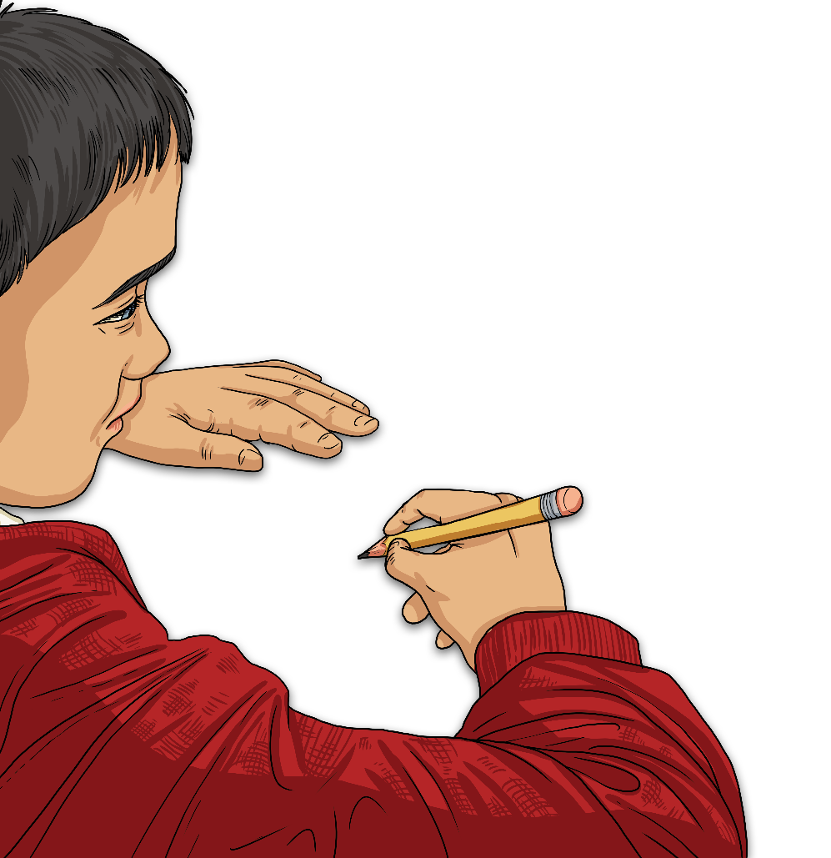
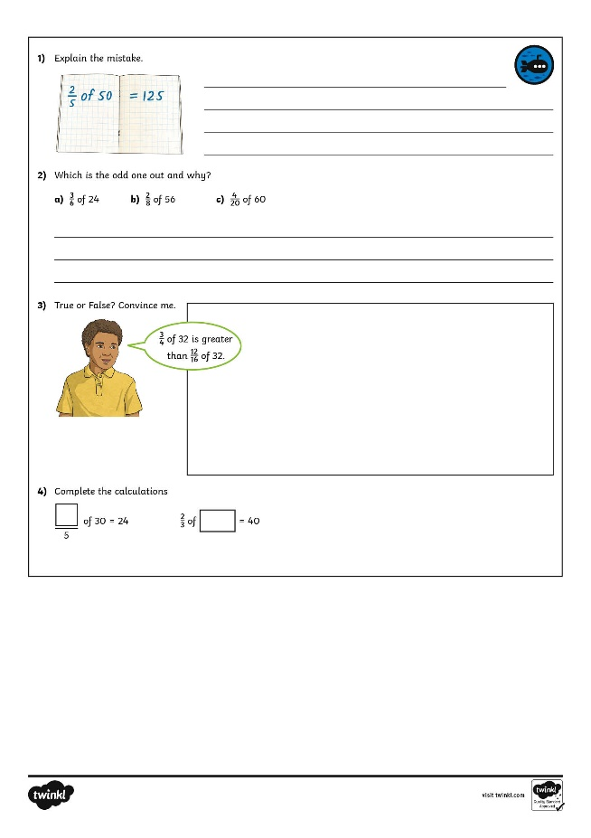
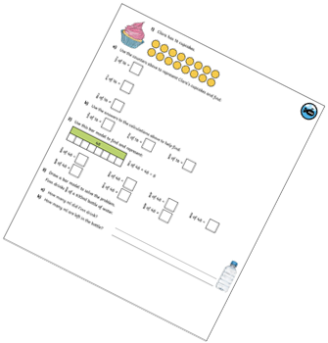
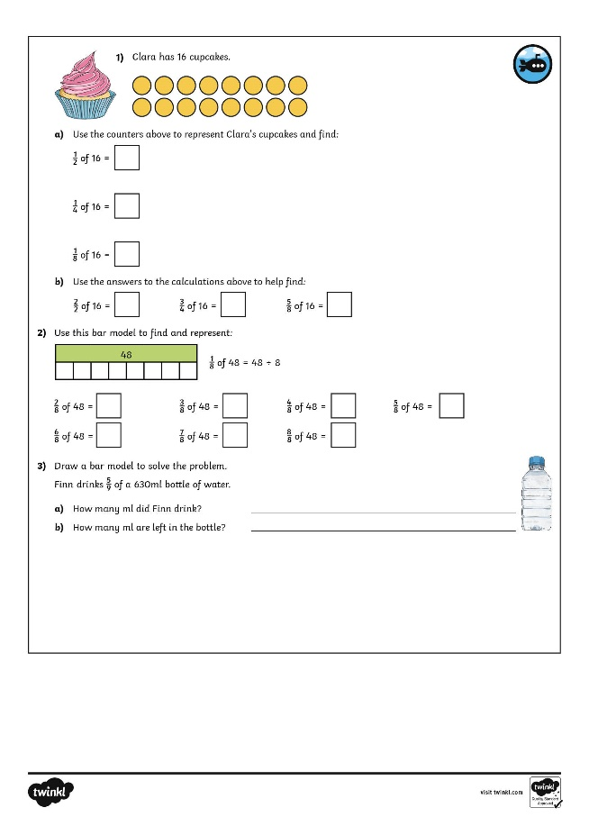
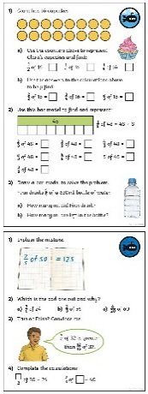
Calculate Fractions of a Quantity
Dive in by completing your own activity!

Slide 16
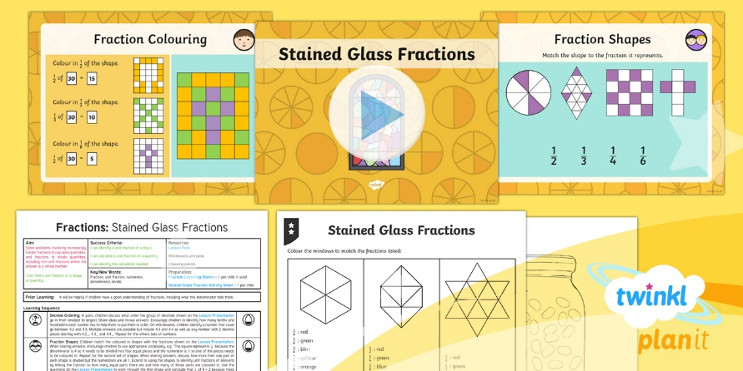
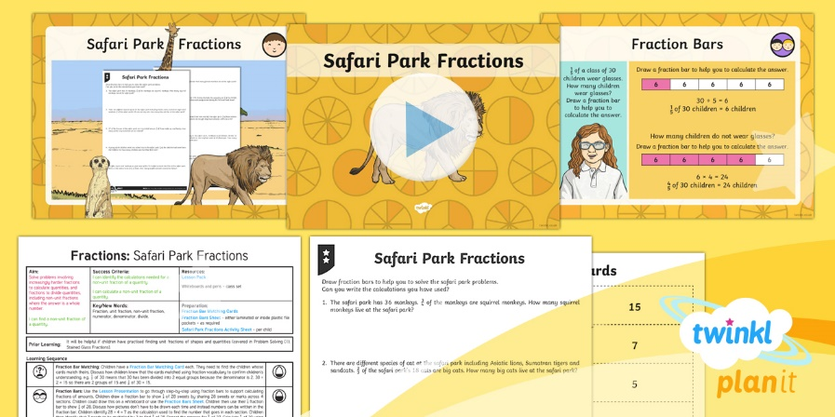

Need Planning to Complement this Resource?
National Curriculum Aim
Solve problems involving increasingly harder fractions to calculate quantities, and fractions to divide quantities, including non-unit fractions where the answer is a whole number.
For more planning resources to support this aim, click here.
Twinkl PlanIt is our award-winning scheme of work
with over 4000 resources.

