Slide 1
Buddhist Temple

Slide 2

Buddhist worship
We are going to look at worship within Buddhism.
You need to find out:
Where do Buddhists worship?
Who worships?
When do they worship?
Why do they worship?
What do they do?
Where?
Who?
When?
What?
Why?

Slide 3

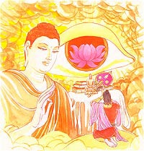
The Buddha’s teachings
Buddhism is based on the teachings of the Buddha, a name which means ‘Enlightened One.’
The Buddha decided to teach others the path to enlightenment and gave his first sermon in the deer park at Sarnath. His teachings are called the Dhamma.
The Buddha believed in the Middle way. This means finding a thoughtful and balanced way to live and giving up greed and selfishness and not causing suffering to ourselves or others.

Slide 4
What objects are used in Buddhist worship?
Buddhist worship is called puja.
Today we are going to look at some of the objects used in Buddhist worship in detail…

Slide 5

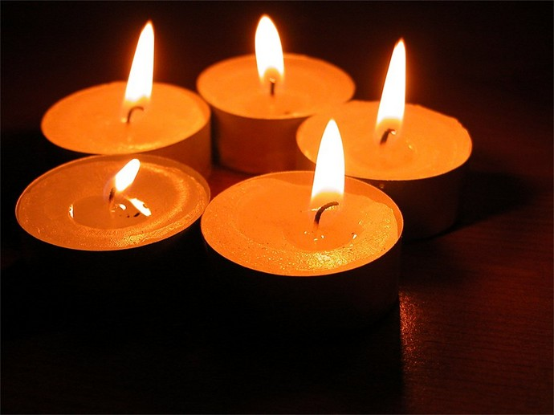
Flowers
Flowers represent the changing nature of the world.
Symbolises that nothing lasts for ever. Fresh and beautiful flowers will soon become withered, scentless and discoloured.
This reminds us of the Buddha's teaching that nothing is everlasting. We should value what we have now and live in the present.
Make the shrine a beautiful place to be.
Candles
Candles show that light represents the brightness that Buddhism brings; Enlightenment
You need to take care of candles, like you should take care of your life.
Light drives away darkness.
Light symbolises wisdom.

Slide 6
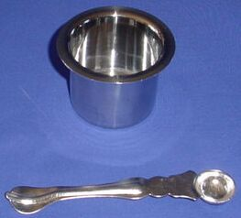
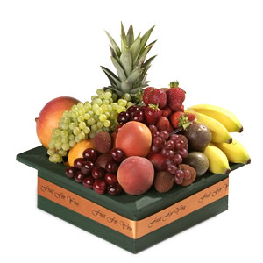
Offering of Water
• Water symbolises purity, clarity and calmness.
This reminds us to practise the Buddha's teachings, so as to cleanse our minds, which are full of desire, ill-will and ignorance, and to attain the state of purity.
Offering of Fruit
Fruit symbolizes the ultimate fruit of Enlightenment which is our goal.
Fruit also reminds us that all actions will have their effect.

Slide 7
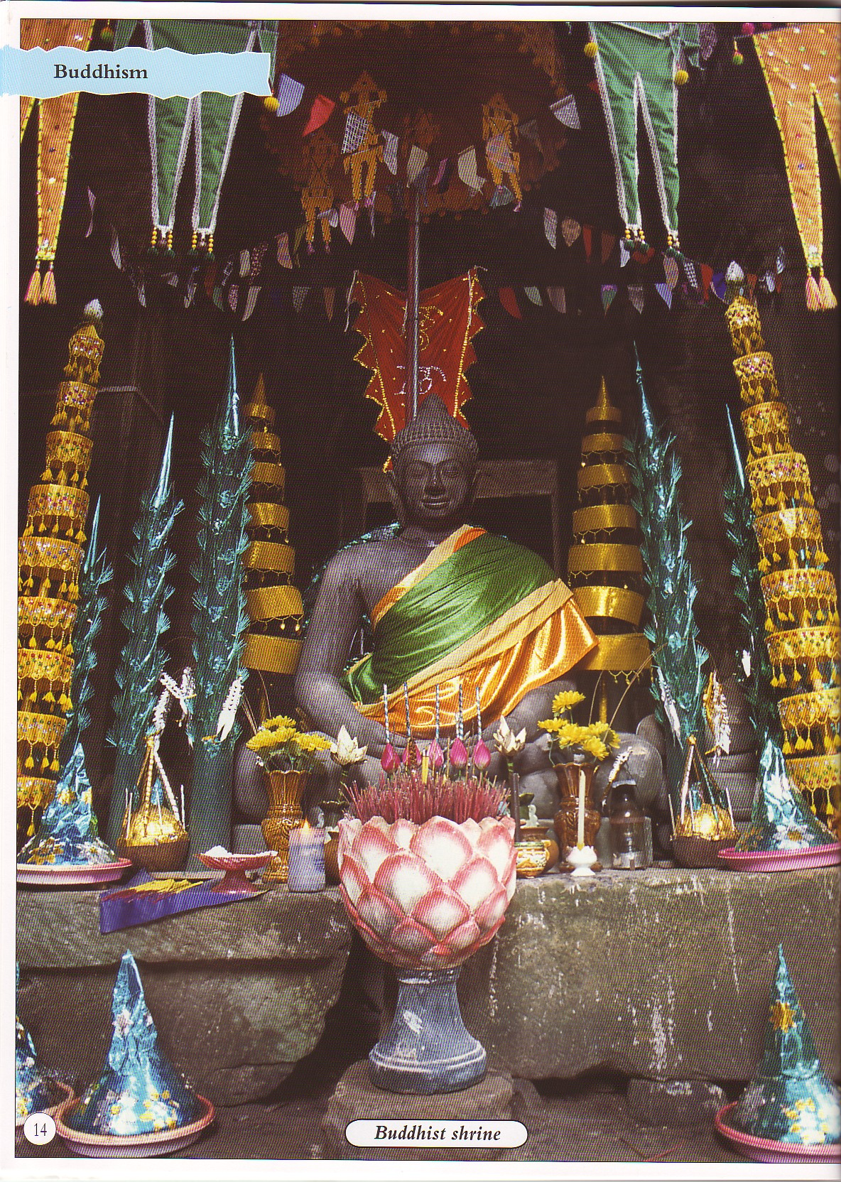
Use your imagination!
Close your eyes. Look at the image of the shrine again and imagine you were there. Think of the sounds, smells and atmosphere at the shrine. How do you feel?
Write down your ideas.
http://www.buddhanet.net/audio-chant.htm
Notes:
You could play the music and burn incense.

Slide 8
A young Buddhist living in London
Rachel is a 15-year-old Buddhist who lives in London. This is what she says about worship.
‘We have a shrine room at home. It is quiet and peaceful room and I love to go into it. When I go in I bow down to the Buddha. We have thankas on the wall and photographs of the Dalai Lama. There are lots of Statues and images of the Buddha. We put flowers in the room and there are candles and incense burning. It is a special place and when I go in, I feel calm and different. I sit on one cushion and meditate and worship. I go there at least once a day. It helps me face the world’
Q. How does the shrine make her feel?

