Slide 1
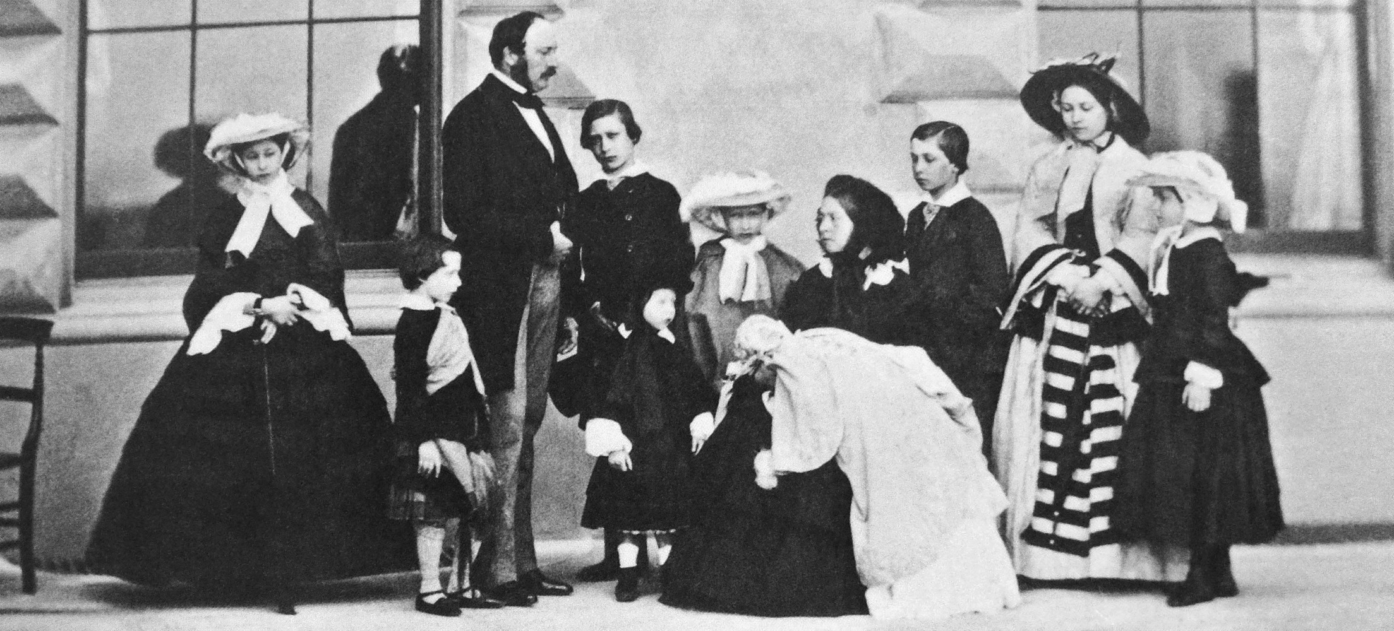
WALT: know why there were rich and poor people in Victorian society
WILF: you can explain what caused people to be rich or poor
15.01.14
Victorian quiz

Slide 2
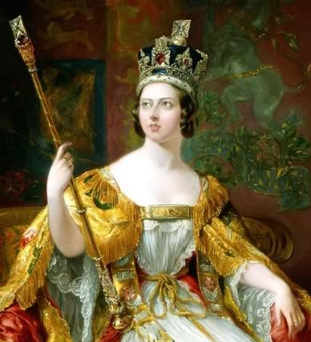
When did Victoria become queen?
1833
1835
1837

Slide 3
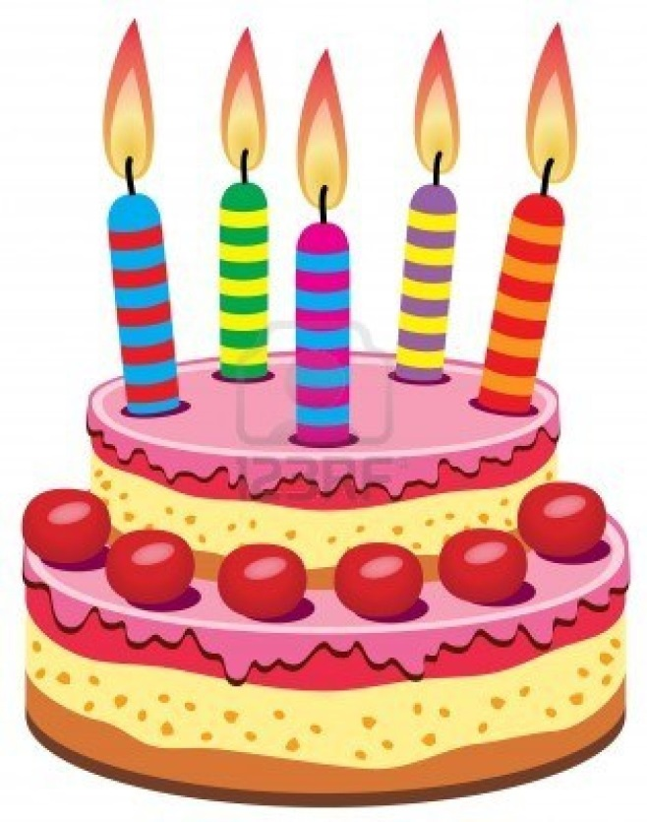
How old was she when she became queen?
18
28
38

Slide 4
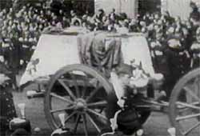
When did she die?
1901
1903
1905

Slide 5
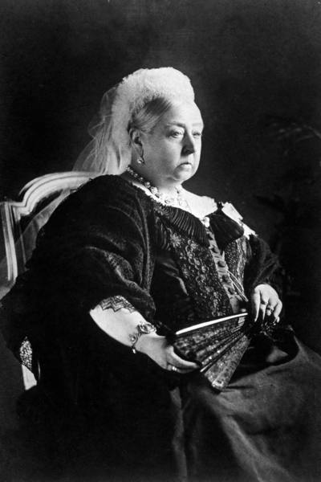
She is still the UK’s longest serving monarch.
How long did she reign for?
61 years 210 days
62 years 212 days
63 years 216 days

Slide 6
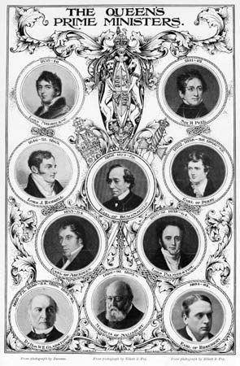
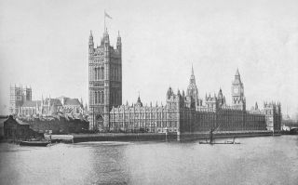
How many UK Prime Ministers were in power during her reign?
8
9
10

Slide 7
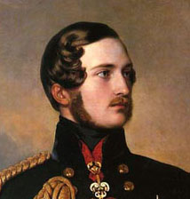
What was her husband’s name?
Alfred
Albert
Alan

Slide 8
How many children did they have?
7
8
9

Slide 9
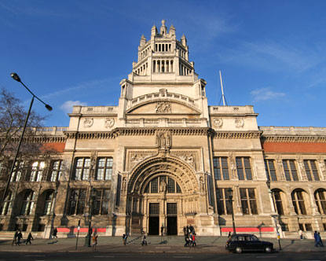
What is this London museum called?
Victoria and Albert
Queen Victoria
Victorian

Slide 10
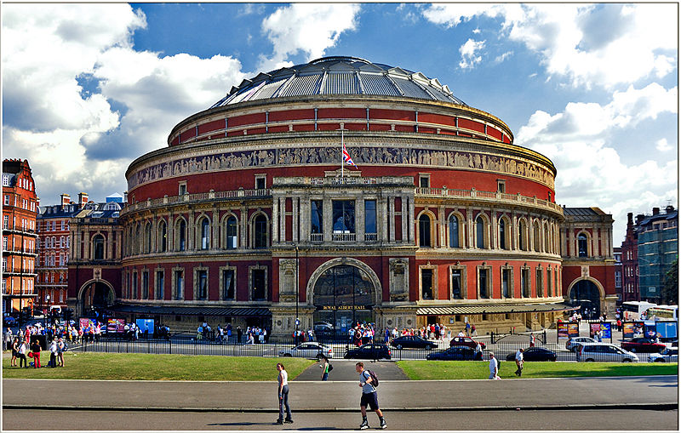
What is this London building called?
Royal Victoria Hall
Royal Albert Hall
Victoria and Albert Hall

Slide 11
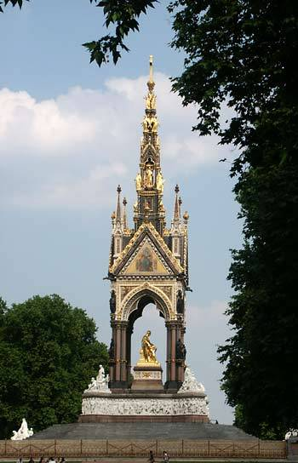
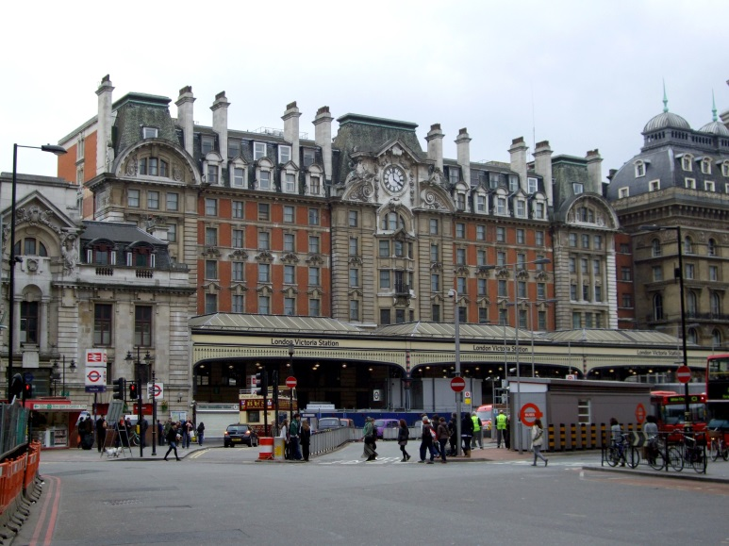
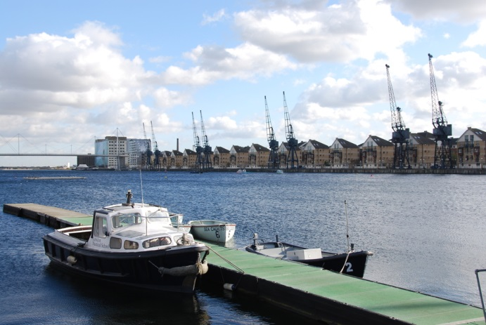
Which of these stands opposite it?
Victoria station
Albert memorial
Royal Victoria dock

Slide 12
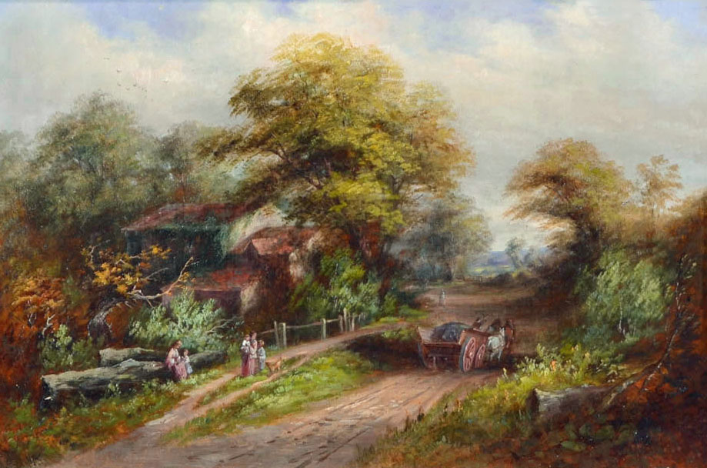
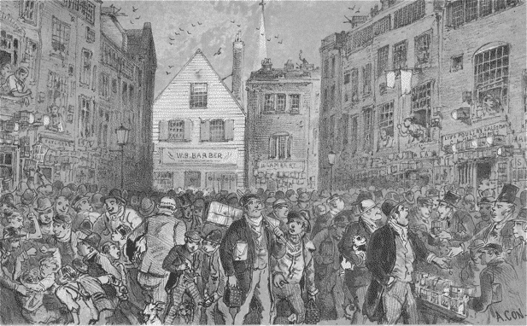
Notes:
Period of enormous change in the UK – move from rural to urban life (WHY?) – increase in population – more resources needed

Slide 13
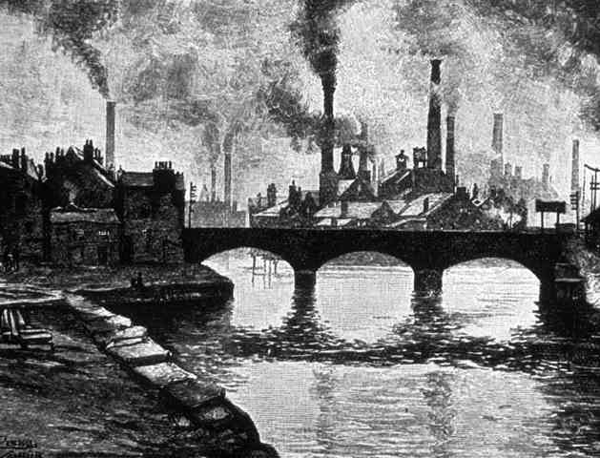
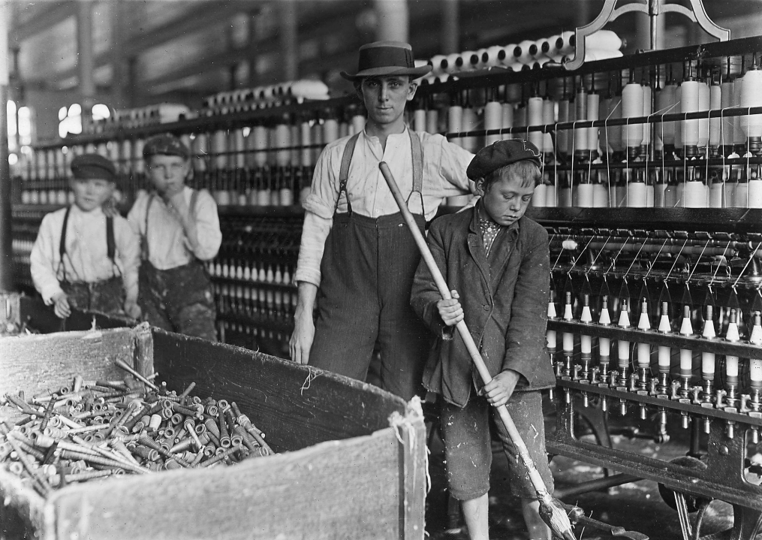
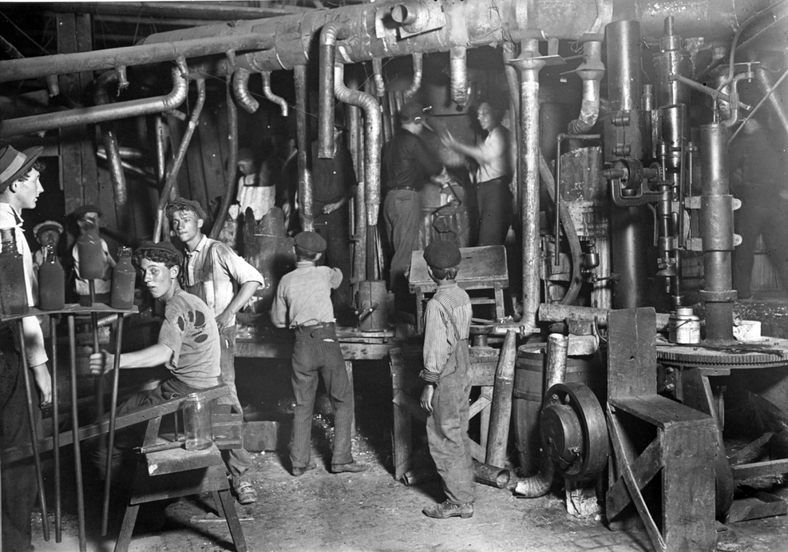
Notes:
Industrial revolution – BBC clip

