Slide 1



Slide 2
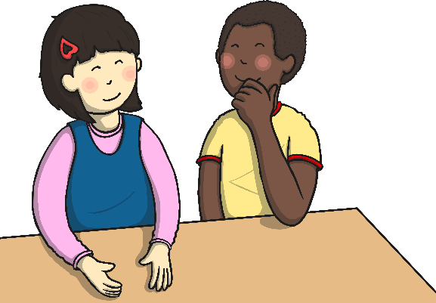
Objectives: English
Add prefixes and suffixes:
using the spelling rule for adding –s or –es as the plural marker for nouns and the third person singular marker for verbs.
using –ing, –ed, –er and –est where no change is needed in the spelling of root words.
Develop their understanding of the concepts by:
leaving spaces between words.
joining words and joining clauses using ‘and’.
beginning to punctuate sentences using a capital letter and a full stop, question mark or exclamation mark.
using a capital letter for names of people, places, the days of the week, and the personal pronoun ‘I’.
Spell: the days of the week.
Name: the letters of the alphabet
Write sentences by:
saying out loud what they are going to write about.
composing a sentence orally before writing it.
re-reading what they have written to check that it makes sense.
discussing what they have written with the teacher or other pupils.
reading aloud their writing clearly enough to be heard by their peers and the teacher.

Slide 3
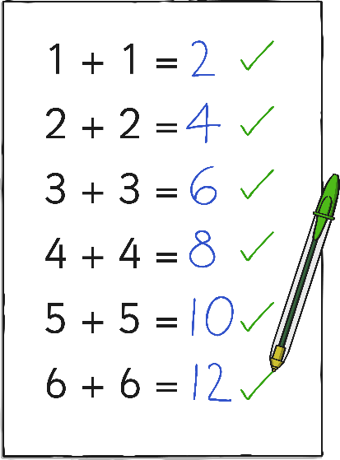
Objectives: Maths
Read, write and interpret mathematical statements involving addition (+), subtraction (–) and equals (=) signs.
Represent and use number bonds and related subtraction facts within 20.
Add and subtract one-digit and two-digit numbers to 20, including zero.
Solve one-step problems that involve addition and subtraction, using concrete objects and pictorial representations, and missing number problems such as
7 = – 9.

Slide 4

Objectives: Science
Identify and name a variety of common wild and garden plants, including deciduous and evergreen trees.
Distinguish between an object and the material from which it is made.
Identify and name a variety of everyday materials, including wood, plastic, glass, metal, water, and rock.
Describe the simple physical properties of a variety of everyday materials.

Slide 5

The Alphabet – Letter Names
English
Say the alphabet in order with a partner.
Now say each letter of the alphabet below.
Remember -
they’re not in
order this time!
k t o w c j x b
f g h i w p v r
l s u n a z m q

Slide 6
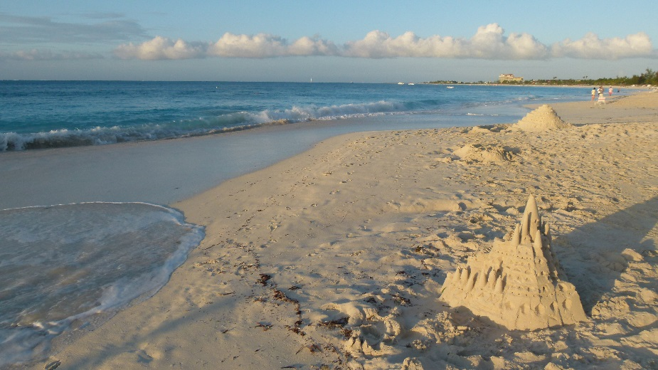





Describe the Settings…
English
Write a sentence to describe what it would be like here.
Use all of your senses:
hear
see
smell
taste
touch
Photo courtesy of Montreal Photo Chick (@flickr.com) - granted under creative commons licence - attribution

Slide 7
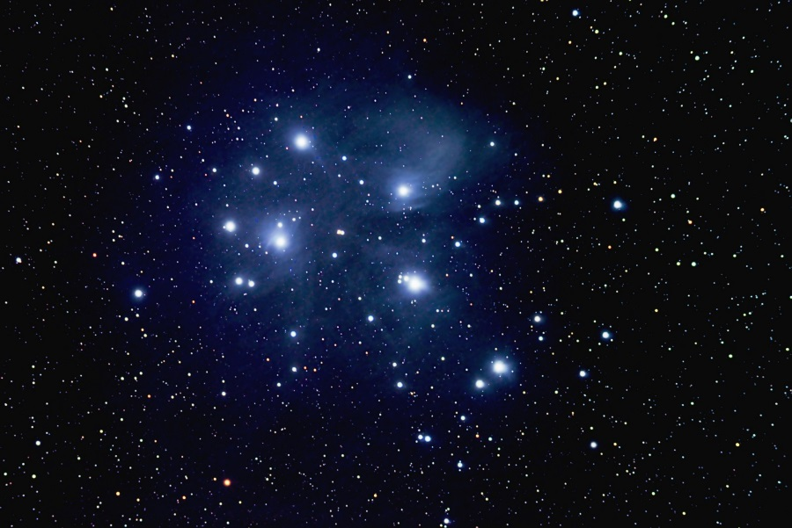
Describe the Settings…
English
Write a sentence to describe what it would be like here.
Use all of your senses:
hear
see
smell
taste
touch
Photo courtesy of arun.venkat (@flickr.com) - granted under creative commons licence - attribution

Slide 8
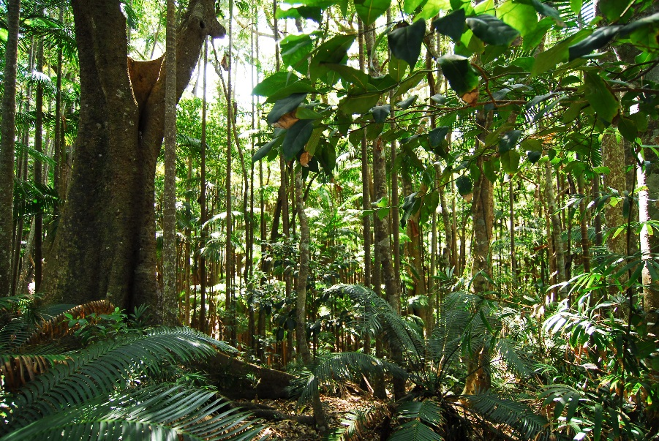
Describe the Settings…
English
Write a longer sentence about this setting using the word and.
Use all of your senses:
hear
see
smell
taste
touch
Photo courtesy of WanderingSolesPhotography (@flickr.com) - granted under creative commons licence - attribution

Slide 9
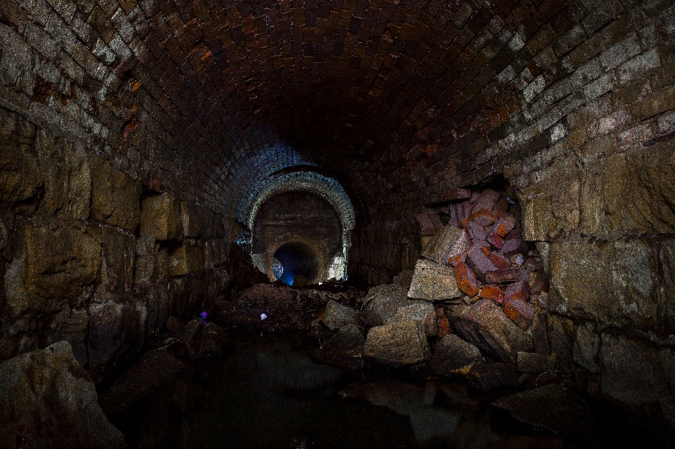
Describe the Settings…
English
Write a longer sentence about this setting using the word and.
Use all of your senses:
hear
see
smell
taste
touch
Photo courtesy of darkday. (@flickr.com) - granted under creative commons licence - attribution

Slide 10
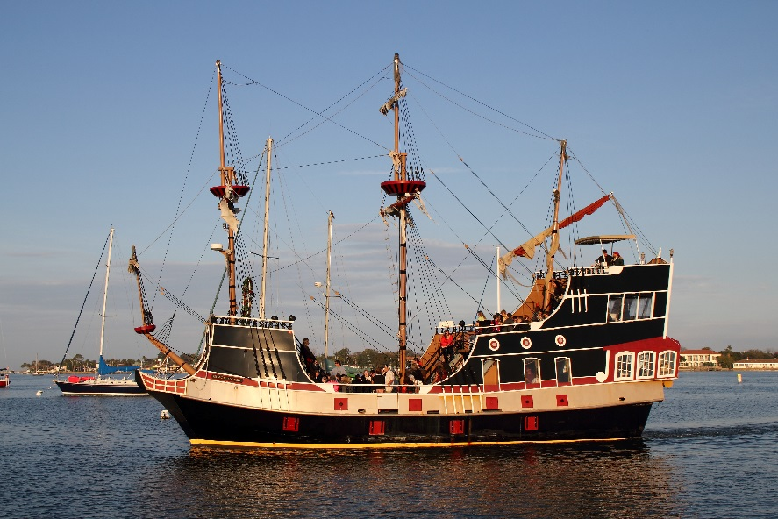
Explore the Settings…
English
Write a question about this setting. Give it to your partner to answer.
Who…?
Where…?
What…?
When…?
Why…?
How…?
Photo courtesy of Mr.TinDC (@flickr.com) - granted under creative commons licence - attribution

Slide 11

Explore the Settings…
English
Write a question about this setting. Give it to your partner to answer.
Who…?
Where…?
What…?
When…?
Why…?
How…?
Photo courtesy of houman_thebrave (@flickr.com) - granted under creative commons licence - attribution

Slide 12
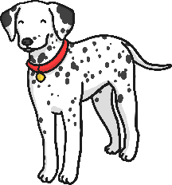
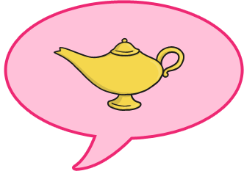

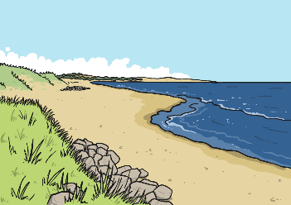
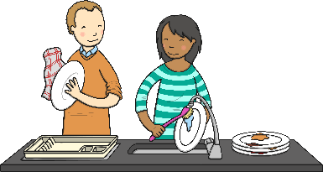
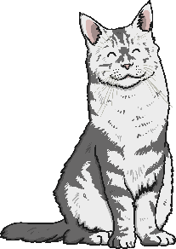
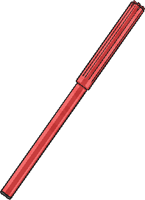

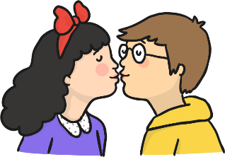

Endings - More Than 1
English
Add ‘s’ or ‘es’ to spell the plurals of these words.
1 dog
1 dish
1 wish
1 frog
1 beach
2 dog__
2 dish__
2 wish__
2 frog__
2 beach__
1 kiss
1 cat
1 pen
1 church
1 blanket
2 kiss__
2 cat__
2 pen__
2 church__
2 blanket__

Slide 13
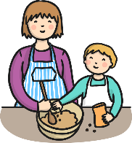
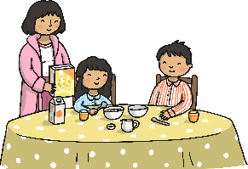
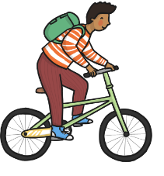


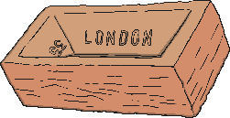


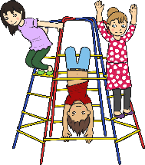
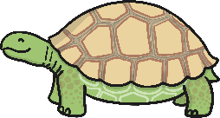
Endings: ‘-ing’, ‘-er’ and ‘-est’
English
Add –ing, -er, or –est to the end of these words to make new words.
Remember – you have to make a real word!
help__
eat__
quick__
hard__
read__
kick__
Can you put them into a sentence?
skateboard__
slow__
play__

Slide 14
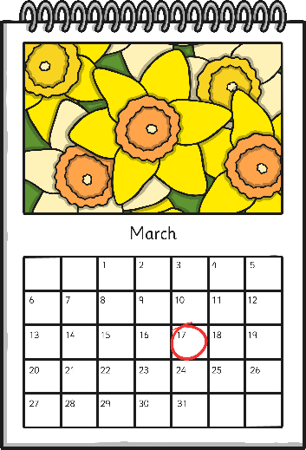
Spelling the Days of the Week
English
Say the days of the week out loud with a partner.
Now fill in the missing letters to spell each day in the right order.
M _ _ _ _ _
_ _ _ _ _ _ y
_ e _ _ _ _ _ _ _
T h _ _ _ _ _ _
_ _ i _ _ _
S _ t _ _ _ _ _
S _ _ _ _ _

Slide 15
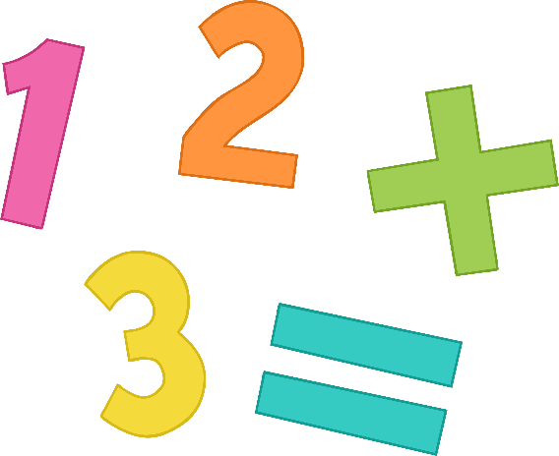
Number Bonds to 10
Maths
With your partner:
Say your number bonds to 10 out loud. Start with 0+….
Write each number sentence on your whiteboard.
0 + 10 = 10
1 + …… = 10

Slide 16
Number Bonds to 10
Maths
Fill in the missing numbers…
5 + _ = 10
10 + _ = 10
2 + 8 = _
_ + 9 = 10
3 + _ = 10
4 + 6 = _
Use cubes, counters or pictures to help you work these out.

Slide 17
Number Bonds to 20
Maths
With a partner:
Say your number bonds to 20 out loud. Start with 0 + ….
Write each number sentence on your whiteboard.
0 + 20 = 20
1 + ……… = 20

Slide 18
Number Bonds to 20
Maths
Fill in the missing numbers…
18 + 2 = _
10 + _ = 20
19 + _ = 20
12 + _ = 20
14 + 6 = _
_ + 5 = 20
_ + 3 = 20
13 + 7 = _
_ + 4 = 20
_ + 1 = 20
Use cubes, counters or pictures to help you work these out.

Slide 19
Subtraction
Maths
Find the answer to these take aways…
3 – 1 =
10 – 5 =
11 – 9 =
4 – 2 =
20 – 11 =
18 – 6 =
7 – 3 =
20 – 10 =
21 – 10 =
8 – 4 =
10 – 8 =
25 – 5 =
9 – 5 =
10 – 4 =
30 – 10 =
Use cubes, counters or pictures to help you work these out.

Slide 20

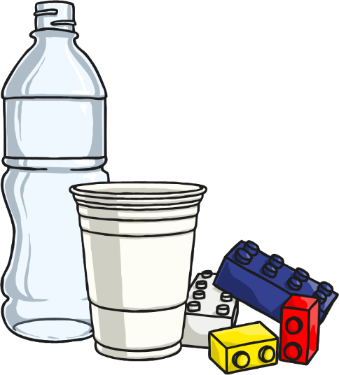

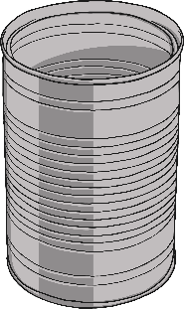
Describe the Materials…
Science
Wood feels…
Plastic feels…
Paper feels…
Metal feels…
What do these materials feel like? Write some describing words for each material.
Think of 3 things that are made of each material. Look around the classroom for some help.

Slide 21
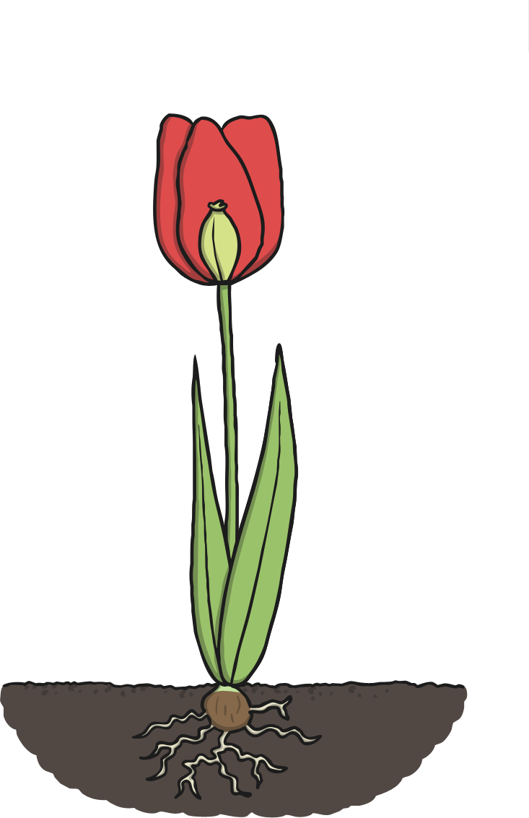
Parts of a Plant
Science
Copy this picture and label the parts of the plant.
seed
flower
root
leaves
stem

Slide 22


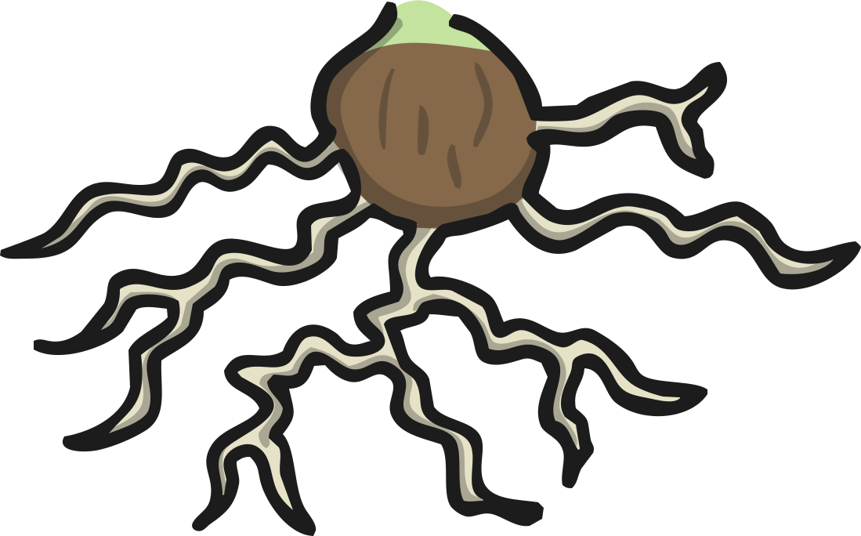

What Do the Parts Do?
Science
Pick a word to finish these sentences. Write them on a whiteboard.
The leaves catch ……….. …….. to make energy.
The seed grows into a new …………………..
The stem ………………………. the plant up.
The roots take in water and nutrients from the …………………….
The flower ……………………. insects and birds.
holds
plant
sunlight
attracts
soil
leaves
seed
stem
roots
flower

Slide 23




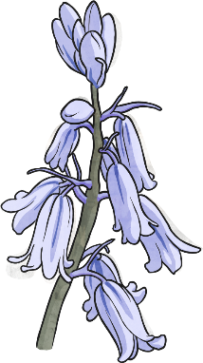
Name the Plants
Science
a
b
c
d
e
daisy ____
bluebell ____
buttercup ____
primrose ____
dandelion ____
Copy the name of the flower and write the letter of the matching picture next to it.

Slide 24



Name the Trees
a
b
c
d
e
holly ____
oak ____
yew ____
horse chestnut ____
beech ____
Copy the name of the tree and write the letter of the matching picture next to it.

