Slide 2
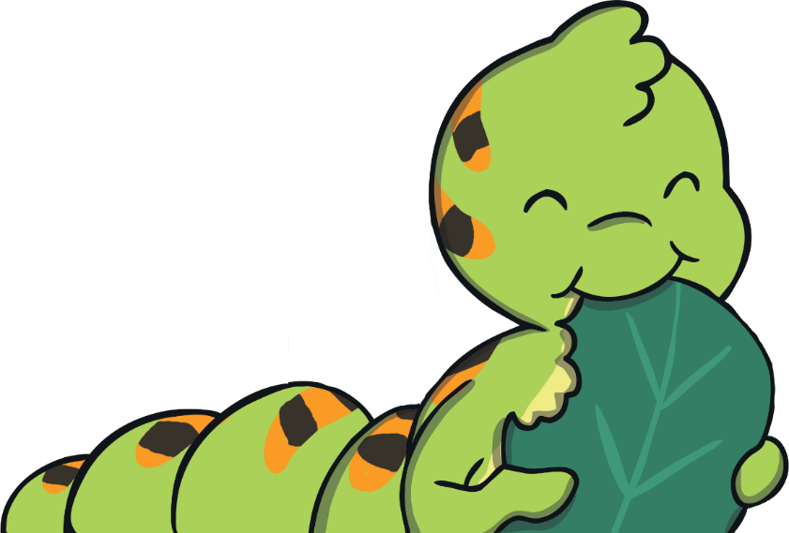
The Cautious Caterpillar
Read the book ‘The Cautious Caterpillar’ and look at the illustrations.
To see a question about the book, click this button:
?

Slide 3
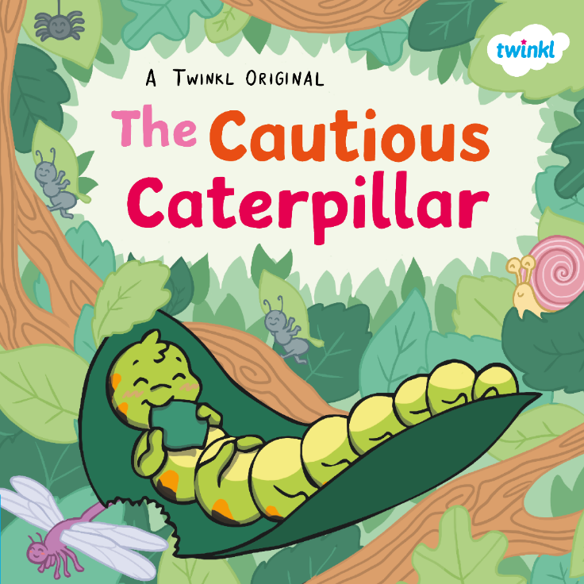
?
What do you think this book is going to be about?
?
Do you think it is fiction or non-fiction?
?
What does ‘cautious’ mean?

Slide 4
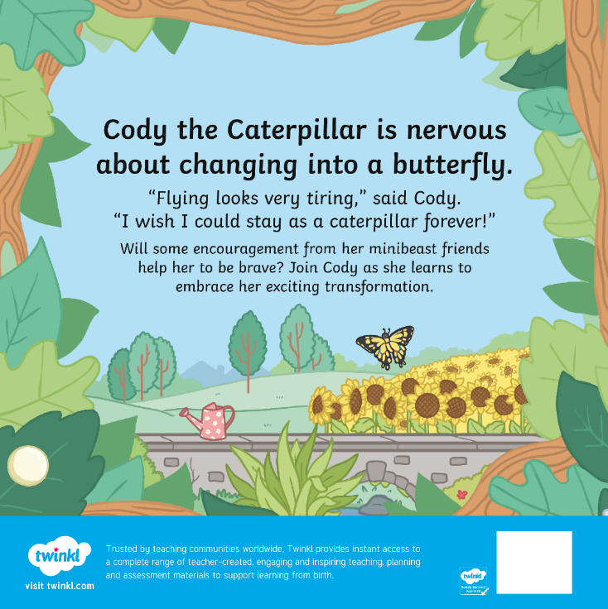
?
Why is Cody feeling nervous?
?
Who might her ‘minibeast friends’ be?

Slide 5
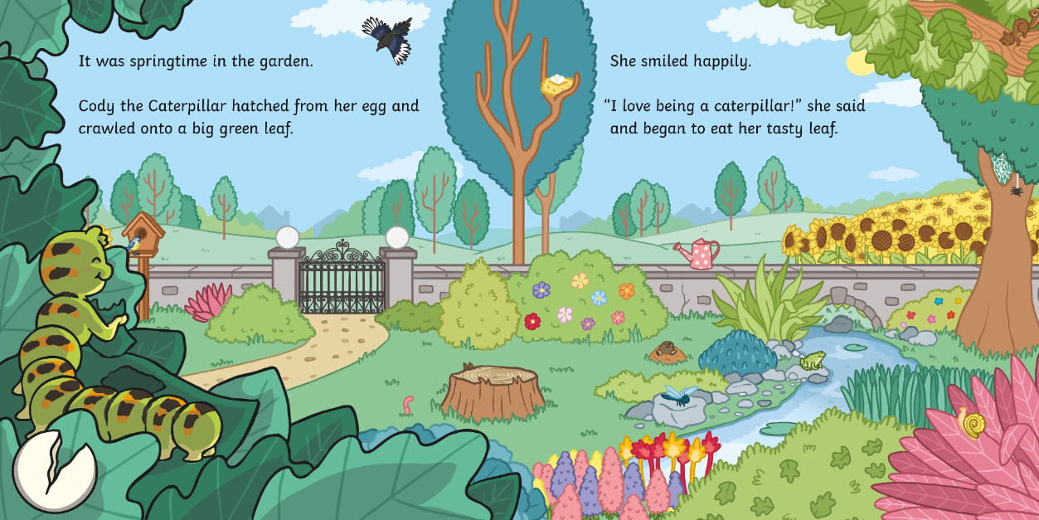
?
Can you think of another word for ‘tasty’?

Slide 6
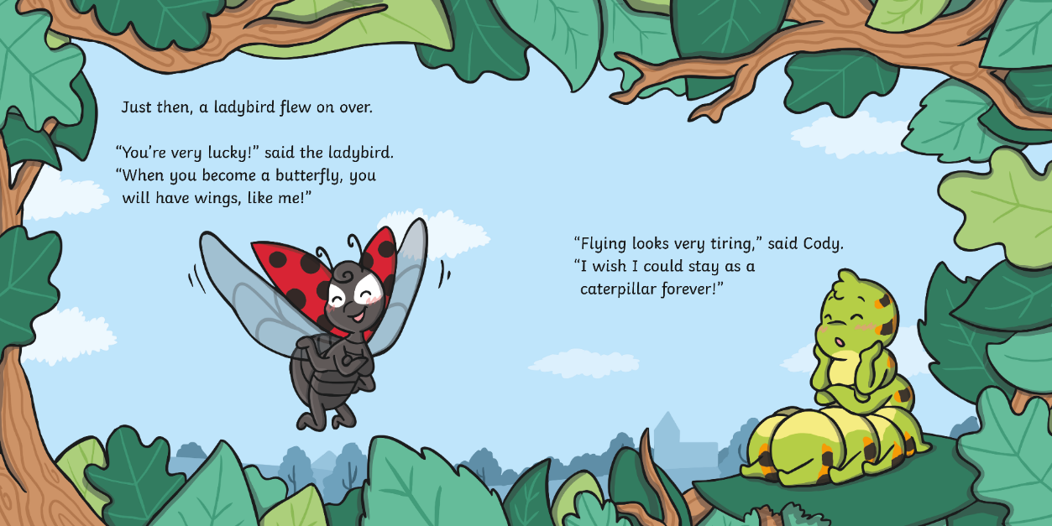
?
Why does Cody want to stay as a caterpillar?

Slide 7
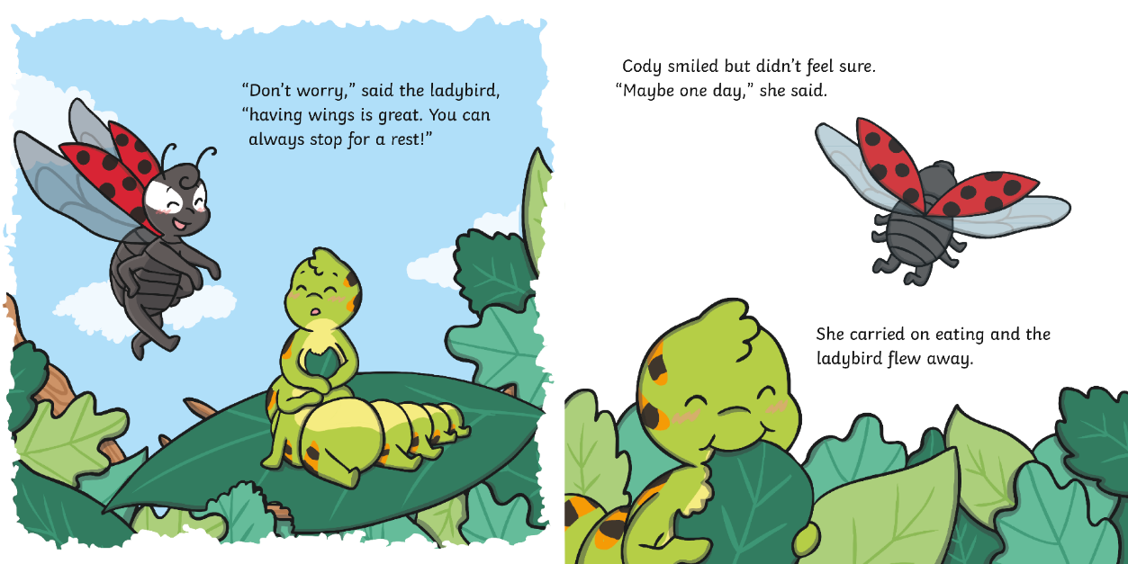
?
How does the ladybird try to make Cody feel better about becoming a butterfly?

Slide 8
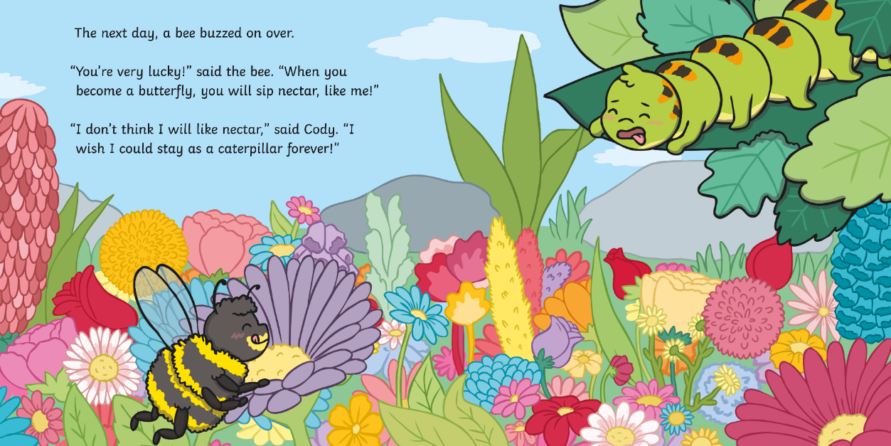
?
Is Cody excited about drinking nectar? How do you know?

Slide 9
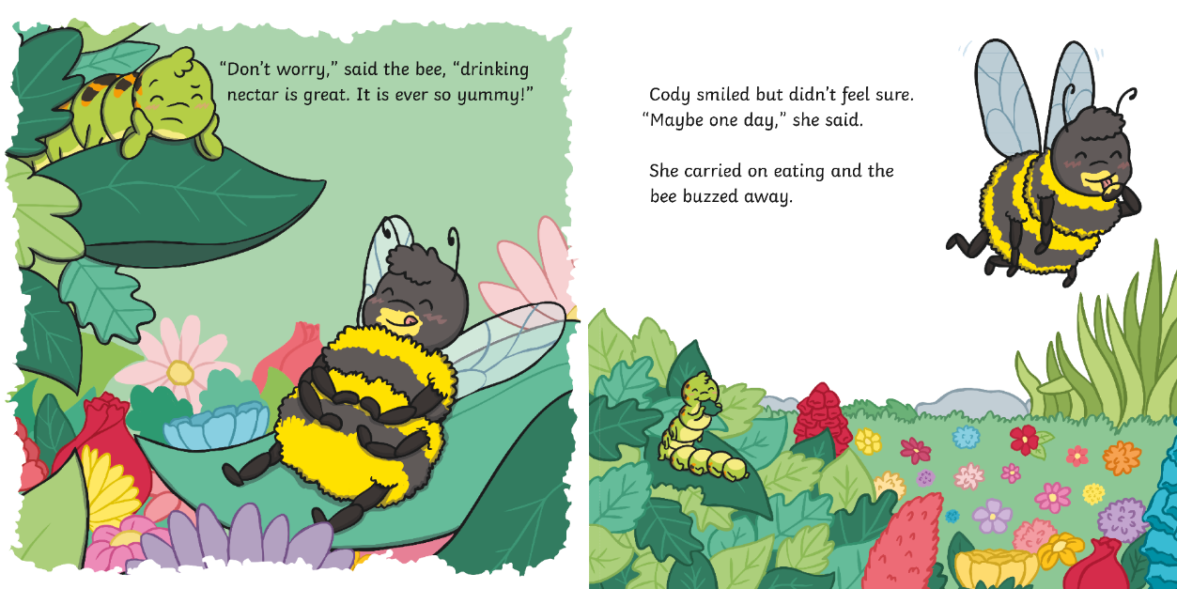
?
Why do you think Cody is eating so much?

Slide 10
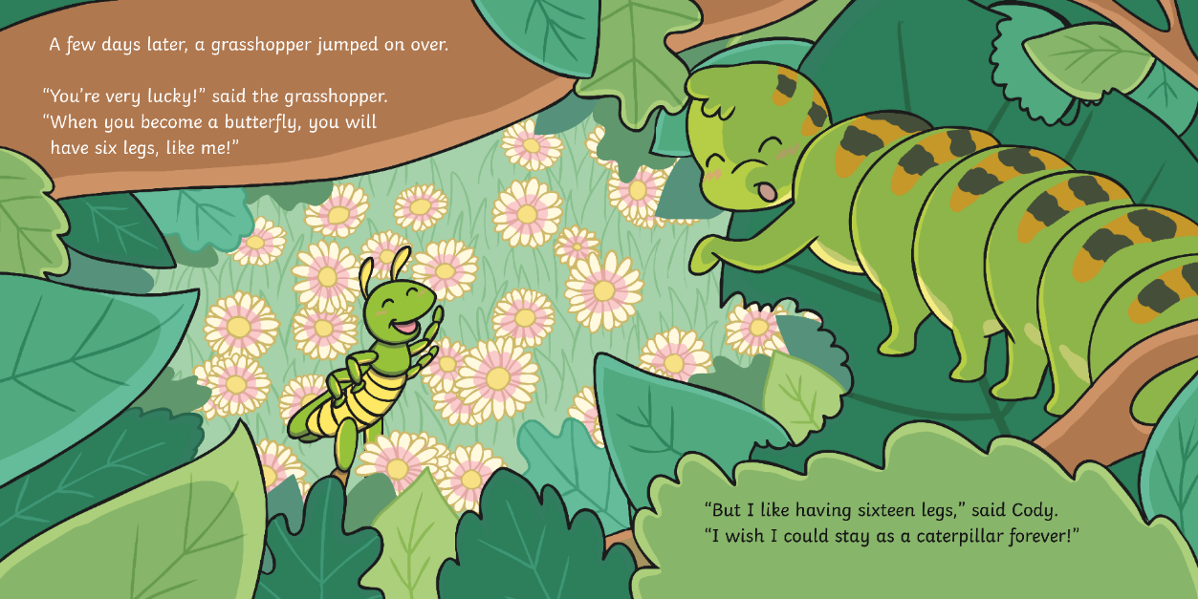
?
Do you think the grasshopper is happy?

Slide 11
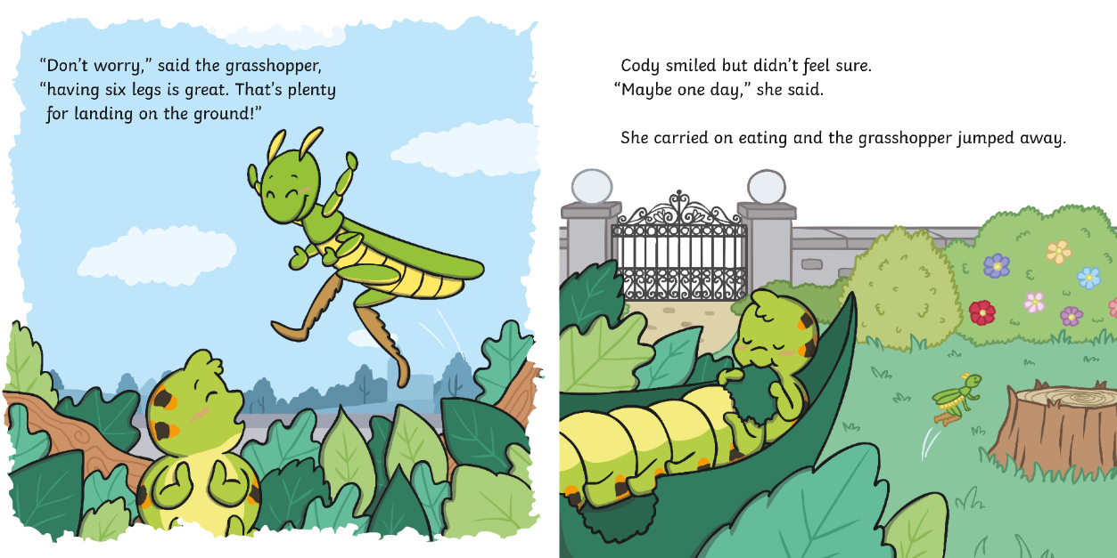
?
Cody keeps saying ‘Maybe one day’. Do you think she will change her mind about becoming a butterfly?

Slide 12
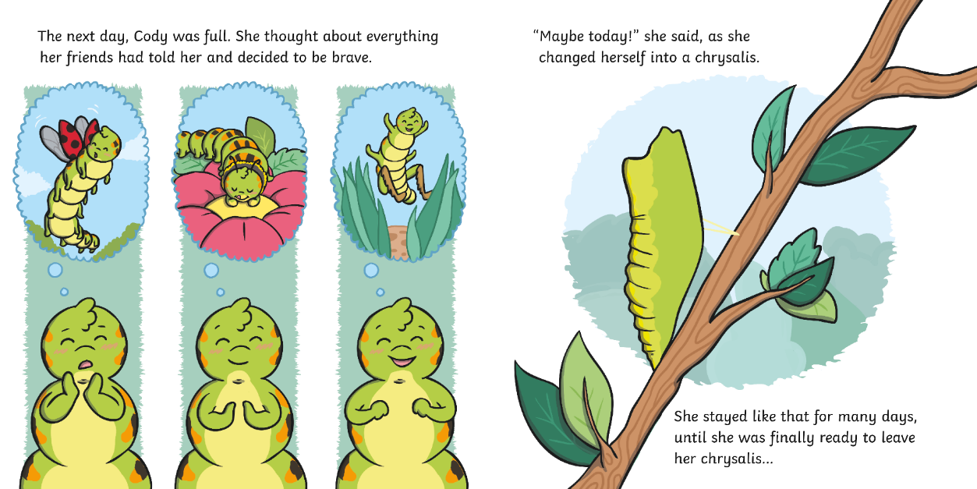
?
What do you think might happen next?

Slide 13
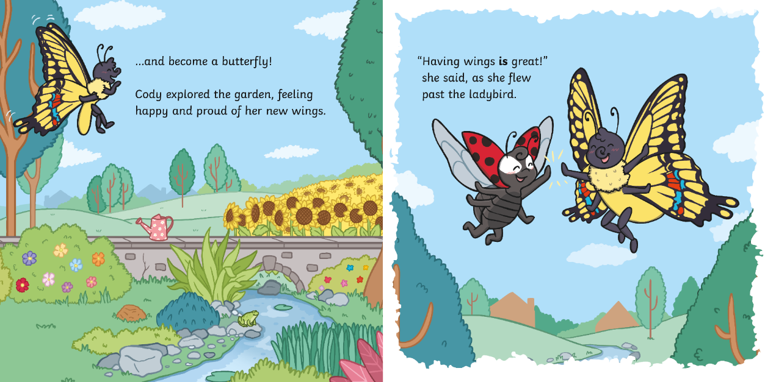
?
Why does Cody think that ‘having wings is great’?

Slide 14
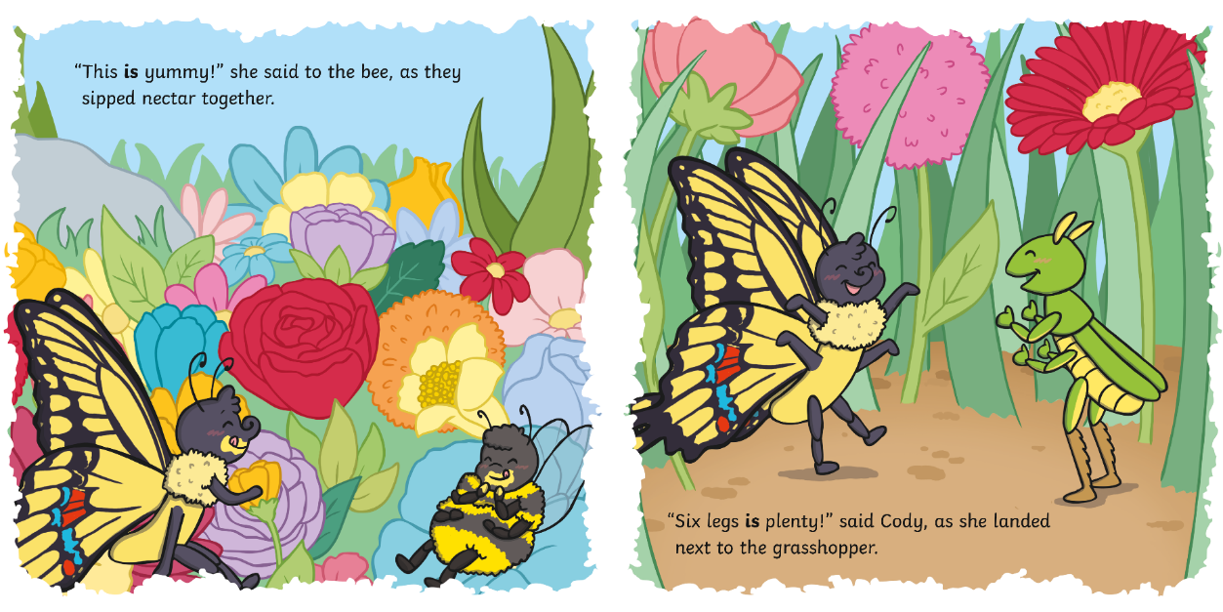
?
Why has the author used bold text here?

Slide 15
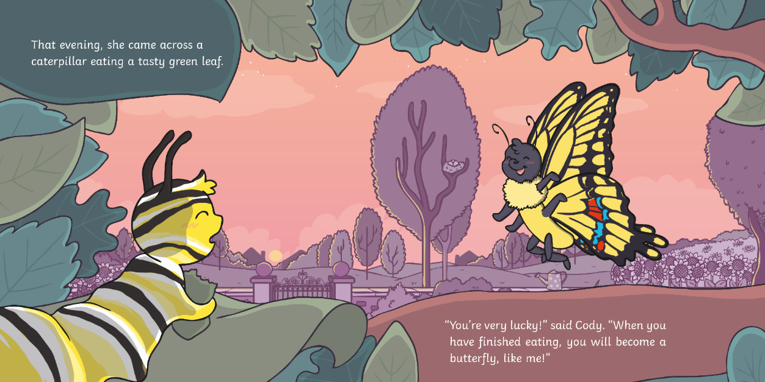
?
How does Cody know that the caterpillar will become a butterfly?

Slide 16
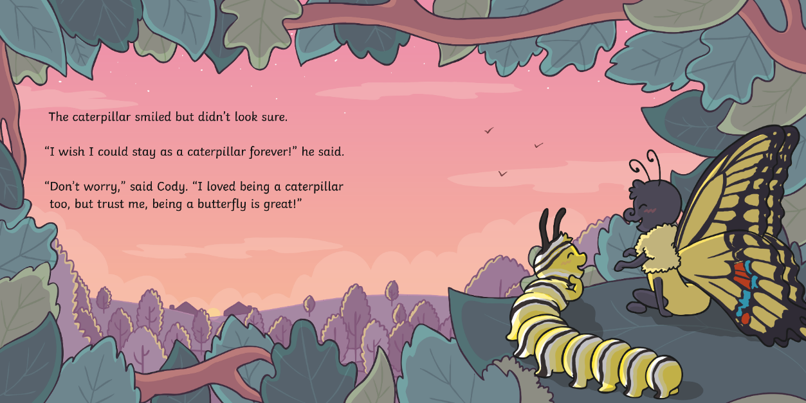
?
Can you think of a word to describe Cody’s behaviour towards the caterpillar?

Slide 17
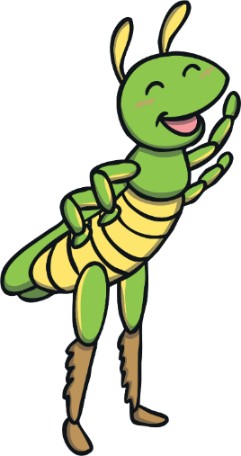
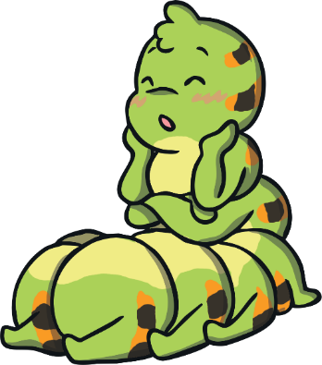
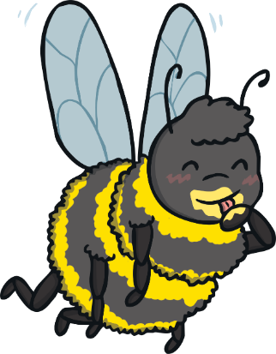
?
Who is the main character in this story?
the grasshopper
Cody
the bee

Slide 18
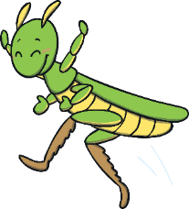
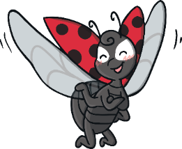
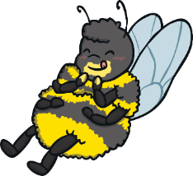
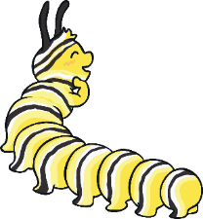
?
Who does Cody meet first?
the grasshopper
the ladybird
the bee
another caterpillar

Slide 19
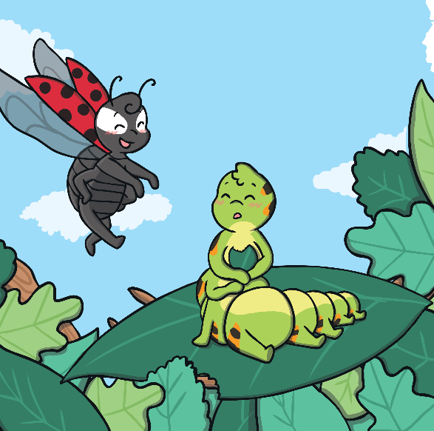
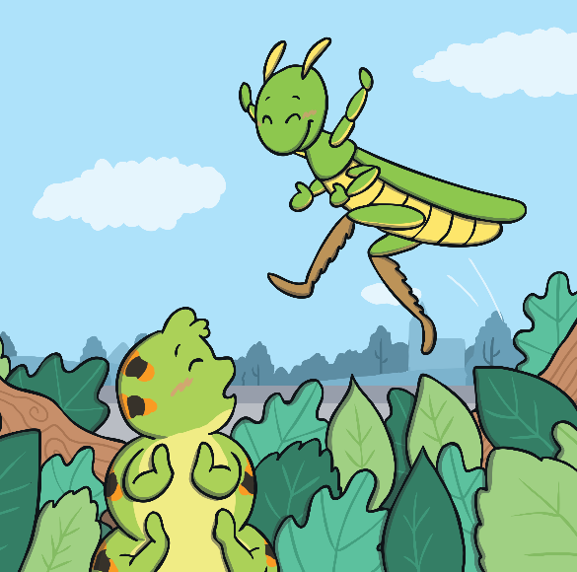
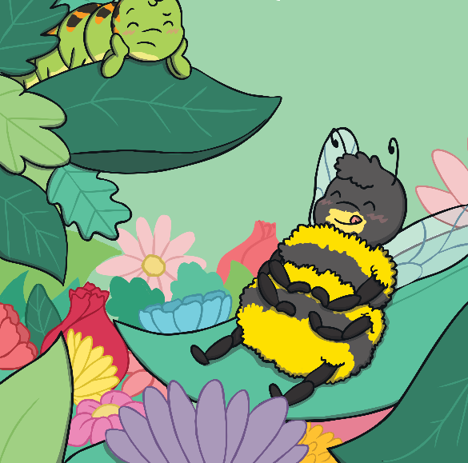
?
How do Cody’s friends help her in this story?

Slide 20
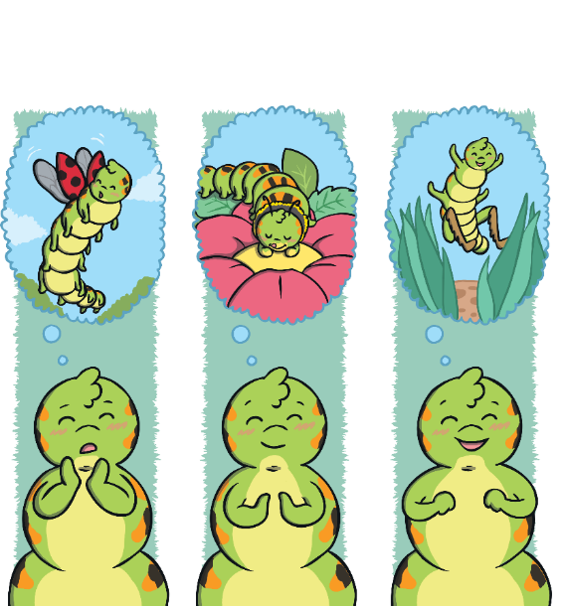
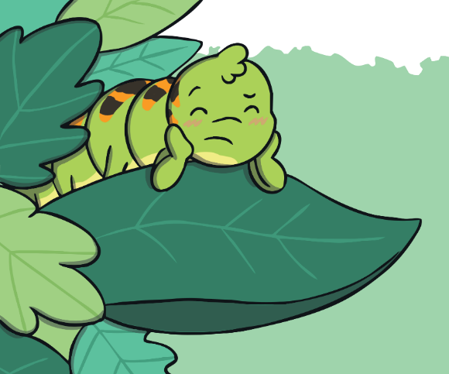
?
Have you ever felt worried about something?
?
Can you remember a time when you were brave?

Slide 21
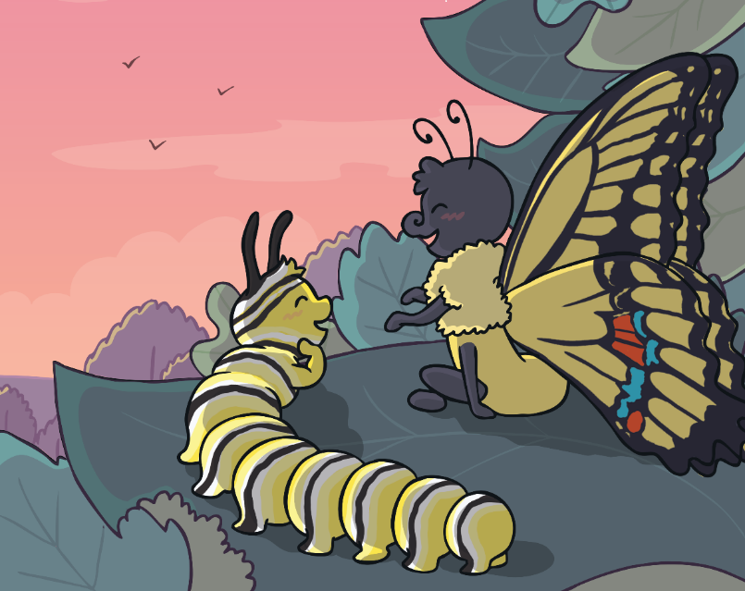
?
Cody uses what she’s learnt to help others. How could you help someone younger than you?

Slide 22
?
Can you think of a different title for this book?

