Slide 2



Diving into Mastery Guidance for Educators
Each activity sheet is split into three sections, diving, deeper and deepest, which are represented by the following icons:
These carefully designed activities take your children through a learning journey, initially ensuring they are fluent with the key concept being taught; then applying this to a range of reasoning and problem-solving activities.
These sheets might not necessarily be used in a linear way. Some children might begin at the ‘Deeper’ section and in fact, others may ‘dive straight in’ to the ‘Deepest’ section if they have already mastered the skill and are applying this to show their depth of understanding.
Diving
Deeper
Deepest

Slide 3
Aim
Solve problems, including missing number problems, involving multiplication and division, including positive integer scaling problems and correspondence problems in which n objects are connected to m objects.

Slide 4

How Many Ways?
Diving
Maya is going to draw a coloured shape. She can choose from 2 different shapes and 3 different colouring pencils.
How many possible coloured shapes could she draw?
Shape | Colour
square | blue
square
square
green
6
yellow
circle
blue
circle
green
circle
yellow

Slide 5


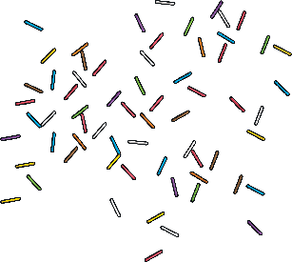
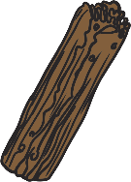

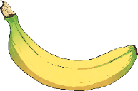
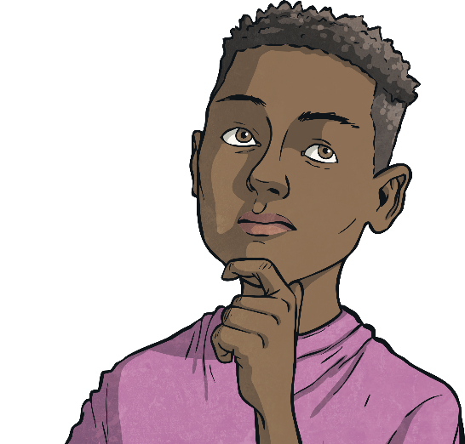
How Many Ways?
Diving
Here are the different flavours and toppings at the ice cream parlour.
Vanilla
Strawberry
Cherry
Sprinkles
Flake
Fruit
Flavours
Toppings
Eddie isn’t sure which ice cream or which topping to get.
List all the different possible combinations that he could choose.
Strawberry and a cherry | Strawberry and a flake | Strawberry and sprinkles | Strawberry and fruit
Vanilla and a cherry | Vanilla and a flake | Vanilla and sprinkles | Vanilla and fruit

Slide 6





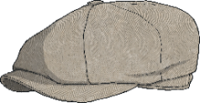
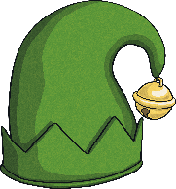

How Many Ways?
Deeper
Husnain needs to choose one hat and one scarf to put on his snowman.
How many different combinations of hats and scarves could he choose?
5
2
10
10
× = .
There are different combinations.
After Husnain has put one hat and one scarf on his snowman, Tom chooses from the hats and scarves that are left.
How many different combinations could Tom choose?
4 × 1 = 4

Slide 7

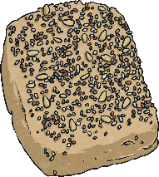
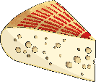
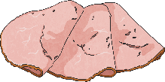
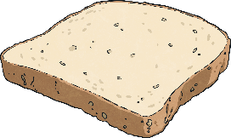
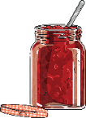
How Many Ways?
Deepest
Fill in each row of the table to show how many different types of sandwiches Gemma could make. She can only use one filling in each sandwich.
Bread | Fillings | Number of Different Sandwiches
2
4
6
What pattern can you see in the answers? Can you explain to your partner why this pattern exists?
Use the pattern you have spotted to work out how many different sandwiches Gemma could make with 7 different fillings and 2 different types of bread.
14

Slide 8
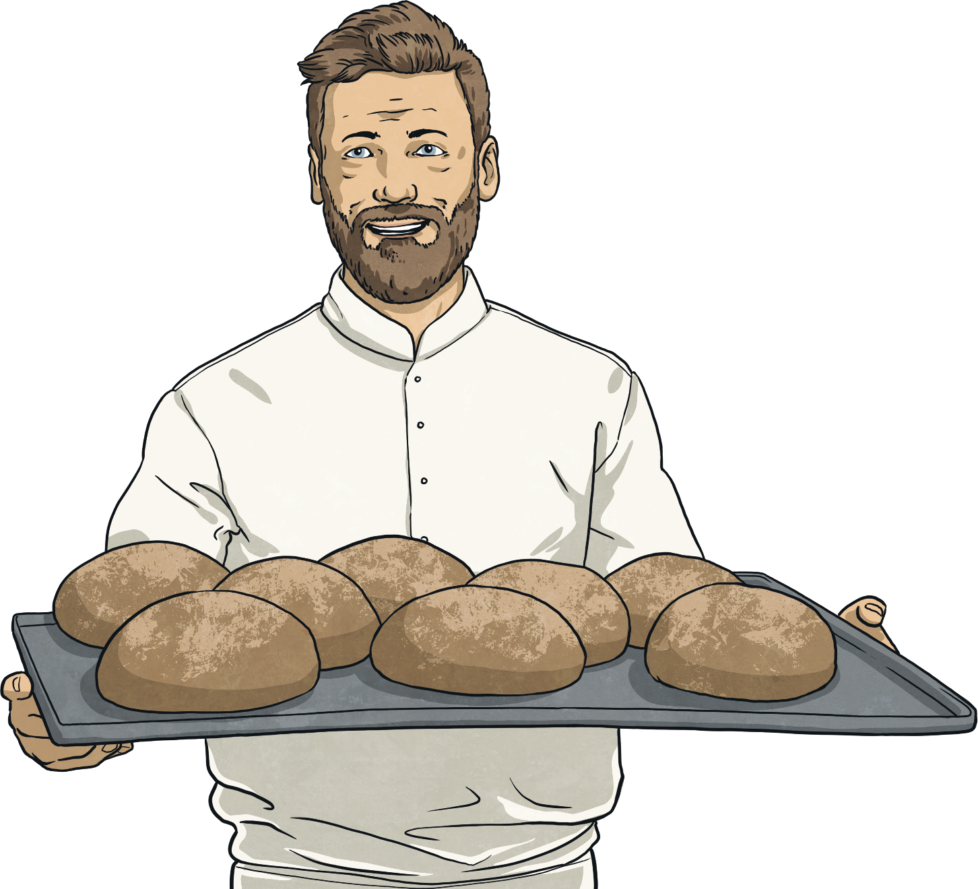
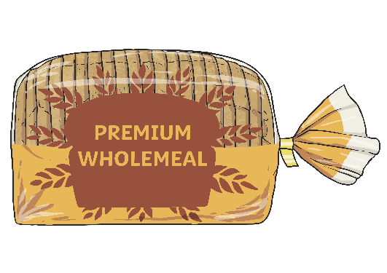

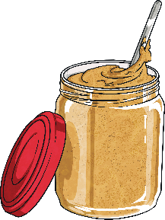
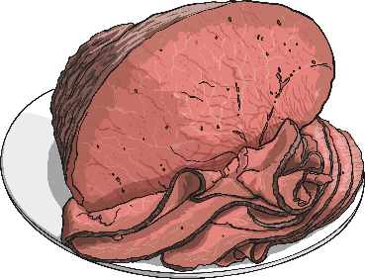
How Many Ways?
Deepest
Alfie can make 18 different sandwiches. He can choose between bread rolls and sliced bread.
How many different sandwich fillings does he have to choose from?
9

Slide 9
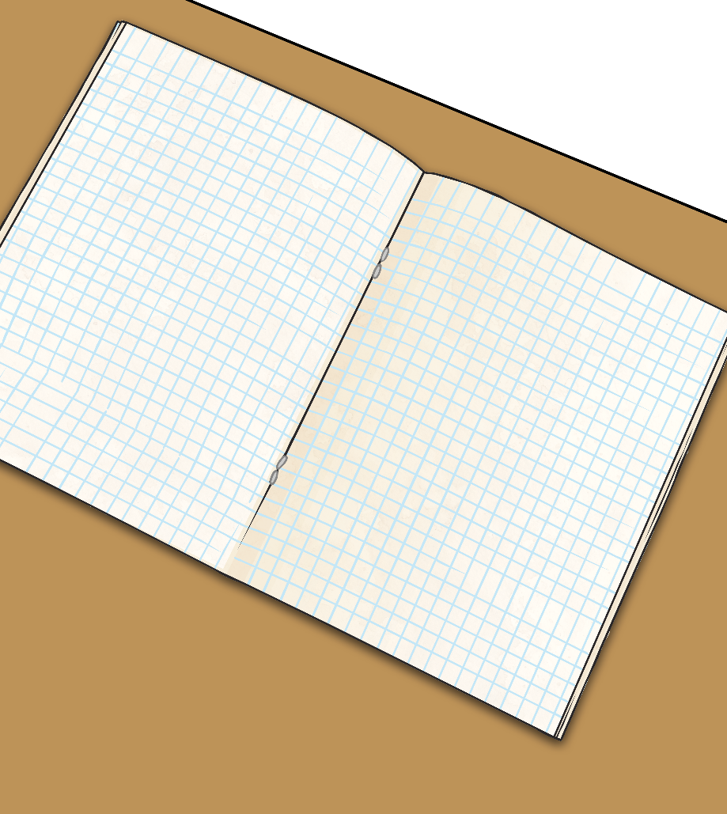
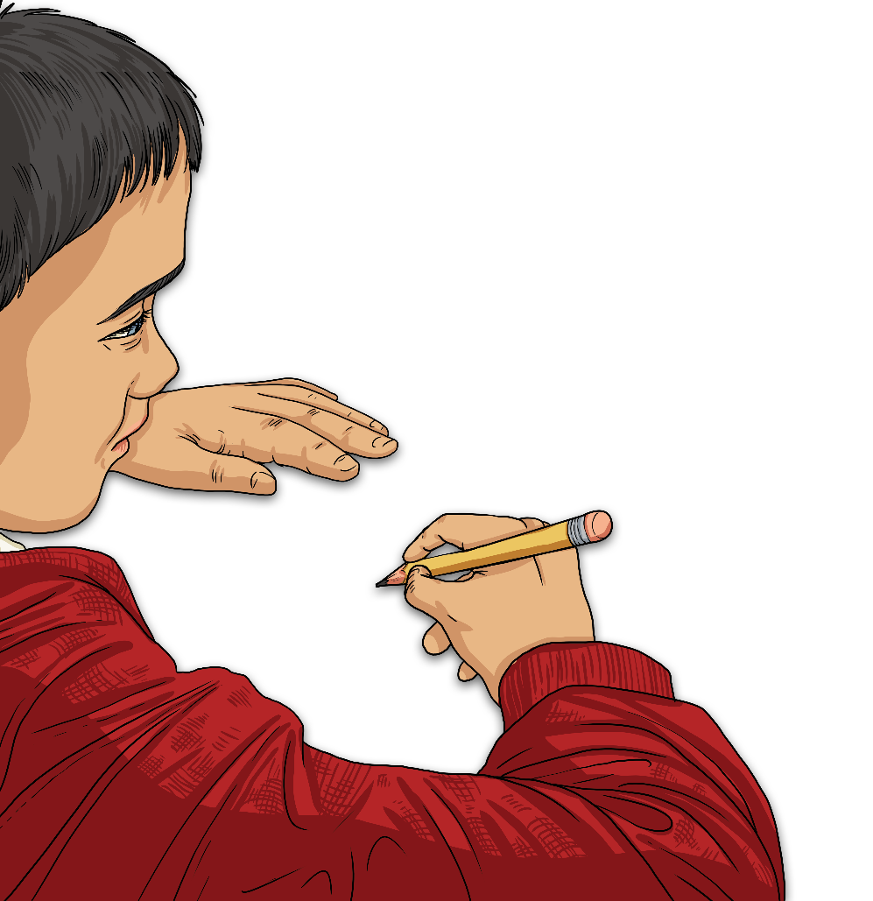
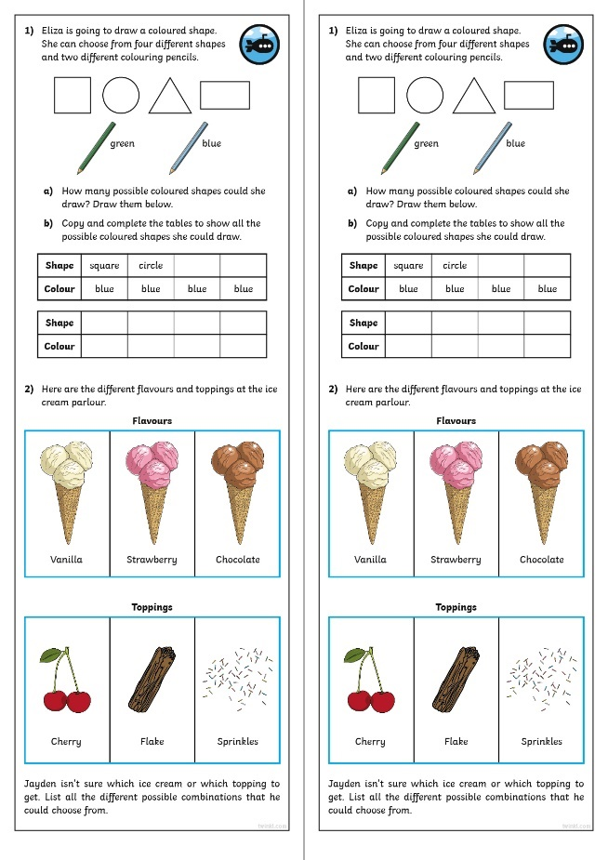
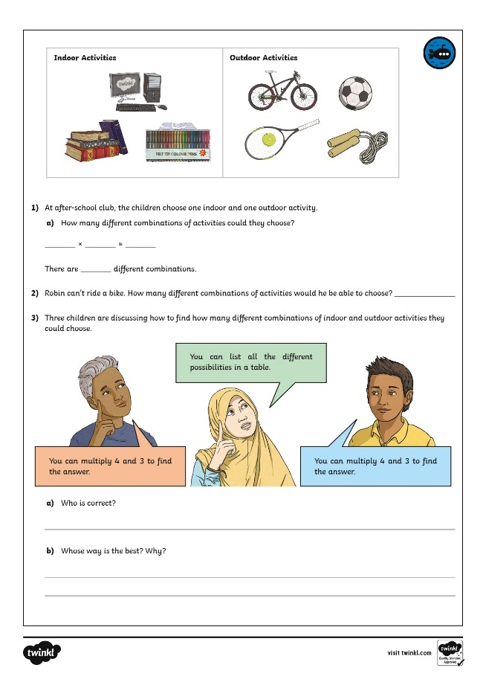
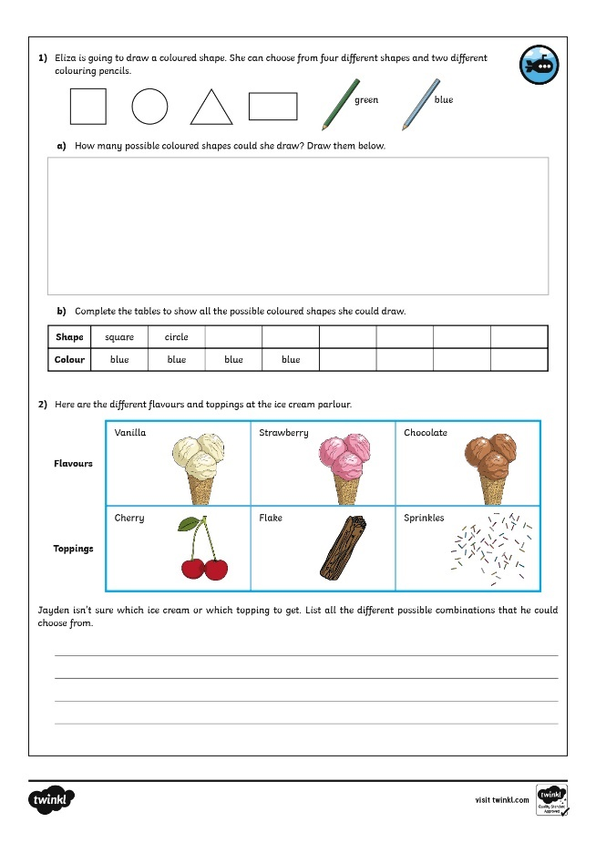
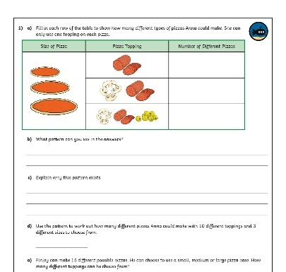
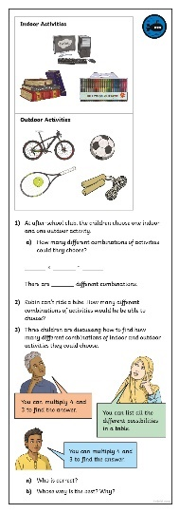
How Many Ways?
Dive in by completing your own activity!

Slide 10
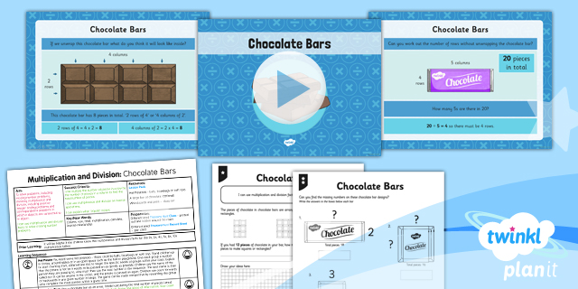
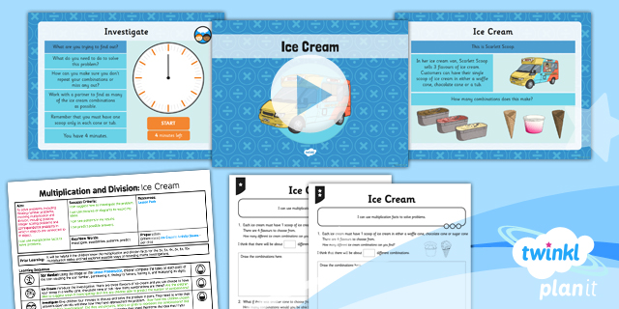

Need Planning to Complement this Resource?
National Curriculum Aim
Solve problems, including missing number problems, involving multiplication and division, including positive integer scaling problems and correspondence problems in which n objects are connected to m objects.
For more planning resources to support this aim, click here.
Twinkl PlanIt is our award-winning scheme of work
with over 4000 resources.

