Slide 1

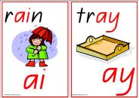

Year 1
Phonics
Screening

Slide 2
What is phonics?
Children are taught to read by breaking down words into separate sounds or ‘phonemes’. They are then taught how to blend these sounds together to read the whole word.
Children have a 20mins phonics lesson each day and they are encouraged to use these strategies to read and write in other lessons.
There are around 40 different sounds.

Slide 3
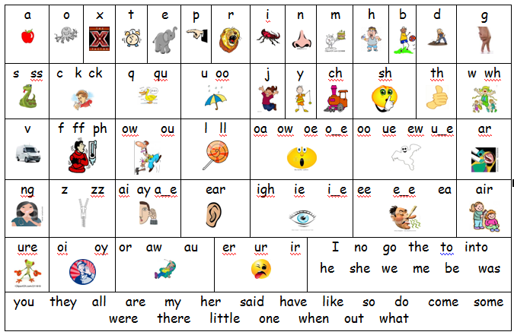

Slide 4

Why are the children being screened?
Every Year 1 child in the country will be taking the phonics screening check in the same week in June.
The aim of the check is to ensure that all children are able to read by the end of year two.
This ‘midpoint check’ will ensure that we have a clear understanding of what the children need to learn in year 2.

Slide 5


What will the children
be expected to do?
The check is very similar to tasks the children already complete during phonics lessons.
Children will be asked to ‘sound out’ a word and blend the sounds together.eg d-o-g - dog
The focus of the check is to see which sounds the children know and therefore the children will be asked to read made up ‘nonsense’ words.
THIS IS NOT A READING TEST

Slide 6
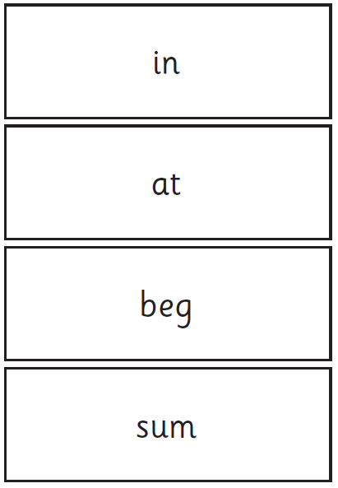
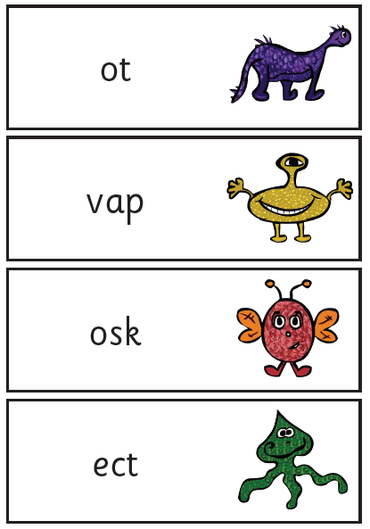
Examples of words:

Slide 7

When will the
screening take place?
The screening will take place throughout a week in June. The children cannot retake the test at any other time so it is very important your child is in school during this week.
The check has been designed so that children of all abilities will be able to take part.

Slide 8

Who will complete the check?
The children will complete the check one at a time in a quiet area of the school.
A teacher will conduct all of the screening checks with the children.
The screening will only take
5-10mins with each child.

Slide 9
How can you help?
Encourage your child to ‘sound out’ when reading or writing. Focusing particularly on spotting more unusual sound patterns.
Eg
Digraph- 2 letters making one sound
cow
Trigraphs- 3 letters making one sound
night
Split digraphs- 2 vowels with a consonant inbetween. Use to be known as the magic e!
spine - i_e

Slide 10

How can you help?
Encourage your child to read at home, sounding out words and using their knowledge of the sounds to blend together.
Children can practise their phonics by playing games online, for example ‘Buried Treasure’
http://www.phonicsplay.co.uk/BuriedTreasure2.html

Slide 11
How can you help?
REMEMBER: Phonics is not the only thing needed to become a fluent reader.
Please continue to read with your child each night and encourage them to:
Sound out
Re-read to check it makes sense.
Use pictures for clues.
Ask questions about the book.
And most importantly ENJOY READING!

