Slide 1
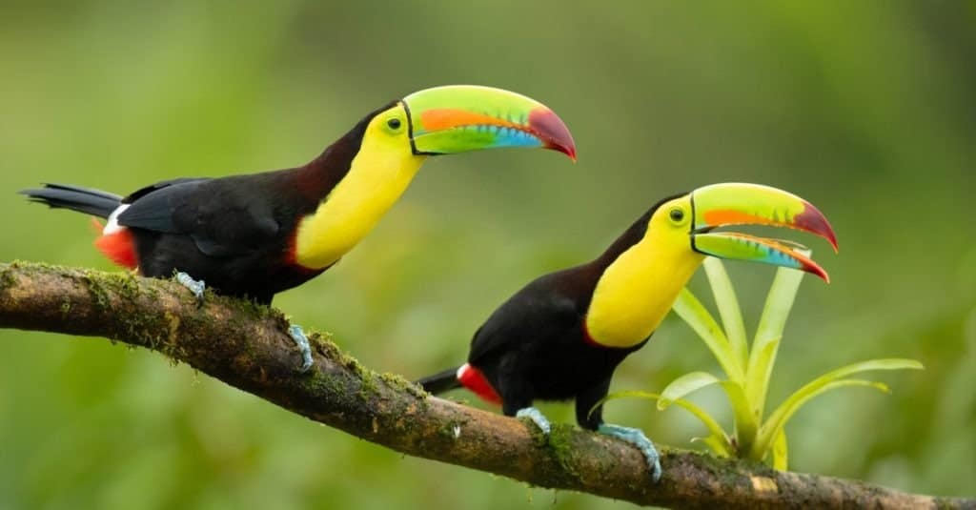

Toucans 2025-2026
Welcome to Year 6!

Slide 2
Staff
Staff
Miss Nicola Cowie (class teacher)
Mrs Austin teaches the class on Tuesday mornings for French/Music, P.E. and Art.
Mrs Henderson and Mrs Austin will support our class at different times during the week.
Mrs Nolan is our volunteer who will support reading each week.

Slide 3




Curriculum
Curriculum

Slide 4
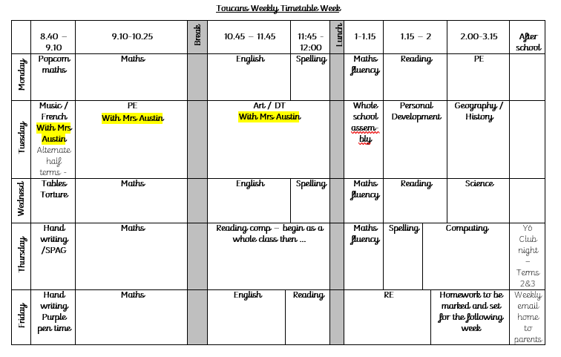
Timetable
Timetable
Prompt daily start at 8:40 am and finishing time at 3:15 pm.

Slide 5
Uniform
Uniform
We would appreciate your support in ensuring the children wear the correct school uniform every day with no jewellery other than stud earrings. Earrings must be removed for PE or covered if they can’t be removed.
Hair which is long enough to be tied back, should be fully tied back please.
Children should wear suitable school shoes at all times – no trainers.
Please make sure that all your child’s clothes are named.

Slide 6
P.E.
P.E.
P.E will (usually) be on Mondays and Tuesdays
P.E. uniform – Plain white t-shirt or Cuddington Primary School T-shirt, tracksuit joggers/pants/shorts, suitable trainers, hoodie / jumper / zip-up hoodie, hat and gloves
If tights are worn, please have a pair of socks in the PE kit. Spare socks are also useful for wet days.
Hall and outside sessions
Please label P.E. kits
P.E kits will be sent home each Friday to be washed
Occasionally, PE sessions may move! Please have kit in all week.

Slide 7
Homework
Homework
Your child will receive homework on a Friday.
This may be online homework for your child to complete via online learning platforms but usually paper based written work in a book that will be provided. I will message you via Class Dojo each Friday so that you are clear on what the expectations are for that week.
Please encourage your child to present their work as they would in class.
Homework should be completed and handed in by the following Wednesday
Please support your child with completing their homework and handing it in on time as this both supports their learning and prepares them for what is to come at high school.

Slide 8
Reading
Reading
In UKS2, it is expected that your child reads for 15-20 minutes every day (Levelled books and other good quality novels) including to an adult on a regular basis.
It is essential to encourage a love for reading, to develop new vocabulary and strengthen writing skills
Ask questions about events that have happened so far, characters' thoughts and motives and to make accurate predictions
Your child will be able to bring home library books or reading books from the class library

Slide 9
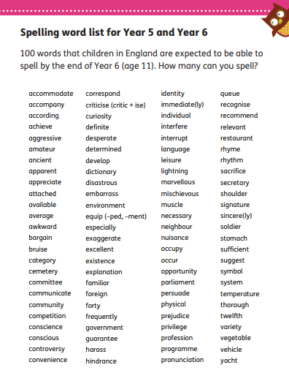
Spelling

Slide 10

11th – 14th May 2026

Slide 11

Min-y-don
20th-24th October https://minydon.com/
Consent form
School Spider form for additional details nearer the time
Kit List

Slide 12
Please provide
Please ensure the children have:
Water bottle with fresh water for your child daily. Hydration is important to good health and learning!
If children don’t order a snack from school, provide a healthy snack for them to eat at break (low sugar and/or low fat). Please remember we are a nut free school.
Warm, waterproof coat regardless of the forecast!
Field shoes to keep on pegs – they will only be allowed on the field in the Autumn term if they have a change of shoes (different to their school and PE shoes). These need to be in a named carrier bag and can stay on their pegs.

Slide 13
Please provide
Food:
If children don’t order a snack from school, please provide a healthy snack for them to eat at break (low sugar and/or low fat)
If it is deemed an unhealthy option (crisps/chocolate), they will be asked to save it for later by staff members
We are a NO NUTS school!

Slide 14
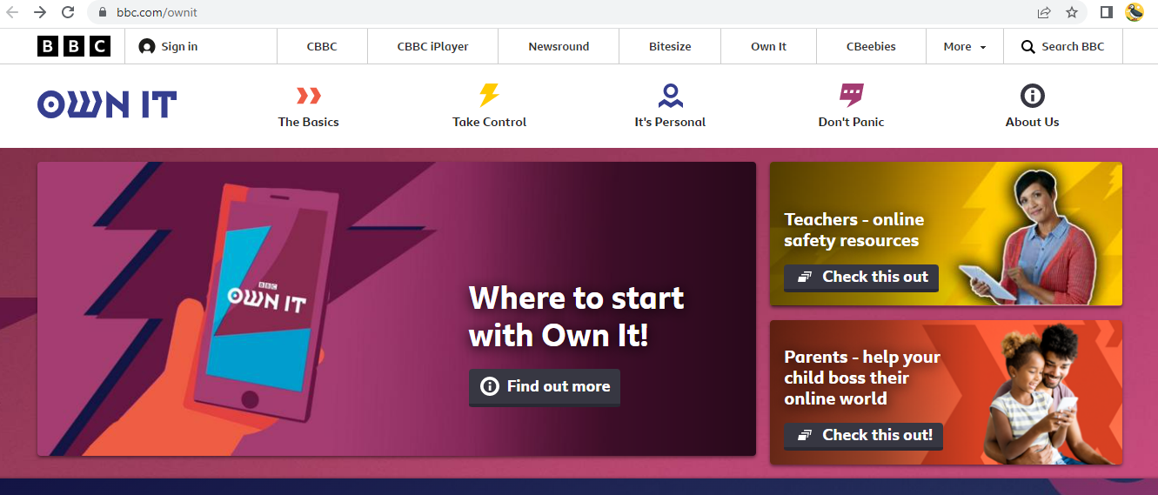

Shed and My Maths
Online safety
https://www.bbc.com/ownit
https://www.nspcc.org.uk/keeping-children-safe/online-safety/social-media/

Slide 15
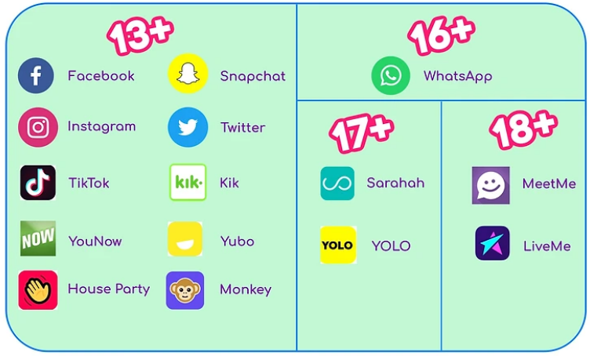
Social Media

Slide 16
Date for your diary
09/09/25 Meet the teacher (3:30 and 4pm)
15/09/25 SEND parents meetings (2 week window) 10 min phone
call – Plan Do Review
02/10/25 National Poetry Day
06/10/25 Harvest Festival week
10/10/25 Cudd Fest
14 and 16/10/25 Parents evening (Autumn Term)
17/11/25 NTS Assessments Week
27/11/25 Share the learning KS2 (9:00 – 9:30) drop ins for parents
03/12/25 EYFS Nativity - 9.30am
10/12/25 KS1 Nativity - 9.30am
Parents evening (Spring Term): 10th and 12th March 2026

Slide 17

Contact – ClassDojo
Can be accessed via website or app – ensure you are signed up
Share positive behaviours at school, homework expectations, photos and information about your child’s learning journey, diary dates / reminders
Parent/Teacher communicate with small queries about your child’s learning or behaviour

Slide 18
Contact
Urgent queries should come via the school office or gate so it can be shared with available staff.
All absence, pick-up arrangements, club queries, minor queries, medical arrangements or medication should come to the school office via the admin email account or by phone.
admin@cuddington.cheshire.sch.uk
School phone: 01270 360030

