Slide 1

RE
Subject leadership

Slide 2
Aims of RE
Know and understand a range of religions and worldviews
Express ideas and insights about the nature, significance and impact of religions and worldviews.
Gain and deploy the skills needed to engage seriously with religions and worldviews.

Slide 3
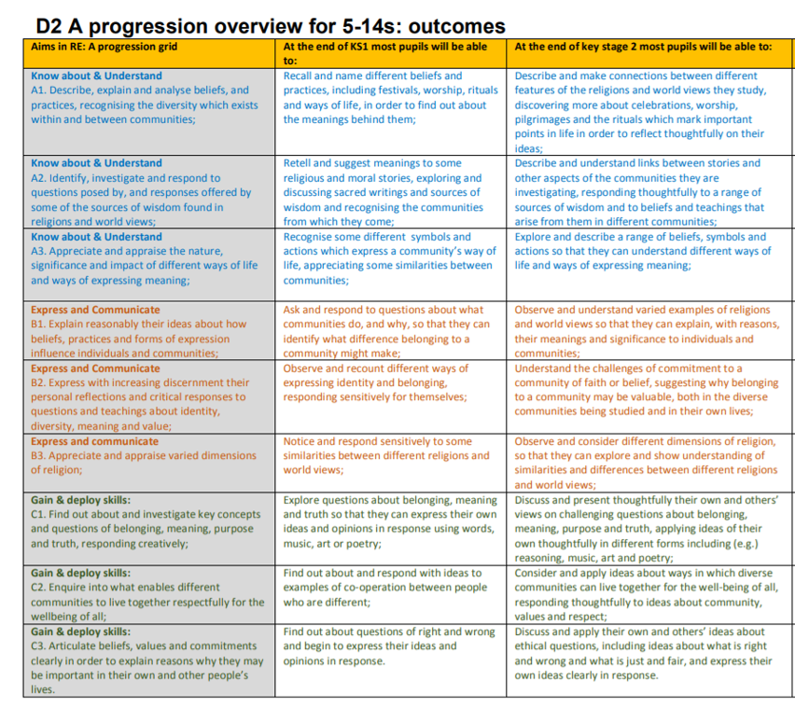

Slide 4
Why it needs to be taught
RE enriches children’s outlook on diversity, culture and beliefs around the world.
Helps children to know, understand and have respect for varying beliefs of their peers in school.
Linked to personal, social and emotional development. Fosters British Values and tolerance of others.
Encourages discussion and exploration of big questions about life.

Slide 5
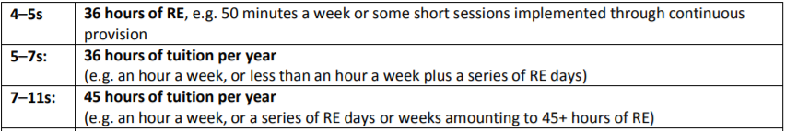
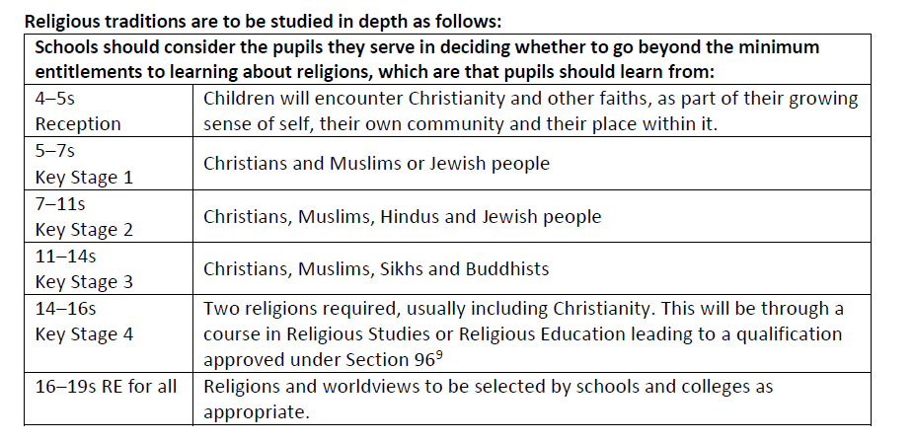
Time allocated for RE and what needs to be taught

Slide 6
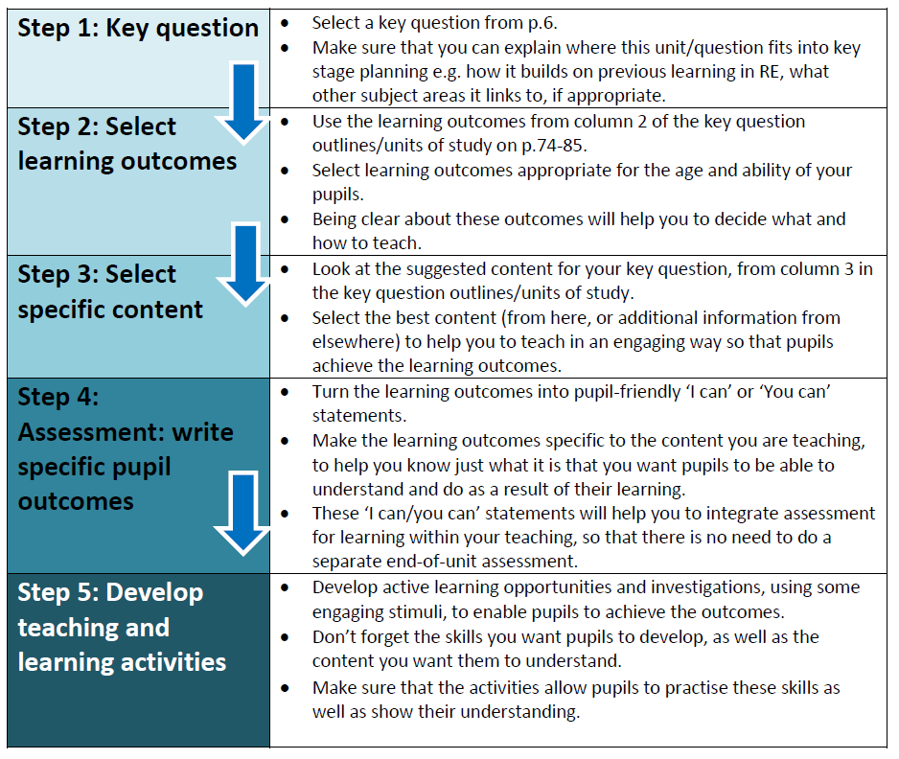
How re is planned/taught

Slide 7
10 minute monitoring
Children talked positively about their RE lessons, could give me some examples of things they had learnt (different religious festivals, places of worship). KS1 children could tell me that the Bible ‘has stories about Jesus in it.’ Year 2 child said RE teaches them ‘to be more thankful in life.’
KS2 children could tell me about the discussions they have had, differences in beliefs of different religions. Year 6 talked a lot about humanism and what it meant and the main differences in beliefs.
Floor books – evidence of the children’s work and learning taking place.

Slide 8
Next steps
Ensuring RE lessons are taken from the Trafford SACRE syllabus and are reflected against long term plan:
Reception – 6 questions from Discovering the World.
KS1 and KS2 - 3 units covered across the year. Key questions picked as main lesson objective and focus point for discussion.
Planning and lessons need to build on previous learning.
Floor books regularly updated – currently main form of assessment so important to produce that as evidence.
Communication between teachers and TAs on where the children are up to/understanding and assessment/feedback on planning etc.

Slide 9
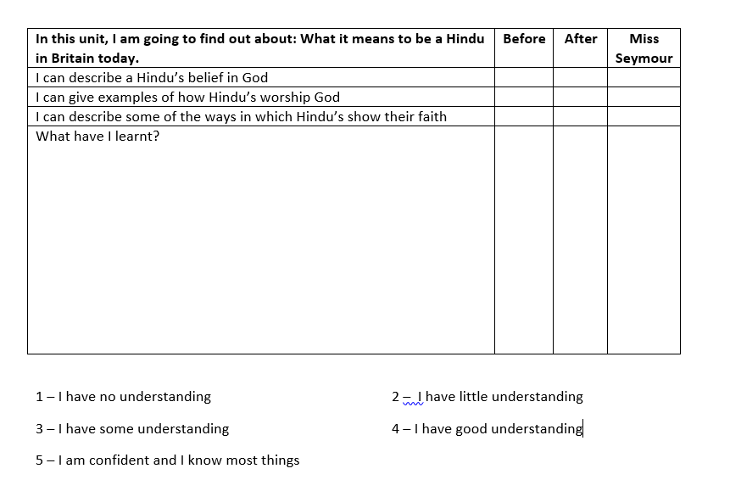
Thoughts?

