Slide 1
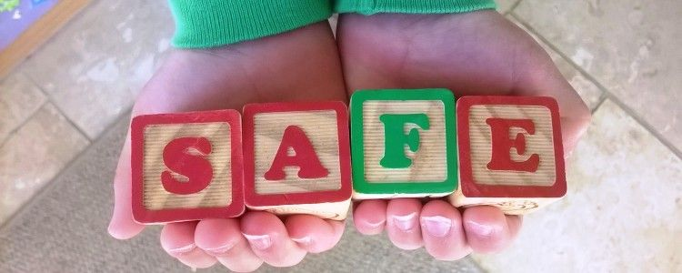
Keeping happy and safe
Nurture, Respect, Inspire, Achieve

Slide 2
At Kingsway Primary School we want all children to grow up in a safe and loving environment and be happy, confident individuals.
We are here to listen to you and will help you with any of your worries.

Slide 3

Who keeps us safe in school?
Head teacher & deputy head teacher
Teachers and teaching assistants
Office staff
Midday supervisors
Site Manager
Cleaner
Everybody who works in school has the responsibility to
keep children safe

Slide 4

How do they keep us safe?
School Rules
Prepared
Equipment
Listening
Quiet
Ready to try
Ready to learn
Peers
Equipment
Learning
Staff
Yourself
Your future
On the internet
Adult supervision
Listening
Kind hands
Kind feet
Follow instructions
Walking in corridors

Slide 5
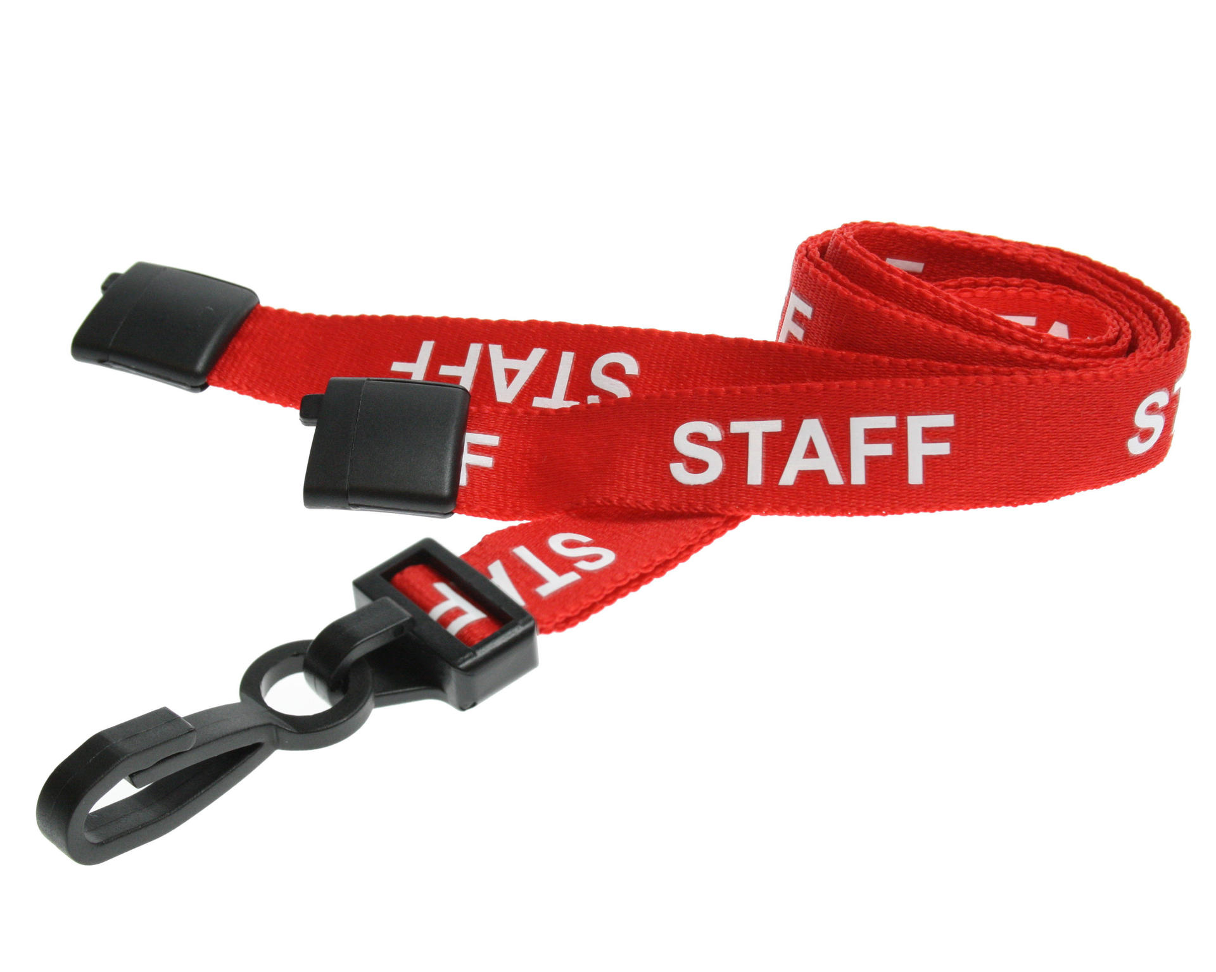

How do they keep us safe?
Staff & visitors
What do staff and visitors wear to show they are safe and have signed in at the office?
ALL staff wear these with their photo ID – teachers, learning partners, MDS, office staff, cleaners – everyone!
If adults wear a staff lanyard, they can walk around school WITHOUT a member of staff.
If adults are wearing a red lanyard, they MUST be with a member of staff at ALL TIMES.
Notes:
All staff and visitors who work in school are checked to make sure they are safe to work with children

Slide 6
How do they keep us safe?
Building safety
Gates and external doors are locked when children are
in school
Members of staff need a key to open the doors
Buttons for the exits are up high, out of reach of children
Only adults can press these buttons to exit the grounds
Gates are padlocked and secured during the day
Fire drill

Slide 7
How do they keep us safe?
Attendance
Teachers take the register in the morning and afternoon to see who is in school each day.
Mrs Coleman comes round to check each class if parents and carers have not told us why you are not in school.
Mrs Coleman will ring parents and carers to find out why you are not in school if they haven’t rung or e-mailed the school.
Miss Baskeyfield, Miss Lowe or the class teachers will talk to parents and carers if we are worried about your attendance to see how we can help.

Slide 8

What things might children be worried about?
Worries can be big or small but it is important we talk about them

Slide 9

Home life
Some children may worry about these things at home:
Not enough food to eat at home.
Parents arguing or hurting each other.
Being deliberately hurt by an adult at home. They might hit, kick, punch, bite, throw things at them.
Not enough money to buy things.

Slide 10
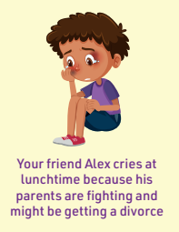
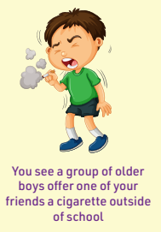
About a friend
A friend might tell you something that makes you feel worried about them.

Slide 11
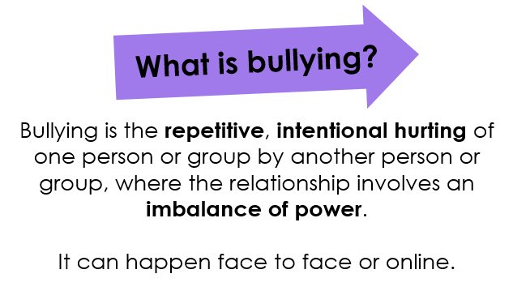


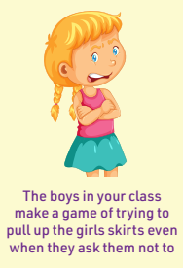
Bullying
.

Slide 12


Online
.

Slide 13
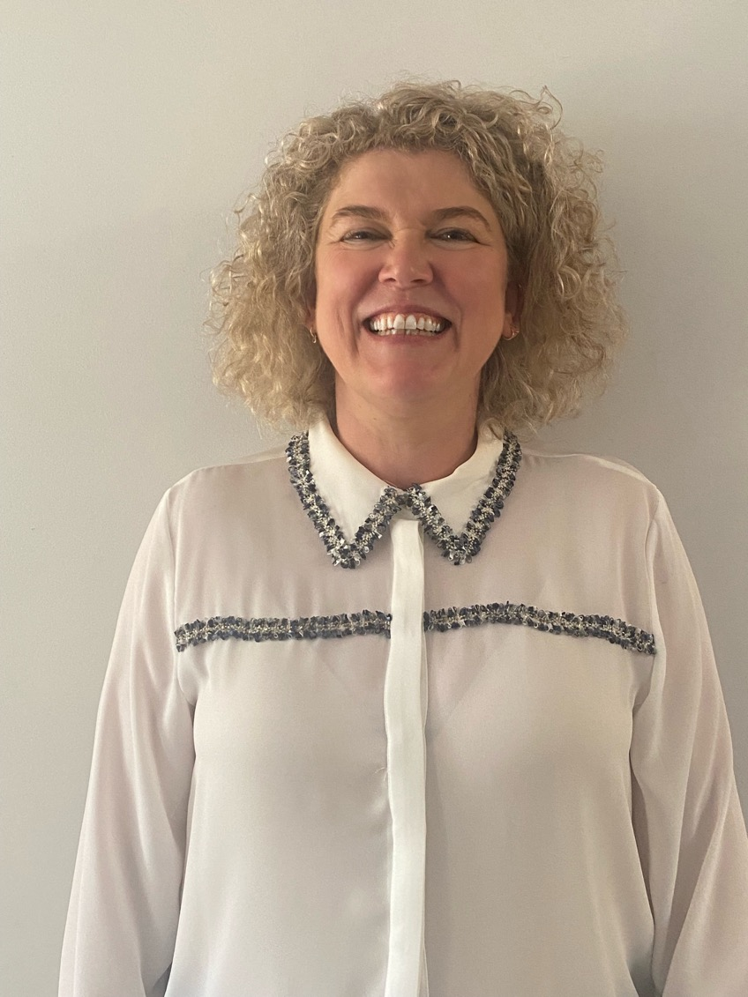
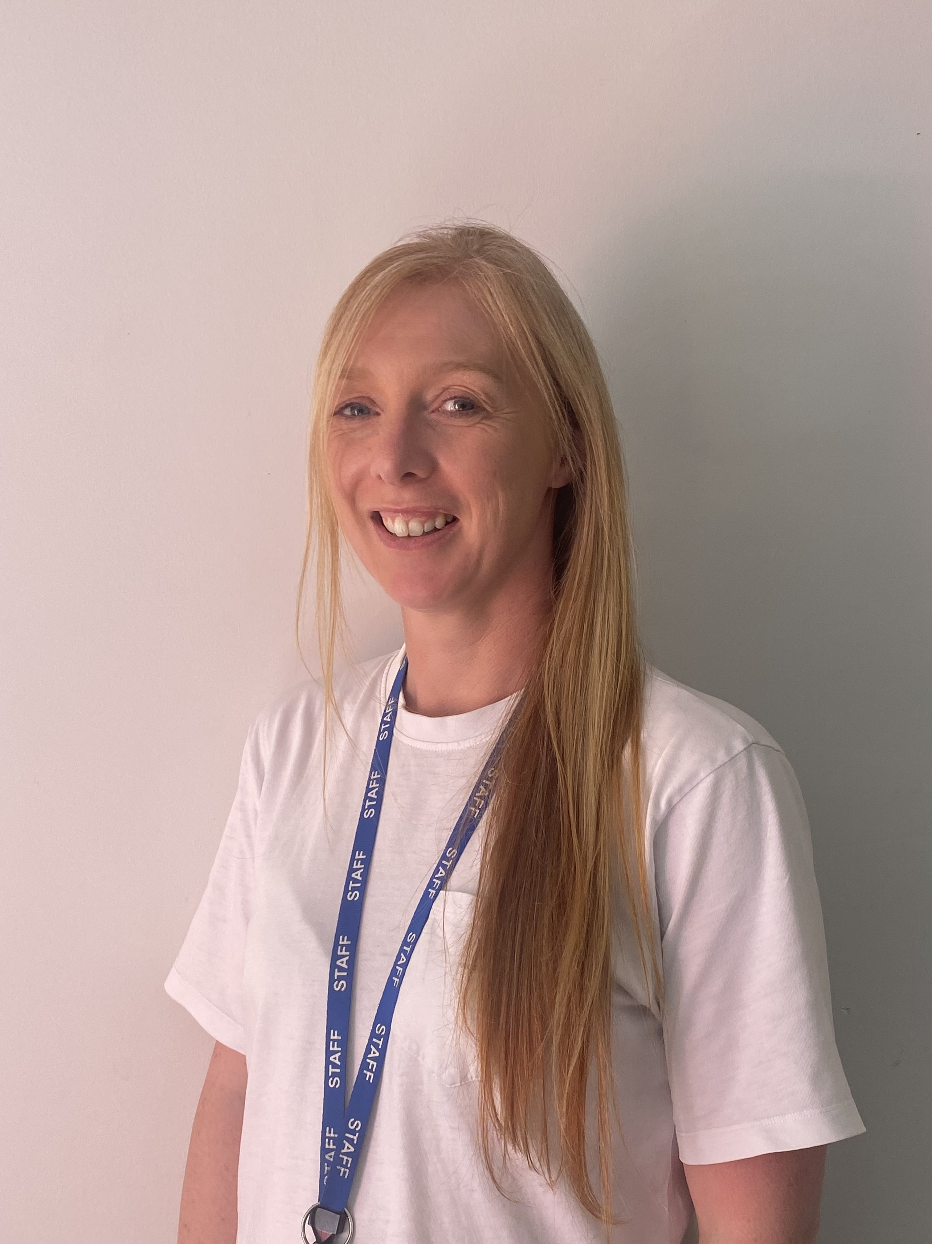
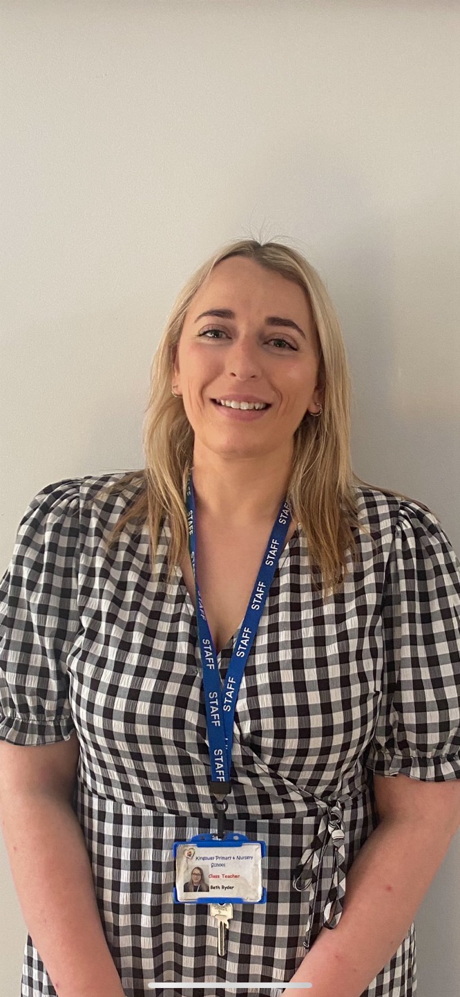
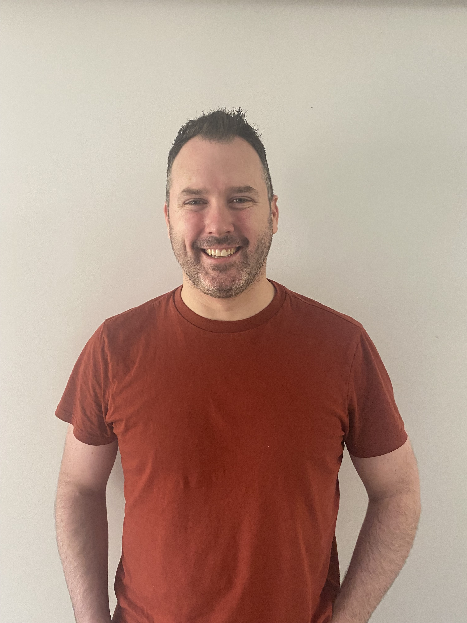
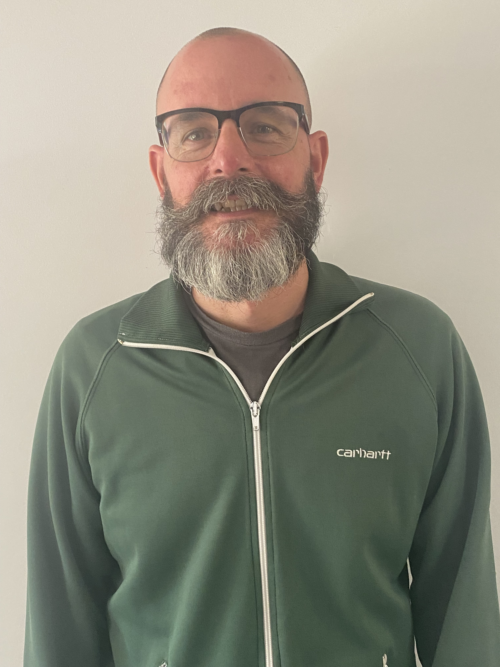
Who can we talk to if we have a worry?
You can always talk to your teacher or learning partner
These adults are the safeguarding leads in the school and will always listen if you have a worry.

Slide 14
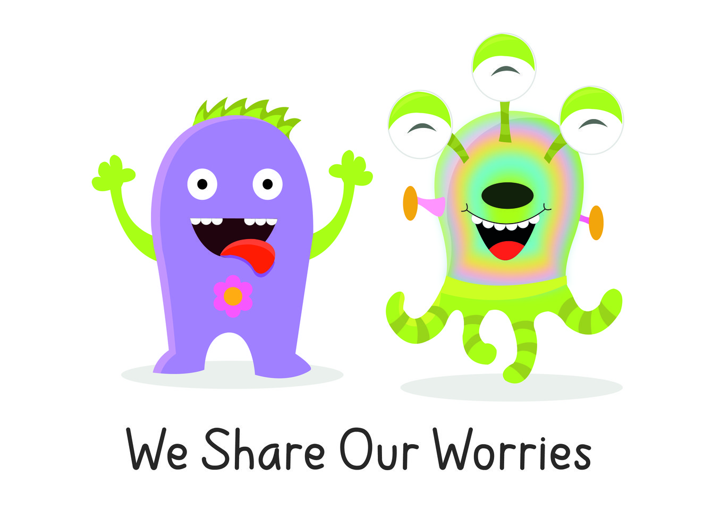
Worries
If you share your worry with an adult in school we will…..
Listen carefully and find out what is happening
Do everything we can to help
Keep you safe

Slide 15

How does school help us if we’re not feeling ok?
Zones of regulation check in
Regular check-ins with your class teacher at the start and the end of the day
Learning breaks
Adult to talk to in class
Breathing exercises
Learn calming techniques
Mr Walker is the school Mental-Health Lead.

