Slide 1
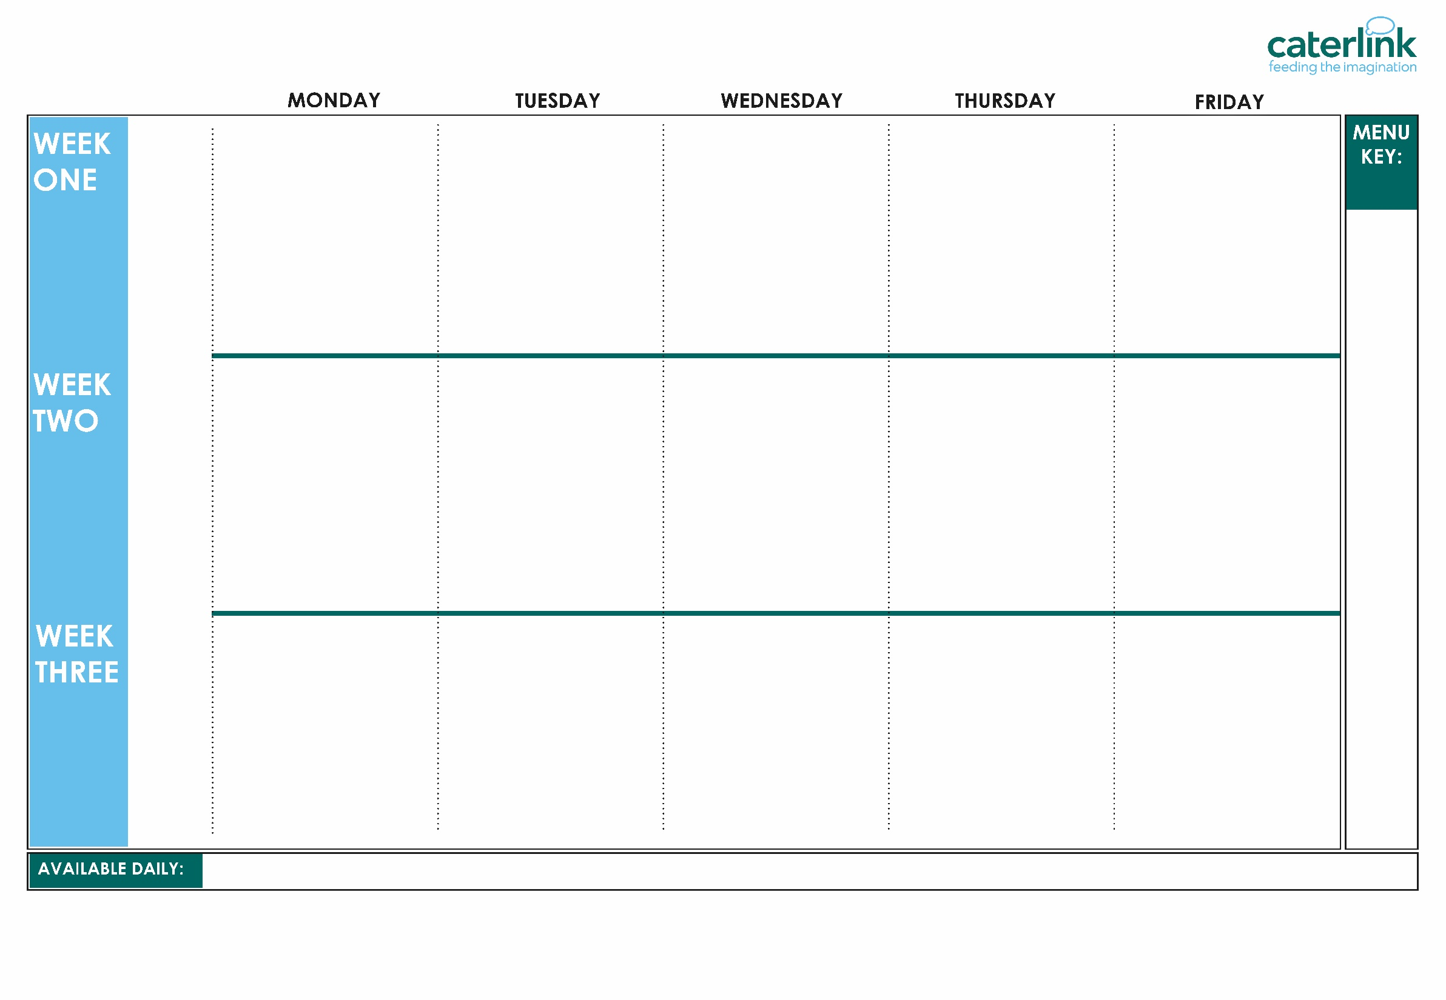






AUTUMN WINTER MENU 2026 / 2027
 |  | Classic Beef Lasagne with Garlic Bread and House Salad | Chicken Korma with Rice | Battered Fish with Chips and Tomato Sauce
With Garlic Bread (V) | Lemon and Garlic Chicken or Falafel. Khobez Bread, Salad and Yoghurt Dip | Garden Vegetable Cottage Pie and Gravy (VE) | Sweet PotatoTikka Masala with Rice (VE) | Cheese and Bean Pasty with Chips and Tomato Sauce (V)
Vegetables of the Day (V/VE) | Vegetables of the Day (V/VE) | Vegetables of the Day (V/VE) | Vegetables of the Day (V/VE) | Vegetables of the Day (V/VE)
Dessert of the Day | Dessert of the Day | Dessert of the Day | Dessert of the Day | Dessert of the Day
Option
One
Option
Two
Sides
Dessert
Whole
grain
Classic Cheese and Tomato Pizza with Wedges (V) | Spaghetti Bolognaise | Sausage and Mash Vegetarian Sausage and Mash | Chicken and Sweetcorn Meatballs in Tomato Sauce with Rice | Breaded Fish or Fishfingers with Chips and Tomato Sauce
Five Bean Chilli with Rice (VE) | Vegan Bolognaise with Spaghetti (VE) |  | Creamy Chickpea and Coconut Curry with Rice (VE) | Cheese Whirl with Chips and Tomato Sauce (V)
Vegetables of the Day (V/VE) | Vegetables of the Day (V/VE) | Vegetables of the Day (V/VE) | Vegetables of the Day (V/VE) | Vegetables of the Day (V/VE)
Dessert of the Day | Dessert of the Day | Dessert of the Day | Dessert of the Day | Dessert of the Day
Option
One
Option
Two
Sides
Dessert
Plant
based
Added plant protein
Option
One
Option
Two
Sides
Dessert
Tomato Pasta Bake (V) | Chicken Souvlaki with Lemon and Herb Rice and Greek Salad | Roast Chicken, Stuffing, Roast Potatoes and Gravy | Mild Caribbean Chicken with Golden Rice Caribbean Stew with Golden Rice (VE) | Fishfingers with Chips and Tomato Sauce
Mexican Bean Roll with New Potatoes (VE) | Greek Feta, Honey and Spinach Parcel with Greek Salad | Vegan Sausage and Roast Potatoes with Gravy (VE) |  | Red Pepper Frittata with Chips & Tomato Sauce
 |  |  |  | Red Pepper Frittata with Chips and Tomato Sauce (V)
Vegetables of the Day (V/VE) | Vegetables of the Day (V/VE) | Vegetables of the Day (V/VE) | Vegetables of the Day (V/VE) | Vegetables of the Day (V/VE)
Dessert of the Day | Dessert of the Day | Dessert of the day | Dessert of the Day | Dessert of the Day
(VE)
Vegan
(V)
Veggie
Jacket Potatoes with a choice of fillings, Salad Bar, Freshly Baked Bread, Fresh Fruit, Yoghurt
If you would like to know about particular allergens in foods, please ask a member of the catering team for information. If your child has a school lunch and has a food allergy or intolerance you will be asked to complete a form to ensure we have the necessary information to cater for your child. We use a large variety of ingredients in the preparation of our meals and due to the nature of our kitchens it is not possible to completely remove the risk of allergen cross contact.

