Slide 1


Birchfield Nursery School
welcome to our world

Slide 2
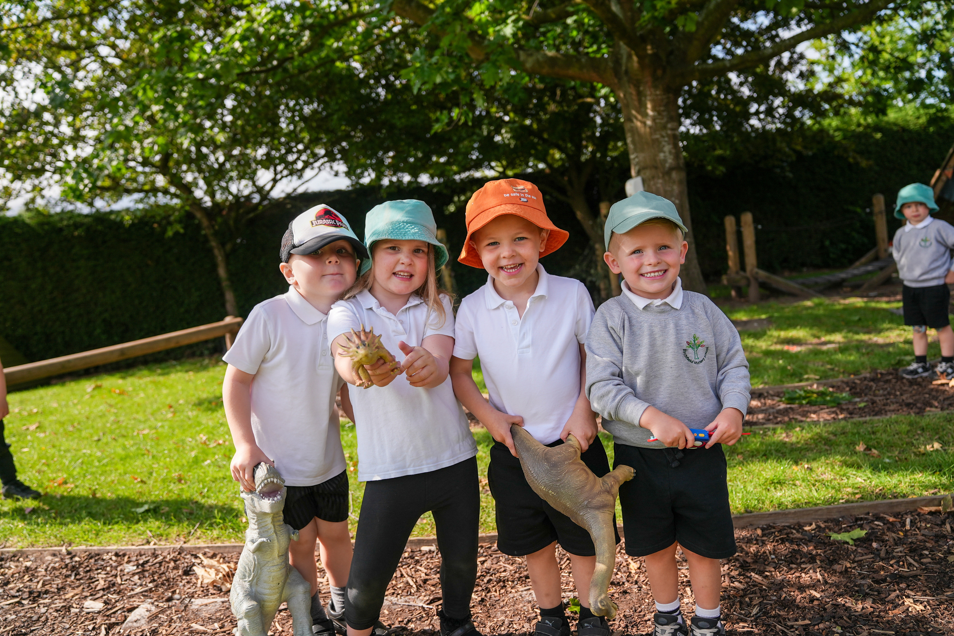
About Us
Welcome To Our School
We are local authority Maintained Nursery School which means we are a teacher led, not for profit school with was established almost 80 years ago!
We are led and staffed by highly qualified teachers and Early Years practitioners, who are dedicated to making sure your child has the very best start to their education in a caring, nurturing, high quality Early Years environment.

Slide 3
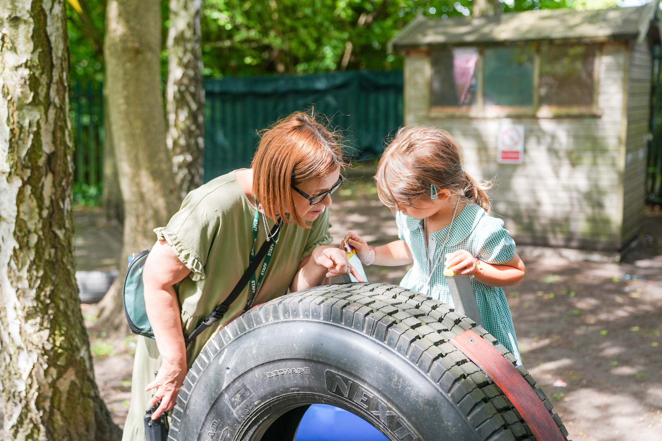
Borcelle
School
Our Vision
Aim High, Shine Bright
An inclusive, high quality, enabling environment that facilitates high levels of engagement and learning. Regularly enhanced to adapt with children's needs and interests.
01
Experienced and passionate staff who are supported on their own continuous development journey who interact sensitively with children, supporting them on their journey.
02
An appropriate but ambitious curriculum that leans into the interests of young learners and builds a sense of curiosity and ownership in each childs own journey as a life-long learner and positive citizen.
03

Slide 4
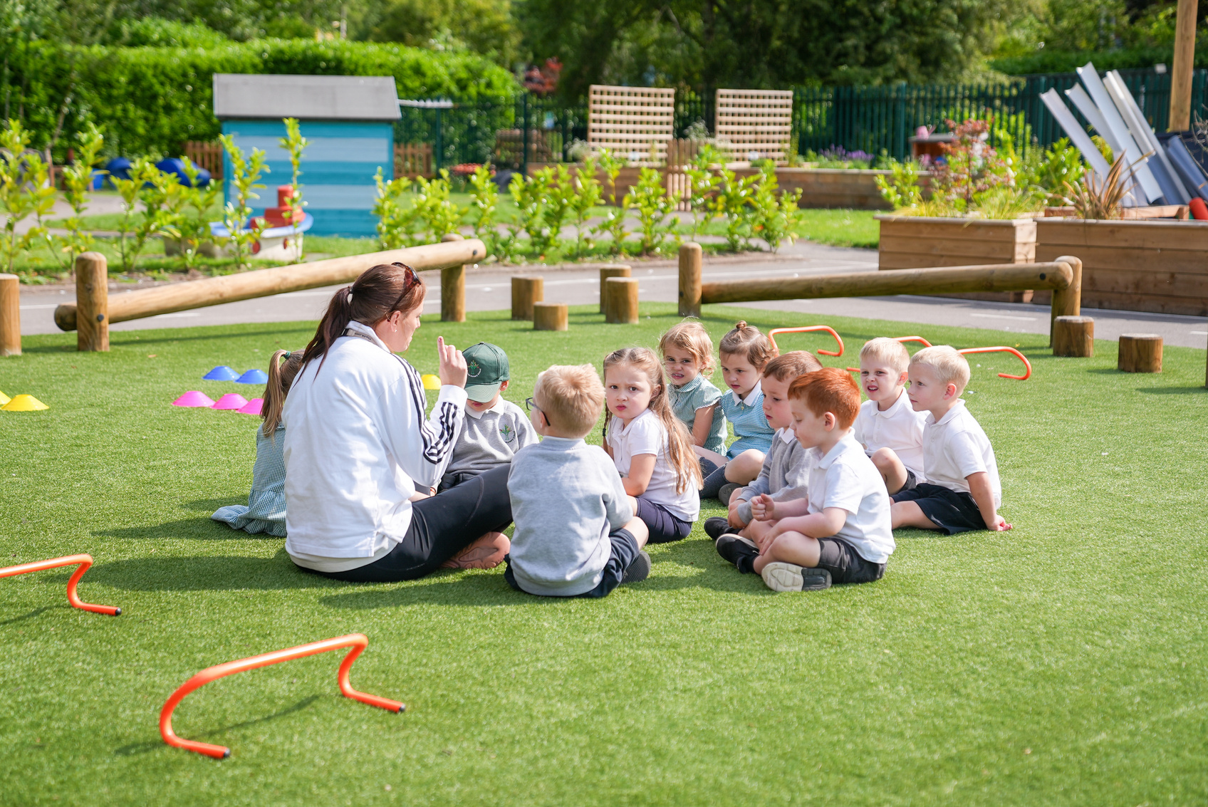
Borcelle
School
Our Mission
To provide a safe, nurturing ‘happy place’ that allows children to thrive.
01
A pledge to work in partnership with parents, carers and the wider community to support those within our own learning community and beyond. Ensuring the highest quality early years learning experience.
02
03
To support our learners in understanding and caring for their environment and the impact their actions have on it.

Slide 5
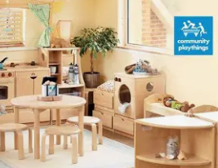
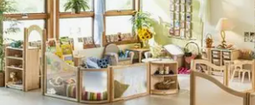
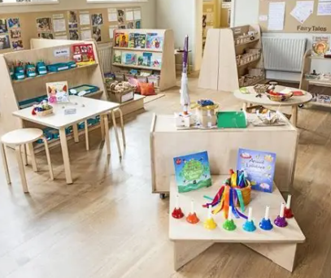
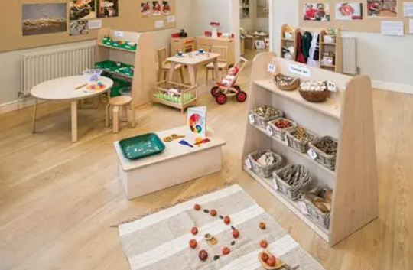
Borcelle
School
Our Provision

Slide 6
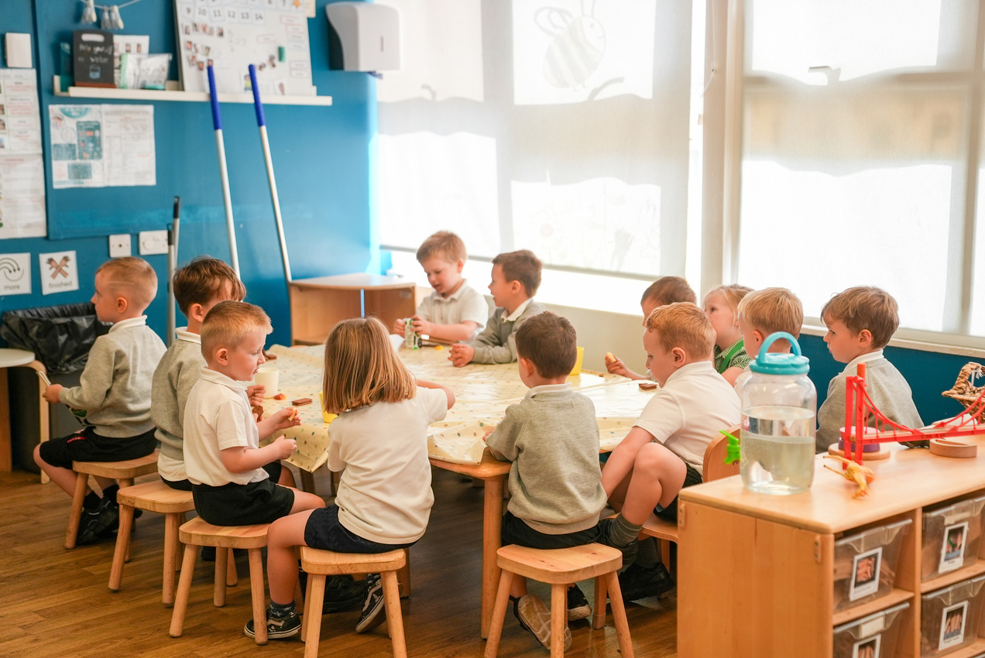
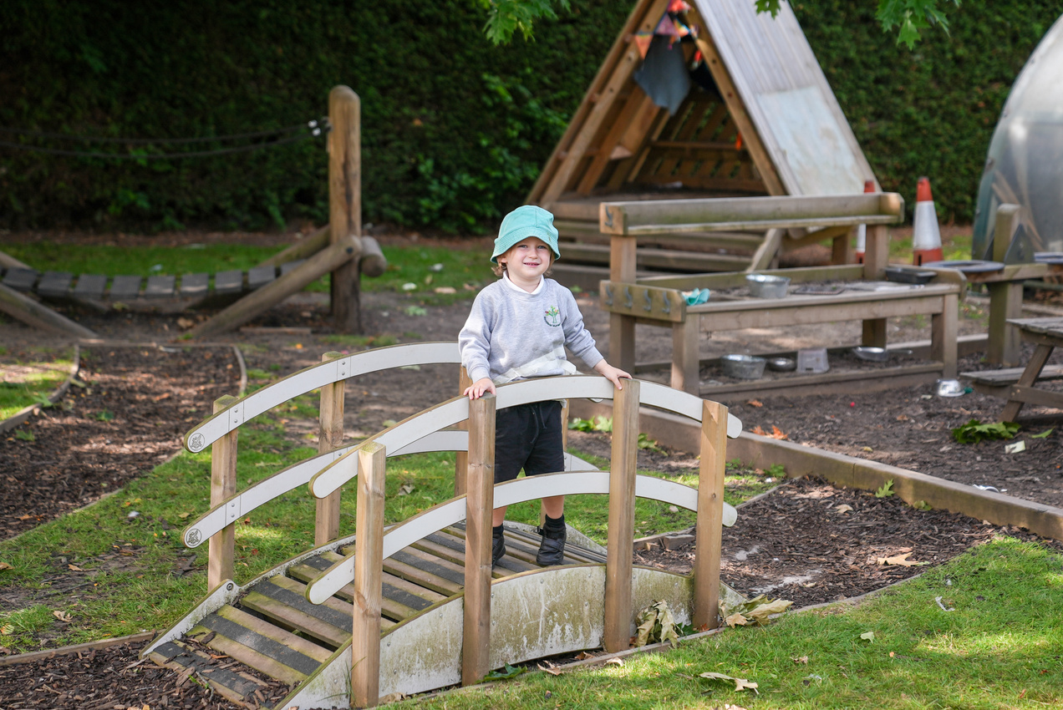
Our Day
Time to feel welcome
Time to be calm
Time to be playful
Time to be busy
Time to rest
Time to be messy
Time to be noisy
Time to be physical
Time inside
Time outside
Time to eat
Time to just be
Time for adventures!!

Slide 7
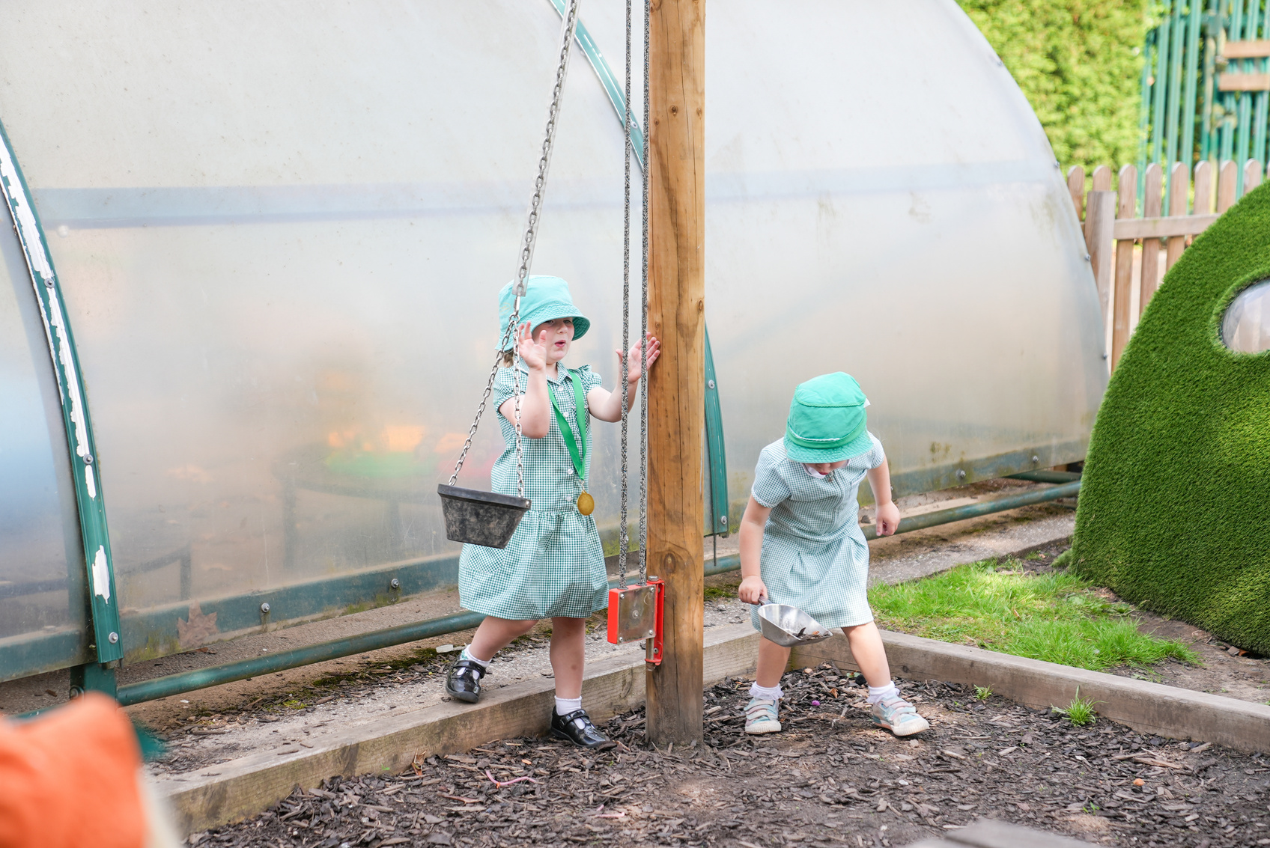
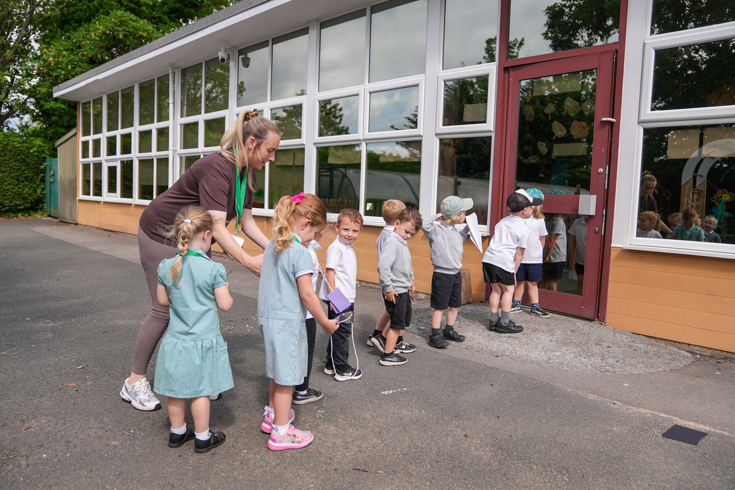
Borcelle
School
Our Rules
01
Kind thoughts
02
Kind words
03
Kind hands

Slide 8
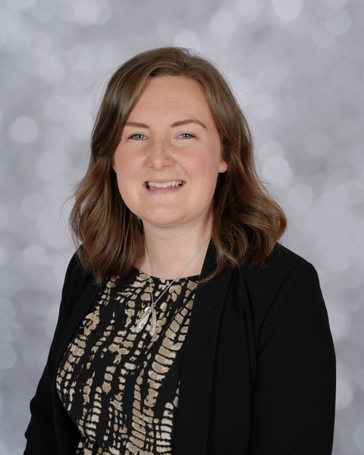
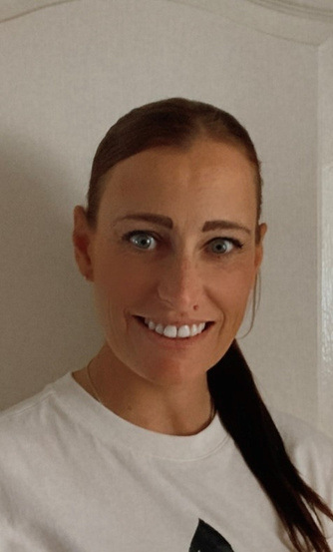
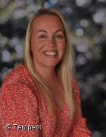
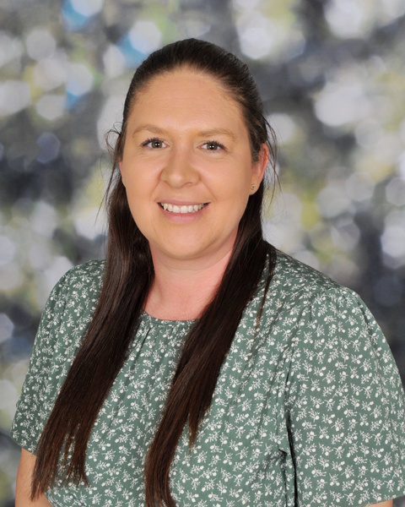
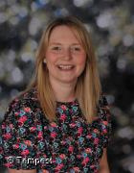
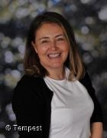
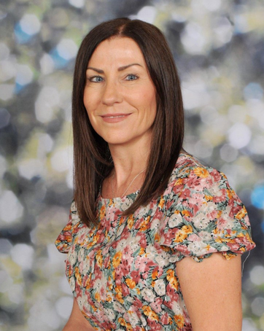
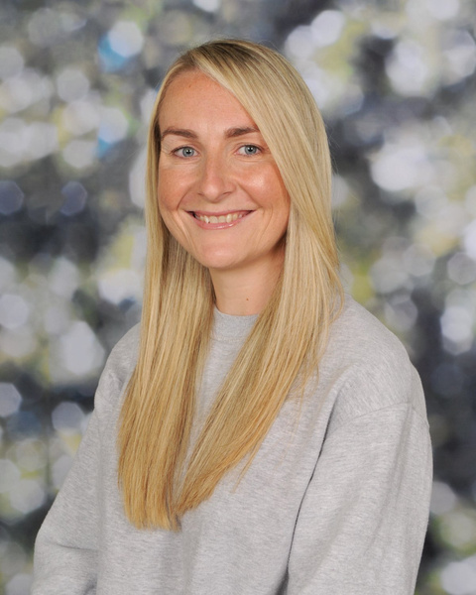
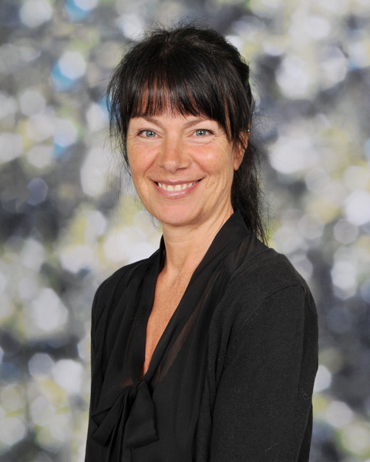
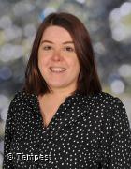
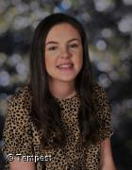

Borcelle
School
Meet Our Team

Slide 9
Our Fees
3 Year Old Chargeable Extras
DESCRIPTION | COST PER WEEK
Free entitlement hours - 15 hours per week | Free
Free entitlement hours - 30 hours per week | Free
Additional hours - lunch provision 12.00-12.45pm | £30.00
Snack (15/30 Hours) - access to fresh fruit daily | £3.00
Additional voluntary services (15/30 Hours) - Dance Additional voluntary services (15/30 Hours) - Forest School | £3.00 £3.00
Consumables (30 Hours Only) - suncream/baking/trips/visitors | £5.00
Total | £44.00
Fees are non;statutory but allow us to provide the qulaity of provision and extensive opportunities for your child.
WE URGE ALL PARENTS TO REGISTER FOR A TAX FREE CHILDCARE ACCOUNT AS THIS
ENTITLES FAMILIES TO A 20% REDUCTION ON CHARGEABLE EXTRAS.

Slide 10
Our Fees
2-Year-Old Chargeable Extras
DESCRIPTION | COST PER WEEK
Free entitlement hours - 15 hours per week | Free
Free entitlement hours - 30 hours per week | Free
Additional hours - lunch provision 12.00-12.45pm | £45
Snack - access to fresh fruit daily | £3.00
Additional voluntary services - Dance Additional voluntary services - Forest School | £3.00 £3.00
Consumables - suncream/baking/trips/visitors | £5.00
Total | £59.00
Fees are non:statutory but allow us to provide the quality of provision and extensive opportunities for your child.
WE URGE ALL PARENTS TO REGISTER FOR A TAX-FREE CHILDCARE ACCOUNT AS THIS
ENTITLES FAMILIES TO A 20% REDUCTION ON CHARGEABLE EXTRAS.

Slide 11
Wrap Around Care
We offer the following Wrap Around Care:
Breakfast Club (Monday-Friday 8.00am-9.00am)
A maximum of 16 spaces available.
Cost is £6.50 per session and will include a selection of appropriate breakfast food items
and drink choices.
After-school Club (Monday-Friday 3.45pm-4.30pm)
A maximum of 8 spaces available.
Please let us know if you would like your child to access Wrap Around Care.

Slide 12
Our Uniform
Core Uniform (Available from Boydell’s suppliers)
https://www.boydellsport.com/
Grey School logo Jumper/Cardigan
White polo
Black joggers/leggings/shorts
Black velcro fastening trainer style/comfortable flat shoes
Optional
School Coat
School Cap
PLEASE LABEL ALL UNIFORM CLEARLY AND IN AN ACCESSIBLE PLACE

Slide 13
Forest School
Mrs Helen Young
Forest School/Literacy Lead

Slide 14

Curriculum Enhancements
Mrs Royle
Physical Education
Learning Challenge – Big Question of the week
Mrs Julia Royle
Physical Education and
Learning Challenge Curriculum Lead.

Slide 15


Borcelle
School
Contact Us
0151 424 4681
https://www.birchfieldnursery.co.uk/
office@birchfiled.halton.sch.uk
3 Victoria Avenue, Widnes, WA87TH

Slide 16
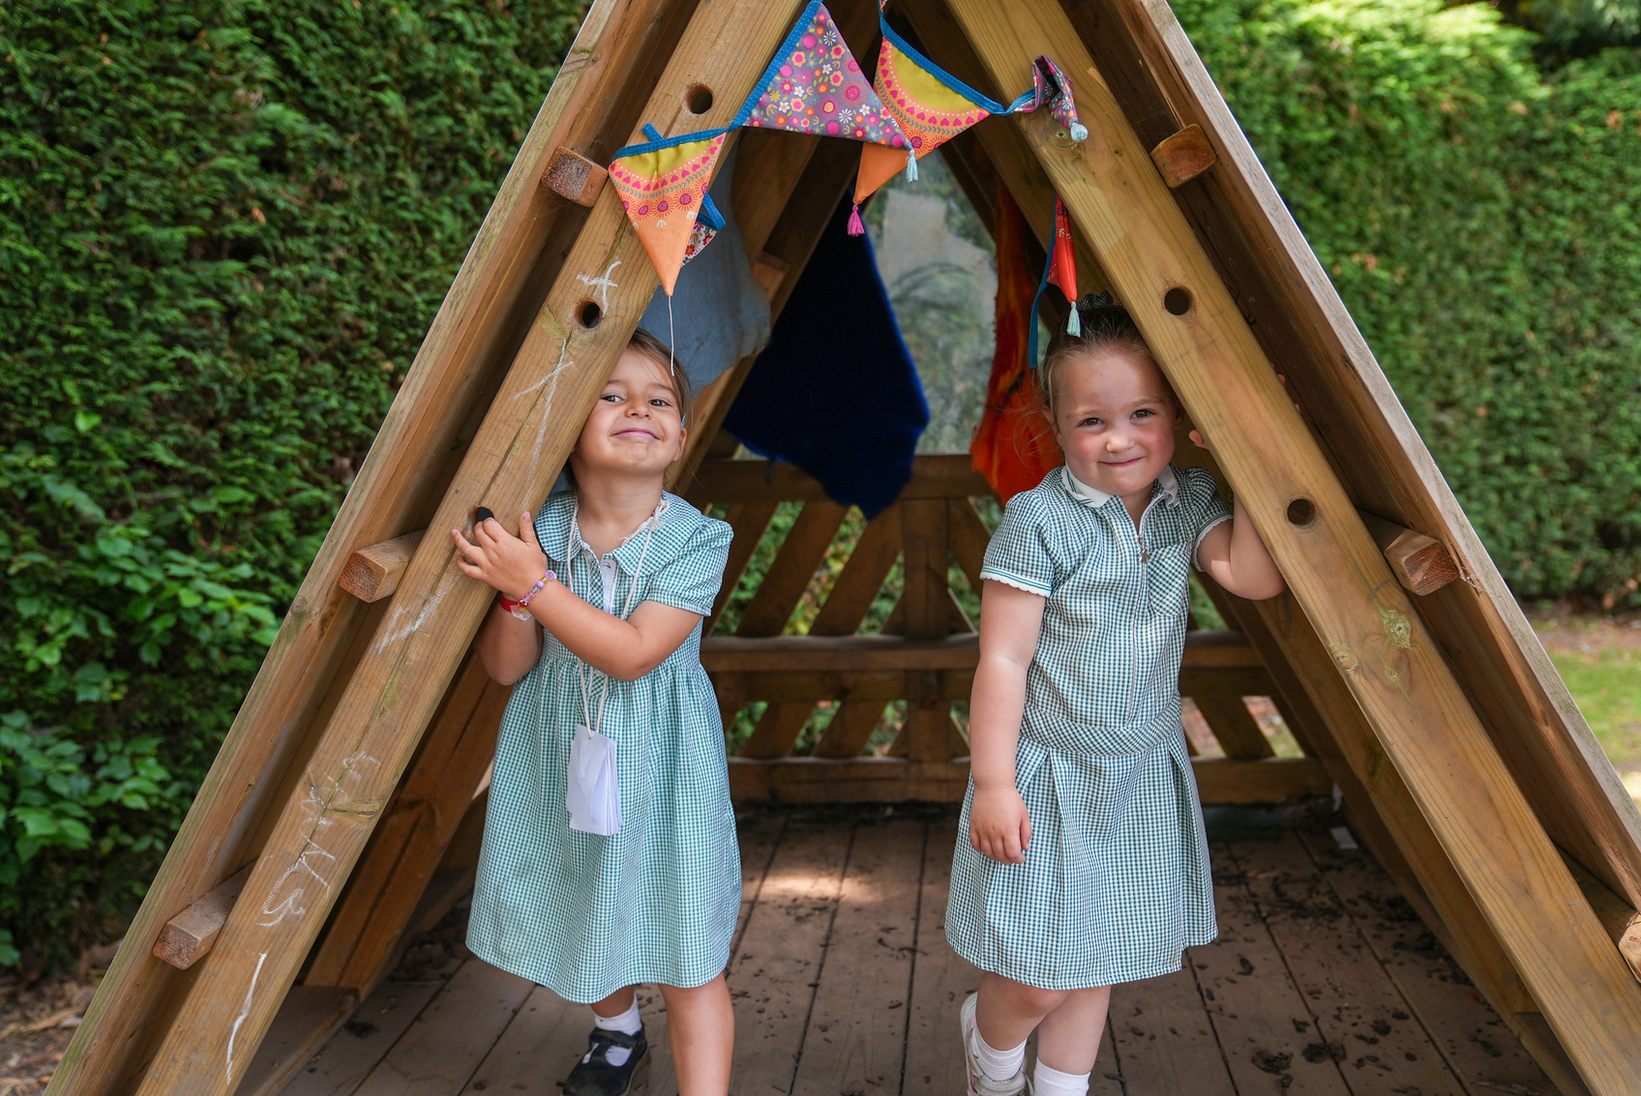
Borcelle
School
Thank You

Slide 17




Calm down my big feelings
Change activity calmy on request
Use the toilet with limited support
Getting ready to start my Birchfield journey
Put on and take off my coat
Pay attention to an activity for 2-3 minutes
Play a game with another child
Follow a simple instruction
Open a food packet

