Slide 2
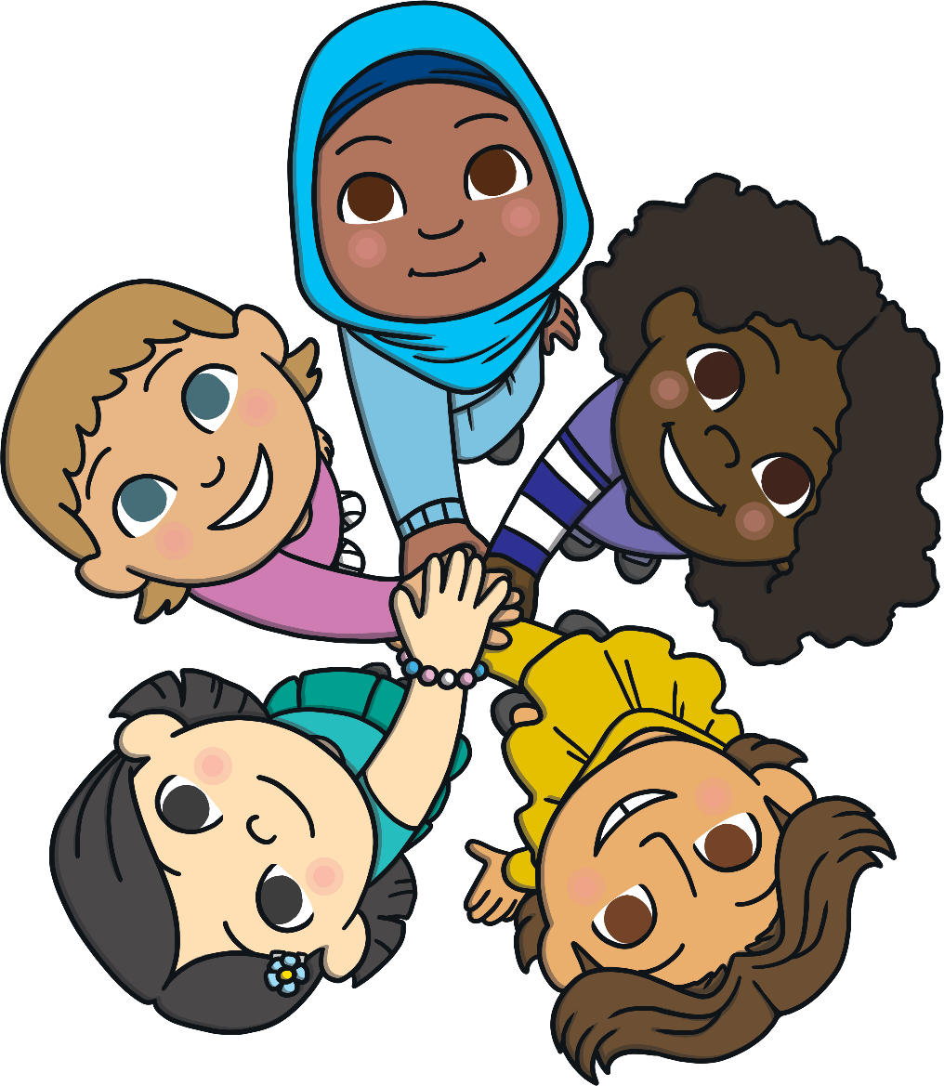
Aim
To explore what bullying is, how it can affect people and what we can do to help tackle it.

Slide 3
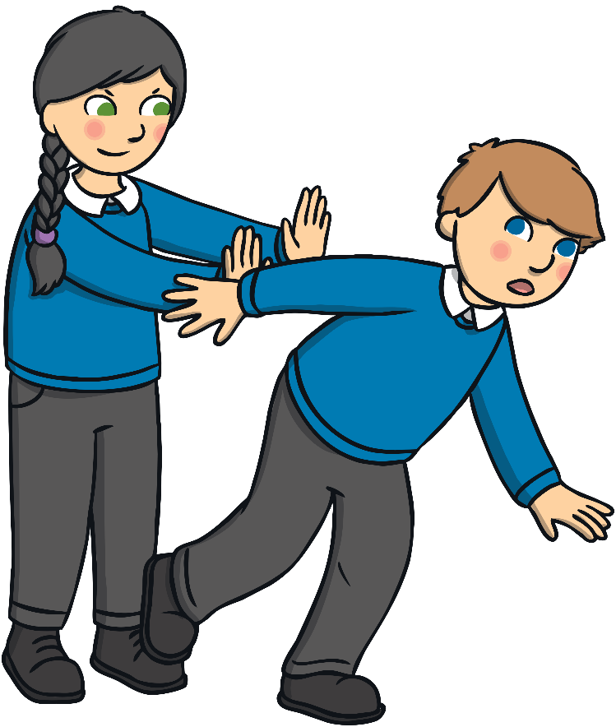
What Is Bullying?
Bullying is behaviour that repeatedly hurts
someone or a group of people on purpose.
Bullying behaviour can be unkind actions
or words.
Bullying can include situations where
someone feels or makes others believe
that they are more powerful or important
than someone else. This is called an
imbalance of power.
Bullying can happen to anyone.
Bullying is not OK.

Slide 4
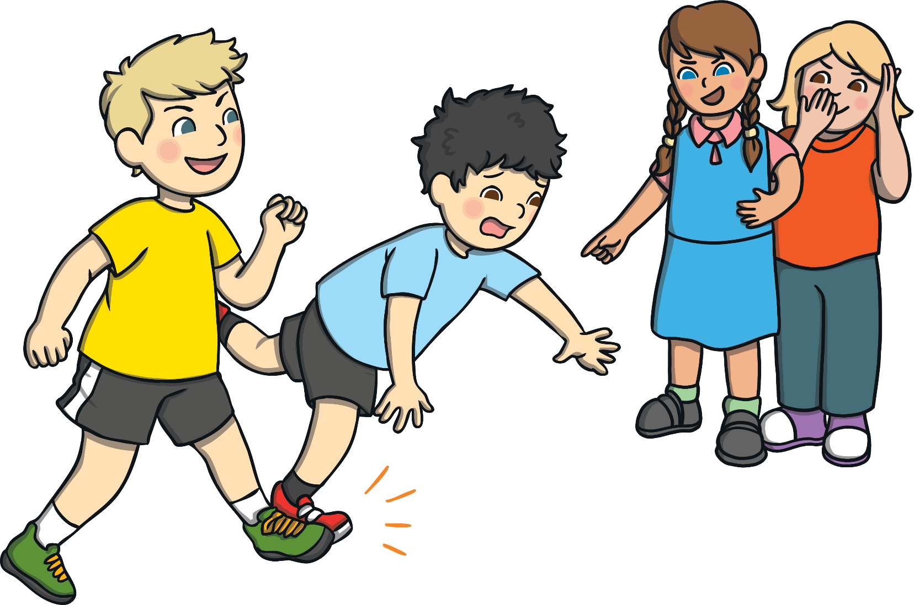
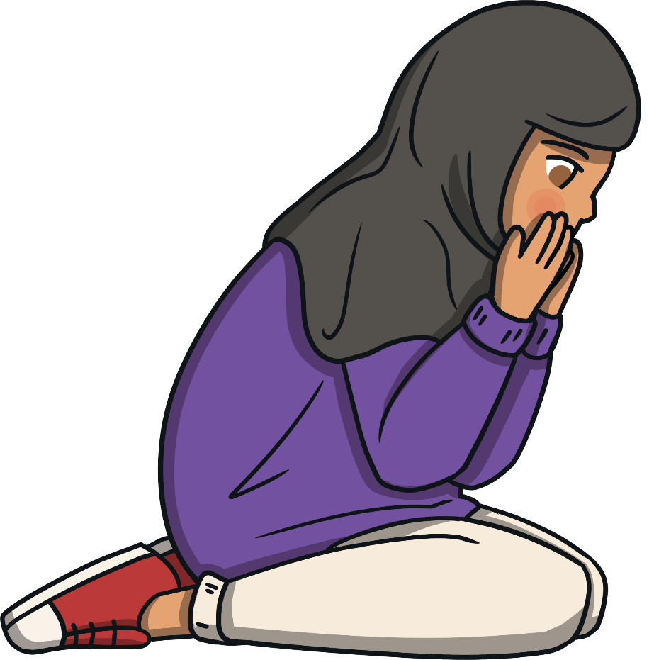
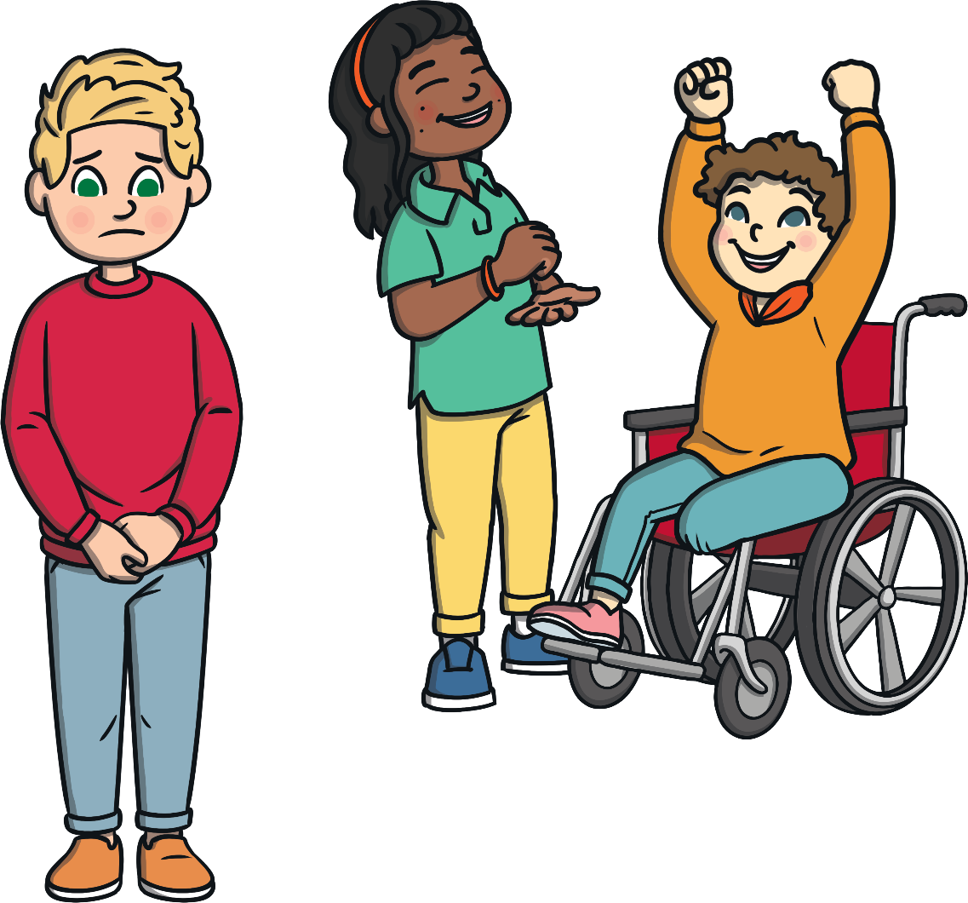
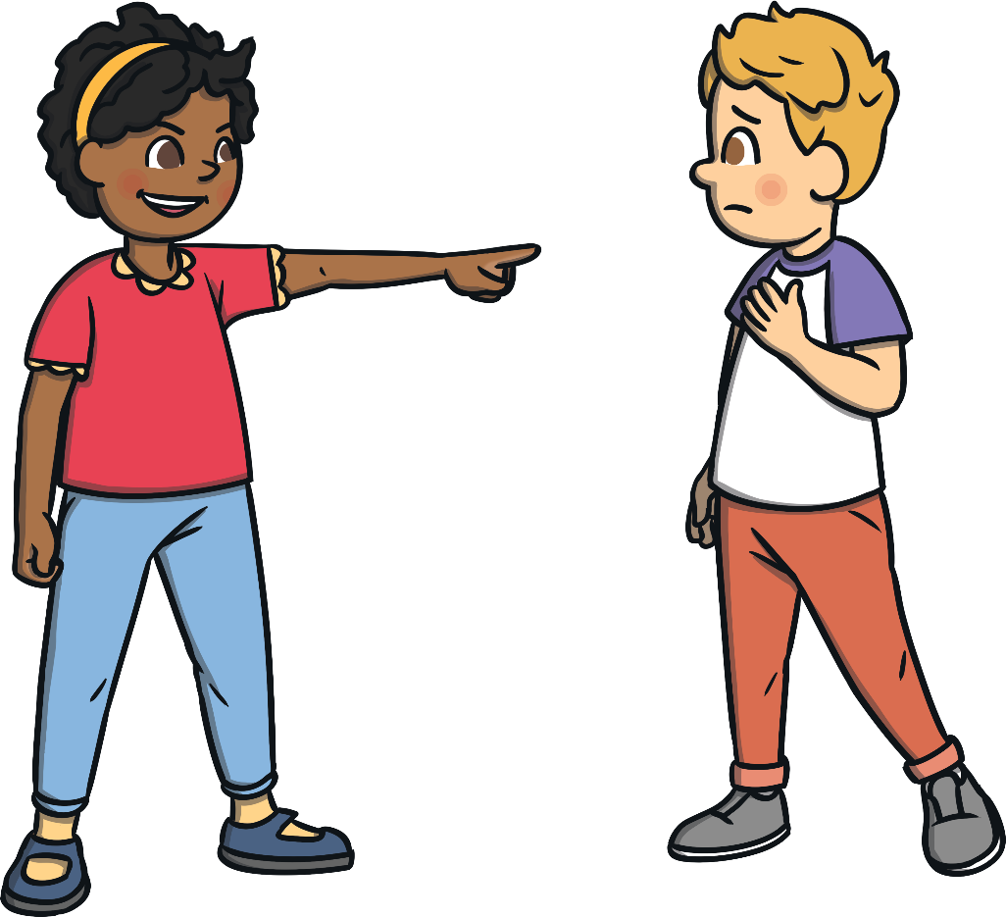
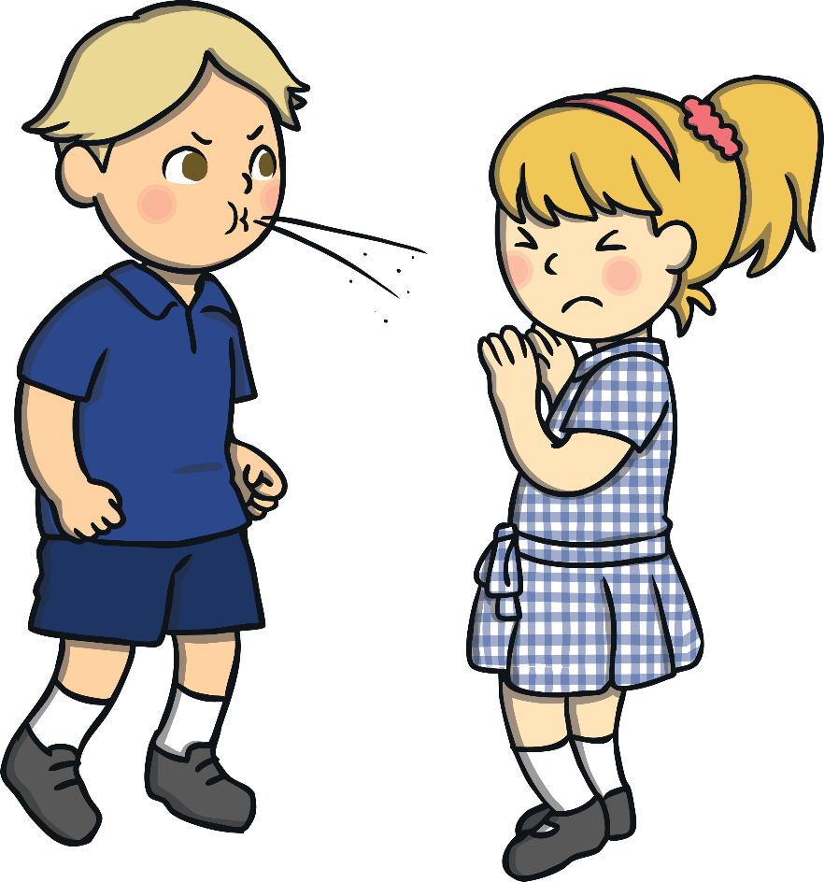



What Might Bullying Look Like?
What is happening in the pictures?
How are the people in these pictures being bullied?

Slide 5
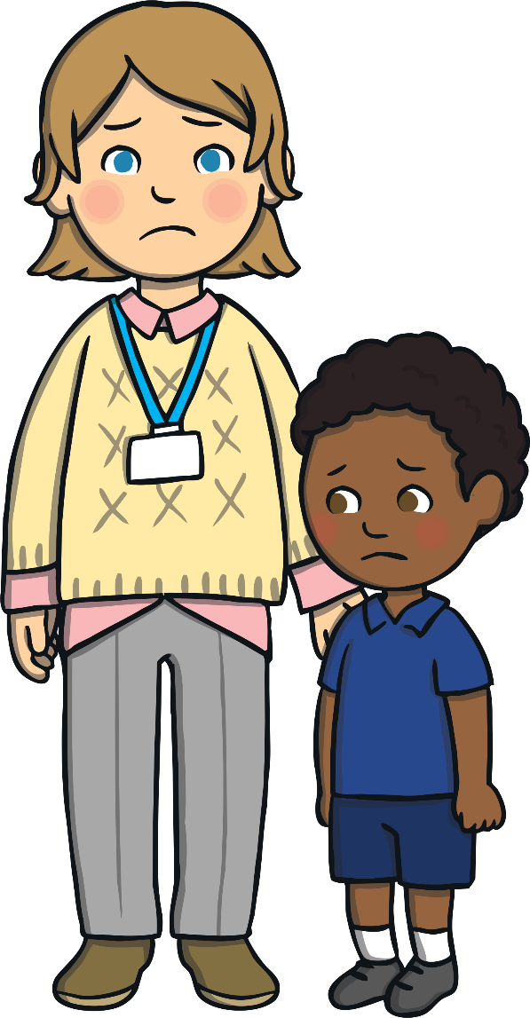
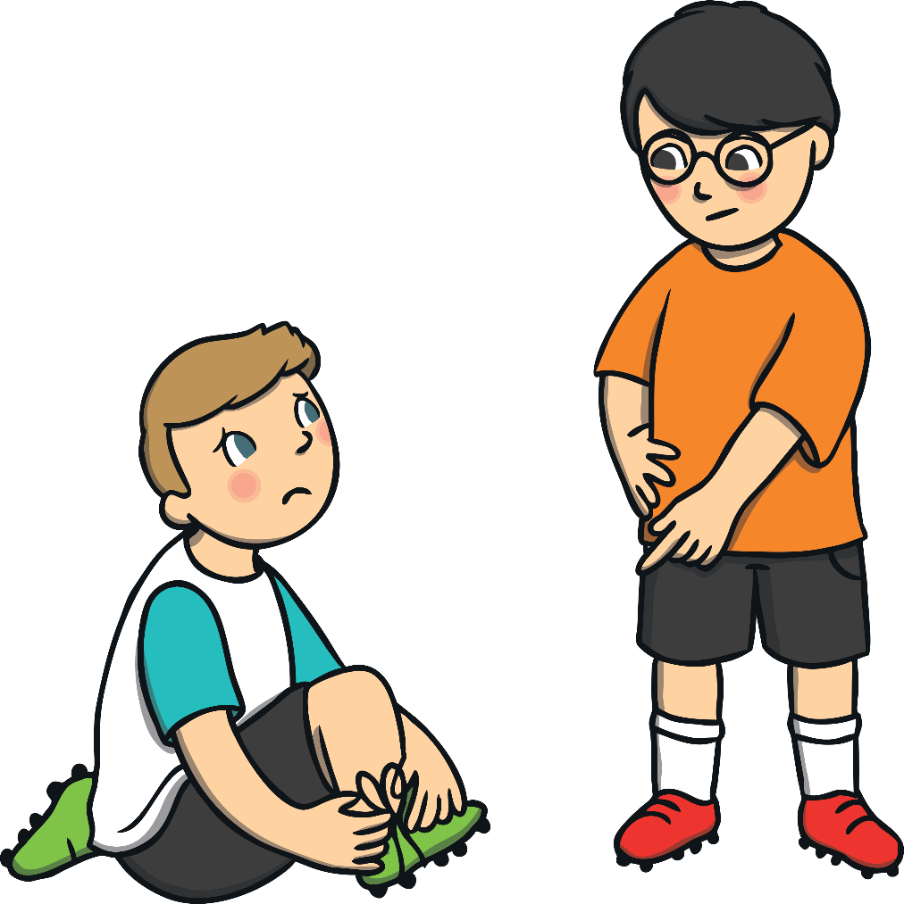
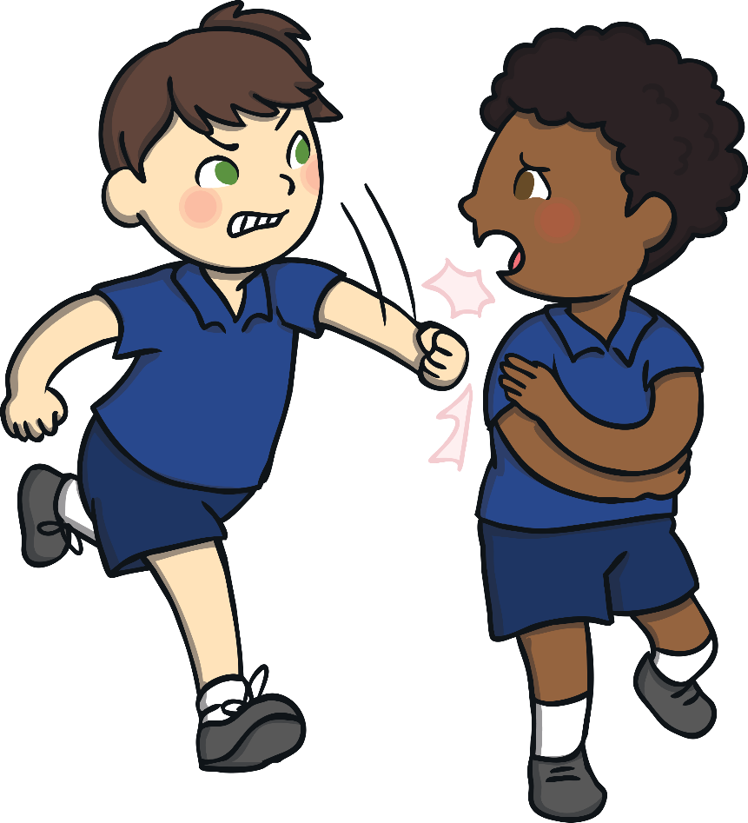
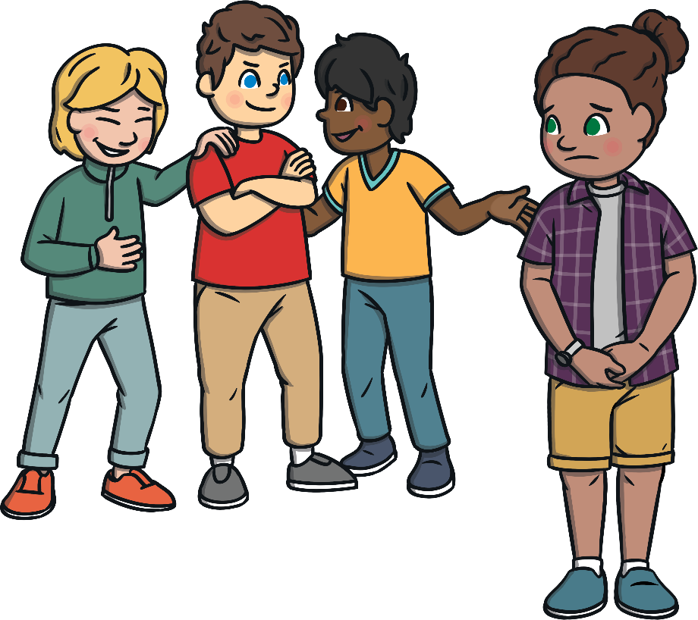
How Can Bullying Affect People?
What is happening in the pictures?
How are the people in these pictures being bullied?
Bullying can isolate people. This means they feel lonely and feel they have nobody they can turn to.
Bullying can make people feel like they don’t matter.
Bullying can make people feel lots of uncomfortable emotions.
Bullying can stop people from doing their best in and
out of school.

Slide 6

How Can Bullying Affect People?
Bullying can affect people’s mental health
and wellbeing.
Bullying can make people feel angry and
can cause them to get into trouble.
The effects of bullying can stay with people for a long time.
The good news is that we can do something about bullying!

Slide 7
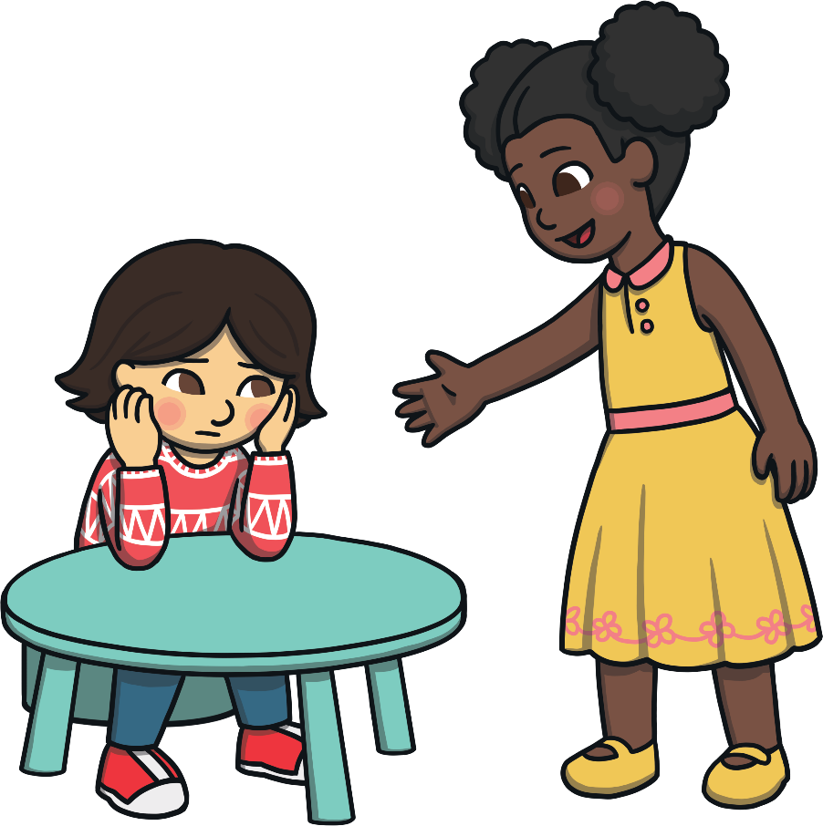
Tackling Bullying
Bullying is unacceptable and everyone has the right to a life without being bullied.
However, bullying won’t go away on its own. We all need to make changes and take action against bullying.
What do you think we can do
in our day-to-day lives to make
a difference?
Take a moment to think about this.

Slide 8

Anti-Bullying Week
Anti-Bullying Week is an annual event organised by the Anti-Bullying Alliance.
Schools across England take part in this event each November to try and spread awareness about bullying in all forms and how to stop it.
The Anti-Bullying Alliance choose a theme to focus on each year. They work with over 1,000 children and young people to decide the theme every year.
This year, the theme for Anti-Bullying Week is Reach Out.

Slide 9
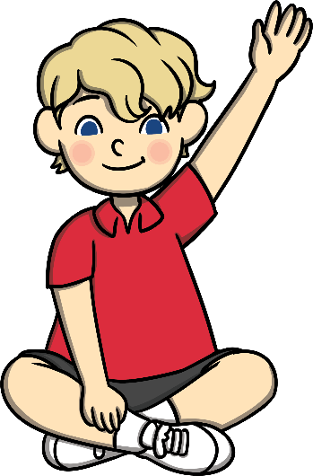

Reach Out
Reach out and speak to an adult you trust.
Reach out to somebody you know who is being bullied.
Reach out to a trusted adult if you know someone who is bullying others.
Reach out and help make changes in your school for the better.

Slide 10
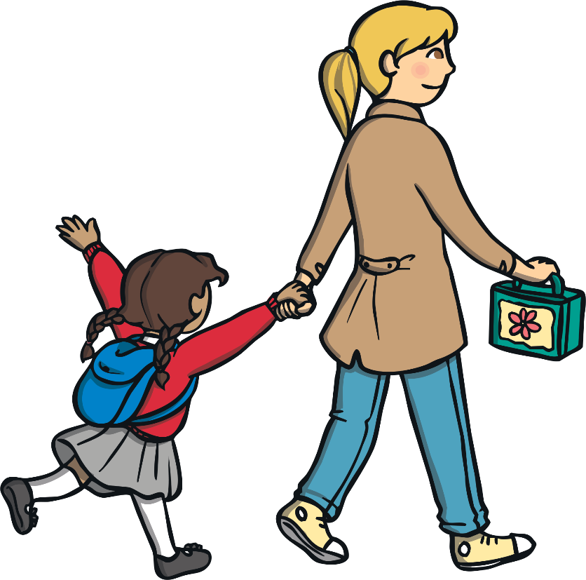
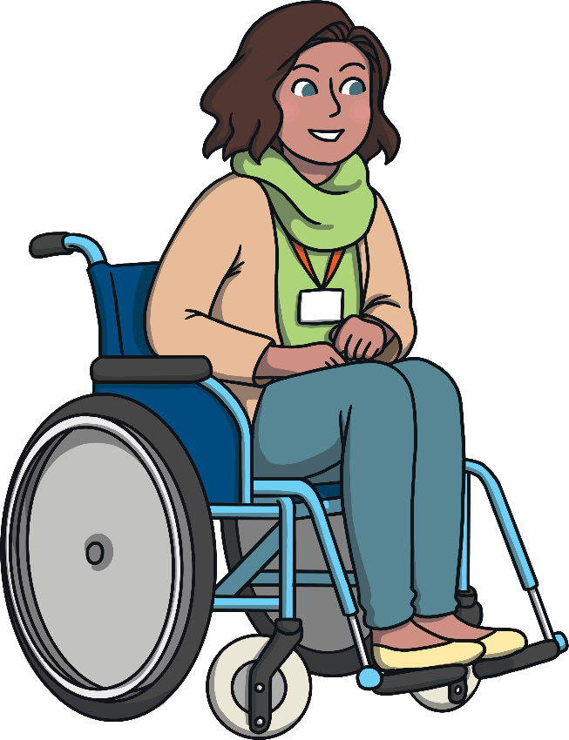
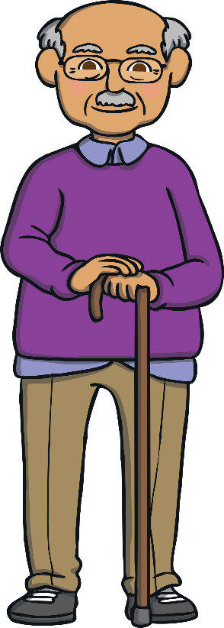
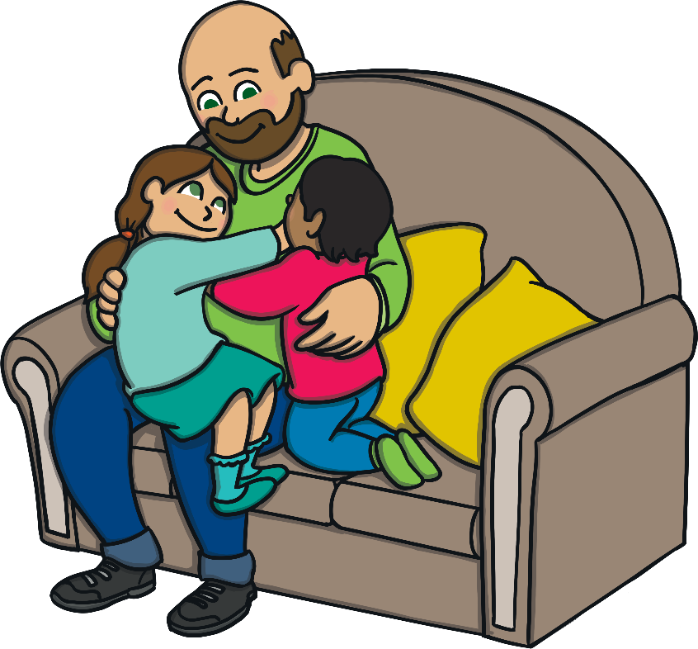
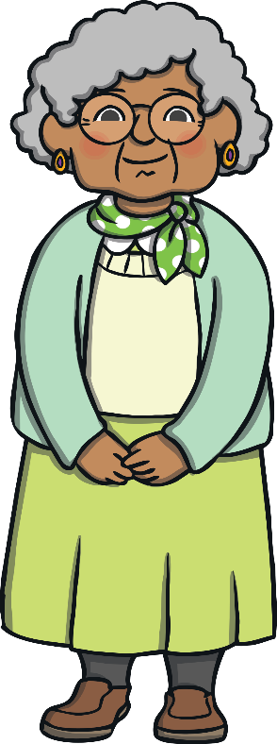
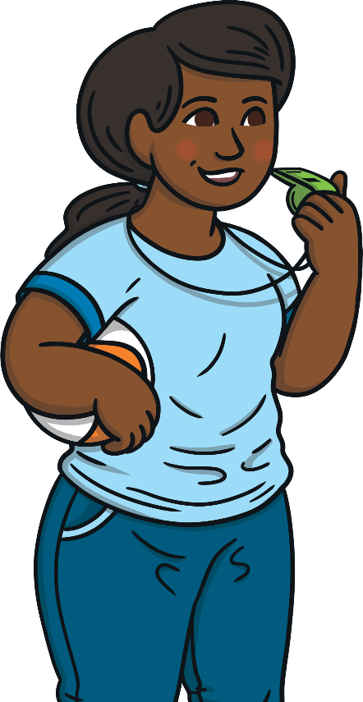
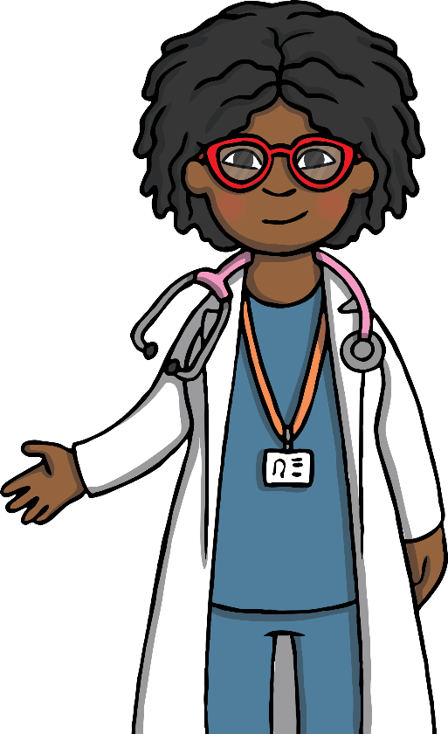
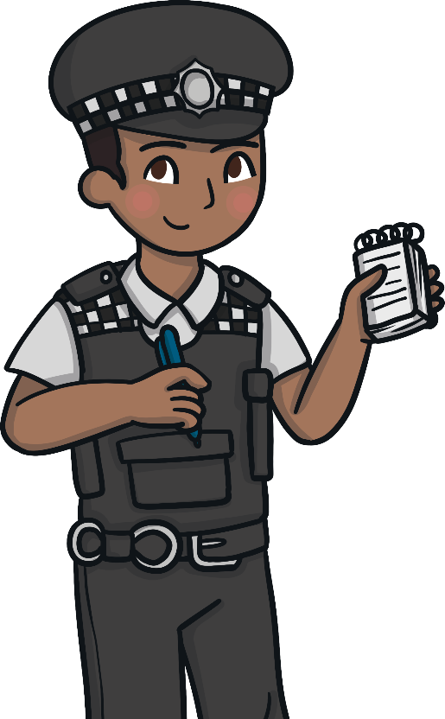
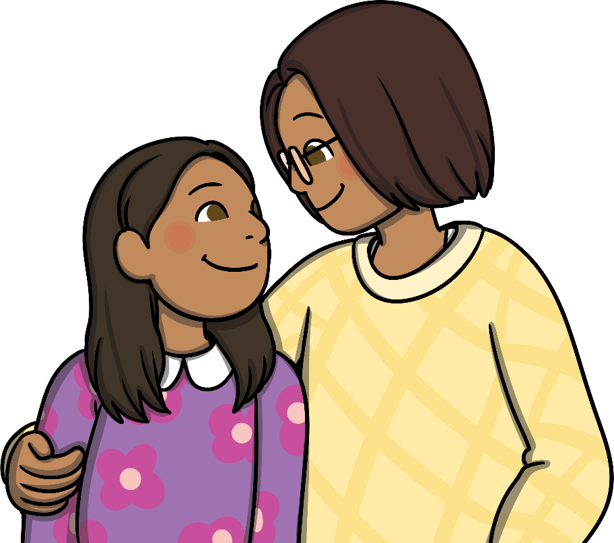
Reach Out
If you have any concerns about bullying or if you feel any uncomfortable emotions linked to bullying, it is important that you speak to an adult you trust.
An adult you can trust is someone you feel safe with, who makes you feel comfortable and who you can ask for help when you need it.
Everyone's trusted adult will be different because everyone is unique and has had different experiences.
Who could your trusted adult be?
grandparent
other family members,
such as aunts and uncles
teachers
childminder
sports coach
someone whose job
it is to keep us safe
parent

Slide 11
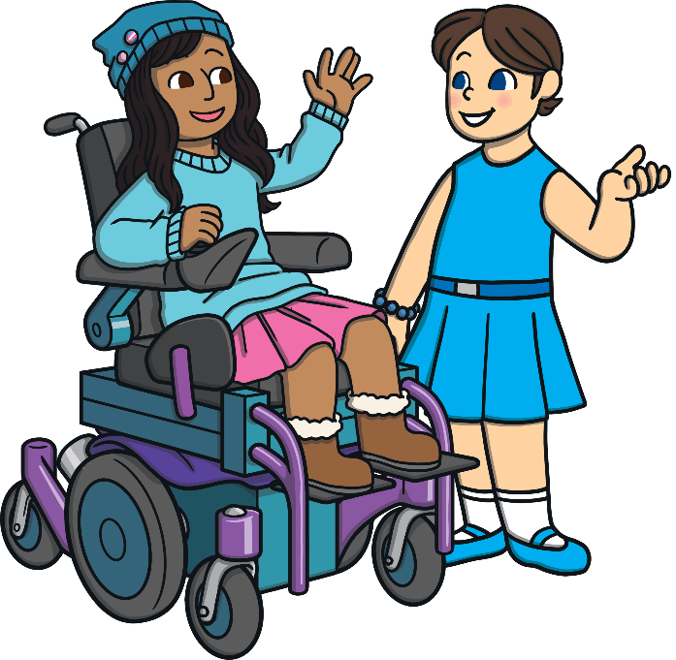
Working Together to Make a Difference
We can all choose
to take small actions:
be kind to everyone, through our words and actions
include others in our games and conversations
treat everyone with respect, no matter who they are, how old they are, where they are from, what they look like, what they can or can’t do or what they do and don’t like

Slide 12
Working Together to Make a Difference
We can all choose to make small changes:
celebrate differences as our differences are what make us special
say no to bullying behaviours
look out for people who are sad or lonely and make time to ask if they are OK
remember everyone deserves to be healthy, happy and safe

Slide 13



Working Together to Make a Difference
Everyone has a responsibility to work together to stop bullying.
Can you think of anything else?

Slide 14
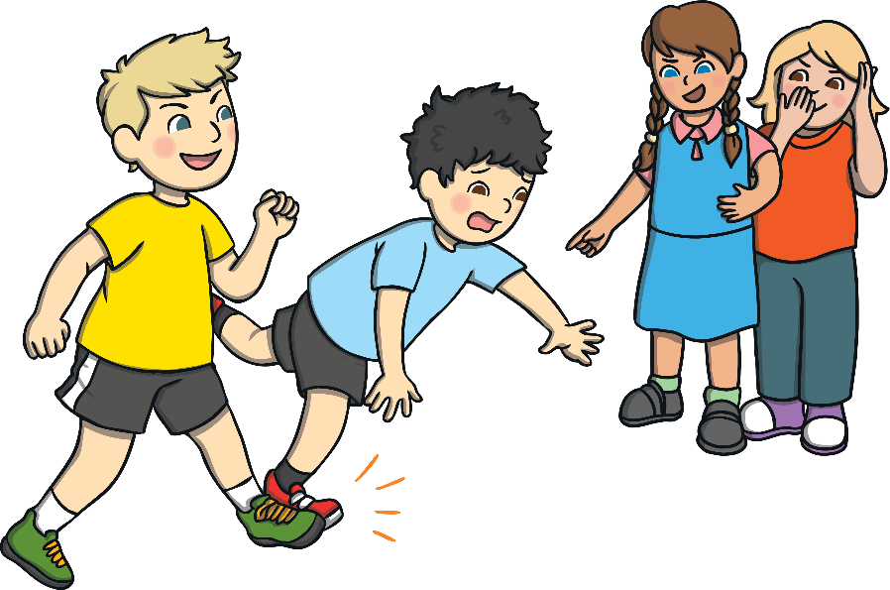
Working Together to Make a Difference
What could you do if you see someone being bullied?
What could you do if you experience bullying?
Remember, bullying is unacceptable and there are people who can help. If you are worried about bullying, it is important to talk to a trusted adult and ask for help.

Slide 15
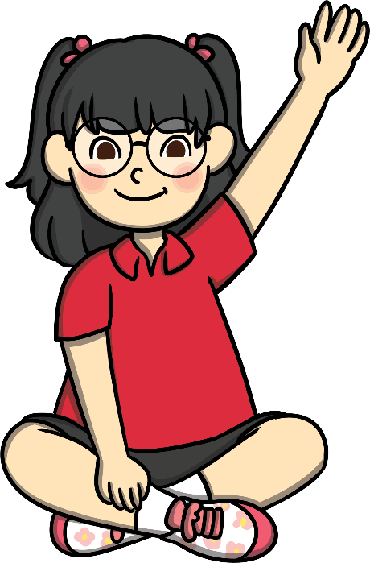
Reflection
Making small changes and taking small actions can make a big difference in helping to stop bullying.
What actions are
you going to take?
What changes are
you going to make?
Remember to Reach Out!

