Slide 1



Slide 2


Bonfire Night & Halloween
2020 During COVID19 restrictions
This year England, like the rest of the world is subject to social distancing and restrictions to control the spread of the Virus.
No-one is allowed to gather outside in a group bigger than 6 people.
Please make sure you stick to the restrictions in YOUR AREA

Slide 3


Halloween and Bonfire Night
Personal Safety

Slide 4
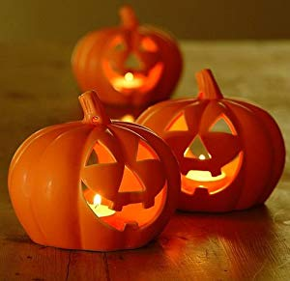
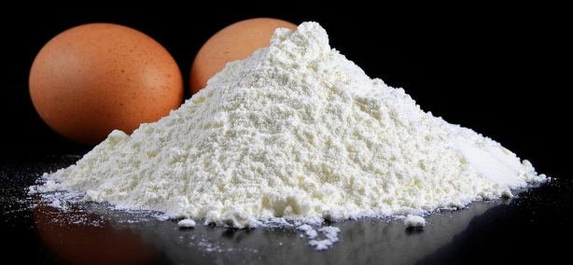

What kind of things Should we NOT do on Halloween?

Slide 5

DON’T play tricks or games like ‘knock a door run’ – people may get frightened, consequences could get you in trouble with the police!
DON’T go out on your own, you may get lost – Always stay with an adult
We have signs which people can put up if they don’t want to be disturbed on Halloween – don’t think these homes are miserable and boring. It may be that they have a baby in the house or are elderly

Slide 6



Anti-Social Behaviour
Throw Eggs and Flour
Smash windows
Damage to cars
Intimidate people

Slide 7
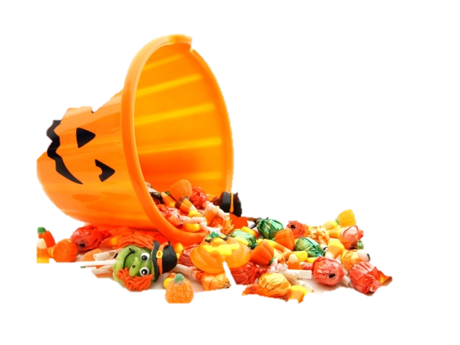
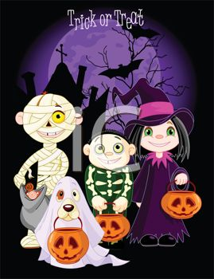
What kind of things
should we DO on Halloween?

Slide 8
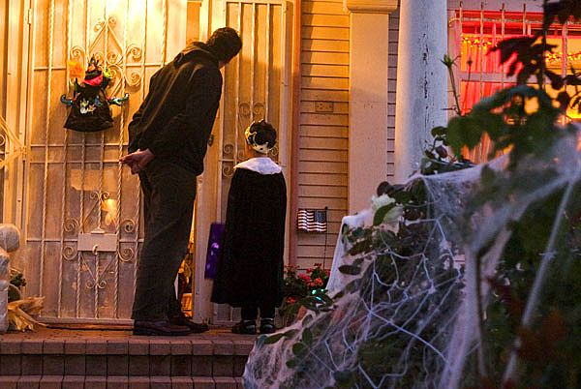
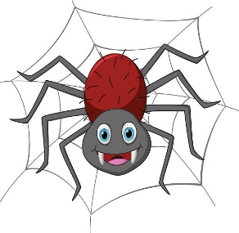
Sadly we won’t be able to do trick or treat this year
Go out with a parent
Wear bright reflective clothing
Carry a torch
Respect people’s property
Say please and thankyou

Slide 9

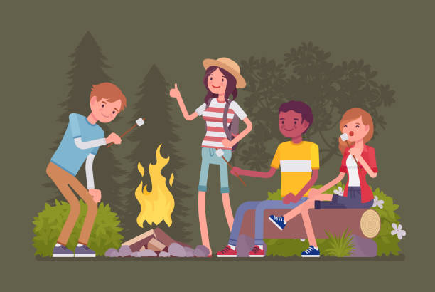
HOME BONFIRES
Make sure your bonfire is not too big for your garden
Make sure no trees are over hanging the fire, also make sure it’s not close to any outbuildings.
Stand well back
Don’t throw items into the fire
Always keep a bucket of water or sand close by

Slide 10

FIREWORKS
You cannot
Buy or carry any fireworks (under 18)
Throw a firework
Let fireworks off in a public place
Set off fireworks between 11pm and 7am on normal nights
Never go back to a firework which has not gone off, tell an adult.

Slide 11

The Law
Using materials such as fencing and wheelie bins
for bonfires which belong to other people is
classed as theft & or damage to property.
Lighting bonfires is classed as arson and if it
endangers someone’s life it can lead to a
sentence of life imprisonment.

Slide 12
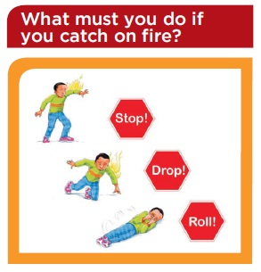
Do you know what to do if your clothes are on fire?
STOP!
DROP!
ROLL!
STOP, DROP, ROLL - https://www.youtube.com/watch?v=MySKfhQqens

Slide 13
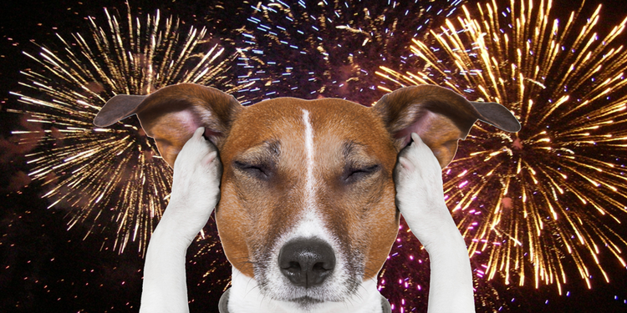
PETS
Always keep pets indoors as they get very frightened by the noise

Slide 14

ANY QUESTIONS

