Slide 1
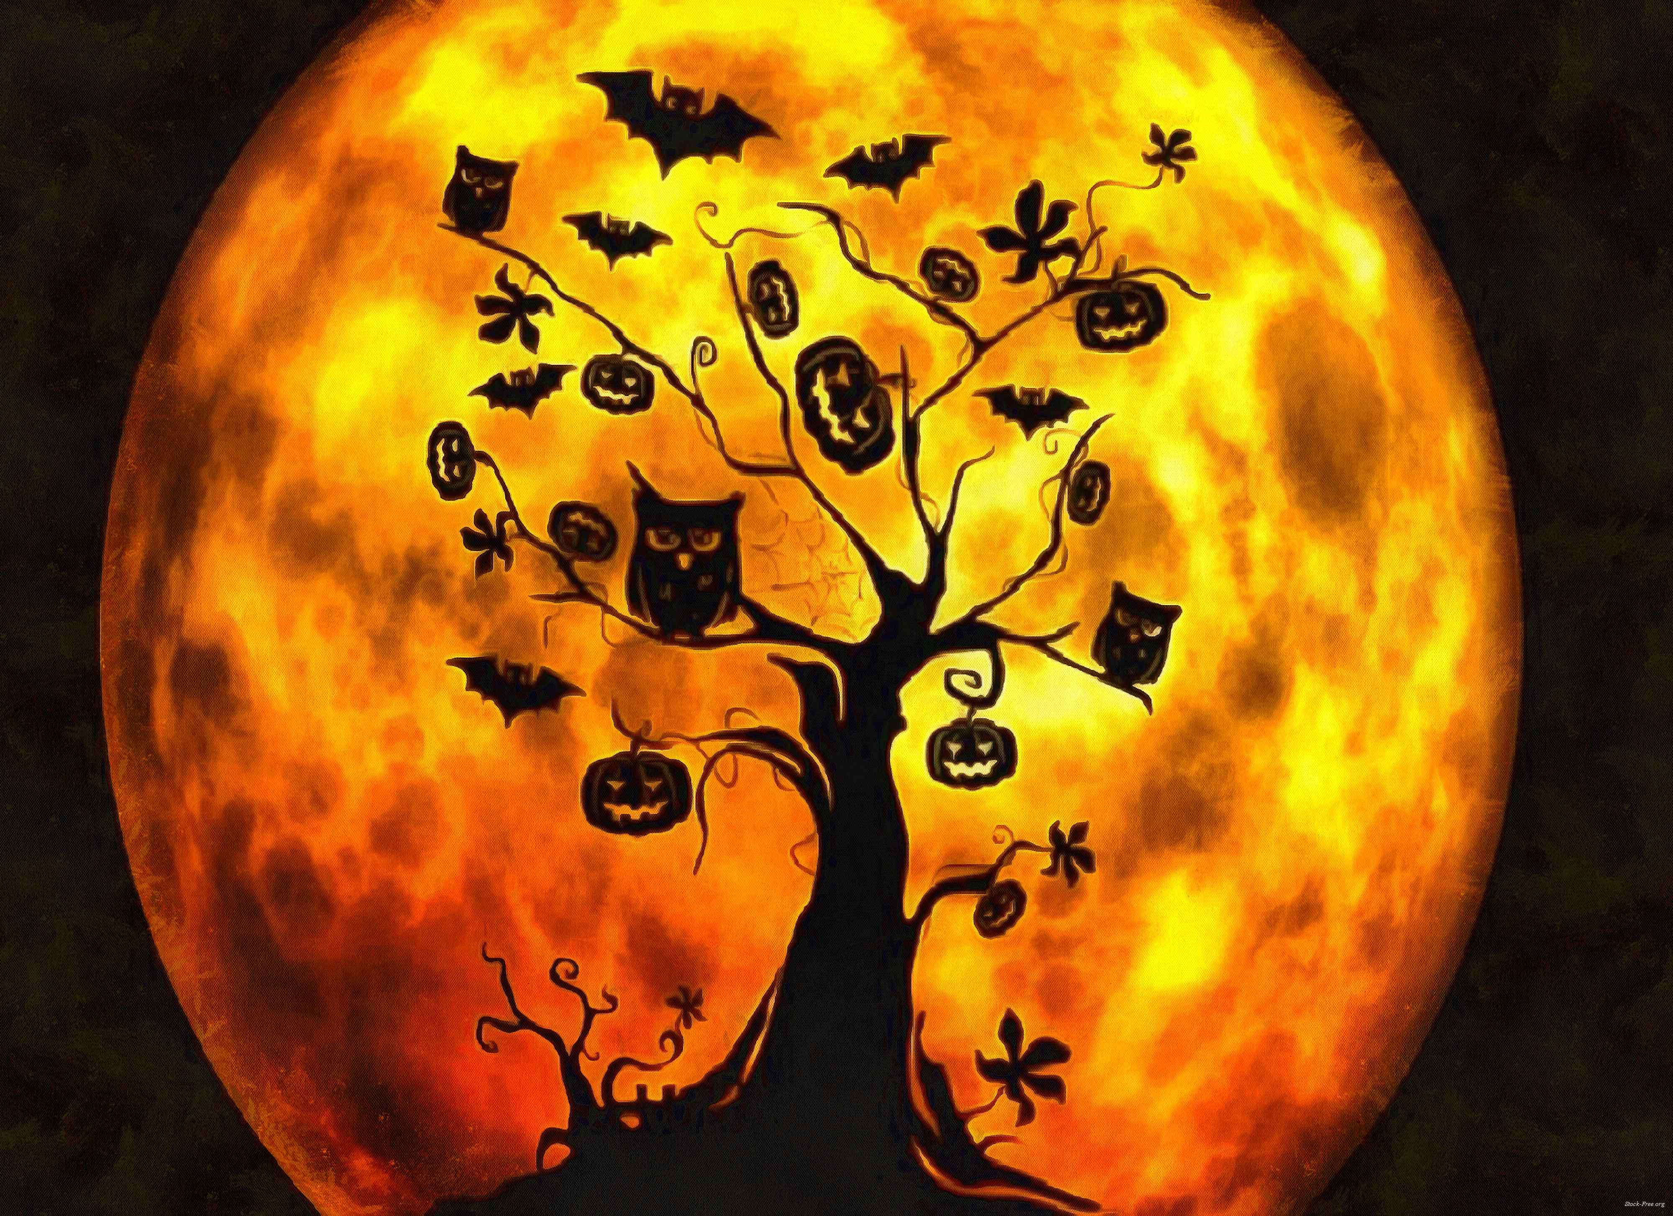
HALLOWEEN
Halloween

Slide 2
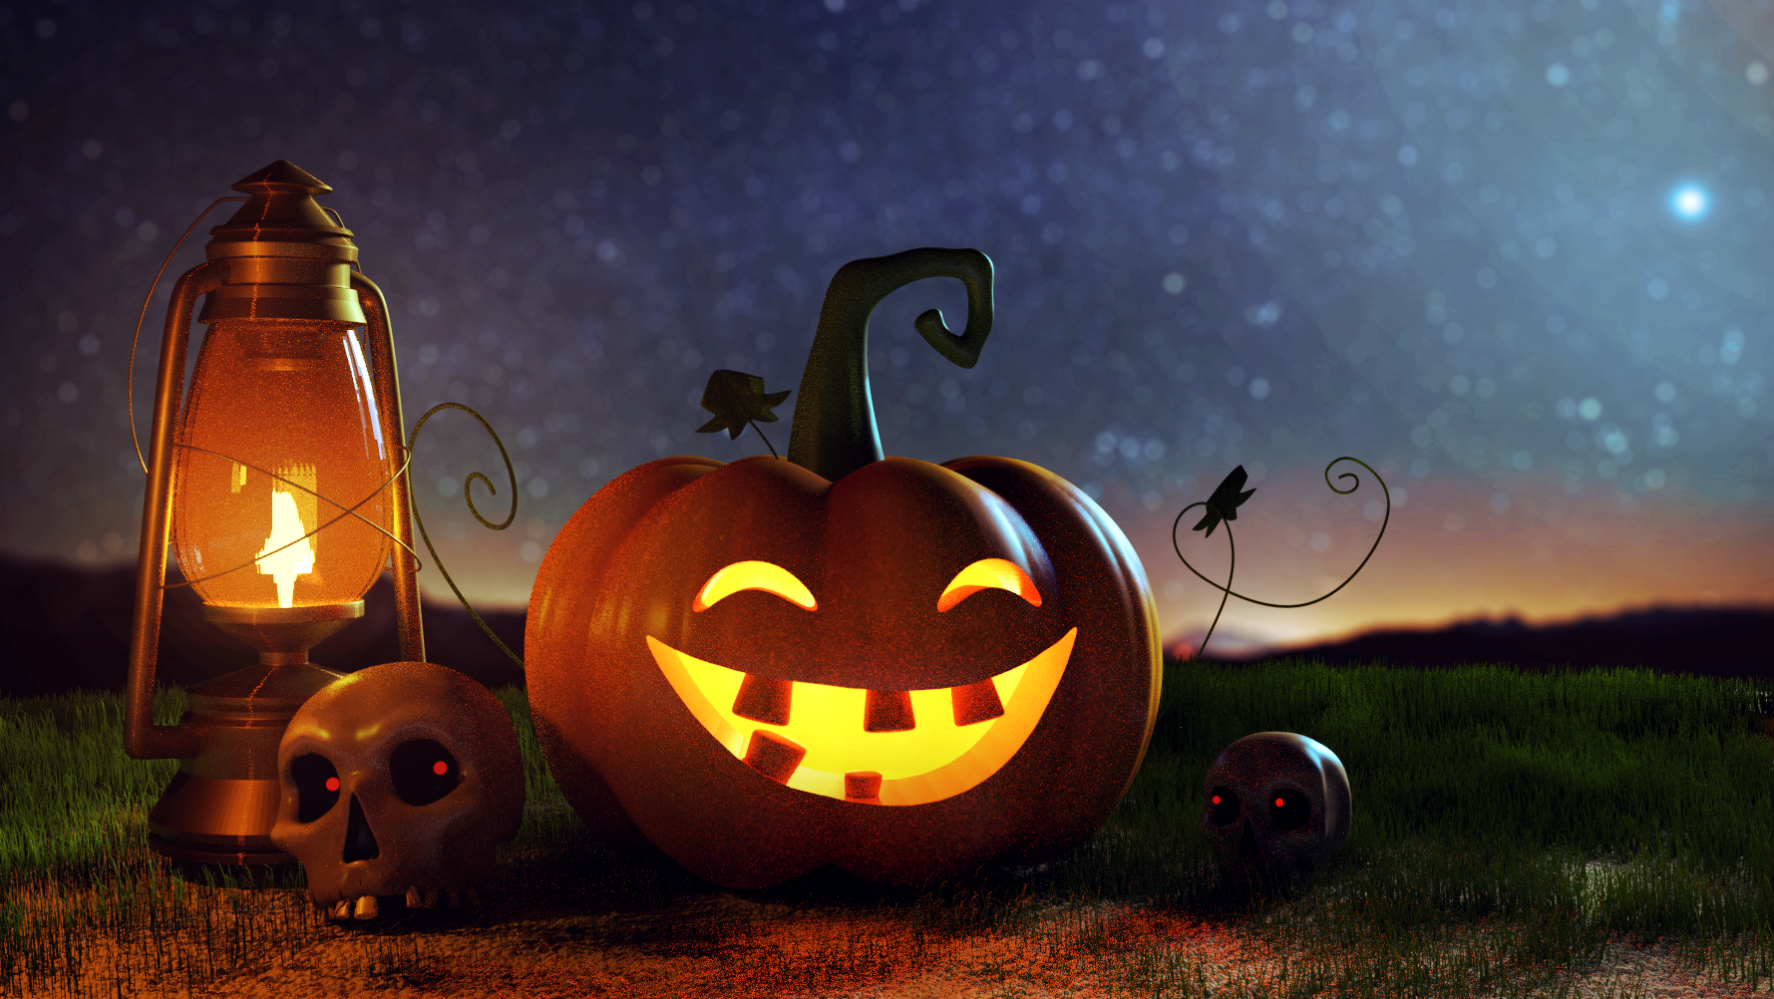
BE BRIGHT BE SEEN BE SAFE

Slide 3


Green Card
Red Card

Slide 4
So Halloween is coming up
People may be going trick or treating by themselves . We need to be careful and make sure we keep safe. If you see a red card near a door or on a window, you should go to other houses because this is a sign that people don’t want you knocking at their front door. If they have a bowl of sweets outside don’t take them all.
If there is not green card or red this means it’s ok. Green means it’s fine to come and knock on their door. They may have a spooky snack for you. Some people do not like it when you trick or treat at their door so be cautious.

Slide 5
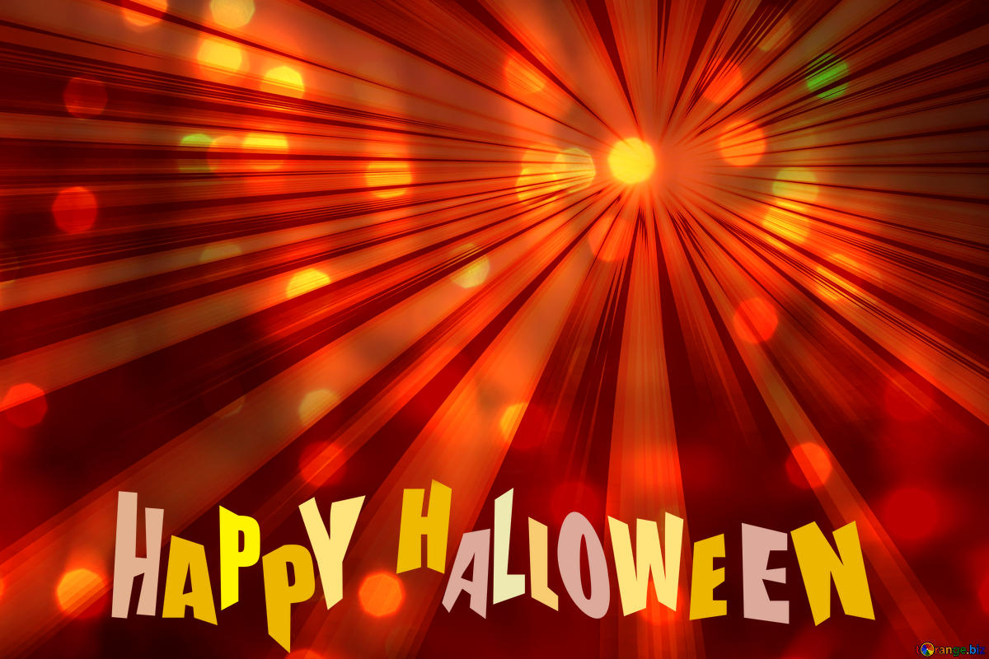
So hope you have a great Halloween and a spooky one !!!!!!!!!!

Slide 6
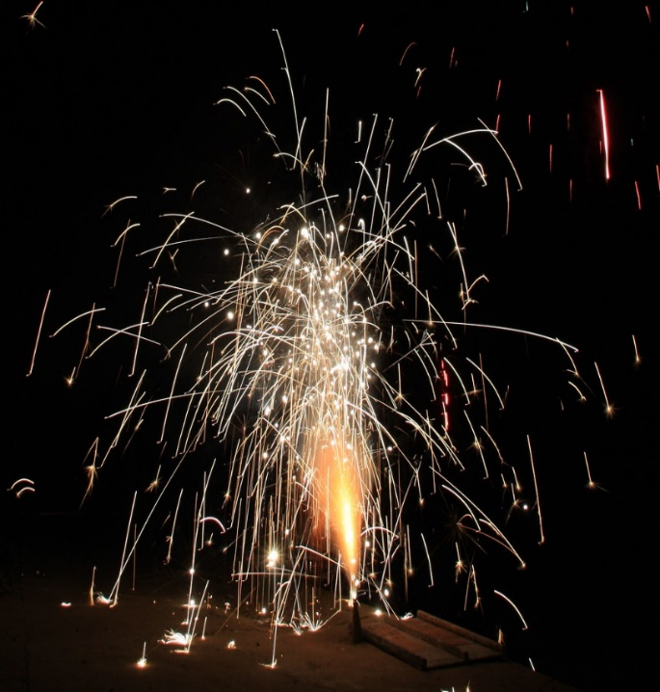
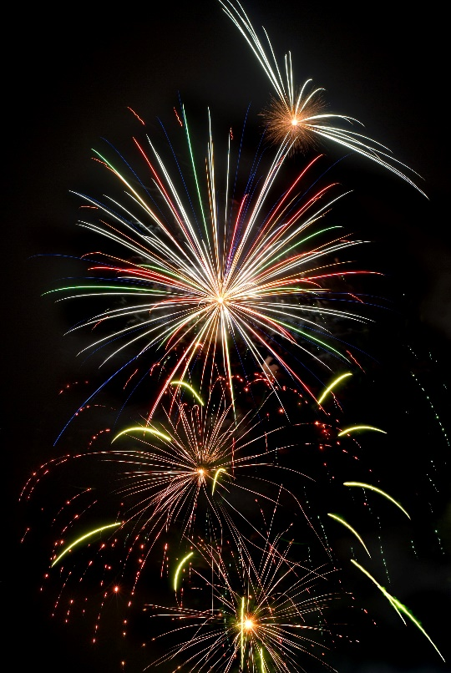
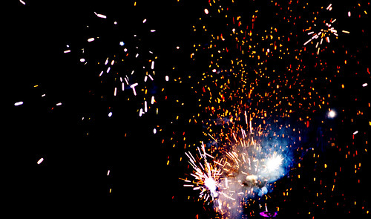
Bonfire night
WE’RE ALL SO EXCITED FOR IT BUT WE HAVE TO BE CAREFUL!

Slide 7
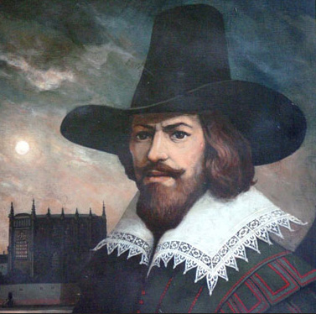
WHAT IS BONFIRE NIGHT?
On bonfire night we celebrate how Guy Fawkes was caught before he burnt down the houses of parliament. The fireworks represent the gunpowder and the bonfire represents the fire he could have made. Luckily he was caught and now we can celebrate these events.

Slide 8
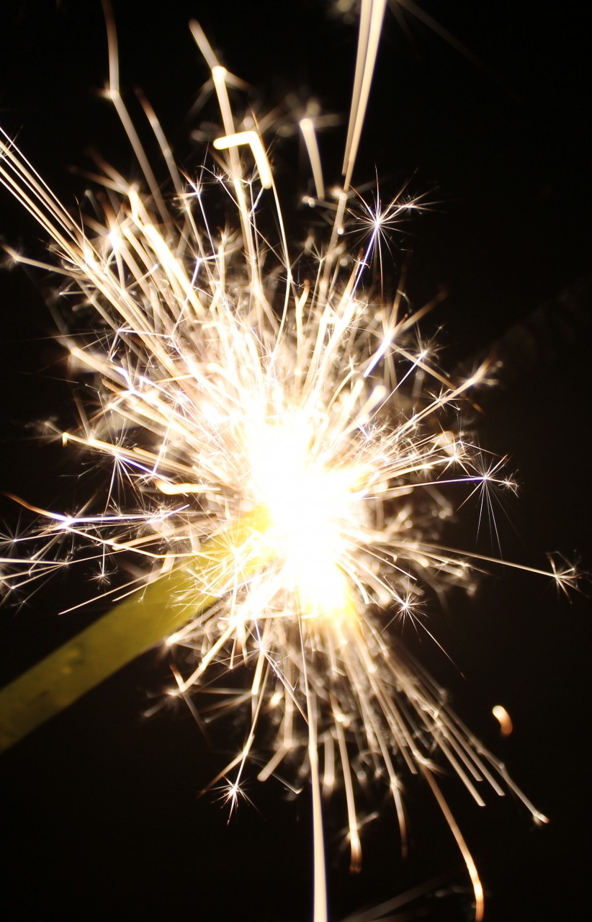
Bonfire night is coming up
Bonfire night is a very fun time of the year but we have to stay clear of fireworks and flames. MAKE sure you stay back when fireworks are being set off and wear protective gloves if you are holding a sparkler.

Slide 9
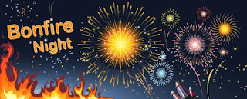
And a great bonfire night !!!!!

