Slide 2
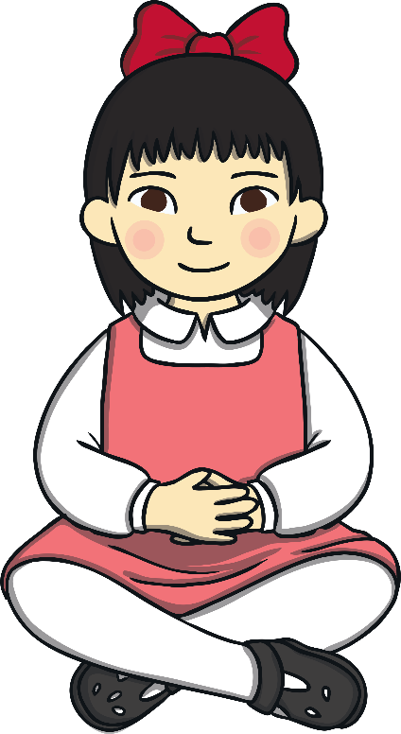
All About Self-Esteem
What is self-esteem?
How can positive self-esteem help me?
How can I develop positive
self-esteem?

Slide 3
What Is Self-Esteem?
Self-esteem is all about how we feel about ourselves.
It includes how confident we feel in who we are and what we can do.
sad
proud
happy
Take a few moments now to think about how you feel about yourself.
upset
kind
good
brave
cross
friendly
thoughtful
What words, feelings or emotions come to mind?

Slide 4
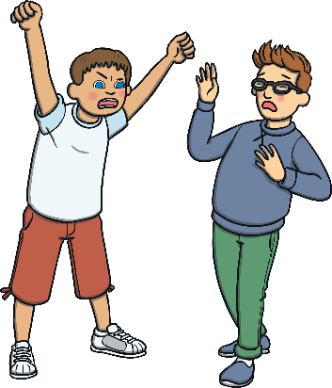
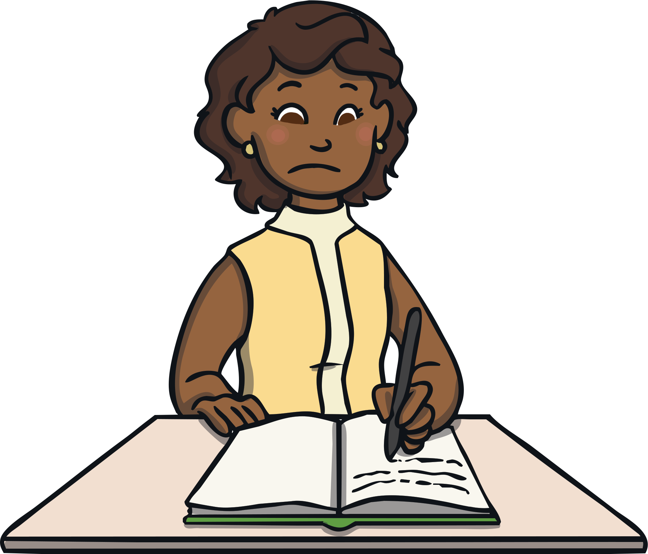
Where Does Self-Esteem
Come From?
Our self-esteem comes from lots of different things, including how we feel about people around us, things that have happened to us and thoughts we have about ourselves.
x
How do you think the child in each picture might
be feeling about themselves? Why do you think that?
What might be making them feel that way?

Slide 5
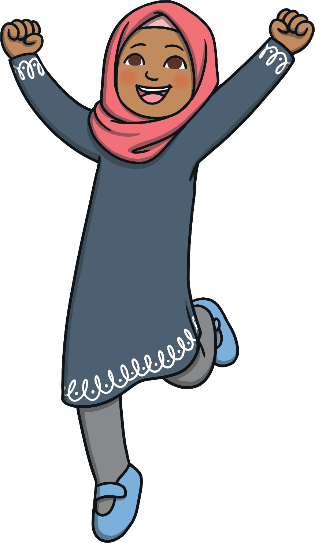
How Does Self-Esteem Affect Us?
Our self-esteem can affect how we behave, the thoughts we have and
how we get along with other people.
If we are feeling good
about ourselves, we often
display positive behaviour,
think positive thoughts,
feel positive emotions and
get along well with others.
How might we behave
towards others
if we are feeling good
about ourselves?

Slide 6
How Does Self-Esteem Affect Us?
Our self-esteem can affect how we behave, the thoughts we have and how we get along with other people.
If we are feeling bad about ourselves,
we can find it difficult to get along with
others. We might feel sad or cross.
How might we behave
towards others if we
are feeling bad
about ourselves?

Slide 7
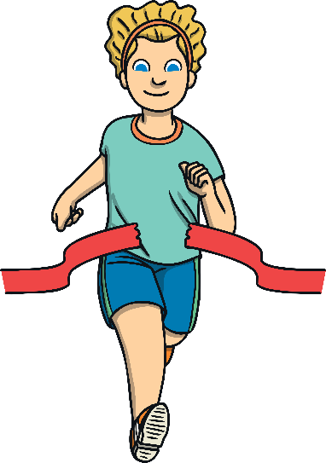
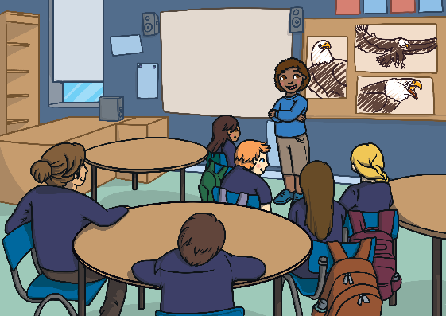
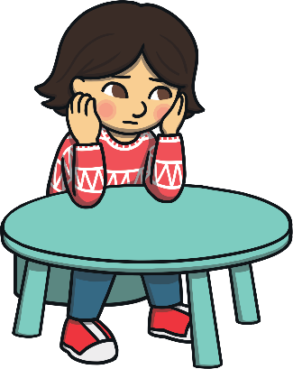
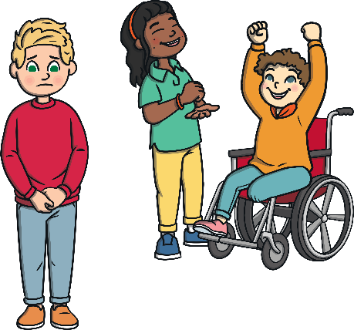
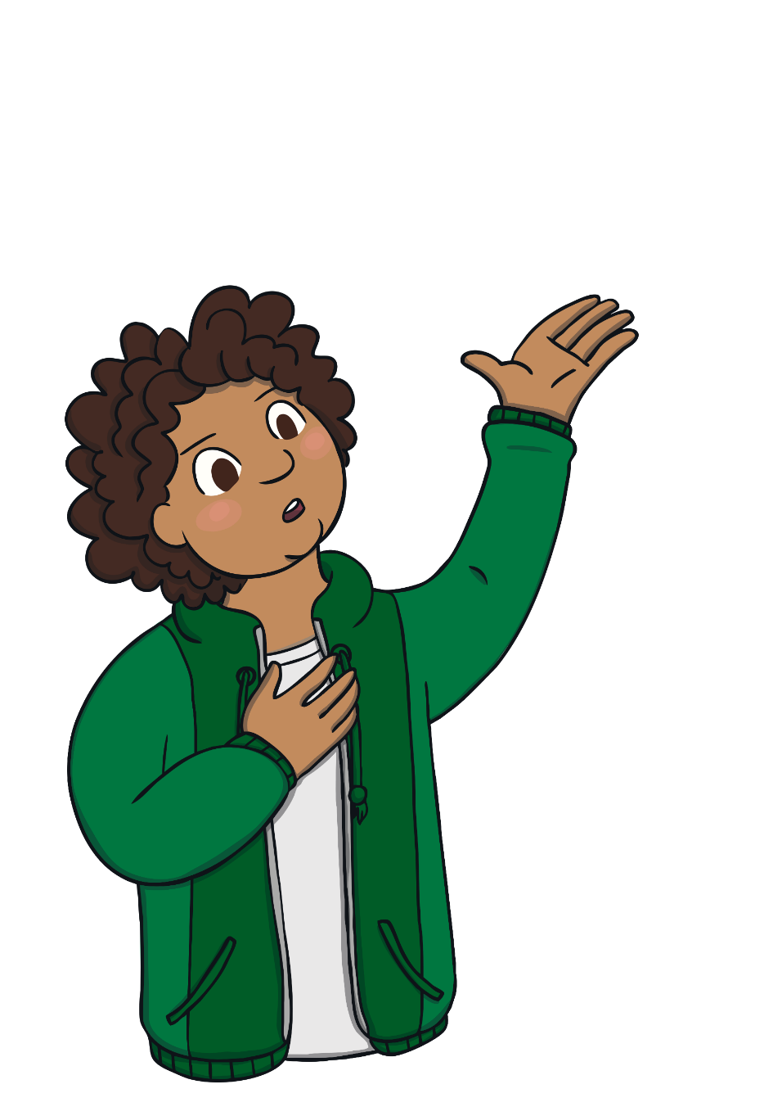
Helping Others with Self-Esteem
If we feel happy about ourselves, we are more likely to have good self-esteem but if we feel bad about ourselves, we are more likely to have low self-esteem.
One of the most powerful things we can do to help other people feel good about themselves is to be kind and include them in what we do.
Which of these pictures do you think might create low self-esteem? What could you do to help?

Slide 8
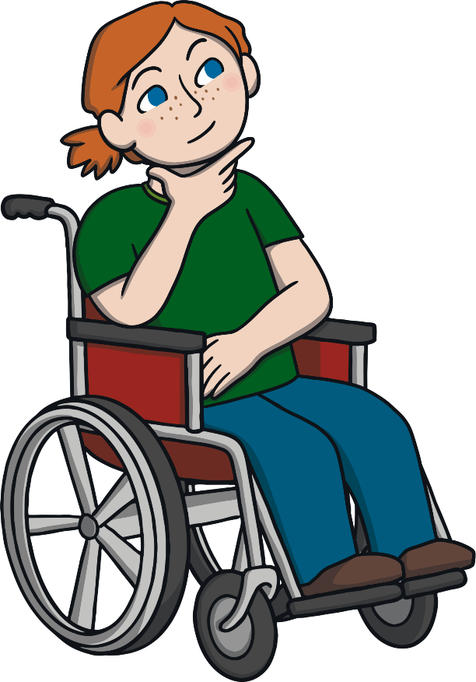
Helping Ourselves with Self-Esteem
If we aren’t feeling good about ourselves,
our self-esteem will be low.
It is important that we do things to help us feel better and to help us start having more positive thoughts and feelings about ourselves and our abilities.
What could
we do to help our self-esteem?

Slide 9

Helping Ourselves with Self-Esteem
Talk to a trusted adult about how we are feeling and ask for help.
Make a list of all the things other people like about us.

Slide 10


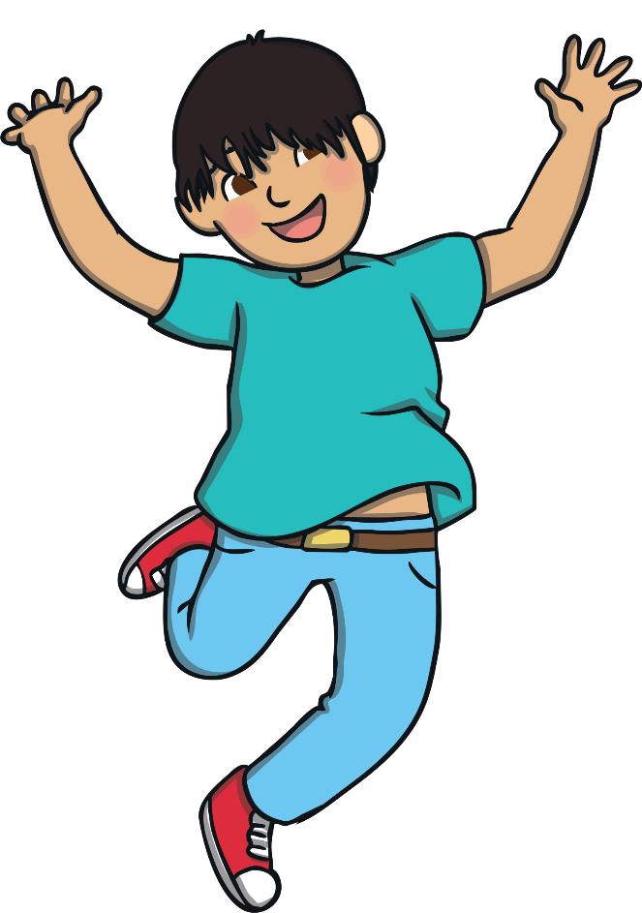
Helping Ourselves with Self-Esteem
Make a list of all the things we have achieved, no matter how small.
I am really good at singing.
Say positive things about ourselves out loud.

Slide 11
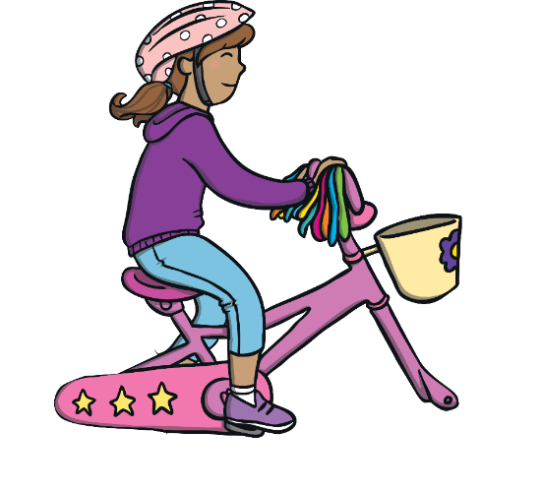




Helping Ourselves with Self-Esteem
Have a goal or a dream that we would like to achieve and work a little bit each day towards it, all the time picturing success in our mind.
= 12
6 + 6
Help others.

Slide 12




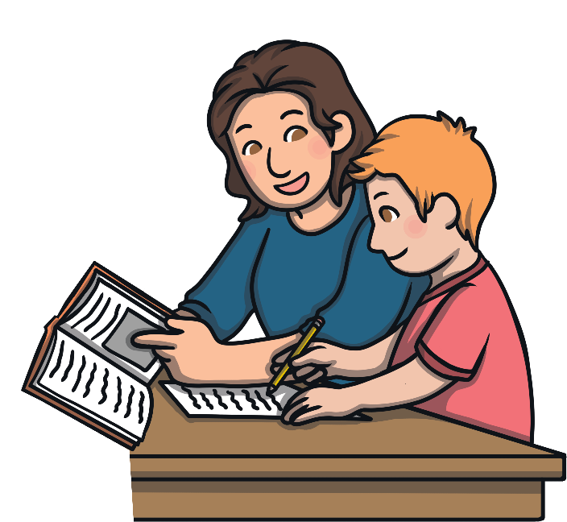

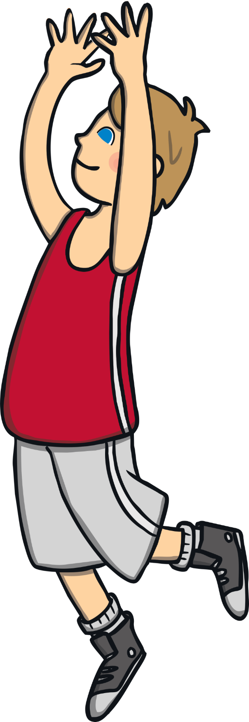
Helping Ourselves with Self-Esteem
Do something each day
that we really enjoy.
Spend time with people
who make us feel good
and treat us with kindness and respect.

Slide 13



Reflecting
Remember, we are all worthy and deserve to feel good about ourselves. If this is tricky for you, talk to a trusted adult – there are people who can help.
Now, think of someone you are going to help to feel better about themselves. Think of something you could do.
Sit quietly for a moment and think about all of the things that you really like about yourself – all the amazing things that make you, you!
Think about your interests, your hobbies, what you can do well, what makes you happy and the people who are kind to you.
Enjoy the feelings that thinking about these things brings.

