Slide 2
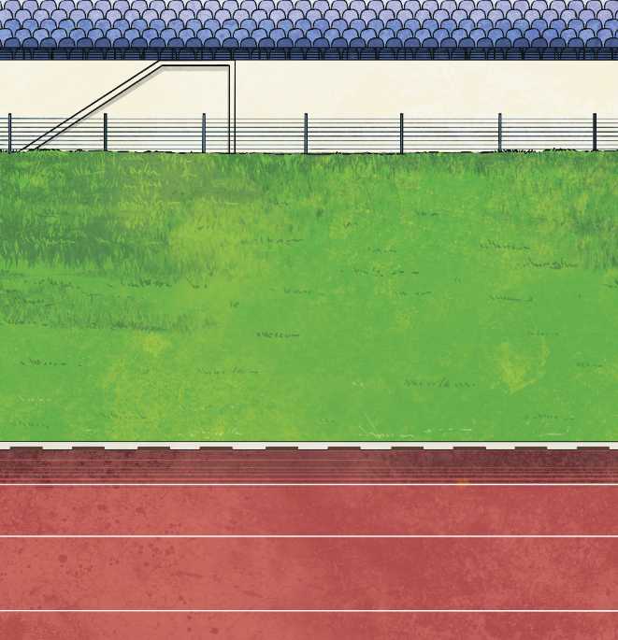

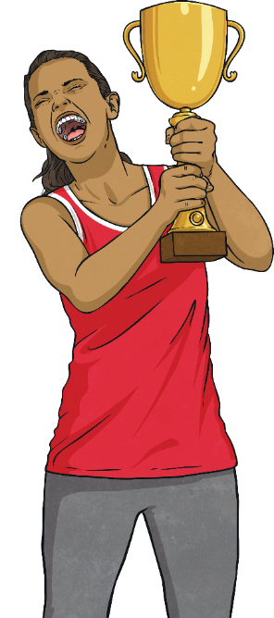
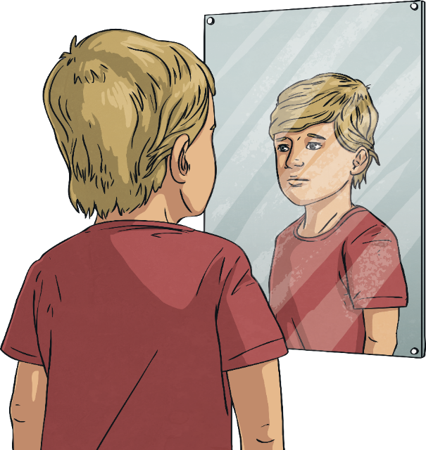
What Is Self-Esteem?
Self-esteem is all to do with how we feel about ourselves.
It includes how confident we feel in who we are and what we can do.
Self-esteem also includes how valuable and worthy we feel and how much respect we have
for ourselves.

Slide 3
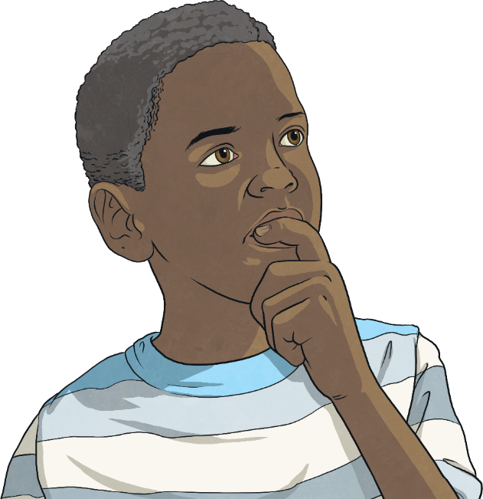




What Is Self-Esteem?
Self-esteem comes from within. It can change over time and even throughout the day.
Take a few moments to just reflect on how you feel about yourself right now. What words, feelings or emotions come to mind?

Slide 4
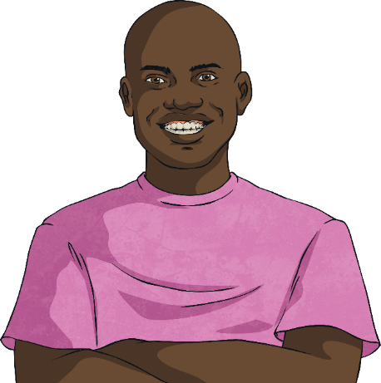
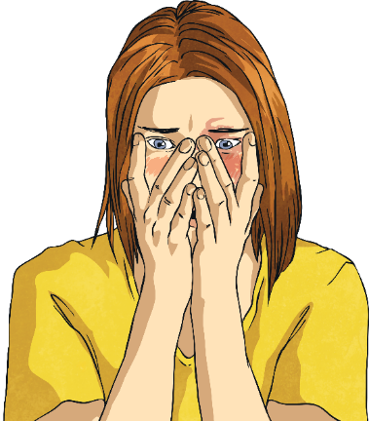


Where Does Self-Esteem Come From?
Our self-esteem comes from the thoughts we have, our relationships with the people around us and the things we have experienced in our lives.
When we have positive
self-esteem, we feel good about ourselves on the inside. We feel like we deserve for other people to show us kindness and respect and to have good things happen to us.
When we have a negative and low level of self-esteem, we feel bad about ourselves on the inside. We don’t feel good about ourselves or our abilities and we don’t expect people to be kind or respectful towards us.
There are so many things that can help to create positive or negative
self-esteem.

Slide 5
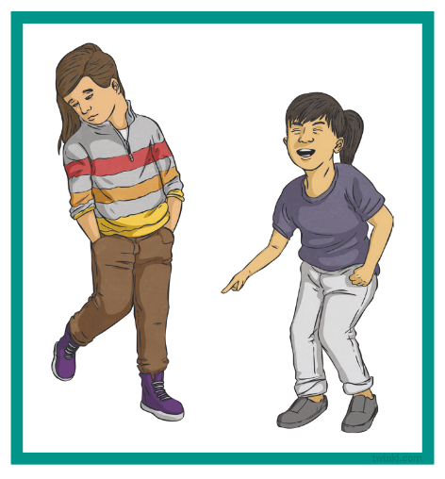
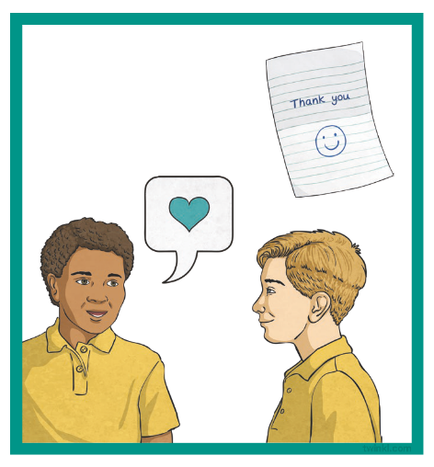
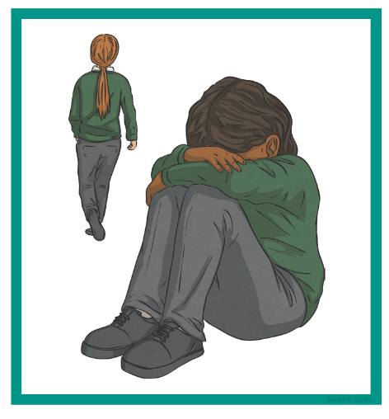
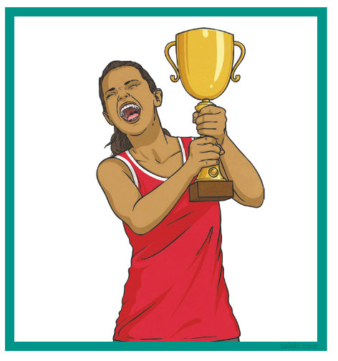
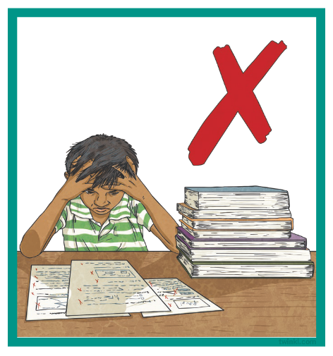
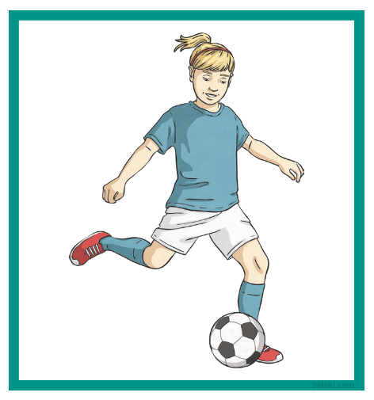
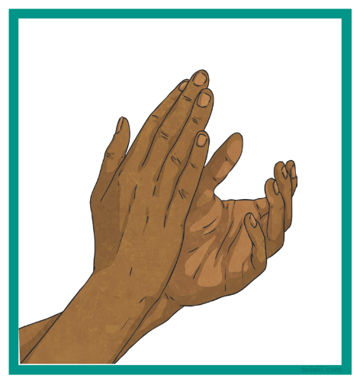
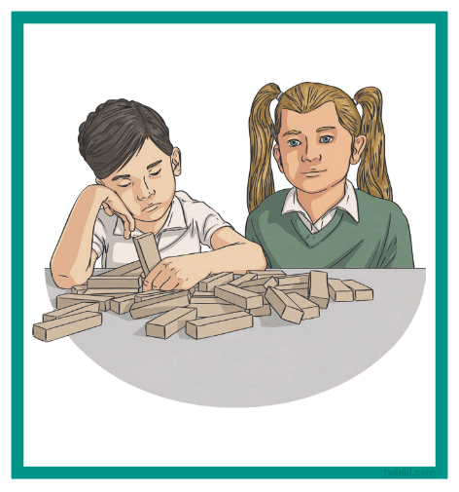
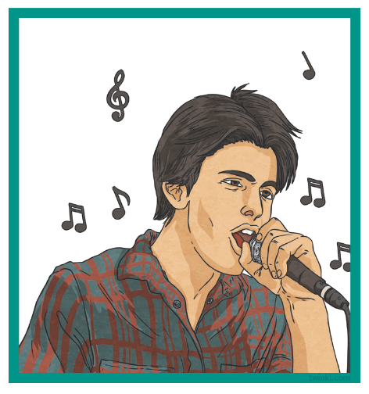
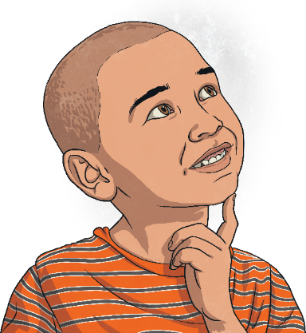
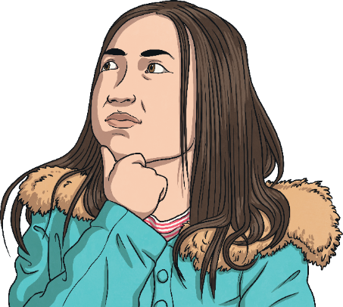
Where Does Self-Esteem Come From?
Look at these pictures. How do you think the person in each
picture is feeling?

Slide 6

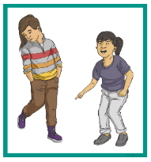




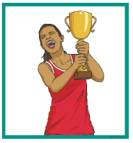

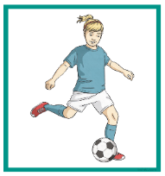
Where Does Self-Esteem Come From?
Influences on Self-Esteem
Now, let’s think about each of these pictures and add to the spider diagram. Can we create a sentence that explains how the event happening in each picture might make someone feel?

Slide 7
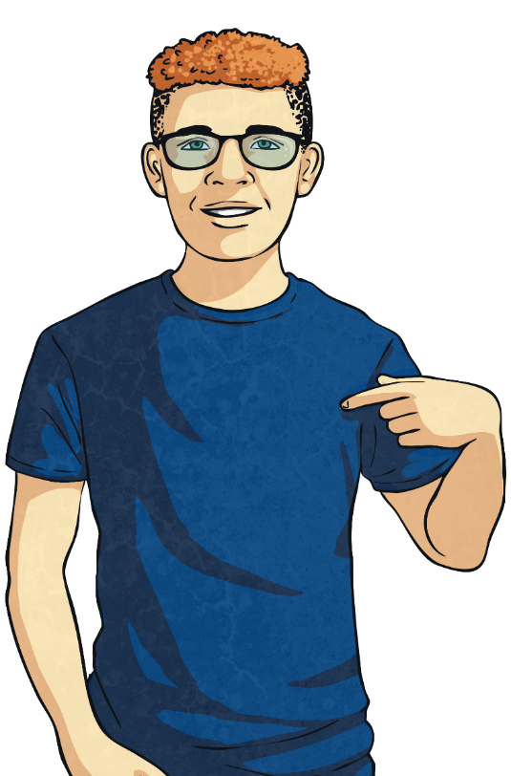
How Does Self-Esteem Affect Us?
Whether our self-esteem is positive or negative, it can affect how we behave, the thoughts we have and how we get along with other people.
If we are feeling good about ourselves, we often display positive behaviour, think positive thoughts, feel positive emotions and get along well with others.
How might people behave towards others when they are feeling good about themselves?

Slide 8
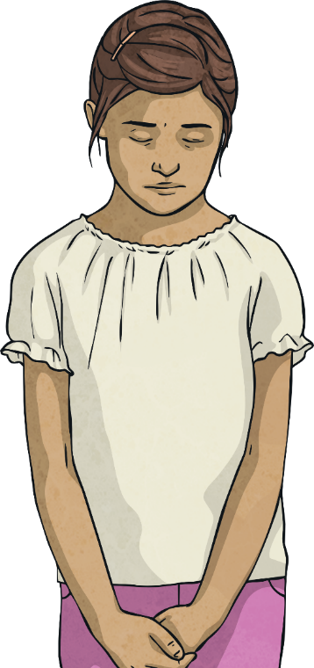
How Does Self-Esteem Affect Us?
Whether our self-esteem is positive or negative, it can affect how we behave, the thoughts we have and how we get along with other people.
If we are feeling bad about ourselves, we can behave in a disruptive way, think negative thoughts and feel uncomfortable emotions. It can mean we find it hard to get along with
other people.
How might people behave towards others when they are feeling bad about themselves?

Slide 9
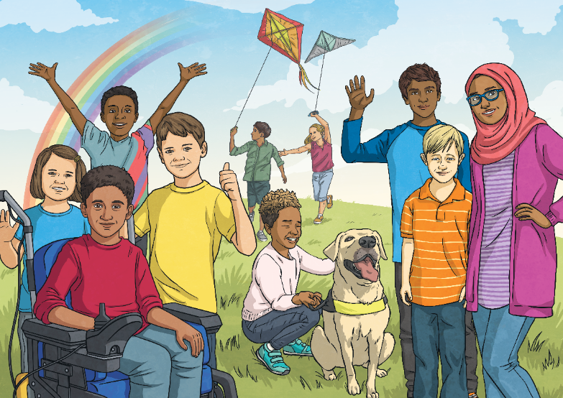
Helping Others with Self-Esteem
If we have positive self-esteem and are feeling good about ourselves, it is important to use this to help others to feel good about themselves too.
How could we do this? What could we say to somebody who is having more negative experiences to help them improve their self-esteem?
One of the most powerful things we can do to help other people feel good about themselves is to show them kindness and respect and include them in the things we do or the conversations we are having.

Slide 10
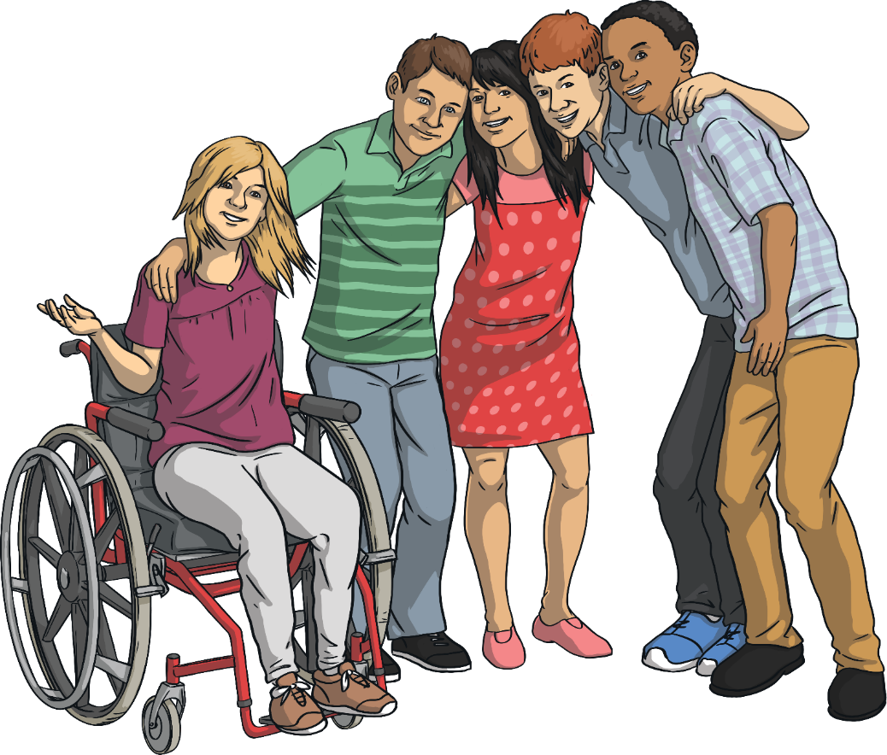
Helping Others with Self-Esteem
If we aren’t feeling good about ourselves, our self-esteem will be low. It is important that we do things to help us feel better and to help us start to have more positive thoughts and feelings about ourselves and
our abilities.
What could we do?

Slide 11
Helping Others with Self-Esteem
Talk to a trusted adult about anyone or anything that is making us feel bad about ourselves.
Make a list of all the things we have achieved – however big or small.
Make a list of all the things other people like about us.
Talk to a trusted adult about how we are feeling and ask for help. They will be able to help us work out why we feel bad about ourselves and help us to
feel better.
If we aren’t feeling good about ourselves, our self-esteem will be low. It is important we do things to help us feel better and to help us start to have more positive thoughts and feelings about ourselves and
our abilities.
What could we do?
We can do some of the following things to help ourselves
with self-esteem.

Slide 12
Helping Others with Self-Esteem
Have a goal or a dream we would like to achieve and work a little bit each day towards it, all the time picturing success in our mind.
Every time a negative thought about ourselves pops into our head, replace it with a positive one.
If we aren’t feeling good about ourselves, our self-esteem will be low. It is important we do things to help us feel better and to help us start to have more positive thoughts and feelings about ourselves and
our abilities.
Say positive things about ourselves
out loud.
What could we do?
Help others.
We can do some of the following things to help ourselves
with self-esteem.

Slide 13
Helping Others with Self-Esteem
Try something new and see how it feels to achieve something that perhaps we thought we couldn’t do.
Spend time with people who make us feel good and treat us with kindness
and respect.
Make sure we remember we are worthy and just as deserving of happiness, kindness and respect as everyone else!
Make sure we are eating healthily, drinking enough water and sleeping well.
If we aren’t feeling good about ourselves, our self-esteem will be low. It is important we do things to help us feel better and to help us start to have more positive thoughts and feelings about ourselves and
our abilities.
Do something each day which we really enjoy.
What could we do?
We can do some of the following things to help ourselves
with self-esteem.

Slide 14
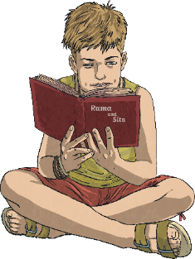
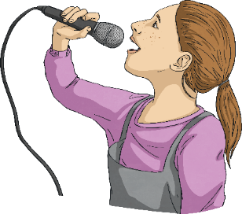
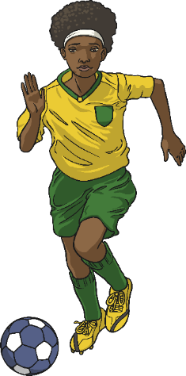
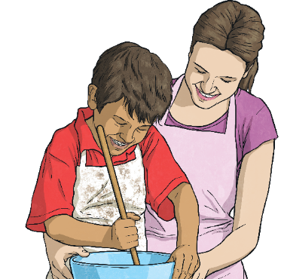
Reflection
Sit quietly for a moment and think about all of the things that you really like about yourself – all the amazing things that make you, you!
Think about your interests, your hobbies, what you can do well, people who are kind to you and what makes you happy.
Enjoy the feelings that thinking about these things brings.

Slide 15

Reflection
Now, think of someone you are going to help to feel better about themselves. Think of something you could do for them.
Remember, we are all worthy and deserve to feel good about ourselves.
If this is tricky for you, talk to a trusted adult – there are people who
can help.

