Slide 1

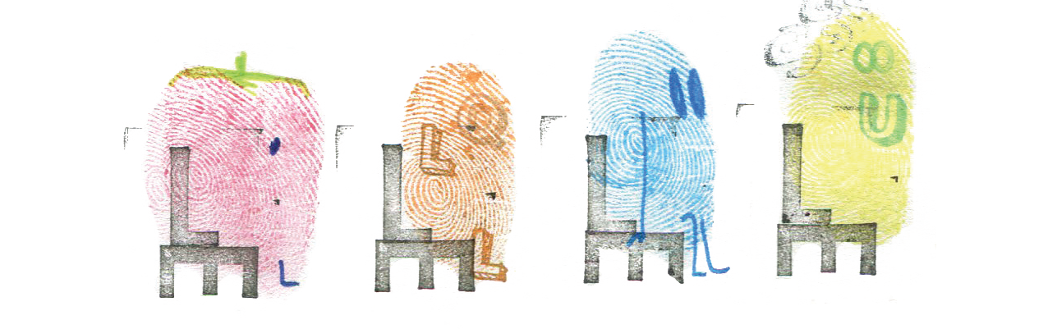
Children’s Mental Health Week!
Meeting for Parents

Slide 2
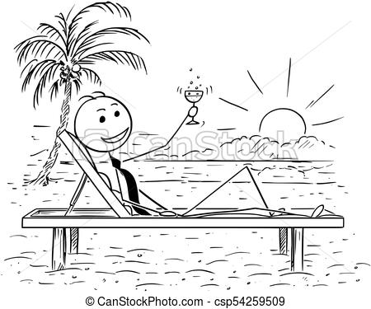
Time to Chill!!
https://www.youtube.com/watch?v=z9_SqJcNons&safe=true

Slide 3



What’s important to us at Manor Park?
Wellbeing of children
Staff Wellbeing
Improving outcomes
for all

Slide 4
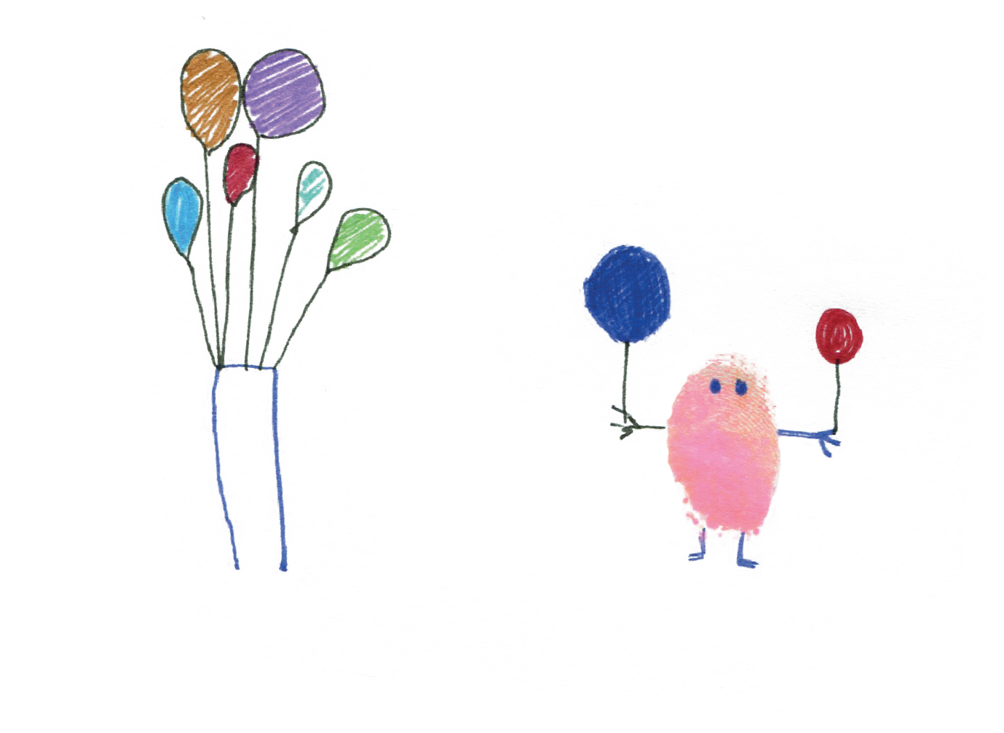
What Is Mental Health?
Mental health is all about how we think, feel and act.
Sometimes people have happy, comfortable thoughts and feelings. Sometimes, people have thoughts and feelings that don’t feel so good and might feel upsetting or uncomfortable.
All these thoughts and feelings are what make up our mental health.
It is about our feelings, our thinking, our emotions and our moods.

Slide 5
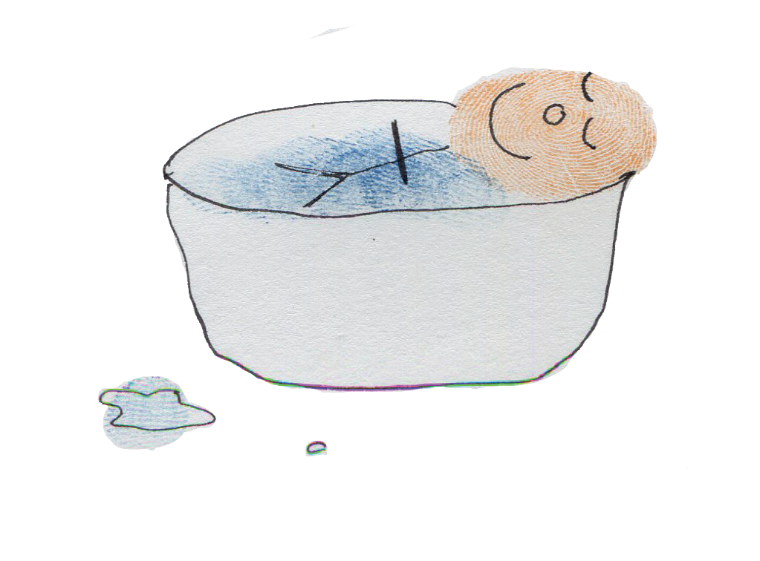
Everybody knows how to look after physical health…
…looking after our mental health is just as important.

Slide 6

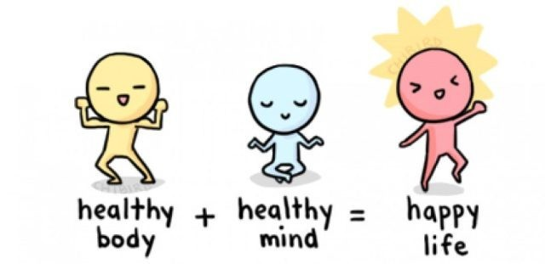
Our minds and bodies are connected. To learn, we need to have both healthy minds and healthy bodies. Our mind can affect our body and our body can affect our mind. We need to look after both to be healthy inside and out and to be in a position where we can learn..

Slide 7

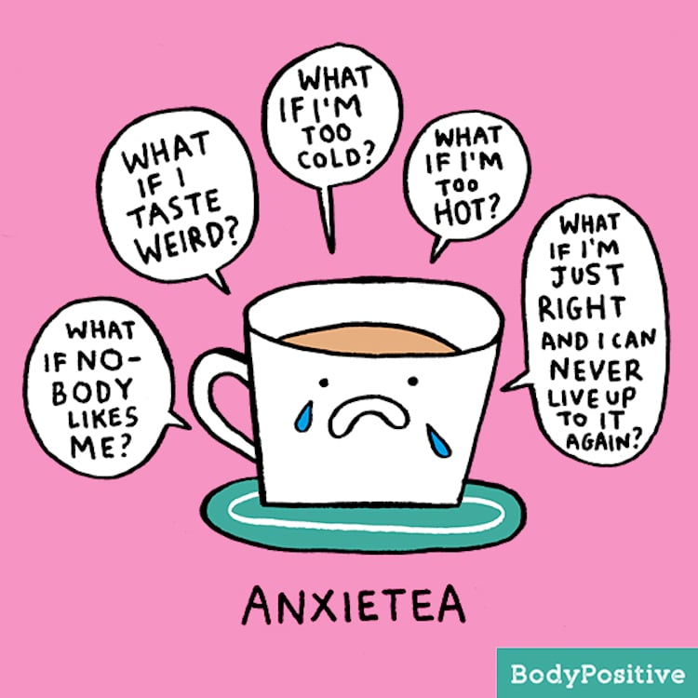
Facts and Figures
One in ten 5 to 16yr-olds has a diagnosed mental health concern
At least 3% of children suffer from anxiety disorders but relatively few are referred for treatment
Nearly 80,000 children and young people suffer from severe depression. Over 8,000 children aged under ten years old suffer from severe depression.

Slide 8
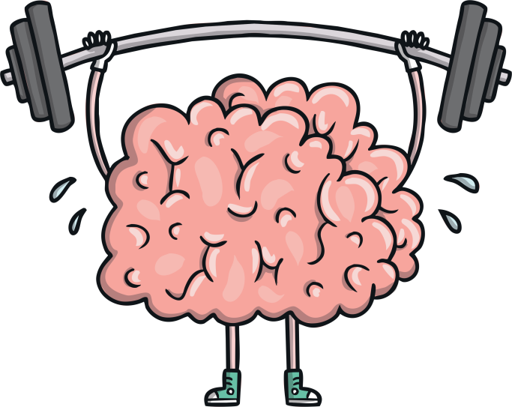
What do we see in school?
Anxiety
Reluctance to join in with others
Low self esteem
Lack of empathy with others
Poor appetite
Argumentative
Disruptive Behaviour
Tiredness
Frequent headaches
School Refusal
Feeling sad all the time
Tearfulness
Appearing withdrawn
Violent outbursts
Regularly complaining of feeling unwell
Lack of concentration
Do you recognise any of these?

Slide 9
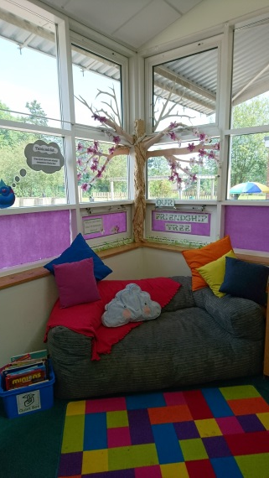
What do we do in school?
Have a full time Learning Mentor available to work with children
Have a designated safe space where children can take time to discuss their concerns and regroup their emotions
Deliver a range of emotional interventions
Organise regular drop ins and catch ups with specific children
Encourage the children to express their emotions and label their feelings
Provide opportunities for teaching relaxation techniques to all children throughout the day
Help individuals to recognise their strengths
Encourage rehearsal for how they would manage a stressful situation
Use our school values to teach about resilience

Slide 10
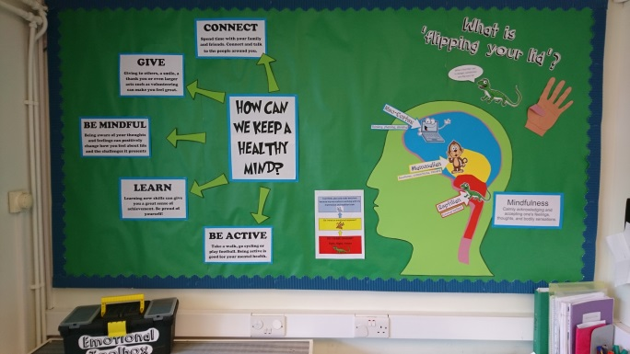
Develop a purposeful environment to work with parents on ways to support their children
Create an emphasis on problem solving rather than the behaviour
Teach the children about how/why they react in certain ways
Have a calm zone on the playground for those children who find playtimes too busy
Model play, turn-taking etc
Run a mindfulness club at playtime
Provide additional lunch time provision for those children who find the dining room too busy
Help the children to see that not all stress is bad e.g. a bit of adrenaline is good to enable high performance

Slide 11
What should you do if you are concerned?
Come in and talk to us at school
The School Nurse
G.Ps
Paediatricians.
Educational Psychology services.
Family support workers.
Social workers
Counsellors/therapists.
Above all else …. TALK TO AND LISTEN TO YOUR CHILD!
Finally .. Check out our school website for useful telephone numbers

Slide 12

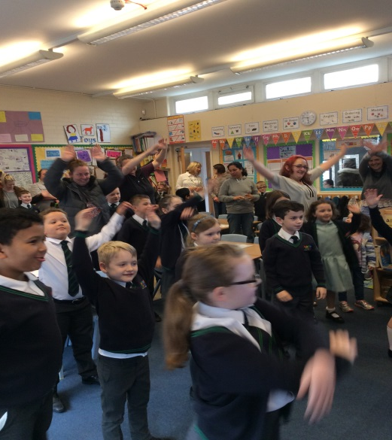

Moving Forward………..
We are on a continual journey….
Tell us if you think there is something we can improve….
….. or investigate to do in the future

